Slide 1

wiControl
Jo Simons (simonjo@telenet.be)
Notes:
Alcatel-Lucent PowerPoint Design Guidelines
When necessary Portfolio/Program Name can wrap to a second or third line to maintain consistent typographic spec
For title slide only, a 5% gray background has been added
General specifications
Page Setup set to “On Screen” format
Update footer to include appropriate “Portfolio/Program Name”
Ensure that only one font “Trebuchet” is used throughout. Following pages provide font sizes for text and graphic pages.
Ensure all text boxes sit in proper location. Sometimes the automatic PowerPoint settings are not exact
Titles on slides, Agenda and Division pages use “Title Case”
Text is set predominantly with regular weight. Bold Trebuchet is used to highlight key words or phases
When a slide has more text than comfortable fits on the page using standard font sizes, treat this instance as an exemption and reduce the font size of the entire block until it fits
For graphic only slides, use as much of the object area as possible to enhance legibility and emphasis
Slides with multiple logos should be adjusted so all logos appear visually equal in size and weight
Please remove any tinted or light color backgrounds from slides other than Agenda and Division slides

Slide 2
Project Target
  Build simple module to control lights and shutters
  Must be small enough to retrofit an existing 220V electrical system (unterputz)
  Able to work standalone
  Or work centralized but then in a wireless fashion
  Upgradable over-the-air
  Remote diagnostic and test functionality
  Secure when connected wireless
  Scalable software framework for different configurations
  Low cost

Slide 3
Module Structure (1/4)
WLAN
Wemos
D1 mini
Wifi AP
Wifi client
HTTP server
Telnet server
MQTT client
inputs
outputs
in0
in1
in2
in3
in0
in1
in2
in3
out0
out1
out2
out3
out0
out1
output
shutter

Slide 4
Module Structure (2/4)
  Makes use of ESP8266 module on Wemos D1 mini subassembly
    Easy due to built-in USB interface and 5V-to-3V3 convertor
    Doesn’t require implicit boardspace due to it’s leveraged mounting
    Has Wifi client to connect to remote access point
      Not required if you want to operate the module in standalone mode
      Else configure SSID + security method + secret
    Has Wifi AP accessible @ 192.168.4.1
      Can be secured with password and/or turned off
      If Wifi client is disabled or fails, the Wifi AP will be turned on at module boot
    Configuration/setup can be done via HTTP
    9 GPIO’s used
  Controllable objects included are:
    4 low-voltage inputs supporting normal-open push-buttons that connect to ground when pressed
    4 high-voltage (220V) SSR outputs upto 1A
  System LED
    Helps to locate a module
  3D printed protective cover
    Against accidental touching 220V contacts
    For mounting in installation box
    For attaching Niko blind frontplate

Slide 5
Module Structure (3/4)
  Functional Block Diagram
WLAN
wiControl
.settings.conf
telnets
https
mqttc
gpiod
io
input
in%
in/out
onRun()
doCmd()
req/rsp
filter/parse
GPIO/I2C
GPIO/I2C
on/off
output
DoCmd()
out%
doCmd()
command
onRun()
doEvt()
onPublish(topic,msg)
filter/parse
on/off
shutter
doCmd()
onRun()
doEvt()
system
publish(topic,msg)
onRun()
doCmd()
format
event
DoEvt()

Slide 6
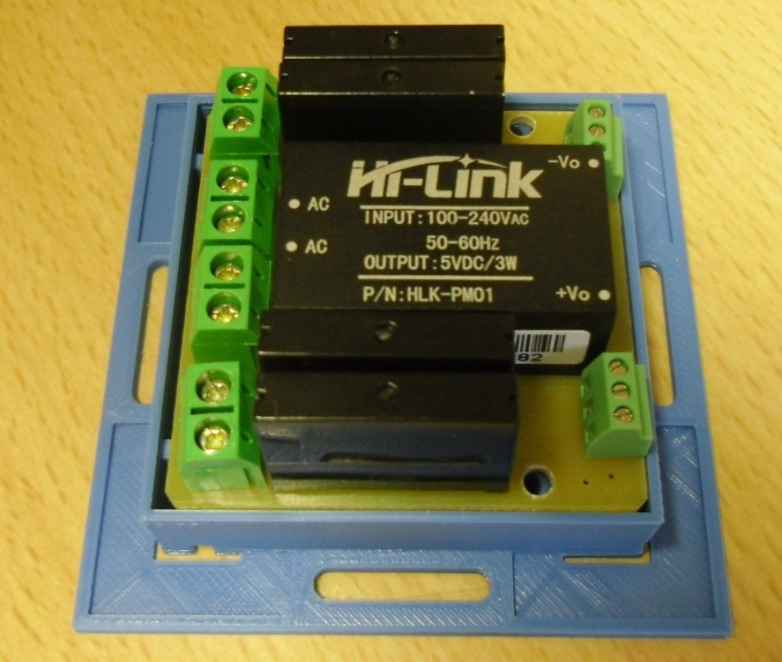
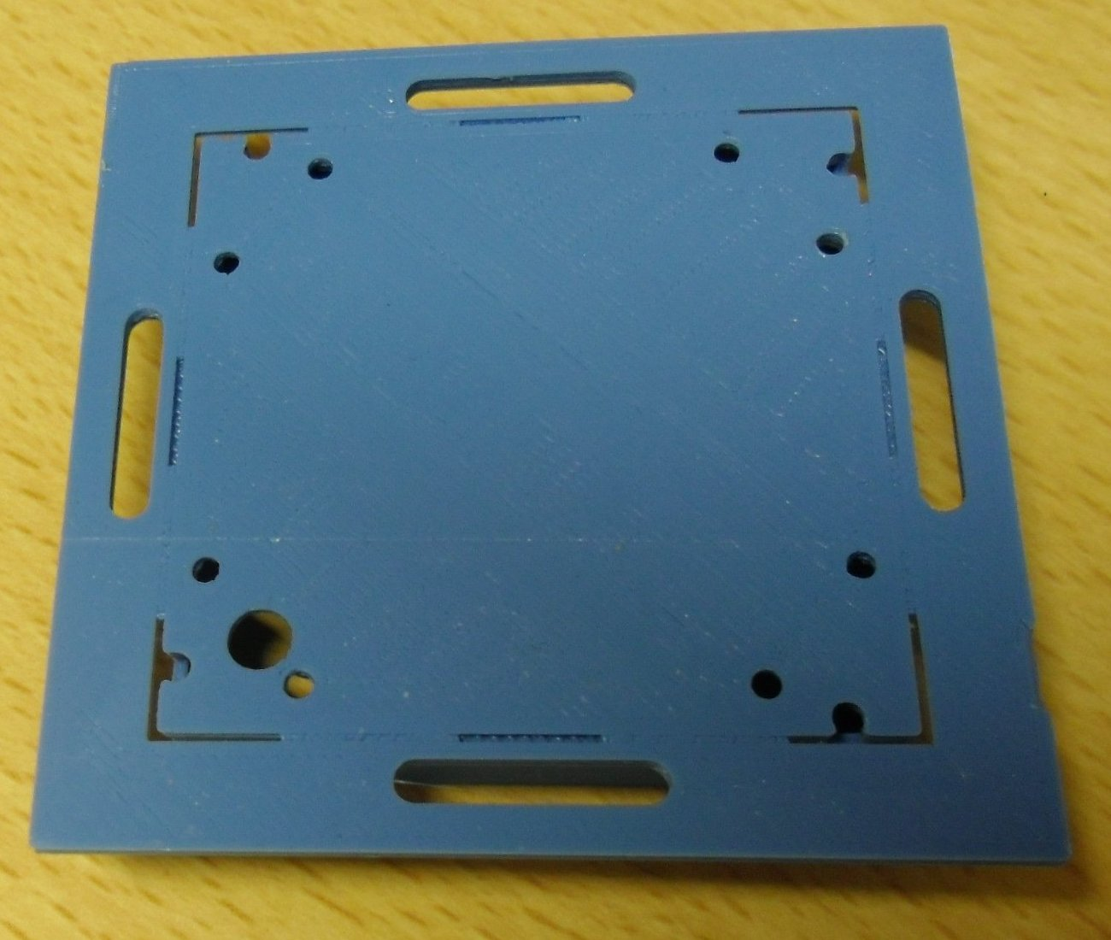
Module Structure (4/4)

Slide 7
Features (1/3)
  Supported emulations:
    Output
      drives 4 individual outputs
      dedicated set of commands: off, on, toggle, ontimed, …
    Shutter
      combines 2x2 outputs to drive 2 shutter/jalousie
      dedicated set of commands: stop, up, down, …
  Supported modes:
    Standalone
      inputs control outputs locally
      requires no extra infrastructure to operate
      emulator has fixed logic onboard to link input events to output commands
    MQTT
      connects to MQTT broker, so extra infrastructure is required
      allows remote operation via MQTT protocol
    Both
      combines standalone and MQTT modes
  Safe mode:
    To be defined

Slide 8
Features (2/3)
  MQTT Client
    Not possible if there is no Wifi connection
    Not required if you want to operate the module in standalone mode
    Else configure broker IP address/port, optional username/password, optional <node-id> override
      default <node-id> is module chipid, i.e. esp12345
      structured <node-id> can be <location>/<floor>/<number>
    Requires an MQTT broker to be operational (i.e. Mosquitto on Synology NAS)
    Uses a request only model
    Is low on memory overhead for the system
    Also used for automatic testing
    Once connected to broker
      the module will subscribe to command topic <node-id>/cmd/#
      the module will publish it’s topology and version <node-id>/boo/hw=<topo>, <node-id>/boo/<sw>=<version>
    In general
      incoming publish messages will be handled by emulator <node-id>/cmd/<object>=<cmd> *[.<parm>]
      object generated events are published to broker <node-id>/evt/<object>=<event>
      object status requests are published to broker <node-id>/sta/<object>=<state>In general
    Event/status formats
      can be textual (default) i.e. myHouse/3/0/out0=on
      can be numerical i.e. myHouse/3/0/out0=1

Slide 9
Features (3/3)
  HTTP Server
    Not possible if there is no Wifi connection
    Uses a request-response model
    Has more overhead on memory for the system, can drain the system
    Main task is to configure the module with a browser
    Also allows to send commands to the controllable objects using structured URL
      URL: http://<ip-address>/ats?ccmd=<object>.<cmd> *[.<parm>] [; <object>.<cmd> *[.<parm>]]
      command results are sent in HTTP response in terse mode
      also used for automatic testing
  Telnet Server
    Not possible if there is no Wifi connection
    Mainly used for remote diagnostic/support

Slide 10
Terminology
  The module contains controllable objects
    in0..in3
    out0..out3 (or out0..out1 for shutter emulation)
  Objects accept commands
    That instructs it to do something and update it’s state
    MQTT <node-id>/cmd/<object>=<cmd> *[.<parm>] *[; <cmd> *[.<parm>]]
    HTTP http://<ip-address>/ats?ccmd=<object>.<cmd> *[.<parm>] *[; <object>.<cmd> *[.<parm>]]
      returns current state in numerical terse format, i.e. ‘0’, ‘1’, ‘2’
      response of multiple commands will be concatinated, i.e. ‘0;1’
  When an object changes state
    It will raise an event which will be distributed depending on configuration
    To output objects as per emulation
    To MQTT <node-id>/evt/<object>=<event>
    Not to HTTP !!!
  A status command will report an objects state regardless of change
    To MQTT <node-id>/sta/<object>=<state>
    To HTTP http://<ip-address>/ats?ccmd=<object>.status
      returns current state in numerical terse format, i.e. ‘0’, ‘1’, ‘2’
      response of multiple commands will be concatinated, i.e. ‘0;1’

Slide 11
Inputs
  Input changes are validated with an adjustable decounce period (Td), default=150ms
  Validated changes are fed into a time based state machine to generate events
  Supported events
      ingt0 (2) input was initially closed
      outlt1 (3) input was opened after less than 1 second
      ingt1 (4) input was closed for more than 1 second
      outgt1 (5) input was opened after more than 1 but less than 2 seconds
      ingt2 (6) input was closed for more than 2 seconds
      out (7) input was opened after more than 2 seconds
  Supported commands
      status return current state of input, 0=out|1=in
      ingt0 simulate input closed initially
      outlt1 simulate input opened after less than 1 second
      ingt1 simulate input closed for more than 1 second
      outgt1 simulate input opened after more than 1 but less than 2 seconds
      ingt2 simulate input closed for more than 2 seconds
      out simulate input opened after more than 2 seconds
ingt0
ingt1
ingt2
closed
Td
Td
Td
Td
open
open
open
opened
0s
outlt1
1s
outgt1
2s
out

Slide 12
Outputs – Output Emulation
  Supported commands
      status return current status of output, 0=off|1=on
      on turn output on
      off turn output off
      onlocked turn output on and lock it
      offlocked turn output off and lock it
      toggle toggle output between off and on
      unlock unlock output, all commands will be executed after this
      ondelayed.<delay> turn output on after <delay> seconds
      offdelayed.<delay> turn output off after <delay> seconds
      ontimed.<run> turn output on during <run> seconds, then back off
      offtimed.<run> turn output off during <run> seconds, then back on
      toggledelayed.<delay> toggle output after <delay> seconds, lock it till command done
      toggletimed.<run> toggle output for <run> seconds, lock it till command done
      lock lock output, no command exept unlock will be executed
      locktimed.<run> lock output for <run> seconds
      timeset.<run> set running time again to <run> seconds
      timeadd.<run> add <run> seconds to running time
      timeabort abort running time without unlocking or final action, will leave output as-is !!!
      blink alternate output between on and off with a 1s cadence, all outputs are synched
      blinktimed.<run> blink output for <run> seconds
  Supported events
      off (0) output was turned off
      on (1) output was turned on
  Parameters
      delay,run 1-3600 seconds

Slide 13
Outputs – Shutter Emulation (1/2)
  Uses the concept of priority level (0=highest, 5=lowest) and lock (0=no-lock, 1=lock)
    When a command of a given level sets the lock, any lower level commands are refused
    Useful for protecting extending sunblinds against strong winds or rain with a sensor locking the blinds in prio 0 or 1
    Mask versus level: a priority mask has a bit per level, level 0=0x01, 1=0x02, 2=0x04, 3=0x08, 4=0x10, 5=0x20
  Supported commands
      status return current status of shutter, 0=stop|1=up|2=down
      stop.<level> stop shutter
      toggleup.<level>.<lock>.<run> toggle between stop and up for given run time
      toggledown.<level>.<lock>.<run> toggle between stop and down for given run time
      up.<level>.<lock>.<run> move shutter up for given run time
      down.<level>.<lock>.<run> move shutter down for given run time
      tipup.<level>.<lock>.<run> short move up to tip the lamello’s on a jalousie
      tipdown.<level>.<lock>.<run> short move down to tip the lamello’s on a jalousie
      priolock.<mask> lock given levels, all non-locked levels remain operational
      priounlock.<mask> unlock given levels
      prioset.<mask> set given levels, only set level and higher levels remain operational
      prioreset.<mask> reset given levels
      delayedup.<level>.<lock>.<delay>.<run> move shutter up for given run time after delay
      delayeddown.<level>.<lock>.<delay>.<run> move shutter down for given run time after delay
      tipdelayedup.<level>.<lock>.<delay>.<run>.<tip> move shutter up for given run time after delay, do reverse tip move
      tipdelayeddown.<level>.<lock>.<delay>.<run>.<tip> move shutter down for given run time after delay, do reverse tip move

Slide 14
Outputs – Shutter Emulation
  Supported Events
      upon (1) shutter started moving up
      downon (2) shutter started moving down
      upoff (3) shutter stopped moving up
      downoff (4) shutter stopped moving down
  Parameters
      <level> 0 (highest) – 5 (lowest)
      <lock> 0 (no lock) – 1 (lock)
      <delay> 0-3600 seconds
      <run> 1-3600 seconds
      <tip> 0-3600 1/10th seconds
      <mask> bit per level, 0=0x01, 1=0x02, 2=0x04, 3=0x08, 4=0x10, 5=0x20

Slide 15
System
  Supported commands
    ping will blink the LED for about 10 seconds
    version get current sw version
    memory get current memory statistics
    loglevel [.<level>.ack] get or set loglevel where level can be decimal or hexadecimal
    emul [.<emul>.ack] get or set emulation, 1=output|2=shutter
    mode [.<mode>.ack] get or set mode, 1=standalone|2=MQTT|3=both
    efmt [.<format>.ack] get or set MQTT event formatting, 1=numerical|2=textual
    lock [.<lock>.ack] get or set lock state of system commands, when locked only get commands and ping will work
    restart.ack restart module
  Supported events
    version 4.x.y.z
    memory %d
    loglevel %d or 0x%08X
    emul 1-2 or output|shutter
    mode 1-3 or %s
    efmt 1 or textual
    lock 0-1 or off|on

Slide 16
Standalone Mode
  Allows module to work without further infrastructure by using input events to control outputs
  Emulation=output
      in%.outlt1 -> out%.toggle
      in%.ingt2 -> out%.blink
  Emulation=shutter
      in0.ingt0/in1.ingt0 -> out0.stop
      in0.ingt1 -> out0.up. <default-time>
      in1.ingt1 -> out0.down. <default-time>
      in2.ingt0/in3.ingt0 -> out1.stop
      in2.ingt1 -> out1.up. <default-time>
      in3.ingt1 -> out1.down.<default-time>

Slide 17
Outstanding
  Scaling of time parameters: seconds, 1/10 second, milliseconds… -> done
  Timer limitation: wrap-around after approximately 4200 seconds -> done
  Additional timer or clock objects
  Configuration commands
  Compact mode
    reduce required pushbuttons
    i.e. outlt1 -> out0.toggle, ingt2 -> out1.toggle
  Variants
    DIN rail module with 8-16 outputs…
  Telnet command interface
  Shrink PCB to fit in Spelsberg in-wall box -> done
  Integrate with Niko quadruple pushbutton or blind frame -> done
  Enhance shutter logic
    introduce clocks
    couple to internet dawn/sunset markers
  Check overall handling of Wifi / broker connection vs mode

Slide 18
Backup slides
Jo Simons (icontrol@telenet.be)
Notes:
Alcatel-Lucent PowerPoint Design Guidelines
When necessary Portfolio/Program Name can wrap to a second or third line to maintain consistent typographic spec
For title slide only, a 5% gray background has been added
General specifications
Page Setup set to “On Screen” format
Update footer to include appropriate “Portfolio/Program Name”
Ensure that only one font “Trebuchet” is used throughout. Following pages provide font sizes for text and graphic pages.
Ensure all text boxes sit in proper location. Sometimes the automatic PowerPoint settings are not exact
Titles on slides, Agenda and Division pages use “Title Case”
Text is set predominantly with regular weight. Bold Trebuchet is used to highlight key words or phases
When a slide has more text than comfortable fits on the page using standard font sizes, treat this instance as an exemption and reduce the font size of the entire block until it fits
For graphic only slides, use as much of the object area as possible to enhance legibility and emphasis
Slides with multiple logos should be adjusted so all logos appear visually equal in size and weight
Please remove any tinted or light color backgrounds from slides other than Agenda and Division slides

Slide 19
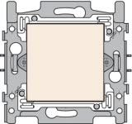

Niko Blindplate

Slide 20
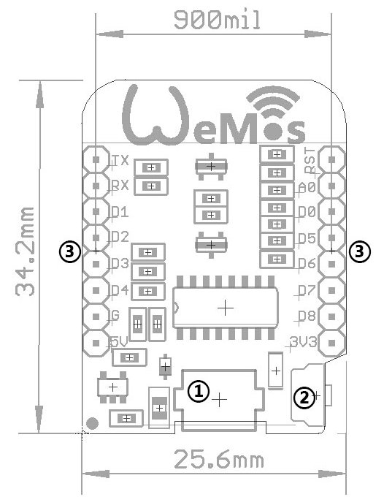
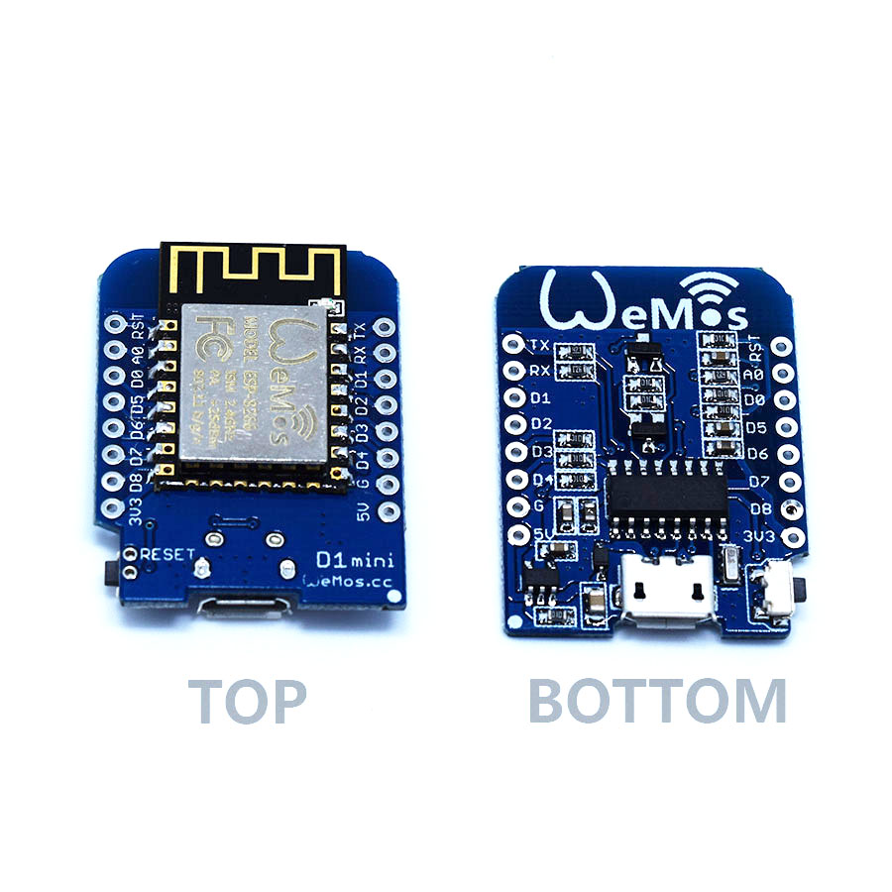
Wemos D1 Mini (1/2)
  ESP8266 based

Slide 21
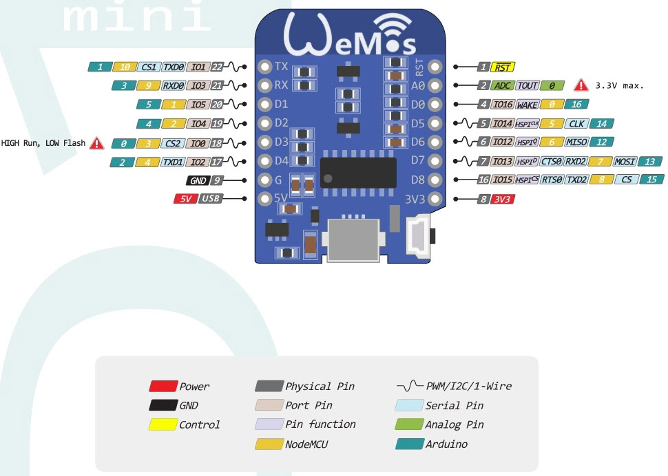
Wemos D1 Mini (2/2)

