Slide 1
Transporter proteins classification based on TC number
Sima Ataei
Hamed Ghazikhani

Slide 2
Project Overview and Objectives
Transporter proteins’ essential role on cell metabolism:
Assisting on movement different substances across the cell
Protein Annotation:
Characterizing proteins from their sequence
Main objective of the project:
Classifying transporter proteins into family and subfamily

Slide 3
Dataset
Transporter Classification Database (TCDB):
Classification system for membrane transport proteins sequences
Contains 19,425 transporter protein (14 Feb. 2020)
Including 1,234 families
And 2,921 subfamilies
Proteins are in FASTA file format

Slide 4
Preprocessing
Preprocessing steps include:
Excluding sequences with unacceptable amino acids (B, Z, X, J, O, U )
Excluding sequences with unacceptable length (length > 1000 or < 50)
Balanced dataset extraction: sampled separate 2 datasets (family & subfamily)
Extract 30 sequences of each family/subfamily randomly based on central limit theorem
Families with less than 30 sequences are excluded (1,138 family and 2871 subfamily)

Slide 5
Extracted Datasets
Dataset name | Number of Sequences | Number of classes
Family Dataset | 2880(96 families * 30 samples) | 96 (families)
Subfamily Dataset | 1500 (950 families * 30 samples) | 50 (subfamilies)

Slide 6
Feature Extraction
3 different feature vectors are extracted:
Amino Acid Composition
Pair Amino Acid Composition
Resampled one-hot encoding

Slide 7
Classification
TC number:
Classifying based on N1.L1.N2 and N1.L1.N2.N3
Subclass
Subfamily
N1.L1.N2.N3.N4
Class
Sequence
Family

Slide 8
Classification Methods
Extracted features are trained to 3 classifiers (using Scikit-Learn):
Support Vector Machine ( RBF, Polynomial, Linear)
Random Forrest (step =100 for number of estimators)
And a distance-based classifier
K-Nearest Neighbor (K between 1 to 100)
Using BLAST metric

Slide 9
BLAST
Basic Local Alignment Search Tool (BLAST):
local sequence alignment method
Compares protein sequences to sequence databases and calculates the statistical significance of matches
E-value is extracted by BLAST

Slide 10
Classification Specifications
Split the dataset to test and train sets [0.2, 0.8]
Run 5-fold cross-validations for each classifier

Slide 11
Results: family dataset
Classifier | Specification | Best Feature vector | Precision | Recall | F1-score
SVM | RBF kernel gamma = 0.1 & c=10 | AAC | 0.4424 | 0.4125 | 0.4093
Random Forrest | No. of estimators = 1000 | One-hot | 0.4846 | 0.4493 | 0.4174
KNN | Mikovski distance | AAC | 0.3455 | 0.3350 | 0.3186
KNN | BLAST (e-value= 1.0 e-6) | - | 0.9764 | 0.9761 | 0.9757

Slide 12
Result: subfamily dataset
Classifier | Specification | Best Feature vector | Precision | Recall | F1-score
SVM | RBF kernel gamma = 0.1 & c=10 | AAC | 0.4663 | 0.6848 | 0.5201
Random Forrest | No. of estimators = 1000 | AAC | 0.3841 | 0.3435 | 0.5535
KNN | Mikovski distance | AAC | 0.4881 | 0.5044 | 0.5332
KNN | BLAST (e-value= 1.0 e-7) | - | 0.9789 | 0.9779 | 0.9781

Slide 13
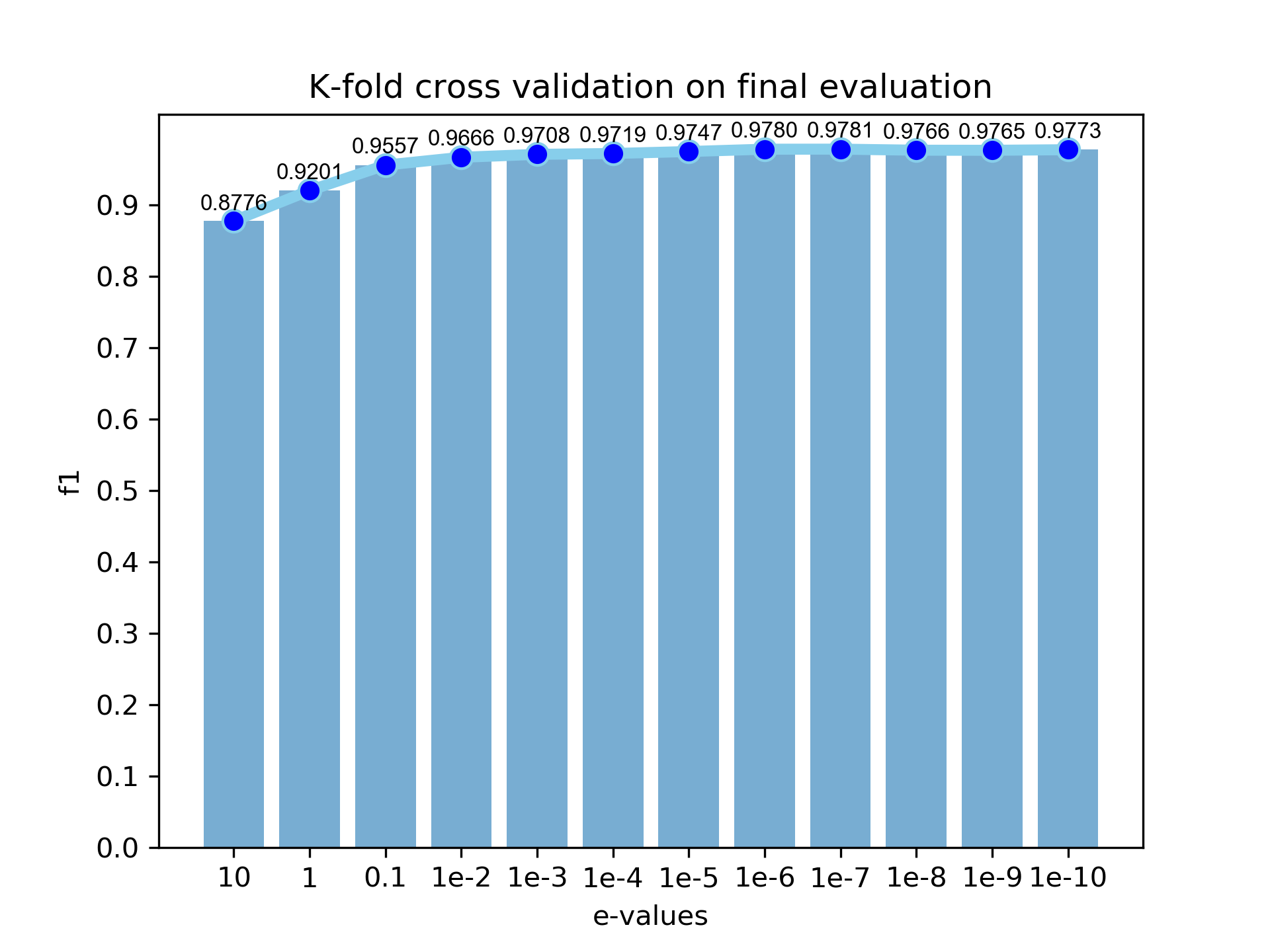
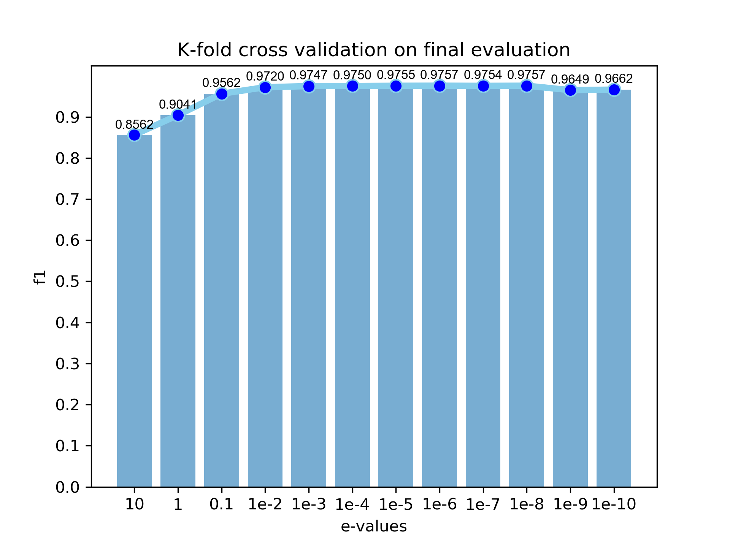
Tuning Hyperparameters : e-value
Subfamily
Family

Slide 14
Tuning Hyperparameters: K
Subfamily
Family

Slide 15
Discussion
Feature extraction needs background knowledge on the data
BLAST works better because of providing knowledge using pairwise alignment score

Slide 16
Conclusion
Transfer protein sequences are classified based on family and subfamily
Using KNN and BLAST method, f1-score reached around 97% on both classifications

Slide 17
Thanks for Your Attention

