Slide 1
Proposed practicum projects

Slide 2
MTI-filter selection
In the script FMCW_MTI_Filtering_Lab.mlx, a Moving target indicator (MTI)-filter is defined with 2 or 3 coefficients. This is a computationally inexpensive method to distinguish moving targets from clutter.
Plot the theoretical frequency response of these two MTI filters.
What is the effect of defining a longer MTI filter? Also show this in the theoretical frequency response.
How can the MTI filter be moved to a different frequency? For example from high-pass to low-pass, such that only clutter is passed.
Design a MTI filter that passes the velocity 1 m/s, with 50 dB suppression for other velocities. Show the frequency response of this filter, and the effect on the FMCW script. Also try different suppression levels. What is the effect?
Can you explain the operation of using the FFT to do Doppler filtering, in terms of MTI filtering? How does the FFT compare in terms of computational complexity?

Slide 3
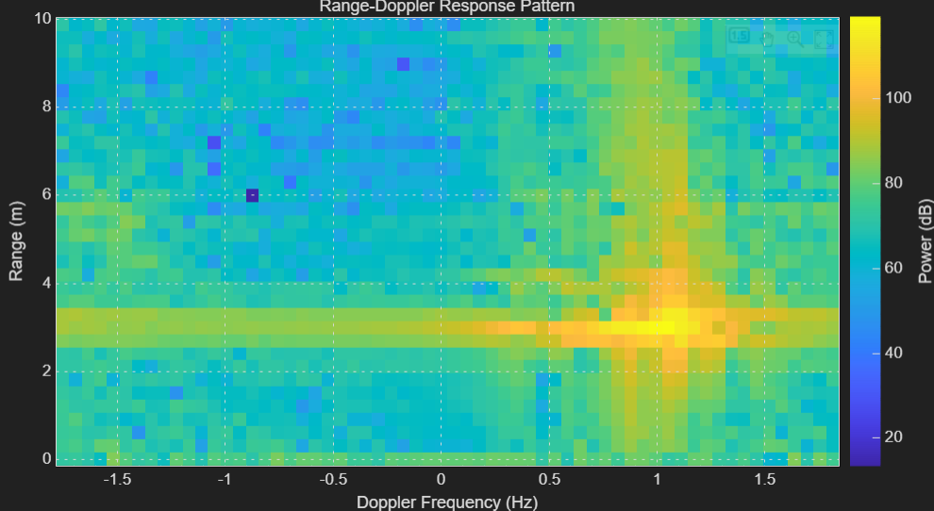
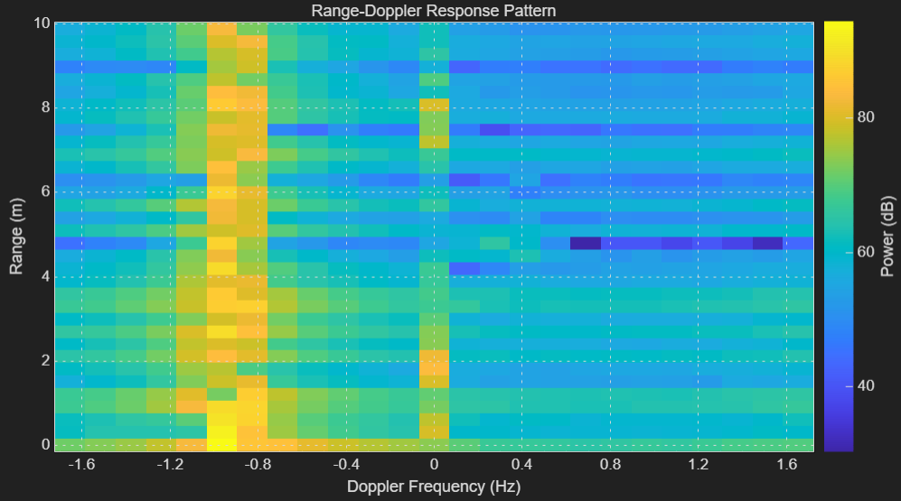
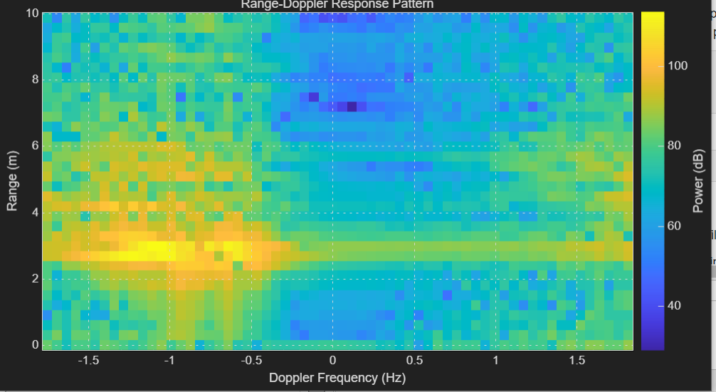
MTI filter selection (results)
Order 1
Order 39, Taylor window
Order 2

Slide 4
Hybrid Beamforming (fixed subarrays)
One method of HBF is to use fixed subarrays, where only the digital weights are used to steer the beam.
First assume a fully uniform taper, both for the analog weights and the digital weights.
  Make a Matlab script and plot the array factor for the subarray, the digital part, and the combination of the two.
  Measure the corresponding beam pattern (Pattern_Tapering_Lab.mlx). Adjust the script to be able to control the digital weights.
Use this method to scan the digital beam 10 degrees, while keeping the subarray pattern fixed. Perform the measurement, and plot the theoretical array factors for analog, digital and combined. What do you see? What are the advantages and disadvantages of this method of hybrid beamforming? Try different digital scan angles.
Note: you can measure the beam pattern by either scanning the Rx beam or by moving the transmitter. What is the difference?

Slide 5
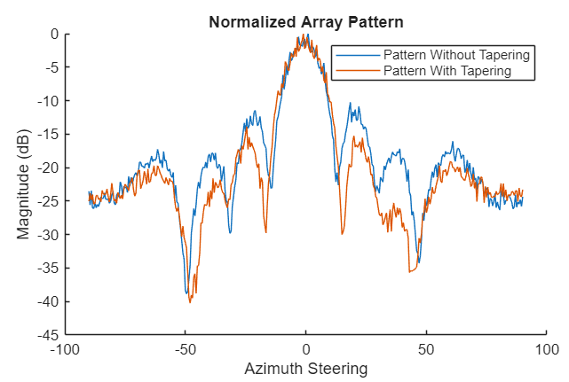
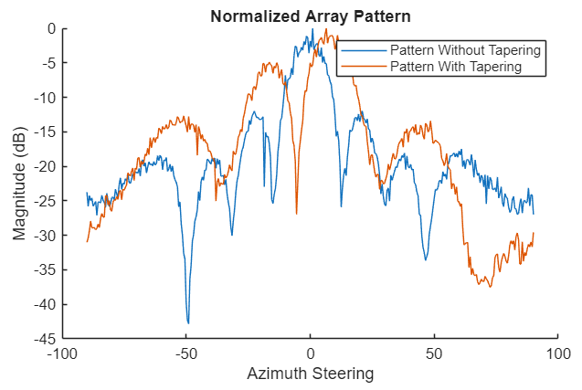
Hybrid beamforming (fixed subarrays) (results)

Slide 6
Quantization in phased-array beamforming
In practical phased-array beamforming systems, the amplitude and phase weights applied to each antenna element cannot take continuous values. Instead, they are quantized into discrete steps due to hardware limitations (finite-bit phase shifters and attenuators). This project will help you explore how such quantization affects the beam pattern, especially the sidelobe level.
In "Pattern_Tapering_Lab", determine the default quantization resolution used for both amplitude and phase.
According to theory (using equations), what happens to the sidelobe levels when the quantization resolution of amplitude and phase decreases? Calculate the theoretical sidelobe levels under different quantization levels (Reduce phase shifter and amplitude weighting quantization by 1 bit, 2, 3, 4, …).
Write a MATLAB script to simulate the effect of these different quantization levels on the array beam pattern. Keep the same amplitude tapering as in "Pattern_Tapering_Lab" and vary the quantization levels of the amplitude and phase.
In "Pattern_Tapering_Lab", change the quantization resolution for amplitude and phase. Perform the measurements and record your observations. Focus on how sidelobe characteristic change. (Tip: place the source in an off-broadside direction to see the effects more clearly.) Also analyse the effect on the gain of the beam.

Slide 7
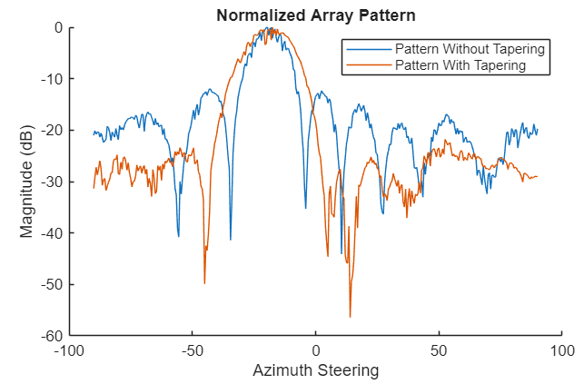
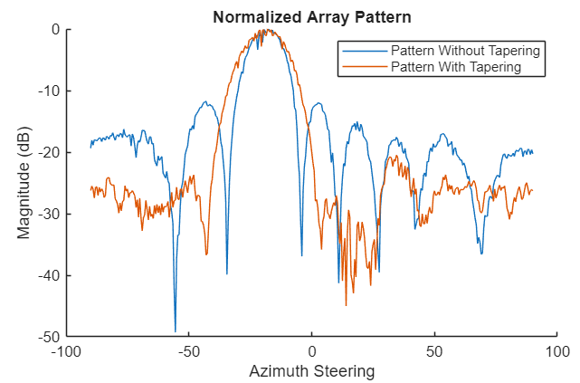
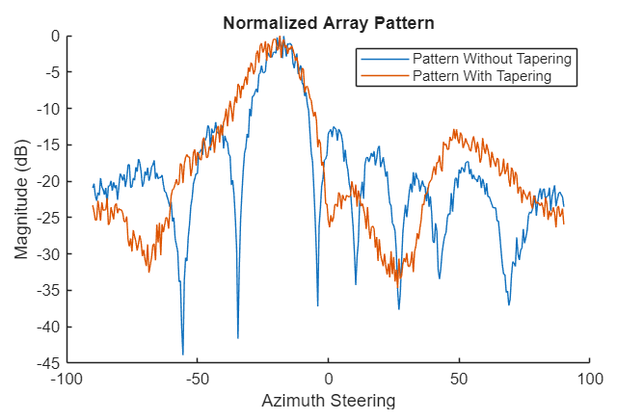
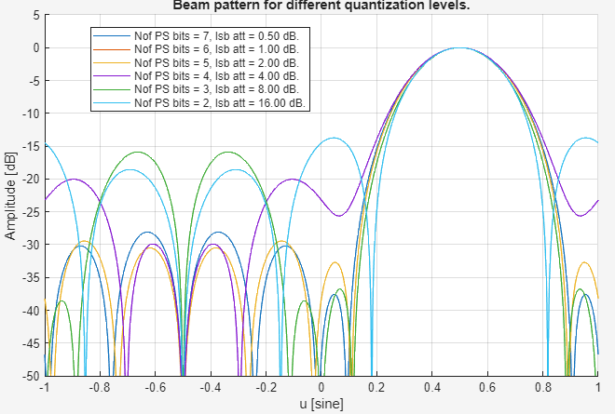
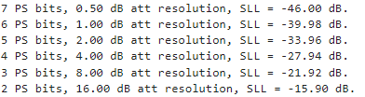
Quantization in phased-array beamforming
(results)
7-bit phase, 0.5 dB amplitude
5-bit phase, 2 dB amplitude
2-bit phase, 8 dB amplitude
Simulation
Analytical

Slide 8
Calibration accuracy
Accurate calibration is essential for phased-array antennas, since erros in amplitude or phase across elements can distort the beam pattern. In this project, you will investigate the effect of calibration accuracy, study the relative importance of amplitude and phase corrections, and compare calibration at near- vs. far- distances.
Perform the calibration at close range (approximately 1 m), plot the resulting beam pattern.
Investigate which calibration parameter has more influence on beam quality:
  Perform phase only calibration, and plot the beam pattern.
  Perform amplitude-only calibration and plot the beam pattern.
  Compare both cases with the full calibration.
  Conclude: Is phase or amplitude correction more critical for beam accuracy?
Using "Pattern_Tapering_Lab.mlx", set the lowest side lobe level in the tapering setting and perform the measurement. Plot the pattern you just measured, and determine the sidelobe level you can achieve.
Now move the source far away (approximately 5 m) and re-calibrate the antenna.
Perform the same measurement using "Pattern_Tapering_Lab.mlx". Compare with the close-range result and explain why the sidelobe levels change with calibration distance.

Slide 9
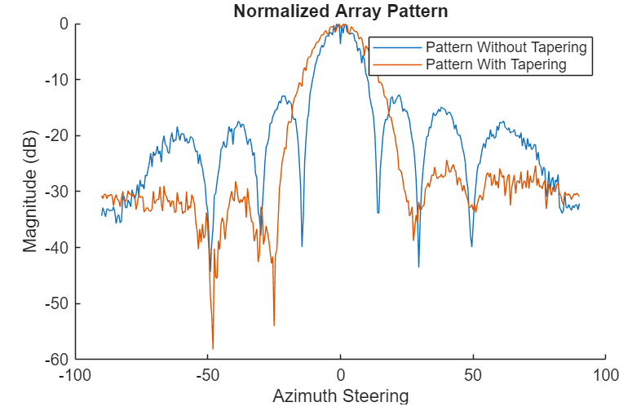
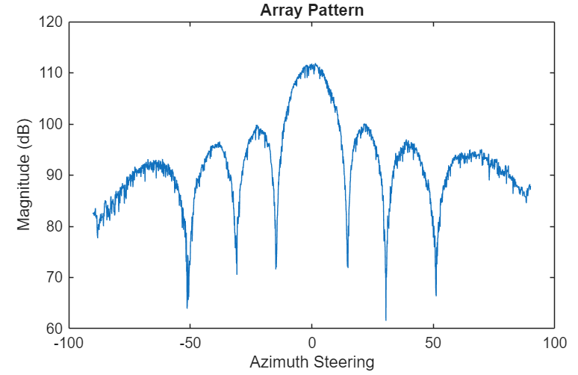
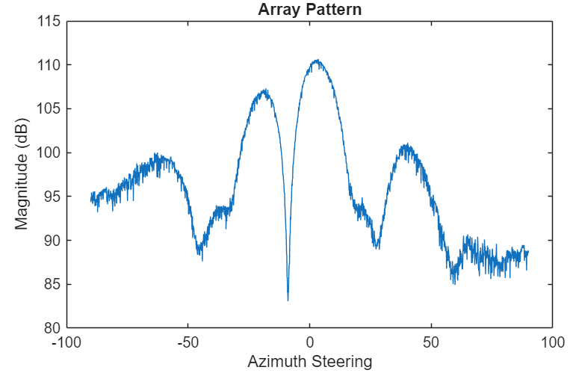
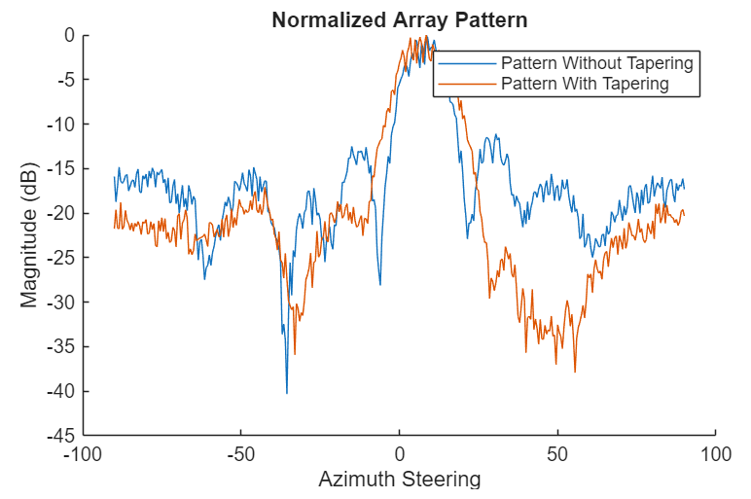
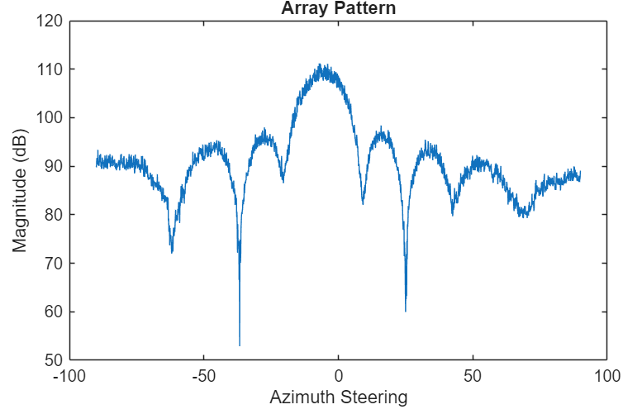
Calibration accuracy (results)
Calibration ampl only
High SNR cal (close by)
Calibration ampl+phase
Low SNR cal (far away)
Calibration phase only

Slide 10
Wave Polarization: Dihedral Corner Reflector
A dihedral corner reflector is a commonly used reference target for polarimetric measurements. Its polarimetric properties change with its orientation angle.
Dertermine the polarization angle of the vivaldi transmitter and the patch element of the receivers theoretically. Place the vivaldi transmitter so that its polarization direction matches with the receiver.
According to the theoratical scattering matrix of the dihedral, provide the expected return power for each polarization state on the receiver side, assuming the transmitted wave has the same polarization as the Vivaldi transmitter you just placed.
Do the measurement (FMCW_Range_Lab) with the diehdral at different rotation angles (0 deg, 45 deg, 90 deg). Observe the results and explain using the scattering matrix.
Rotate the vivaldi transmitter by 90 degrees around its transmission axis and perform the same measurement. Observe the results, compare with the previsous measurement and explain the changes in the receive power.
Now rotate the vivaldi transmitter back to the original angle (so that its polarization angle matches with the receiver). Then, rotate the receiver 45 degrees around its receiving axis. Do the same measurement, compare with the previous results and explain what you observed.

Slide 11
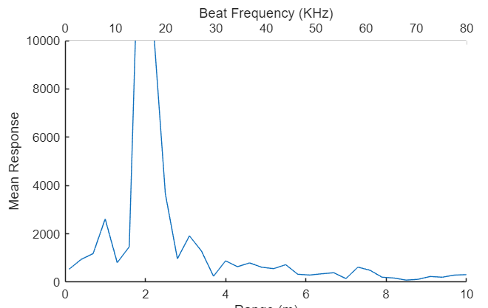
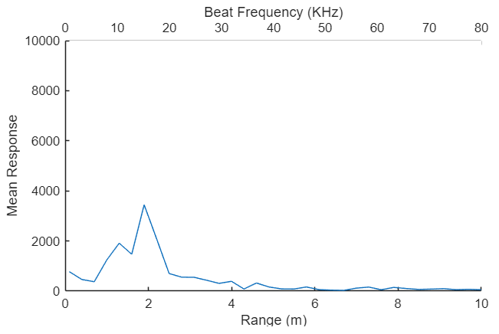
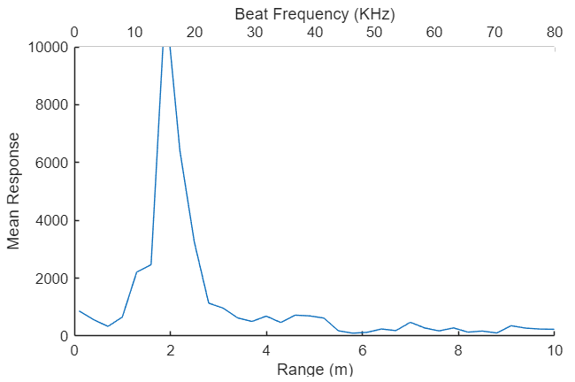
Wave Polarization: Dihedral Corner Reflector (Results)
Dihedral 0 deg
Dihedral 45 deg
Dihedral 90 deg

Slide 12
Fan micro-Doppler investigation
In this project, you will use a rotating fan as a target to observe and analyze micro-doppler signatures with our radar system.
Place the fan at a fixed distance from the radar, make sure all four blades are visible. In "FMCW_Range_Doppler_Lab", set PRF to 2000 Hz and pulse number to 128. Open the fan and do the measurement (one measurement with low rotation speed, one measurement with high rotation speed).
Repeat the measurement with 3 blades, 2 blades, 1 blades.
Now try to explain the relation between the spacing of these bright spots and the rotation speed of the fan.
Try to explain what happened after changing the number of blades.
Explain why do you observe so many bright spots at different doppler velocity.

Slide 13
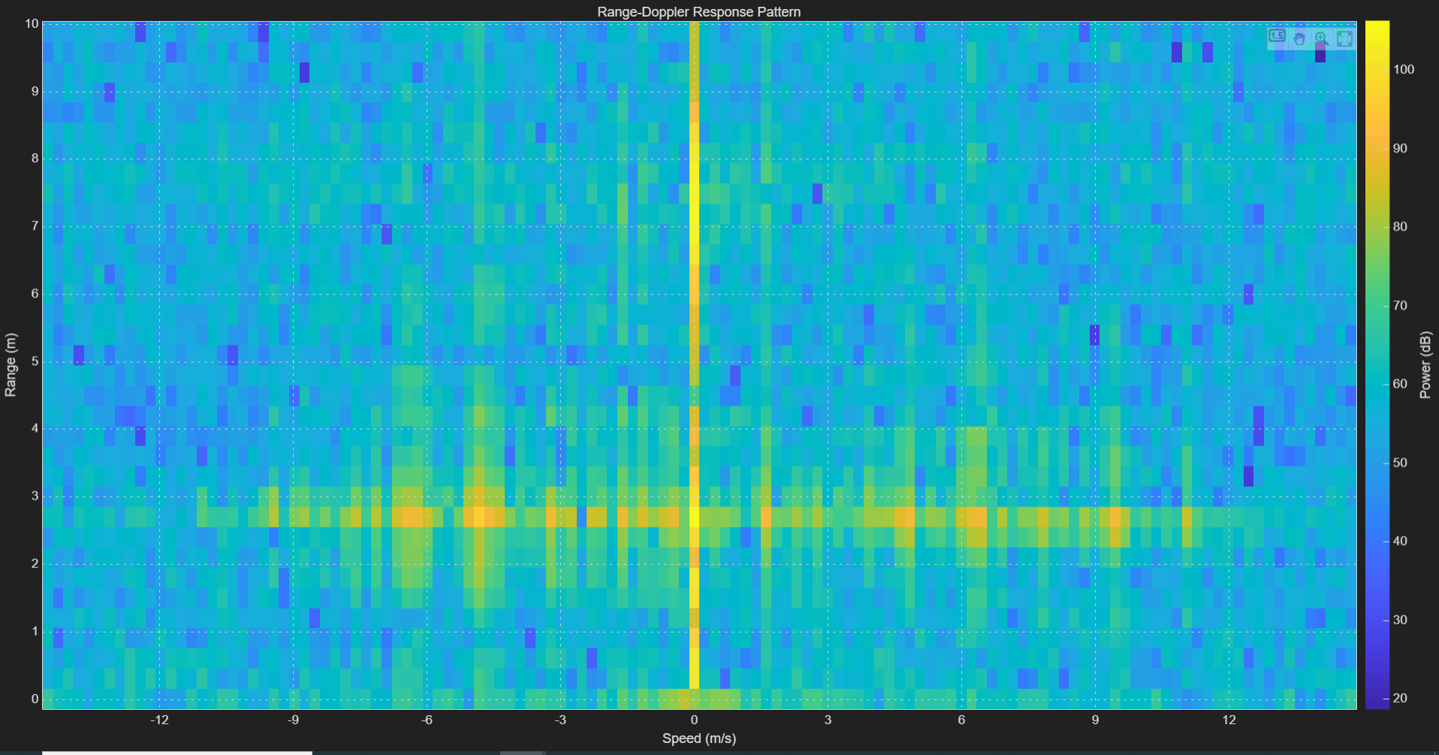
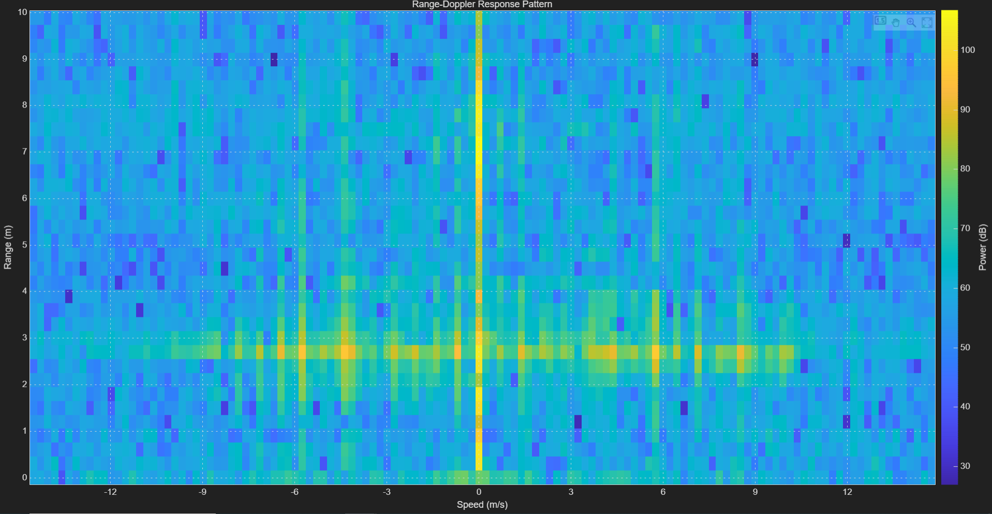
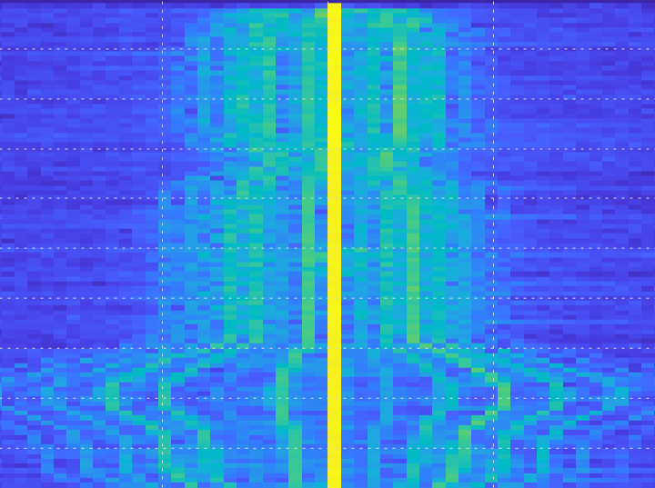
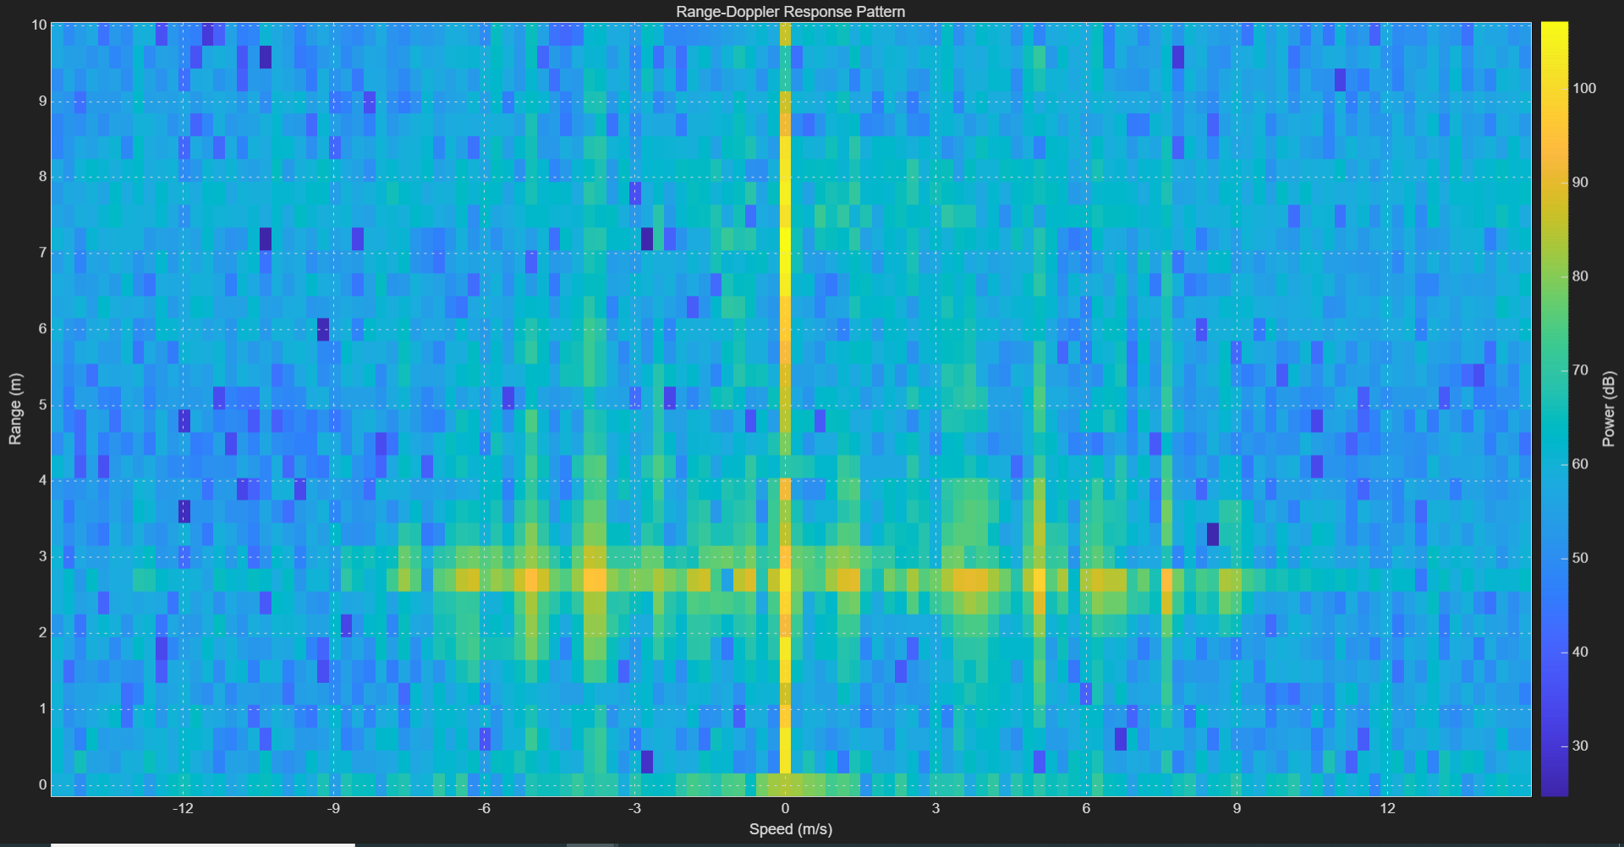
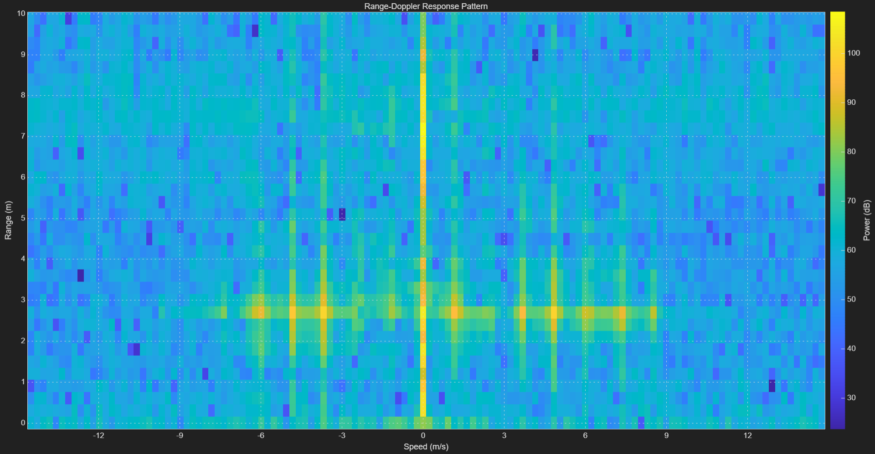
Fan micro-Doppler investigation
(results)
Fan rotates at approximately 16 Hz, with radius 4.5 cm
1 blade
2 blades
Time-Doppler
3 blades
4 blades

Slide 14
DoA performance
Place the Tx at relatively short distance (e.g. 1 meter) at an angle (e.g. around 45 deg.) in azimuth (zero elevation).
Apply beam steering on Rx to identify the direction of arrival (DoA).
At similar distance, move the Tx to wider azimuth angles. Apply beam steering to find the DoA, see and explain the change in performance.
At 1m distance and 45 deg. azimuth angle, move the Tx to wider elevation angles. Apply beam steering to find the DoA, see and explain the change in performance.
At the 45 deg. azimuth angle and zero elevation, move the Tx to further distances. Apply beam steering the find the DoA and explain the change in performance.
Hold two Tx's at relatively short distance. One will stay fixed on broadside. Move the other Tx at similar distance to further azimuth angles. Apply beam steering and see if/when you can resolve the Tx angles.
Hold one Tx at 45 deg in azimuth, and place a plate reflector at –25 deg & -50 deg in azimuth. Apply beam steering and see if you can resolve the Tx and the plate.

Slide 15
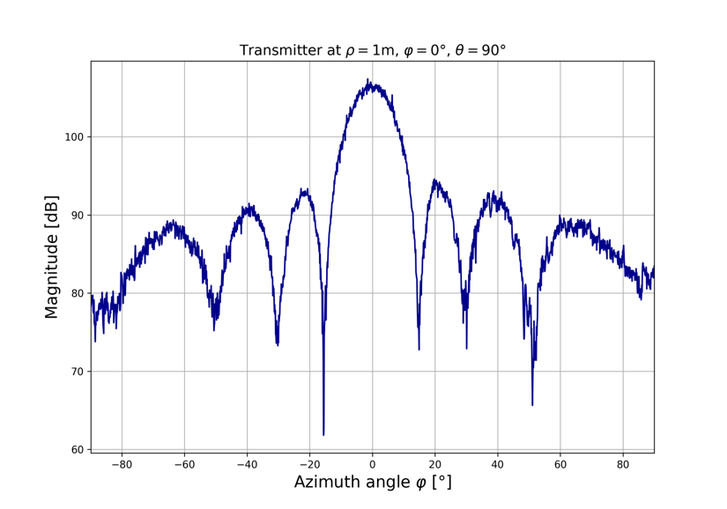
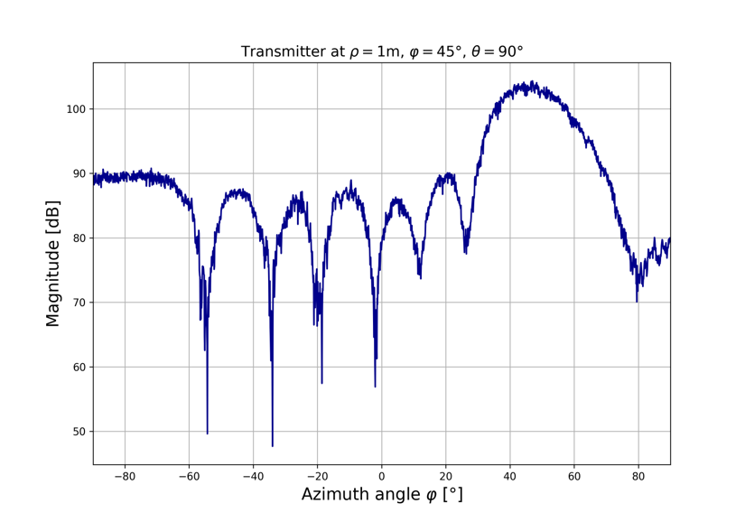
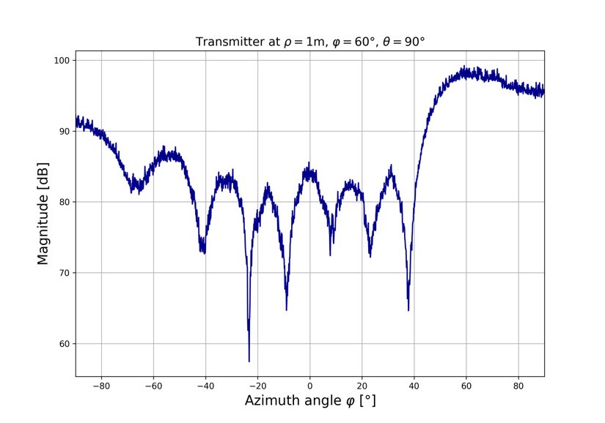
DoA performance results
With one source: sharp performance degradation after roughly 60 degrees. Insert picutres: 3 tests, source at 0 deg, 45 deg and 75 deg. For the last one, target appears to be closer.

Slide 16
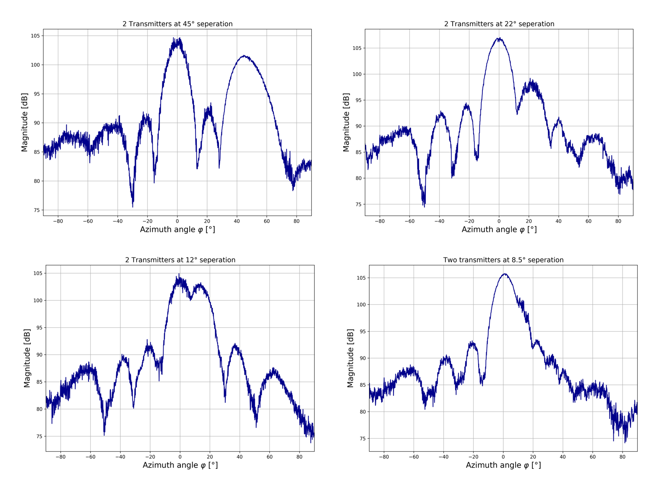
DoA performance results
With two sources

Slide 17
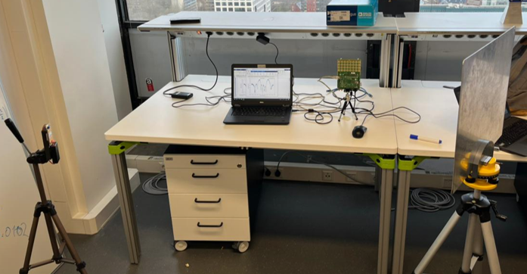
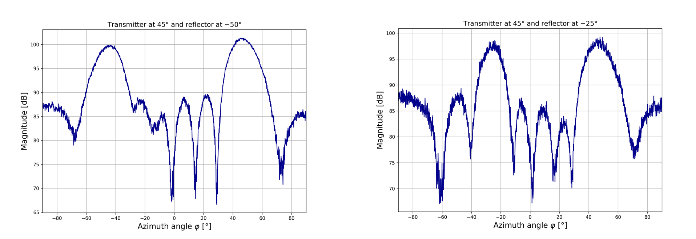
DoA performance results
With one source and a reflector

