Slide 1
Inductive wireless power transfer
Simulation results and analytical validation

Slide 2
Outline
Motivation
Equivalent circuit analysis
Coupled inductors
Resistance
Inductance
Comparison of results
Conclusion
Outlooks

Slide 3

Motivation
Growing demand for WPT systems
Imperfections in the Qi 2.0 standard, especially the Magnetic Power Profile (MPP)
Need for accurate and precise simulations
Collaboration with esteemed companies
Image: How the New Qi2 Standard Will Change the Future of Wireless Charging (graniteriverlabs.com)

Slide 4
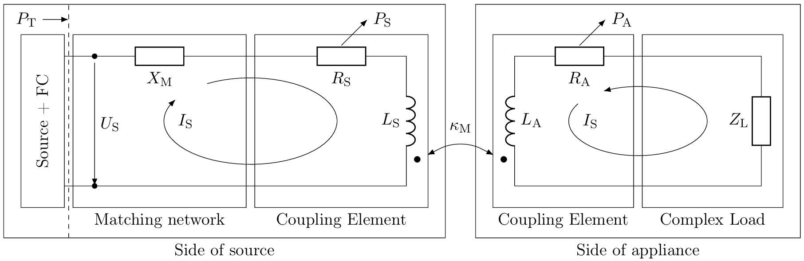
Equivalent circuit analysis – IWPT system

Slide 5
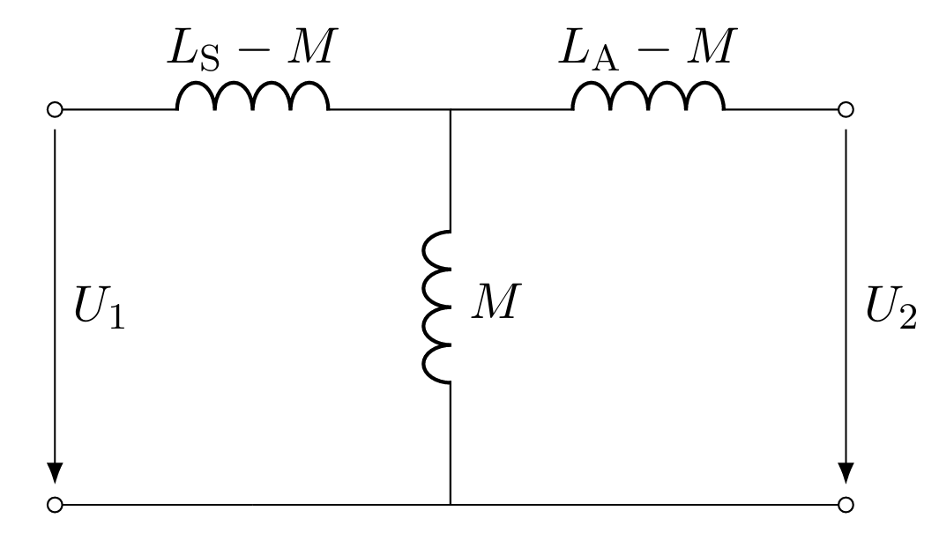
Equivalent circuit analysis – coupled inductors

Slide 6
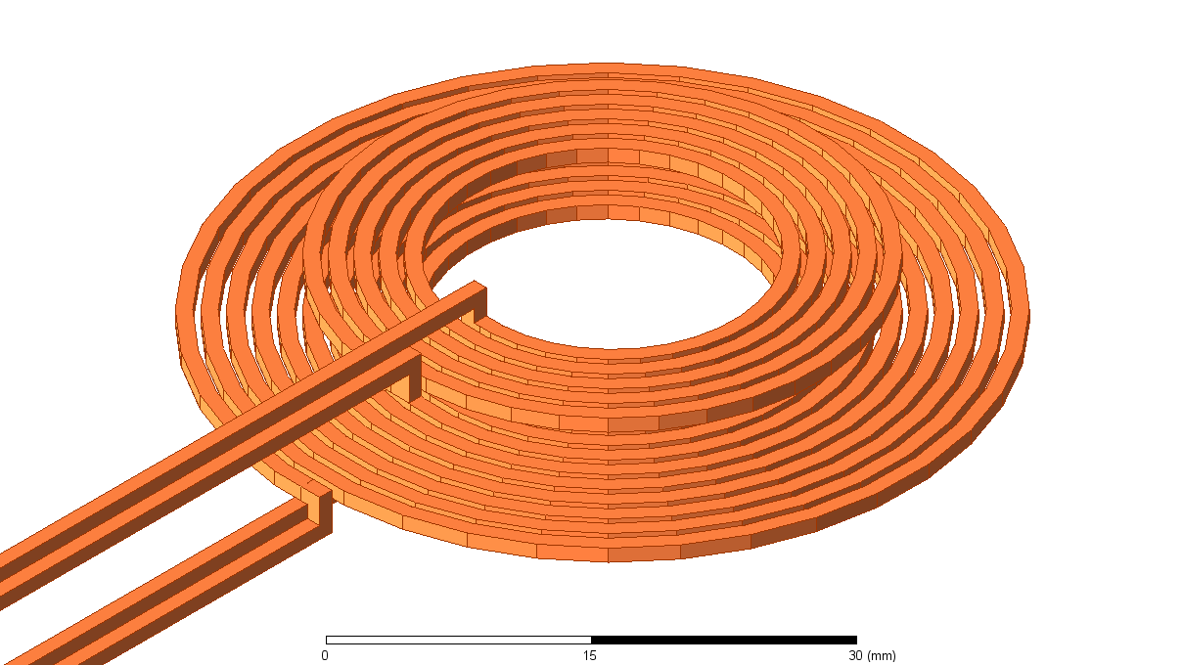
Coupled inductors – 3D CAD model

Slide 7
Coupled inductors – dimensions
Transmitting coil (Tx)
Receiving coil (Rx)
Inner diameter: 20 mm,
outer diameter: 51 mm,
coil height: 1 mm,
number of turns: 10.
Inner diameter: 20 mm,
outer diameter: 36 mm,
coil height: 1 mm,
number of turns: 5.

Slide 8
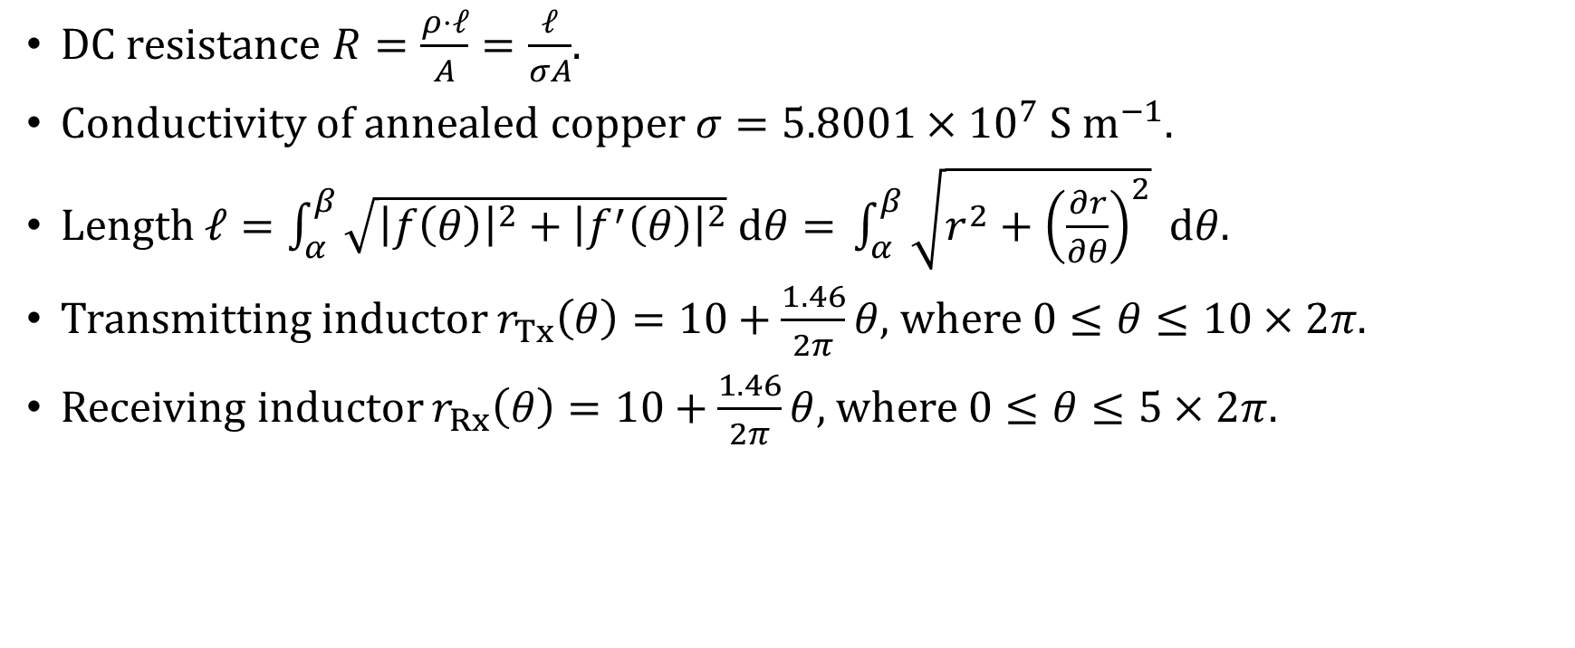
Resistance – analytical formulas
DC resistance $R=\frac{ρ⋅ℓ}{A}=\frac{ℓ}{σA}$.
Conductivity of annealed copper $σ=5.8001×{10}^{7} S m^{−1}$.
Length $ℓ=\int_{α}^{β}{\sqrt{{\left|f\left(θ\right)\right|}^{2}+{\left|f^{′}\left(θ\right)\right|}^{2}} dθ= }\int_{α}^{β}{\sqrt{r^{2}+{\left(\frac{∂r}{∂θ}\right)}^{2}} dθ}$.
Transmitting inductor $r_{Tx}\left(θ\right)=10+\frac{1.46}{2π}θ,$ where $0≤θ≤10×2π$.
Receiving inductor $r_{Rx}\left(θ\right)=10+\frac{1.46}{2π}θ,$ where $0≤θ≤5×2π$.

Slide 9
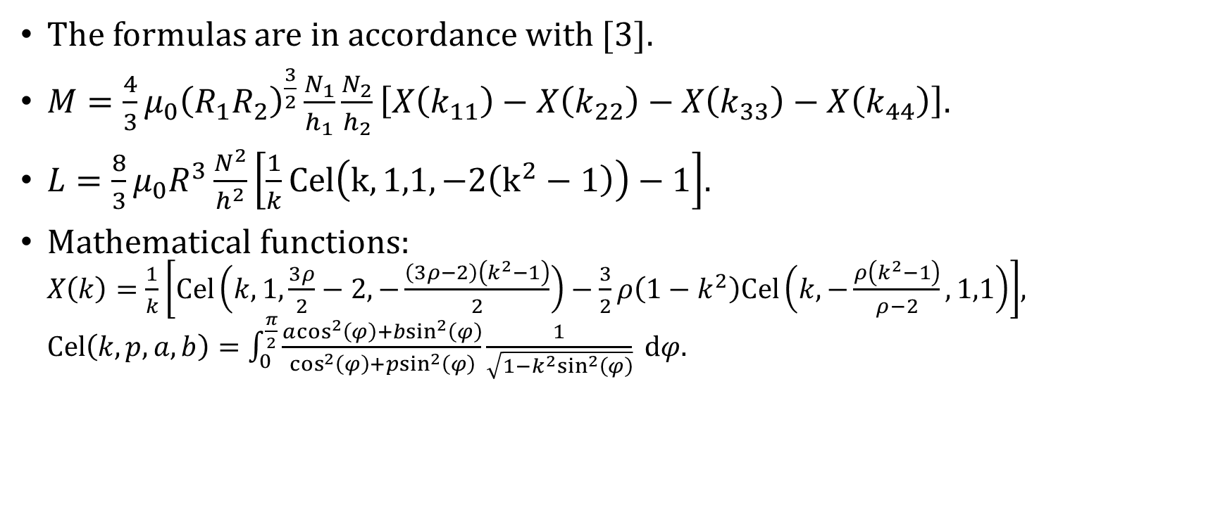
Inductance – analytical formulas
The formulas are in accordance with [3].
$M=\frac{4}{3}μ_{0}{\left(R_{1}R_{2}\right)}^{\frac{3}{2}}\frac{N_{1}}{h_{1}}\frac{N_{2}}{h_{2}}\left[X\left(k_{11}\right)−X\left(k_{22}\right)−X\left(k_{33}\right)−X\left(k_{44}\right)\right].$
$L=\frac{8}{3}μ_{0}R^{3}\frac{N^{2}}{h^{2}}\left[\frac{1}{k}Cel\left(k,1,1,−2\left(k^{2}−1\right)\right)−1\right]$.
Mathematical functions: $X\left(k\right)=\frac{1}{k}\left[Cel\left(k,1,\frac{3ρ}{2}−2,−\frac{\left(3ρ−2\right)\left(k^{2}−1\right)}{2}\right)−\frac{3}{2}ρ\left(1−k^{2}\right)Cel\left(k,−\frac{ρ\left(k^{2}−1\right)}{ρ−2},1,1\right)\right]$, $Cel\left(k,p,a,b\right)=\int_{0}^{\frac{π}{2}}{\frac{a\cos^{2}\left(φ\right)+b\sin^{2}\left(φ\right)}{\cos^{2}\left(φ\right)+p\sin^{2}\left(φ\right)}\frac{1}{\sqrt{1−k^{2}\sin^{2}\left(φ\right)}}} dφ$.

Slide 10
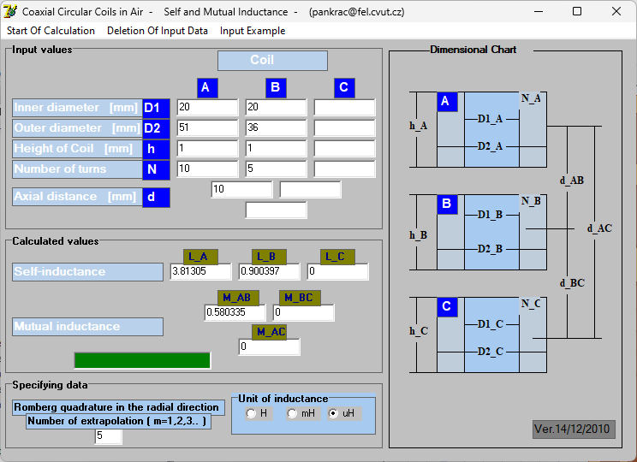
Inductance – numerical software [2]

Slide 11
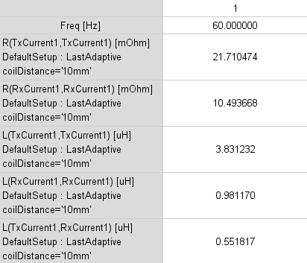

Comparison of results
Analytical
Simulation
$R_{Tx}=21.9 mΩ$,
$R_{Rx}=10.4 mΩ$,
$L_{Tx}=3.8 μH$,
$L_{Rx}=0.9 μH$,
$M=0.6 μH.$

Slide 12
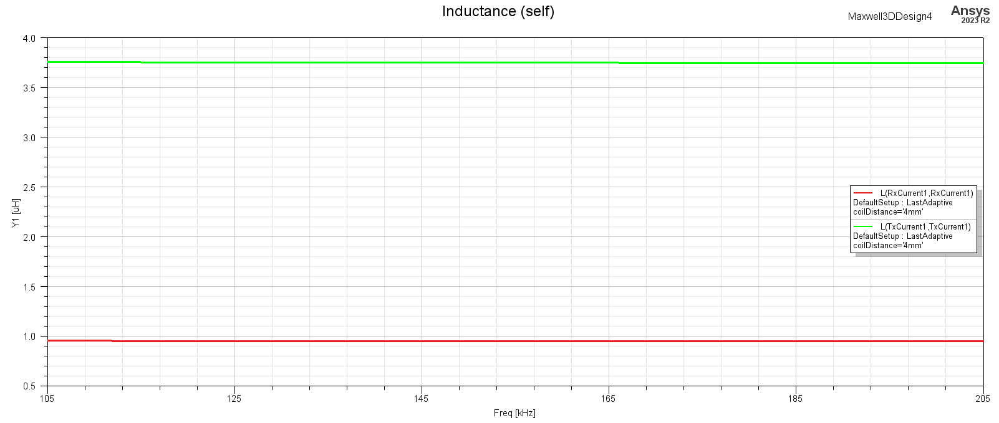
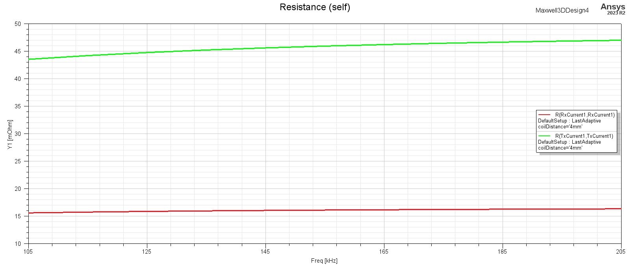
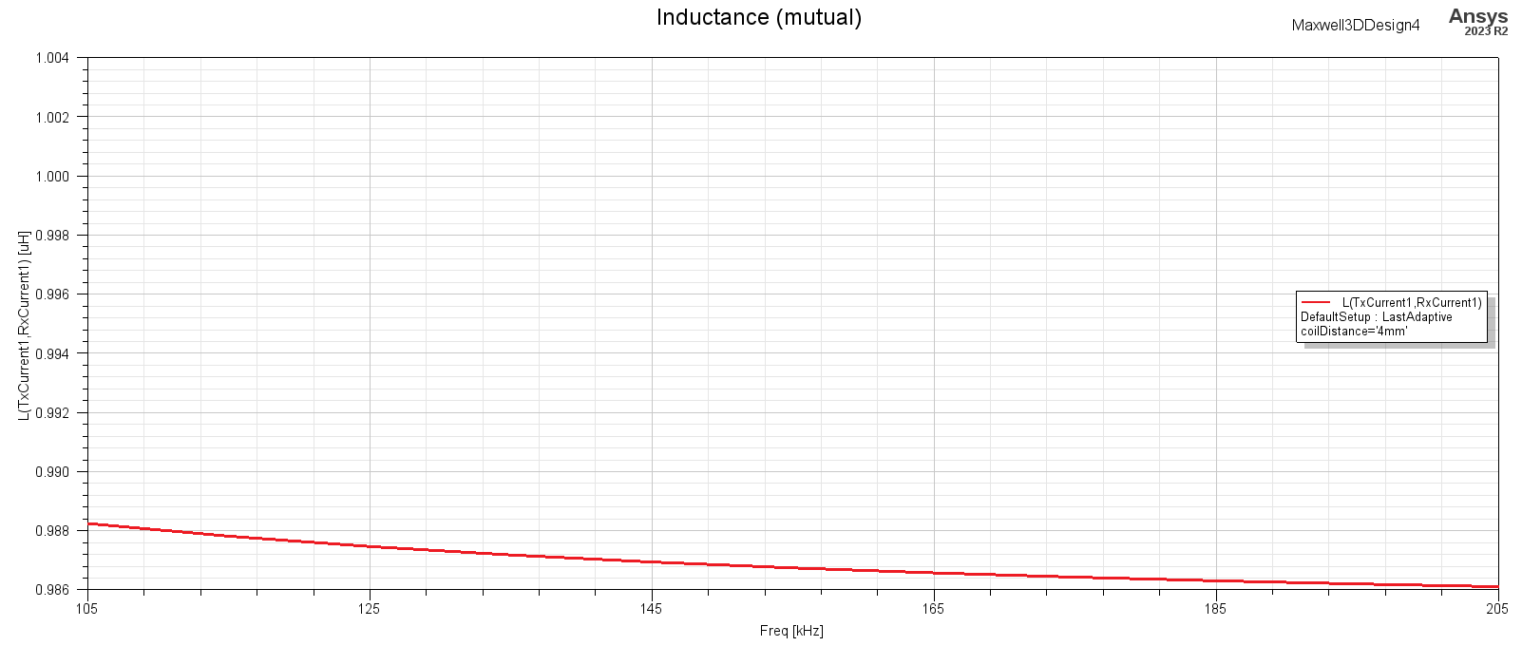
Conclusion
ANSYS Maxwell software result validation
Extension to different geometries
Extension to AC-excited systems

Slide 13
Outlooks – STMicroelectronics
A multinational corporation of French-Italian origin.
Regional headquarters in Singapore and Shanghai.
Design centers across the world including Prague, Czech Republic.
Manufacturer of Qi(氣)-compliant IWPT systems.

Slide 14
References
[1] J. Kraček and M. Mazánek. Power balance of inductive wireless power transmission. Proceedings of the 5th European Conference on Antennas and Propagation, EUCAP 2011, 01 2011.
[2] V. Pankrác. Software for self and mutual inductance calculation of coaxial coils in air. https://elmag.fel.cvut.cz/uzivatel/vitezslav-pankrac/.
[3] V. Pankrác. Power inductors (part 3). Elektrorevue, 12(1):1–15, 2010. ISSN 1213 1539.

Slide 15
Thank you
for your attention

