Slide 1
Inductive wireless power transfer
Power transfer efficiency assessment

Slide 2
Outline
Coupled inductors
Power transfer efficiency assessment
Power balance
Maximal efficiency
Maximal active power delivered
Simulation results
Conclusion

Slide 3
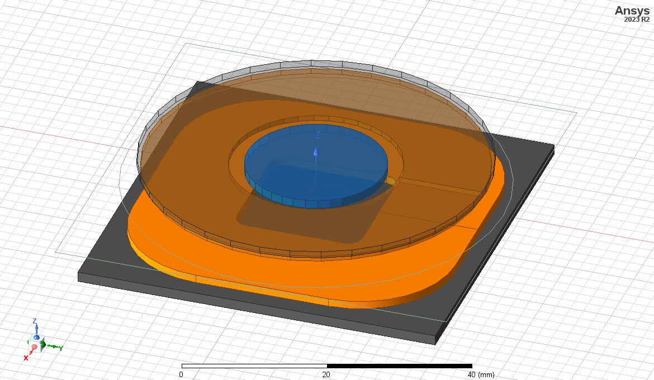
Coupled inductors
Reference coils used by STMicroelectronics
Oval transmitter coil [1]
Ferrite cores

Slide 4
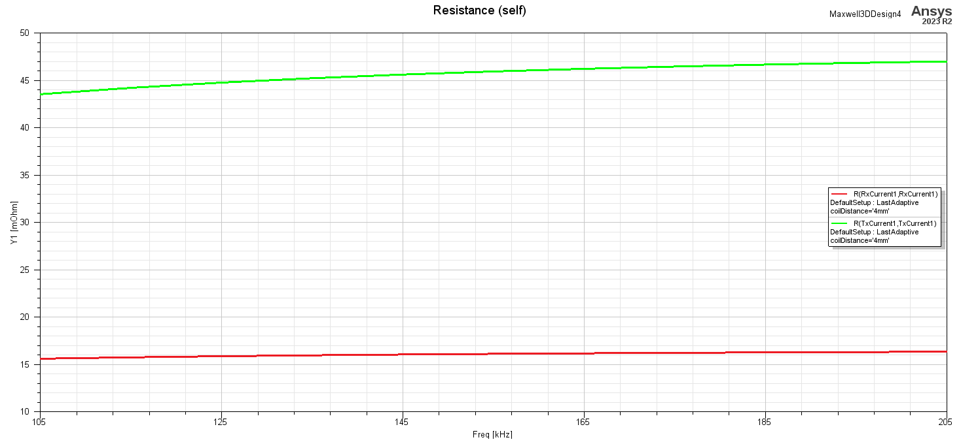
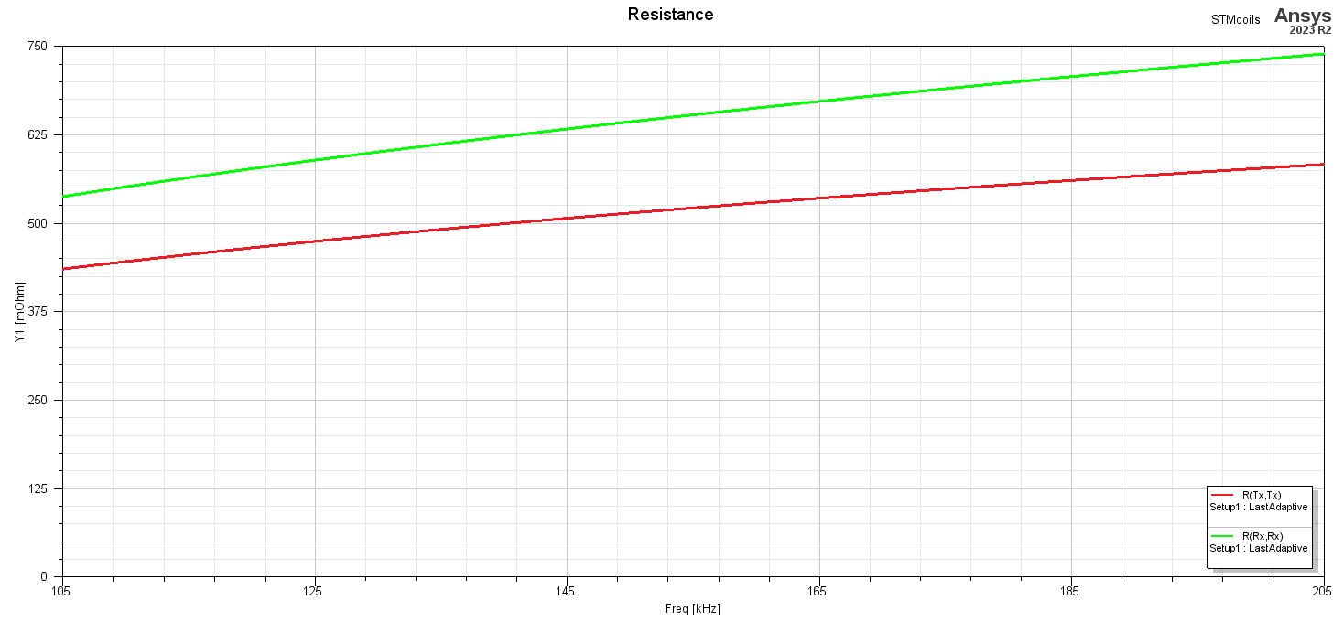

Slide 5
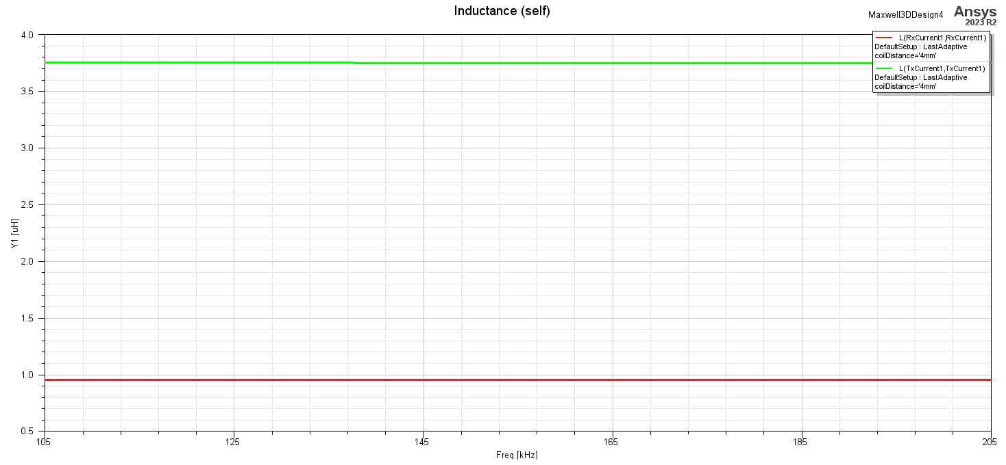
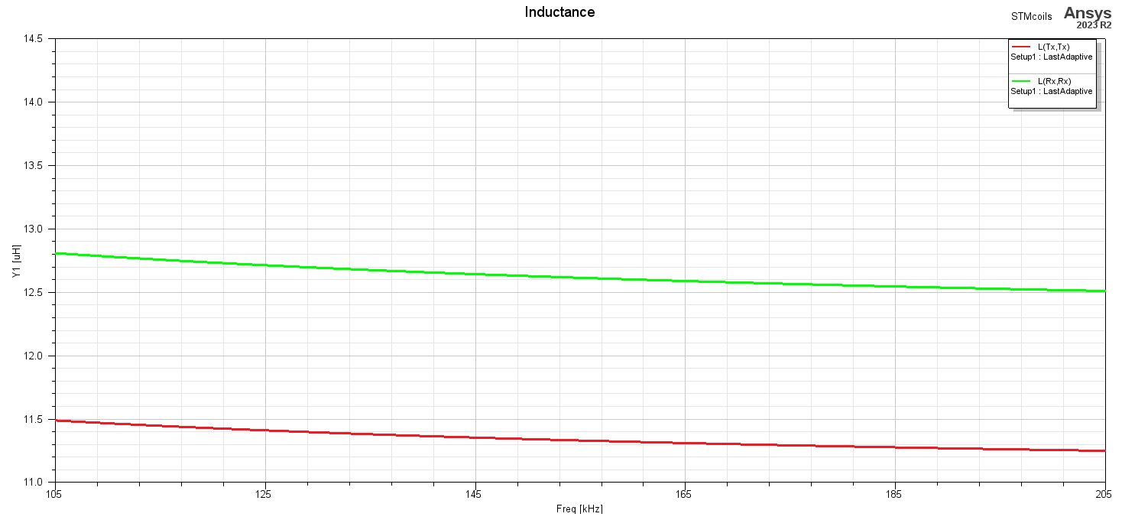

Slide 6
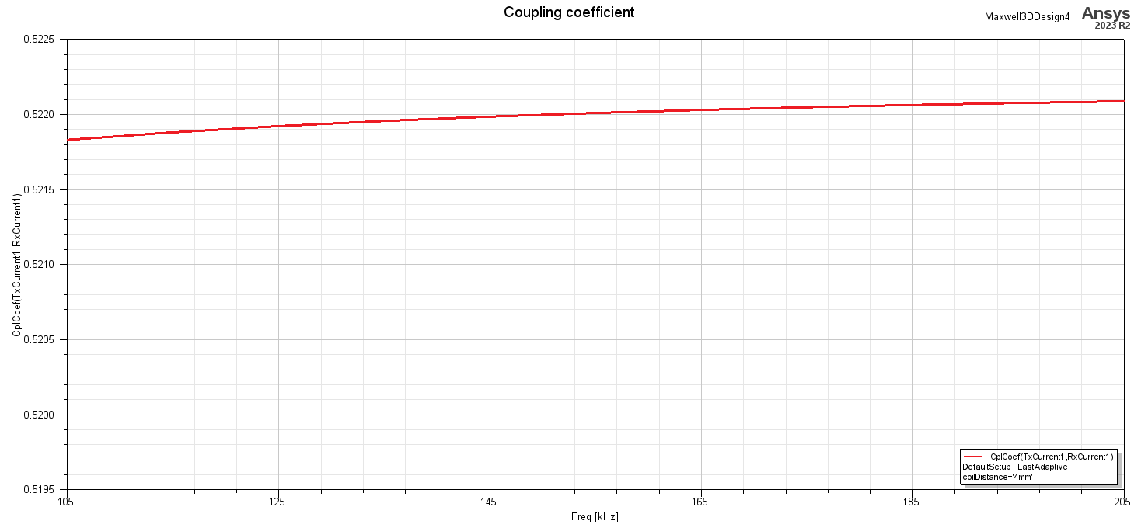
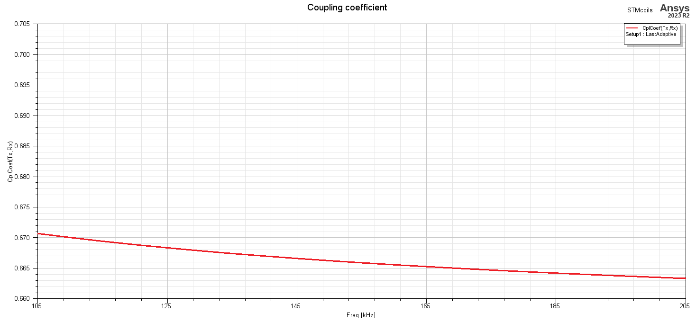

Slide 7
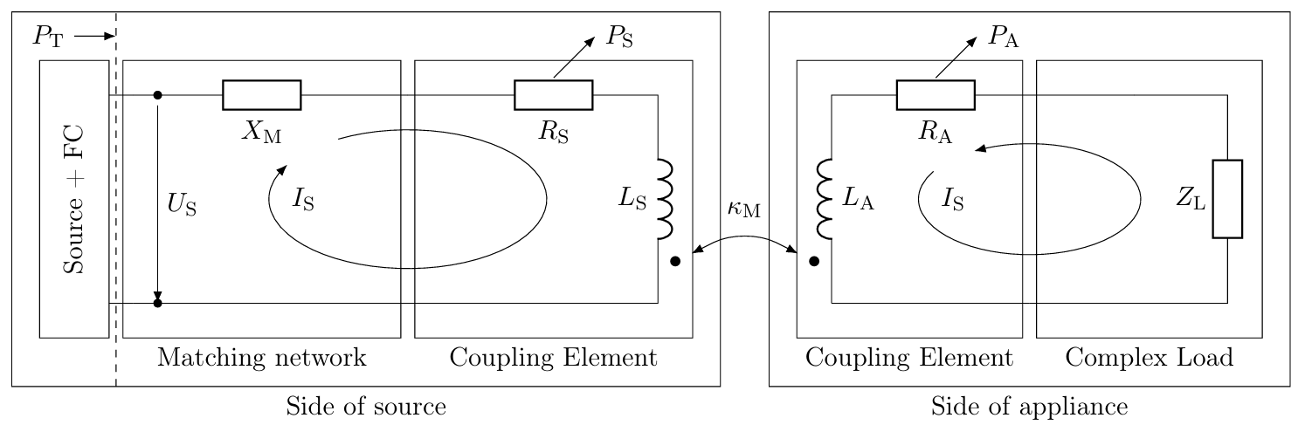
Power transfer efficiency assessment
Whole transmission chain analysis
Source
Source matching circuit
Complex load (appliance matching)

Slide 8
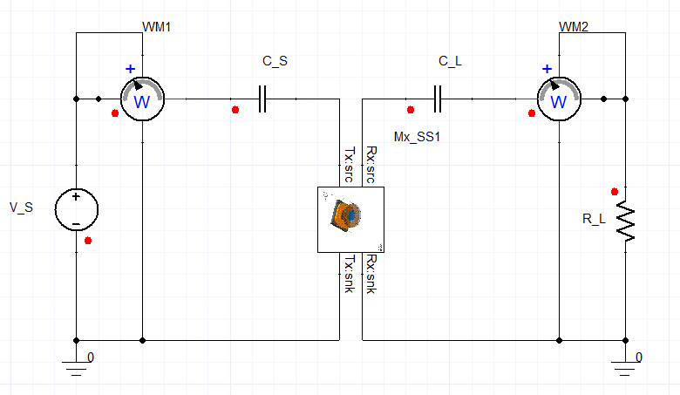
ANSYS Simplorer circuit with ROM
Reduced-order modelling
RLGC-based dynamic description
Embedding the model in a custom circuit
Complex output variables tracking

Slide 9
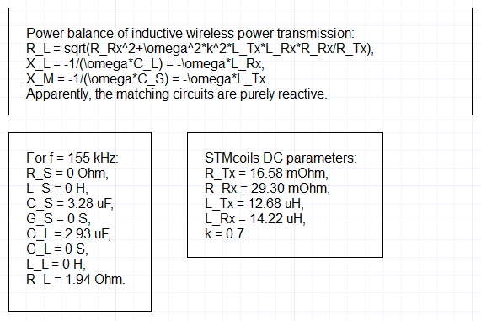
Power balance
Calculation of the matching circuit parameters [2]
Maximization of efficiency
Load impedance
Maximization of active power delivered
Source impedance

Slide 10
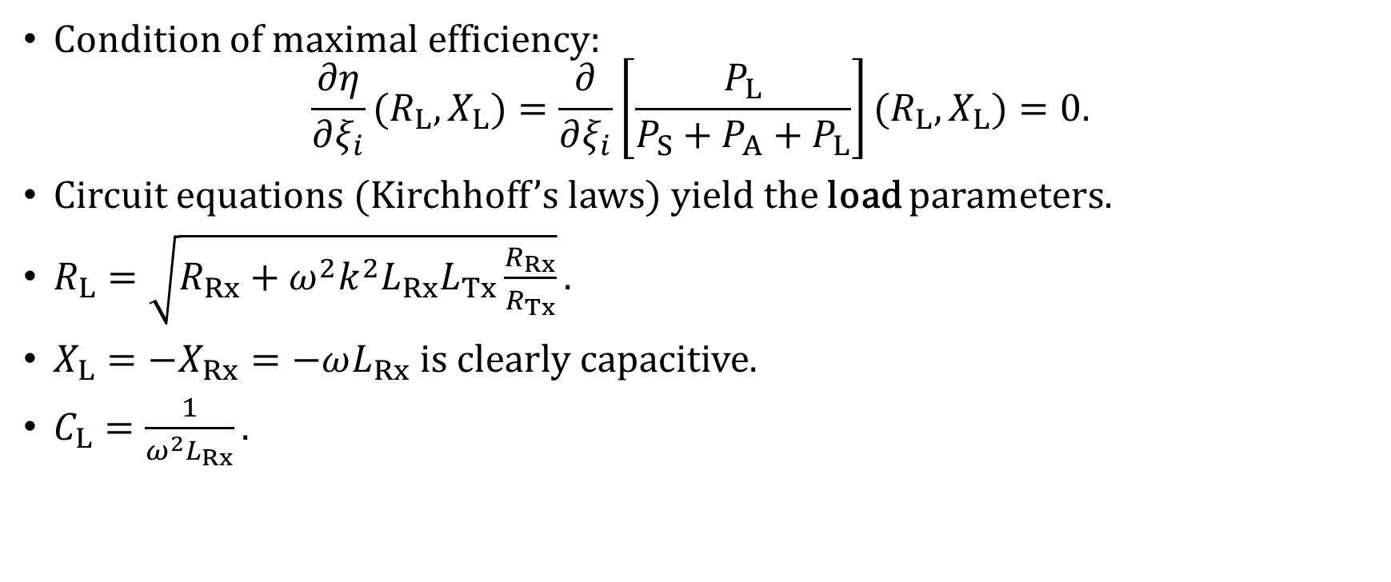
Maximal efficiency
Condition of maximal efficiency: $\frac{∂η}{∂ξ_{i}}(R_{L},X_{L})=\frac{∂}{∂ξ_{i}}\left[\frac{P_{L}}{P_{S}+P_{A}+P_{L}}\right](R_{L},X_{L})=0.$
Circuit equations (Kirchhoff’s laws) yield the load parameters.
$R_{L}=\sqrt{R_{Rx}+ω^{2}k^{2}L_{Rx}L_{Tx}\frac{R_{Rx}}{R_{Tx}}}.$
$X_{L}=−X_{Rx}=−ωL_{Rx}$ is clearly capacitive.
$C_{L}=\frac{1}{ω^{2}L_{Rx}}.$

Slide 11
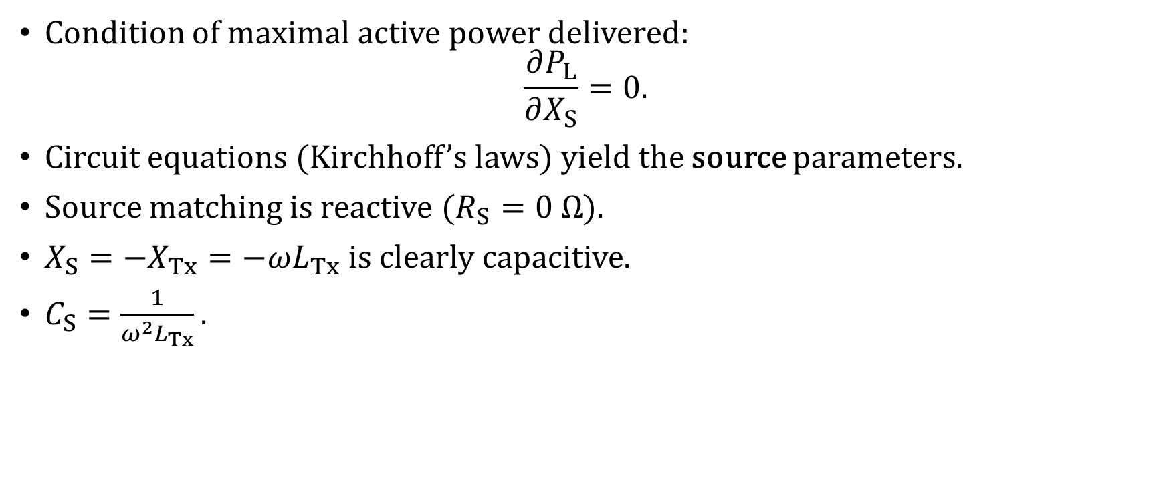
Maximal active power delivered
Condition of maximal active power delivered: $\frac{∂P_{L}}{∂X_{S}}=0.$
Circuit equations (Kirchhoff’s laws) yield the source parameters.
Source matching is reactive ($R_{S}=0 Ω$).
$X_{S}=−X_{Tx}=−ωL_{Tx}$ is clearly capacitive.
$C_{S}=\frac{1}{ω^{2}L_{Tx}}.$

Slide 12
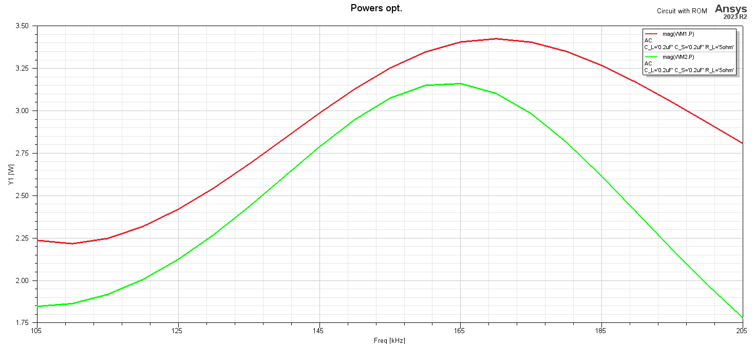
Simulation results – powers

Slide 13
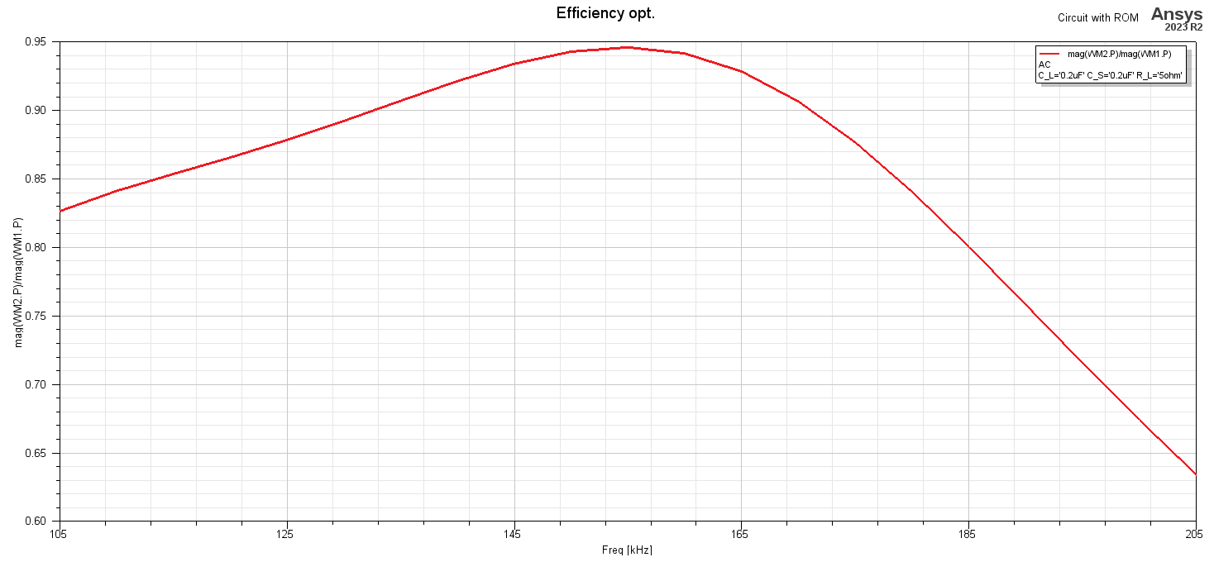
Simulation results – transfer efficiency

Slide 14
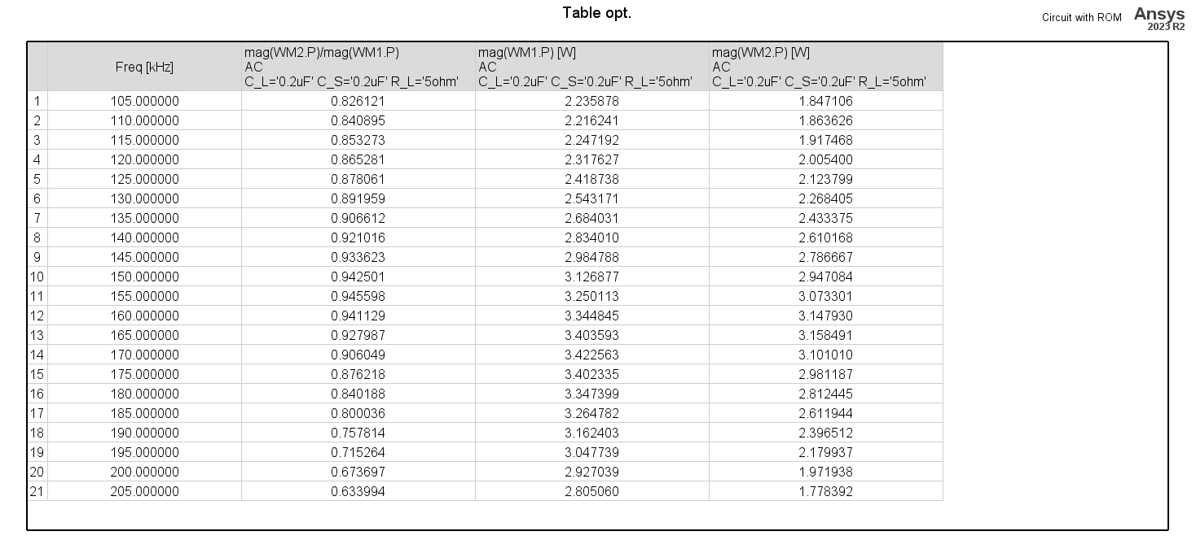
Simulation results – tabular data

Slide 15
Conclusion
Increase of coupling in the new coil arrangement
Ability to assess the transfer efficiency of the whole transmission chain
Analytical guidelines for the selection of matching elements based on power balance
Confirmed within reasonable bounds
Slight tuning was necessary

Slide 16
Thank you
for your attention

Slide 17
References
[1] S. Hasegawa and H. Iwasaki, "Oval double spiral coil for high efficiency wireless power transmission," 2017 11th European Conference on Antennas and Propagation (EUCAP), Paris, France, 2017, pp. 496-499, doi: 10.23919/EuCAP.2017.7928055.
[2] J. Kraček and M. Mazánek, "Power balance of inductive wireless power transmission," Proceedings of the 5th European Conference on Antennas and Propagation (EUCAP), Rome, Italy, 2011, pp. 3974-3978.

