Slide 1
Dual circularly polarized waveguide antenna
Thesis project presentation

Slide 2
Outline
Motivation
Working principle
Common types of waveguide polarizers
Dielectric vane polarizer
Septum polarizer
Corrugated or Iris polarizer
Primary objectives
Finishing objectives
Project specifications
Involved work
References

Slide 3
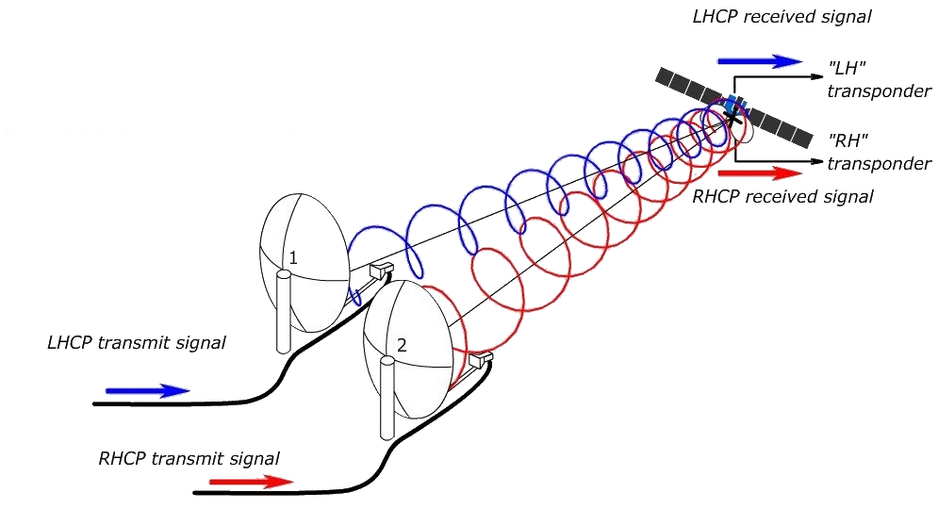
Motivation
Polarization diversity
More efficient utilization of the electromagnetic spectrum
Multipath environments mitigation to avoid fading losses
Low-power applications
WLAN, RFID, tagging
Planar technology
High-power applications
P2P LoS links, spacecraft communication
Waveguide technology [2]

Slide 4
Working principle
Conditions on circular polarization
Two orthogonal polarization planes
Equal amplitudes
Phase shift of 90°
Polarizers principle
Decomposition of the input excitation into two orthogonal modes
Precise delay of one of the modes by structural tuning
Determines LHCP/RHCP direction
Polarizer figures of merit
Return loss (port isolation, coupling, …)
Axial ratio

Slide 5
Common types of waveguide polarizers
Dielectric vane polarizer
Septum polarizer
Corrugated or Iris polarizer
Pictures source: https://flann.com/blog/what-are-waveguide-polarizers/

Slide 6
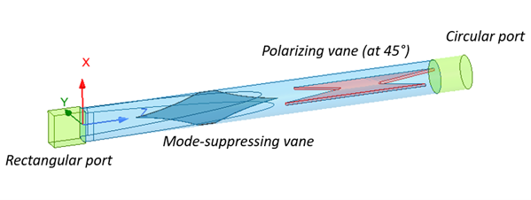
Dielectric vane polarizer
Simple structure
Usually full-band
High dielectric loss
Only decent axial ratio and return loss performance

Slide 7
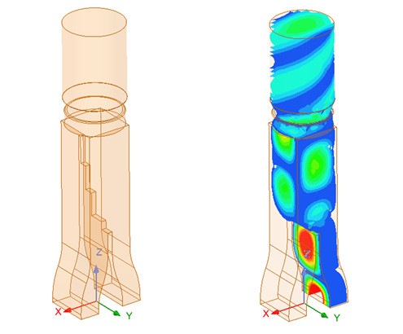
Septum polarizer
Simple and compact structure
Ability to switch RHCP and LHCP polarization without needing an ORT
Superior return loss and axial ratio performance
Generally lower bandwidth
Unique realization utilizing a triangular waveguide for broadband operation [6]

Slide 8
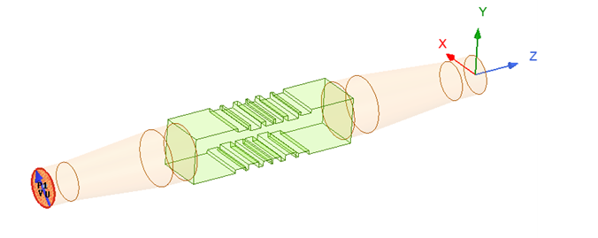
Corrugated or Iris polarizer
Superior return loss and axial ratio performance
Bandwidth up to 40 %
Polarizer on sections of square waveguides with inner corner ridges [1]
Quad-ridged polarizers offer improved broadband performance [3]
Study of optimal iris sets [4]
Good matching possibilities, can be made tuneable [7]
High machining accuracy required

Slide 9
Primary objectives
Waveguide polarizers, literature survey
Frequency band selection for easy realization
Comparison of circular and square waveguides in terms of dominant mode bandwidths and radiation properties.
Excite the waveguide with two orthogonal modes with proper phase shift for analysis
2D eigenmode analysis of transversal resonances on the polarizing structure
Comparison of results with theory of patch antennas with chamfered edges
Optimization for best bandwidth and radiation properties

Slide 10
Finishing objectives
Coaxial cable feed design
Preferably with the ability to excite both RHCP and LHCP
Isolation problem solution
Small horn antenna (say 15 dBi) design
Whole structure optimization
Realization and measurement
Comparison with simulation results

Slide 11
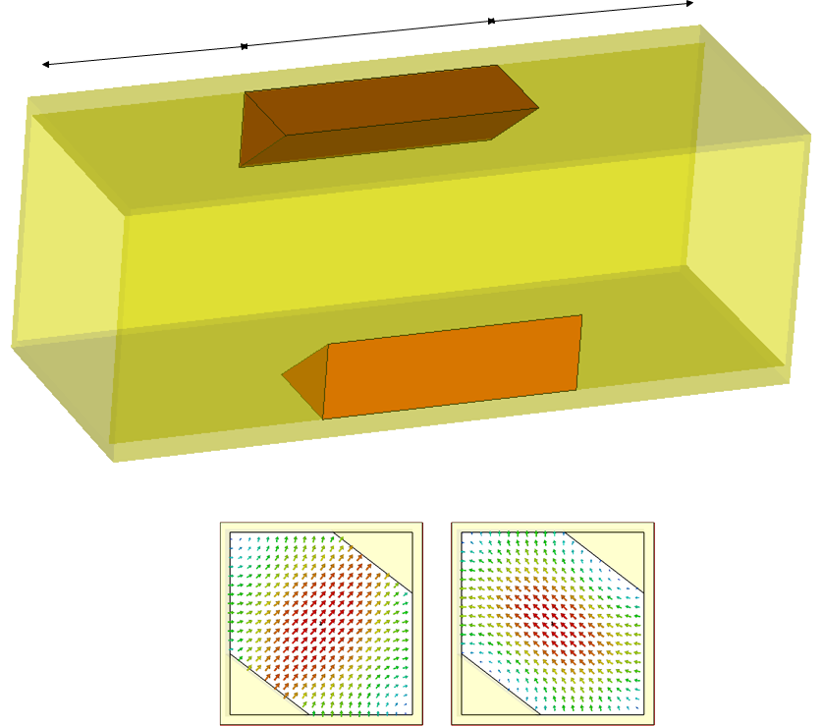
Project specifications
Simulation software CST Studio Suite
Frequency band (tentative) 5 to 10 GHz
Square waveguide structure (tentative) Sections with ridges
A structure Babinet-complementary to a patch antenna with chamfered corners

Slide 12
Involved work
Polarizer modelling and simulation
Mode analysis (transversal resonances)
Other analytical work
Polarizer length determination
Feed design
Antenna design
Structure optimization

Slide 13
References
[1] L. A. Rud and K. S. Shpachenko, "Polarizers on sections of square waveguides with inner corner ridges," 2011 VIII International Conference on Antenna Theory and Techniques, Kyiv, Ukraine, 2011, pp. 338-340, doi: 10.1109/ICATT.2011.6170775.
[2] J. A. Ruiz-Cruz, M. M. Fahmi, M. Daneshmand and R. R. Mansour, "Compact reconfigurable waveguide circular polarizer," 2011 IEEE MTT-S International Microwave Symposium, Baltimore, MD, USA, 2011, pp. 1-4, doi: 10.1109/MWSYM.2011.5972872.
[3] H. Song, L. Jia, J. Tan, Y. Zhang and S. Liu, "Design of Wideband Quad-Ridge Waveguide Polarizer," 2023 4th China International SAR Symposium (CISS), Xian, China, 2023, pp. 1-6, doi: 10.1109/CISS60136.2023.10379971.
[4] G. Virone, R. Tascone, O. A. Peverini and R. Orta, "Optimum-Iris-Set Concept for Waveguide Polarizers," in IEEE Microwave and Wireless Components Letters, vol. 17, no. 3, pp. 202-204, March 2007, doi: 10.1109/LMWC.2006.890474.

Slide 14
References
[5] X. Wang, X. Huang and X. Jin, "Novel square/rectangle waveguide septum polarizer," 2016 IEEE International Conference on Ubiquitous Wireless Broadband (ICUWB), Nanjing, China, 2016, pp. 1-4, doi: 10.1109/ICUWB.2016.7790510.
[6] B. Deutschmann and A. F. Jacob, "Broadband Septum Polarizer With Triangular Common Port," in IEEE Transactions on Microwave Theory and Techniques, vol. 68, no. 2, pp. 693-700, Feb. 2020, doi: 10.1109/TMTT.2019.2951138.
[7] S. Piltyay, A. Bulashenko, H. Kushnir and O. Bulashenko, "New Tunable Iris-Post Square Waveguide Polarizers for Satellite Information Systems," 2020 IEEE 2nd International Conference on Advanced Trends in Information Theory (ATIT), Kyiv, Ukraine, 2020, pp. 342-348, doi: 10.1109/ATIT50783.2020.9349357.

Slide 15
Thank you
for your attention

