Slide 1
Waveguide polarizer design
Dual circularly polarized waveguide antenna – eigenmode analysis

Slide 2
Outline
Principle of operation
Square waveguide
Circular waveguide
Novel alternative
References

Slide 3
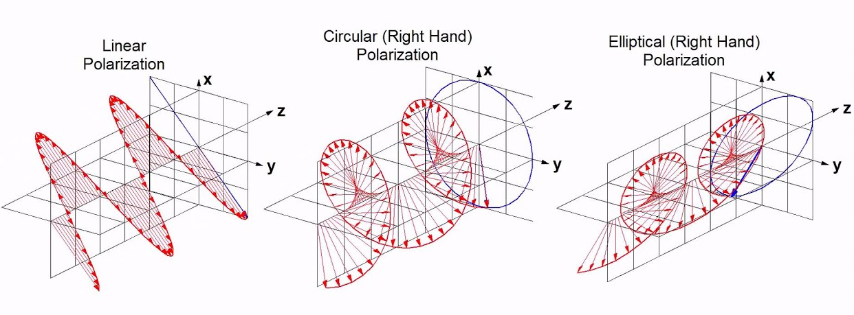

Principle of operation – overview
Linear × circular × elliptical polarization
Elliptical: $E_{major}⋅E_{minor}=0$
Circular: $\left\|E_{major}\right\|=\left\|E_{minor}\right\|$
Polarizer: transition from linear to circular

Slide 4

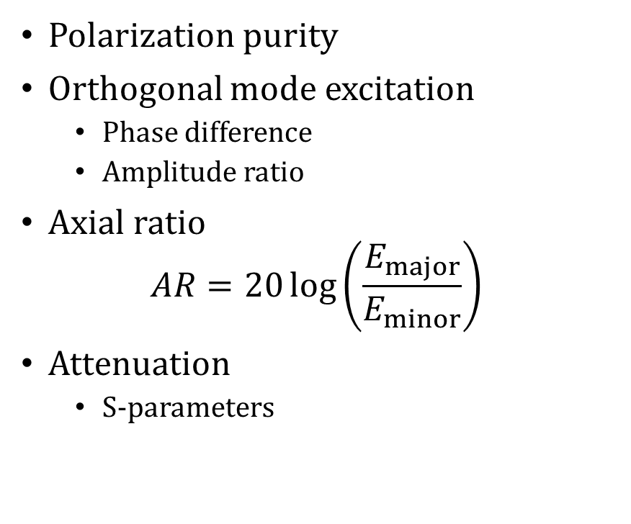
Principle of operation – figures of merit
Polarization purity
Orthogonal mode excitation
Phase difference
Amplitude ratio
Axial ratio $AR=20\log\left(\frac{E_{major}}{E_{minor}}\right)$
Attenuation
S-parameters

Slide 5
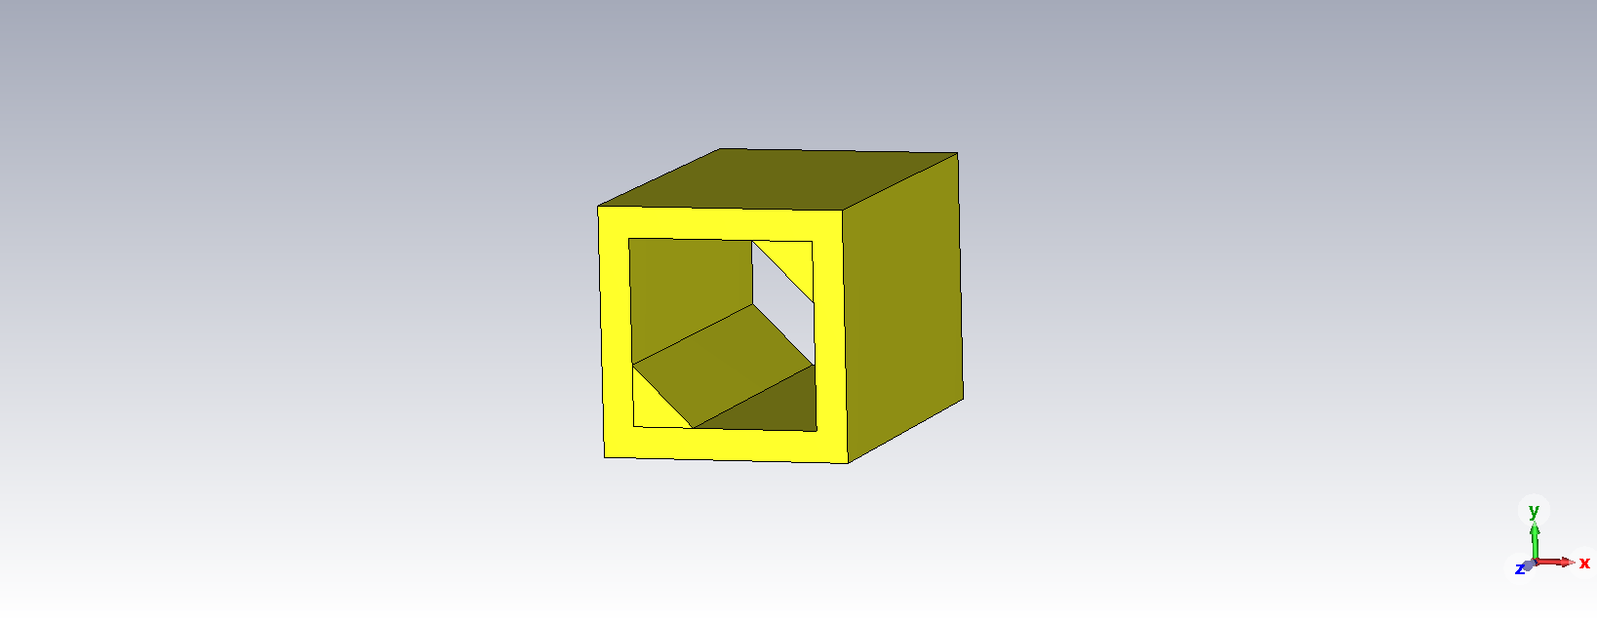
Square waveguide – structure [1-2]

Slide 6
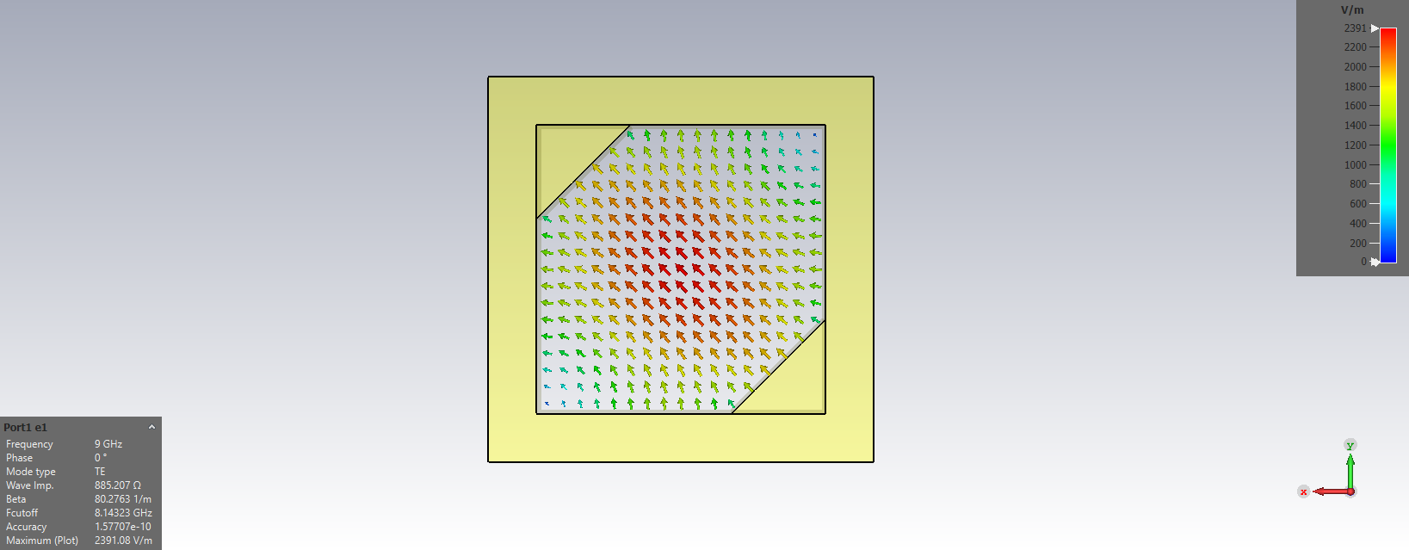
Square waveguide – 1st mode excitation

Slide 7
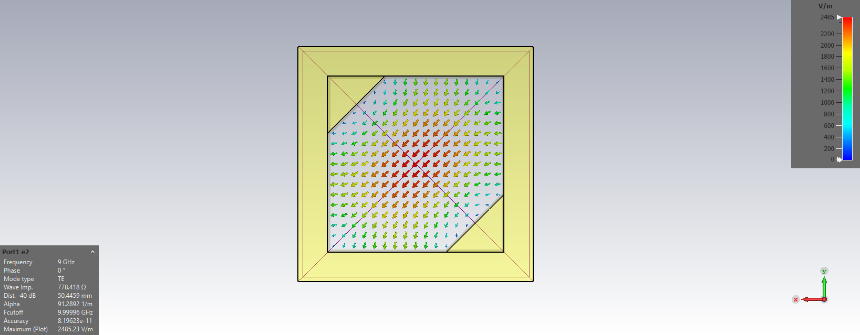
Square waveguide – 2nd mode excitation

Slide 8
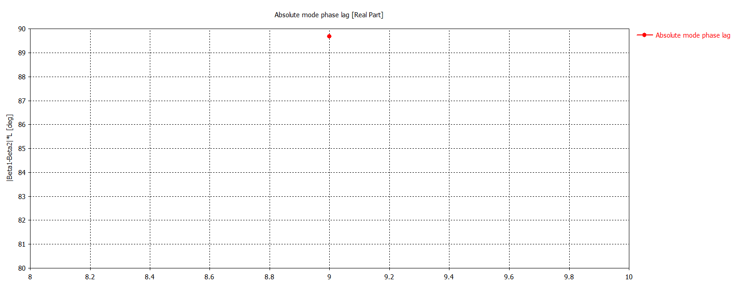
Square waveguide – mode phase lag

Slide 9
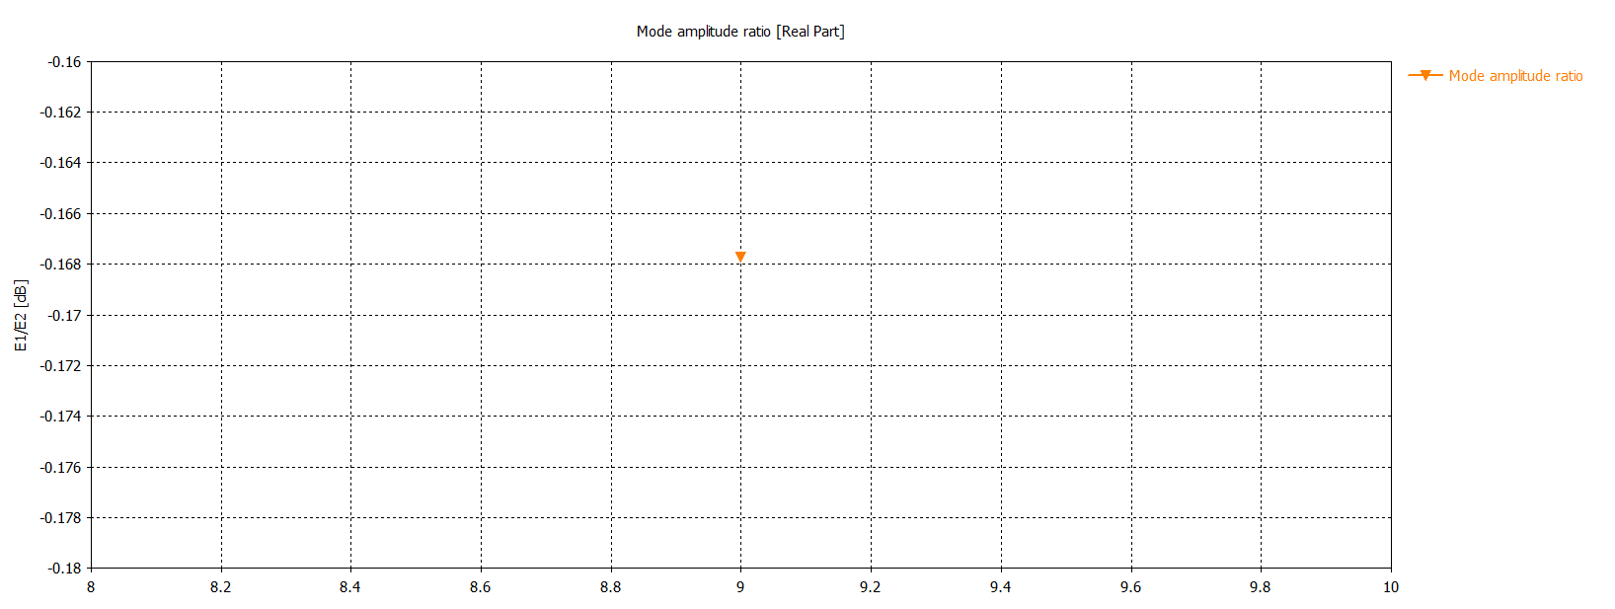
Square waveguide – mode amplitude ratio

Slide 10
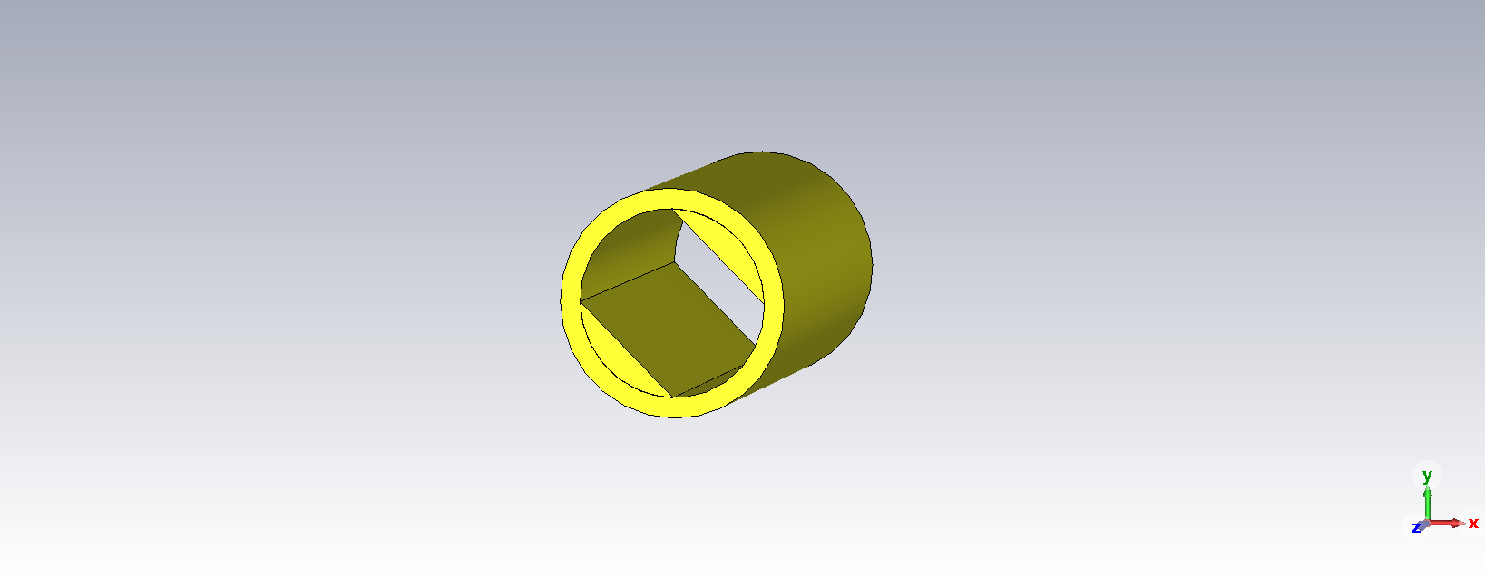
Circular waveguide – structure

Slide 11
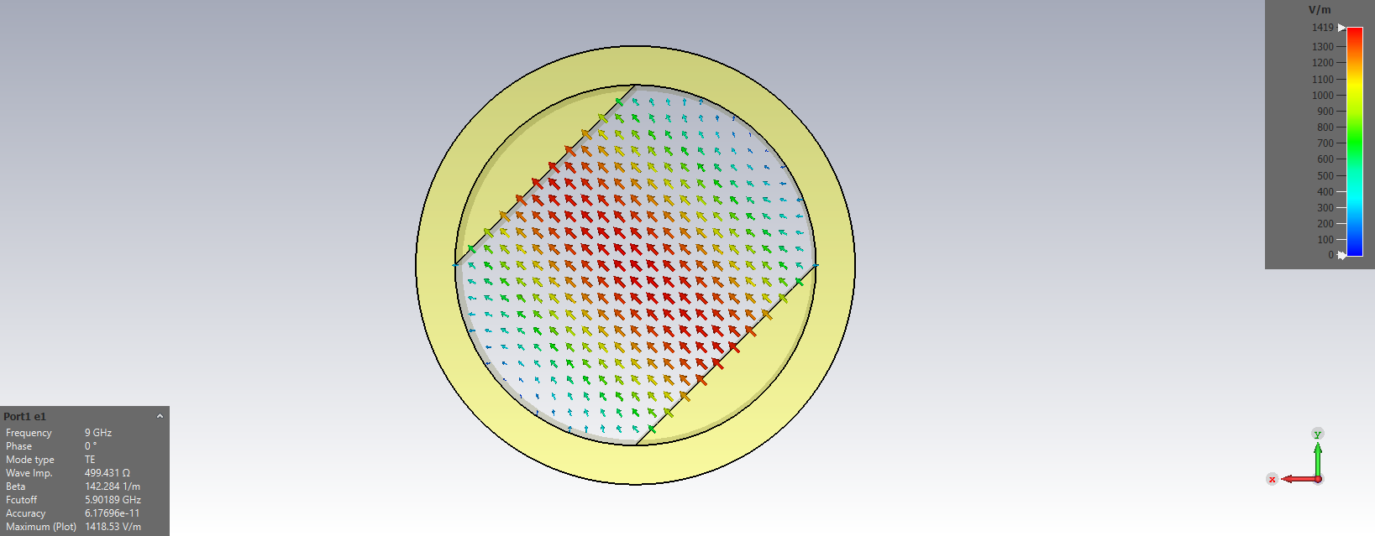
Circular waveguide – 1st mode excitation

Slide 12
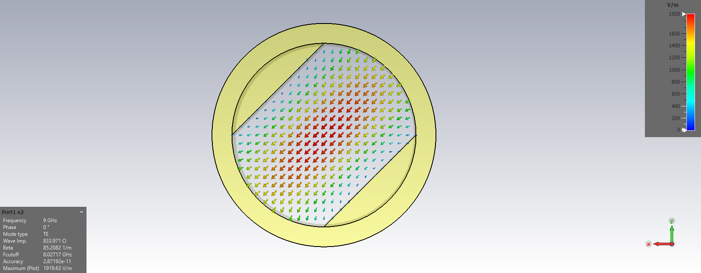
Circular waveguide – 2nd mode excitation

Slide 13
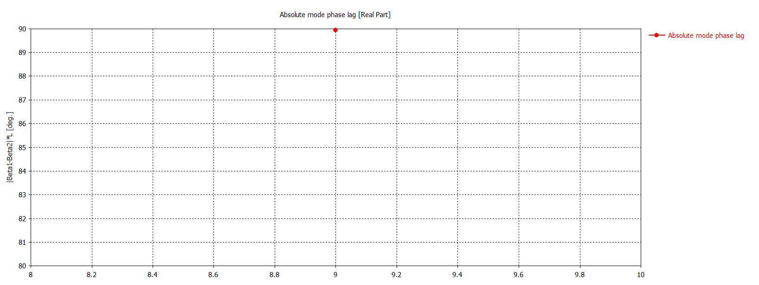
Circular waveguide – mode phase lag

Slide 14
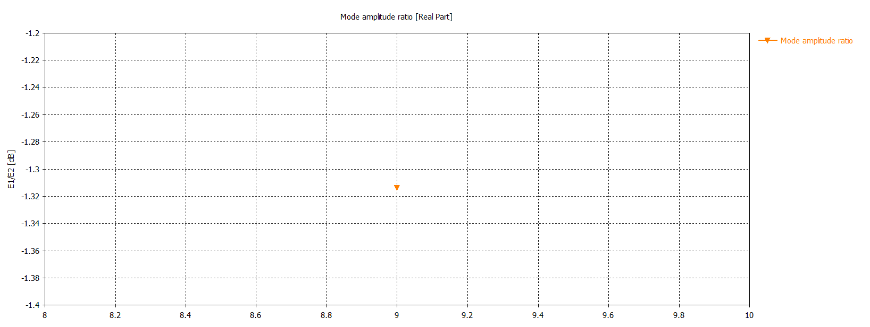
Circular waveguide – mode amplitude ratio

Slide 15
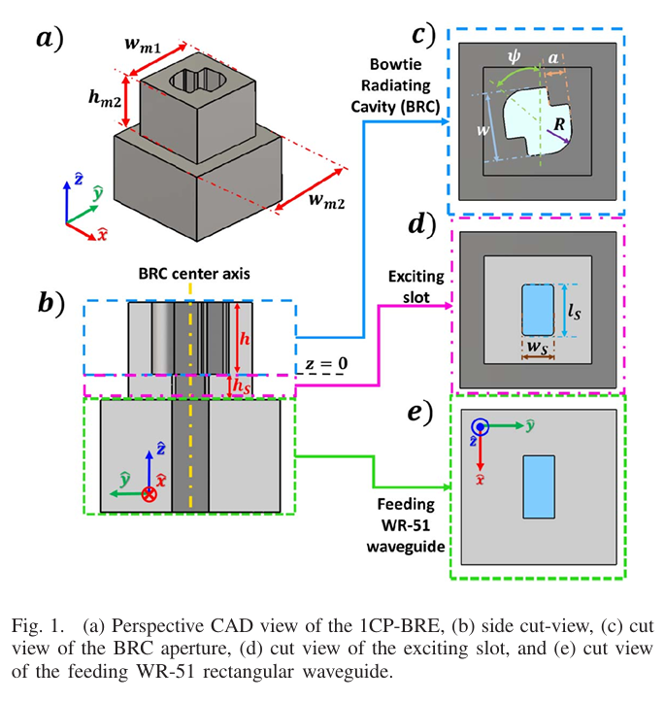
Novel alternative: bow-tie cavity [3]
Structures capable of both single and dual circular polarizations
Improved attenuation and polarization-purity parameters
Complex machining required
Requirement on port isolation for dual polarization makes it even more complex

Slide 16
Thank you
for your attention

Slide 17
References
[1] S. Bhardwaj and J. Volakis, "Hexagonal waveguides: New class of waveguides for mm-wave circularly polarized horns," 2018 International Applied Computational Electromagnetics Society Symposium (ACES), Denver, CO, USA, 2018, pp. 1-2, doi: 10.23919/ROPACES.2018.8364165.
[2] S. Bhardwaj and J. L. Volakis, "Hexagonal Waveguide Based Circularly Polarized Horn Antennas for Sub-mm-Wave/Terahertz Band," in IEEE Transactions on Antennas and Propagation, vol. 66, no. 7, pp. 3366-3374, July 2018, doi: 10.1109/TAP.2018.2829842.
[3] E. Garcia-Marin, J. L. Masa-Campos, P. Sanchez-Olivares and J. A. Ruiz-Cruz, "Bow-Tie-Shaped Radiating Element for Single and Dual Circular Polarization," in IEEE Transactions on Antennas and Propagation, vol. 68, no. 2, pp. 754-764, Feb. 2020, doi: 10.1109/TAP.2019.2943357.

