Slide 1
Dual circularly polarized waveguide antenna
Waveguide polarizer design – broadband performance evaluation

Slide 2
Outline
Evaluation of polarization purity
Far field
Intrinsic
CST Studio Suite results
Post-processing
Port information
S-parameters
E-field probe
Conclusion

Slide 3
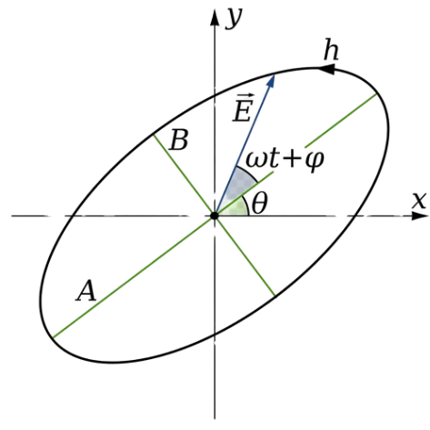
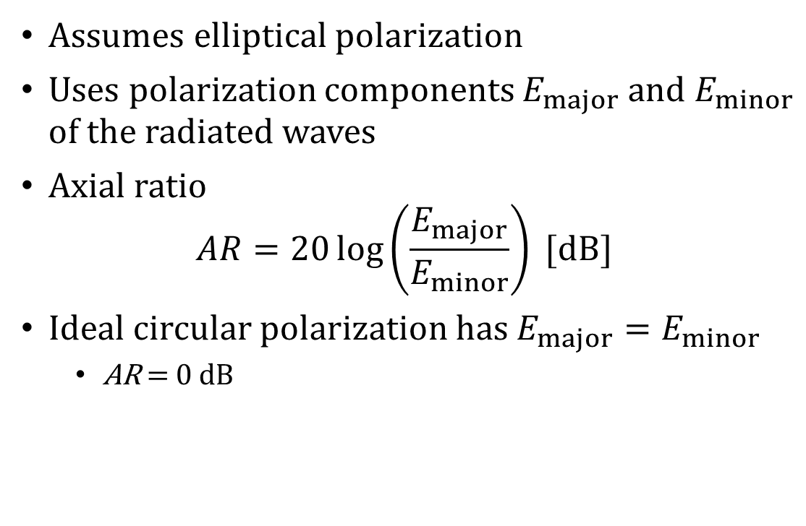
Evaluation of polarization purity – far field
Assumes elliptical polarization
Uses polarization components $E_{major}$ and $E_{minor}$ of the radiated waves
Axial ratio $AR=20\log\left(\frac{E_{major}}{E_{minor}}\right) [dB]$
Ideal circular polarization has $E_{major}=E_{minor}$
$\text{AR}\text{ = 0 }\text{dB}$

Slide 4
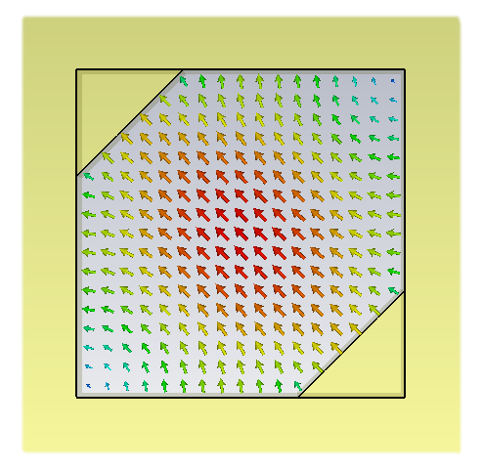
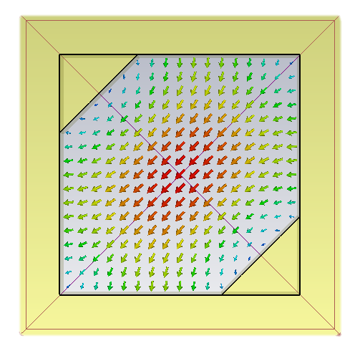
Evaluation of polarization purity – intrinsic
No assumptions
Uses properties intrinsic to the waveguide polarizer
Orthogonal modes TE₀₁ and TE₁₀ excited in the waveguide cavity
Given by the polarizer physical dimensions

Slide 5
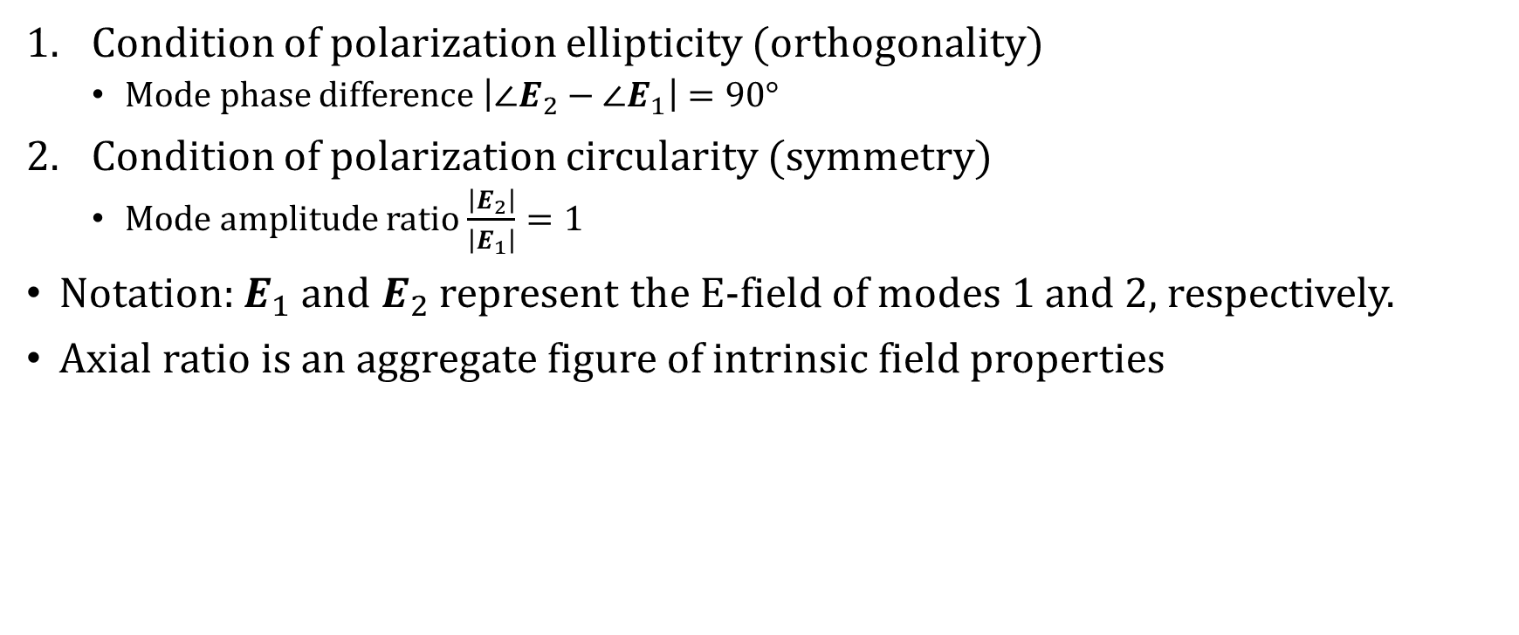
Evaluation of polarization purity – intrinsic
Condition of polarization ellipticity (orthogonality)
Mode phase difference $\left|∠E_{2}−∠E_{1}\right|=\text{90}\text{°}$
Condition of polarization circularity (symmetry)
Mode amplitude ratio $\frac{\left|E_{2}\right|}{\left|E_{1}\right|}=1$
Notation: $E_{1}$ and $E_{2}$ represent the E-field of modes 1 and 2, respectively.
Axial ratio is an aggregate figure of intrinsic field properties

Slide 6
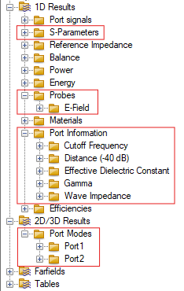
CST Studio Suite results
No direct means of evaluating intrinsic properties
Extracting the properties from existing results:
Port information/Gamma
Port modes
S-parameters
E-field probe
Axial ratio evaluated using a predefined macro

Slide 7
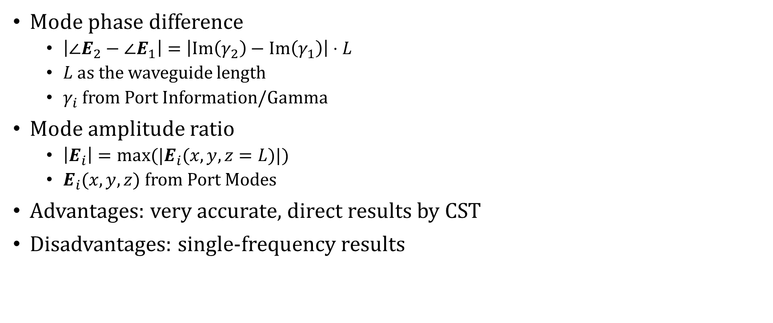
Post-processing – port information
Mode phase difference
$\left|∠E_{2}−∠E_{1}\right|=\left|Im\left(γ_{2}\right)−Im\left(γ_{1}\right)\right|⋅L$
$L$ as the waveguide length
$γ_{i}$ from Port Information/Gamma
Mode amplitude ratio
$\left|E_{i}\right|=max⁡(|E_{i}(x,y,z=L)|)$
$E_{i}(x,y,z)$ from Port Modes
Advantages: very accurate, direct results by CST
Disadvantages: single-frequency results

Slide 8
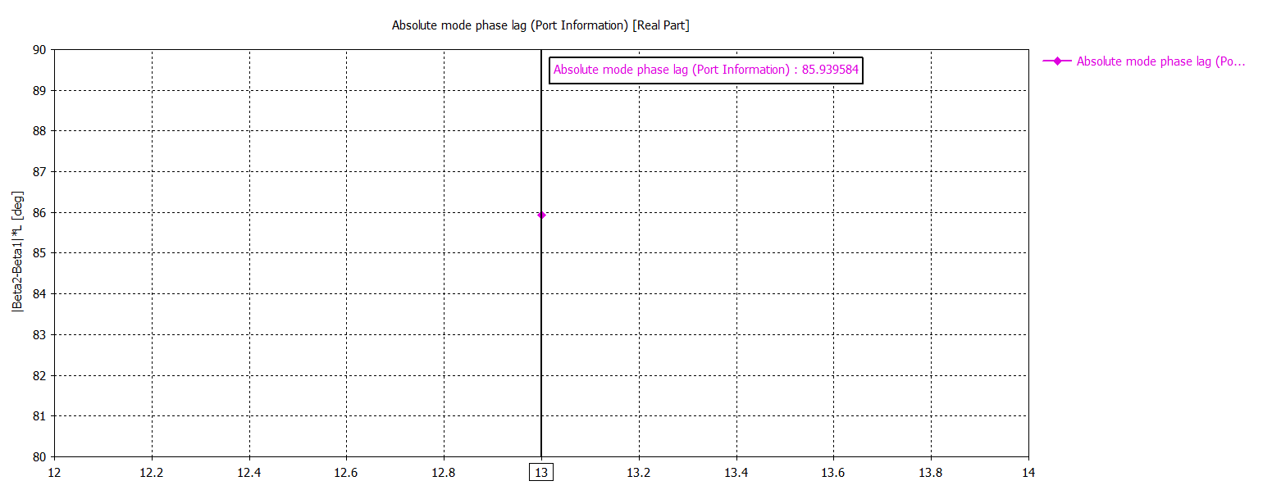
Post-processing – port information (phase)

Slide 9
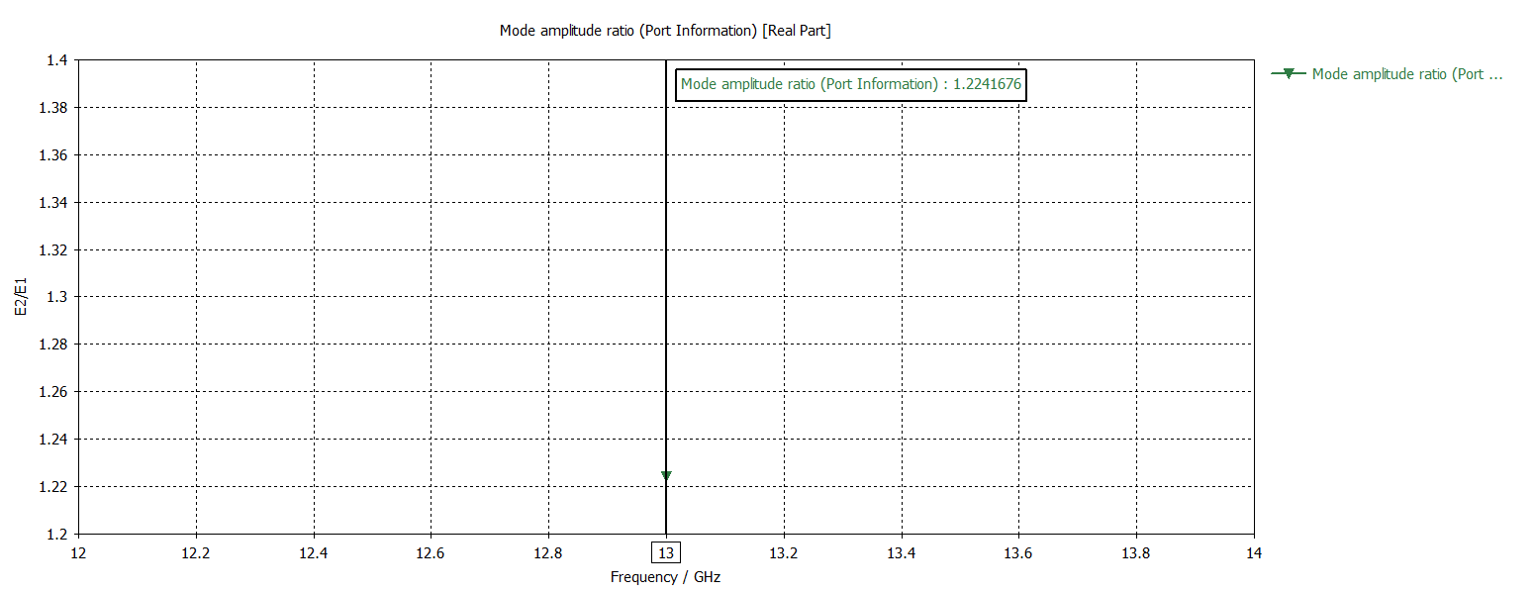
Post-processing – port information (amplitude)

Slide 10
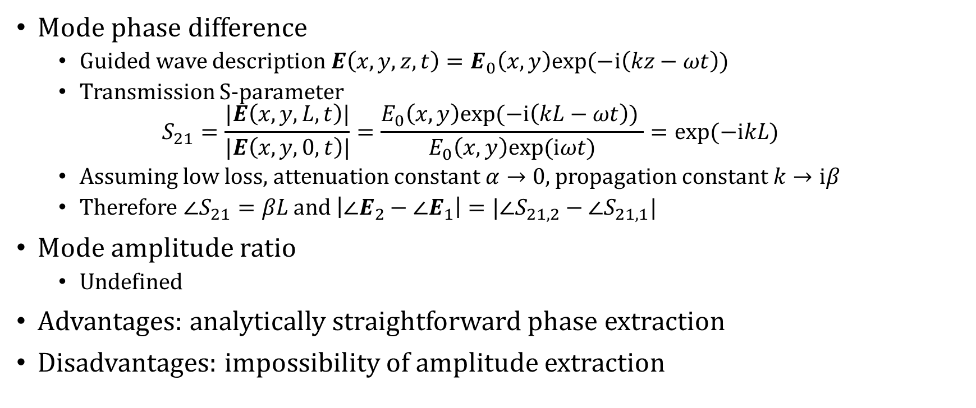
Post-processing – S-parameters
Mode phase difference
Guided wave description $E\left(x,y,z,t\right)=E_{0}\left(x,y\right)exp⁡(−i\left(kz−ωt\right))$
Transmission S-parameter $S_{21}=\frac{|E\left(x,y,L,t\right)|}{|E\left(x,y,0,t\right)|}=\frac{E_{0}\left(x,y\right)exp⁡(−i\left(kL−ωt\right)) }{E_{0}\left(x,y\right)exp⁡(iωt)}=exp⁡(−ikL)$
Assuming low loss, attenuation constant $α→0$, propagation constant $k→iβ$
Therefore $∠S_{21}=βL$ and $\left|∠E_{2}−∠E_{1}\right|=|∠S_{21,2}−∠S_{21,1}|$
Mode amplitude ratio
Undefined
Advantages: analytically straightforward phase extraction
Disadvantages: impossibility of amplitude extraction

Slide 11
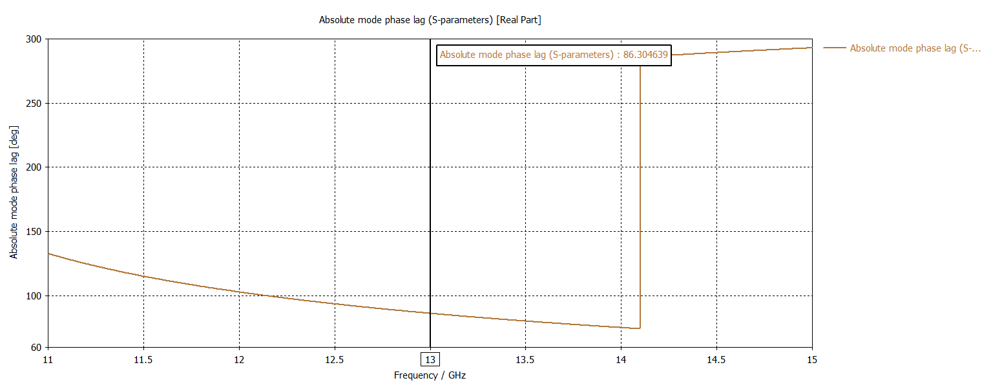
Post-processing – S-parameters (phase)

Slide 12
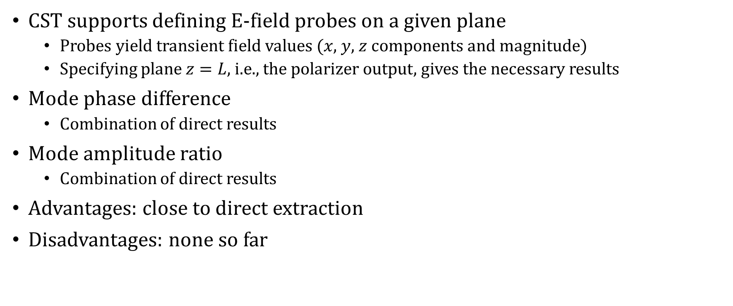
Post-processing – E-field probe
CST supports defining E-field probes on a given plane
Probes yield transient field values ($x$, $y$, $z$ components and magnitude)
Specifying plane $z=L$, i.e., the polarizer output, gives the necessary results
Mode phase difference
Combination of direct results
Mode amplitude ratio
Combination of direct results
Advantages: close to direct extraction
Disadvantages: none so far

Slide 13
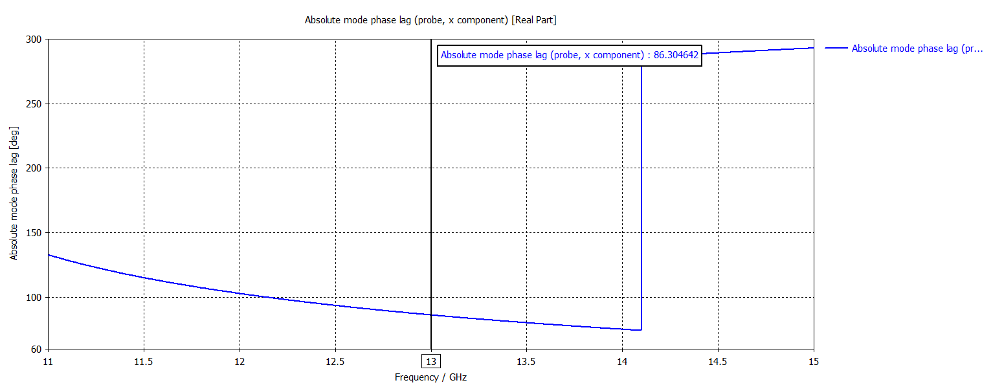
Post-processing – E-field probe (phase)

Slide 14
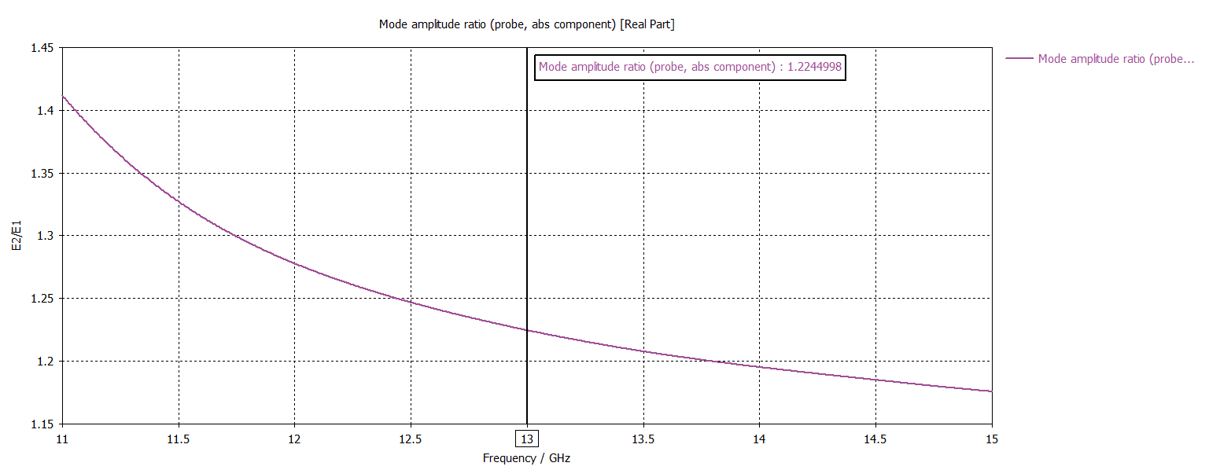
Post-processing – E-field probe (amplitude)

Slide 15
Conclusion
Extraction of intrinsic properties is possible using post-processing
Port information provide reference results for a single frequency point
S-parameters serves as a broadband verification of phase extraction
E-field probe is the candidate for main extraction method
Axial ratio will be easily evaluated in later stages of the design

Slide 16
Thank you
for your attention

