Slide 1
Dual circularly polarized waveguide antenna
Radiation part & Coaxial feeding structure

Slide 2
Outline
Introduction
Part 1: Radiation part
Part 2: Coaxial feeding structure
Single feed
Dual feed
Prototype fabrication
Conclusion

Slide 3
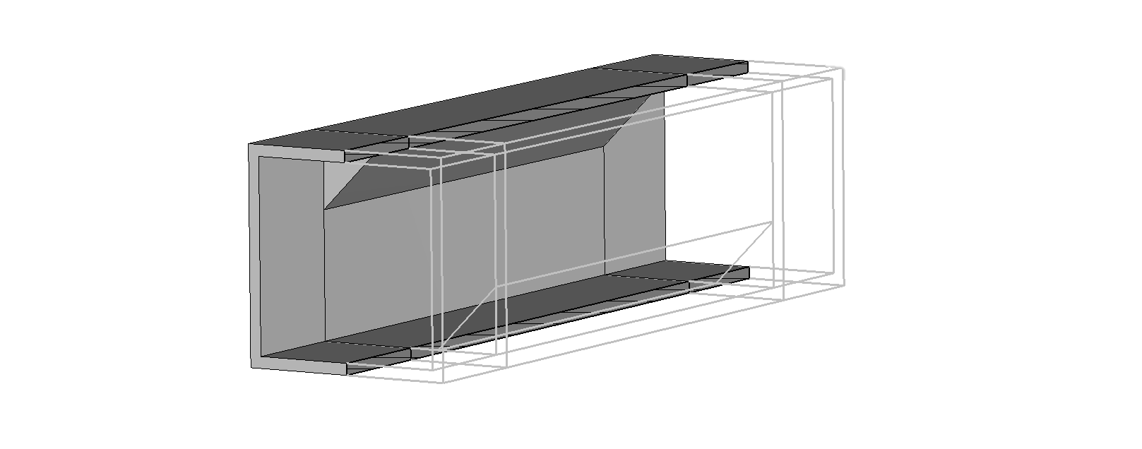
Introduction
Polarizer finished
Radiation part almost finished
Open-ended waveguide radiation
Conical horn to be done
Dual polarization feed in progress

Slide 4
Part 1
Radiation part

Slide 5
Open-ended waveguide radiation
Polarizer design in done for now
Good performance in terms of intrinsic figures of merit (eigenmode analysis)
Section of a square waveguide added at the output to improve the radiation properties
Now evaluated using far-field properties (co-/cross-polarizations)

Slide 6
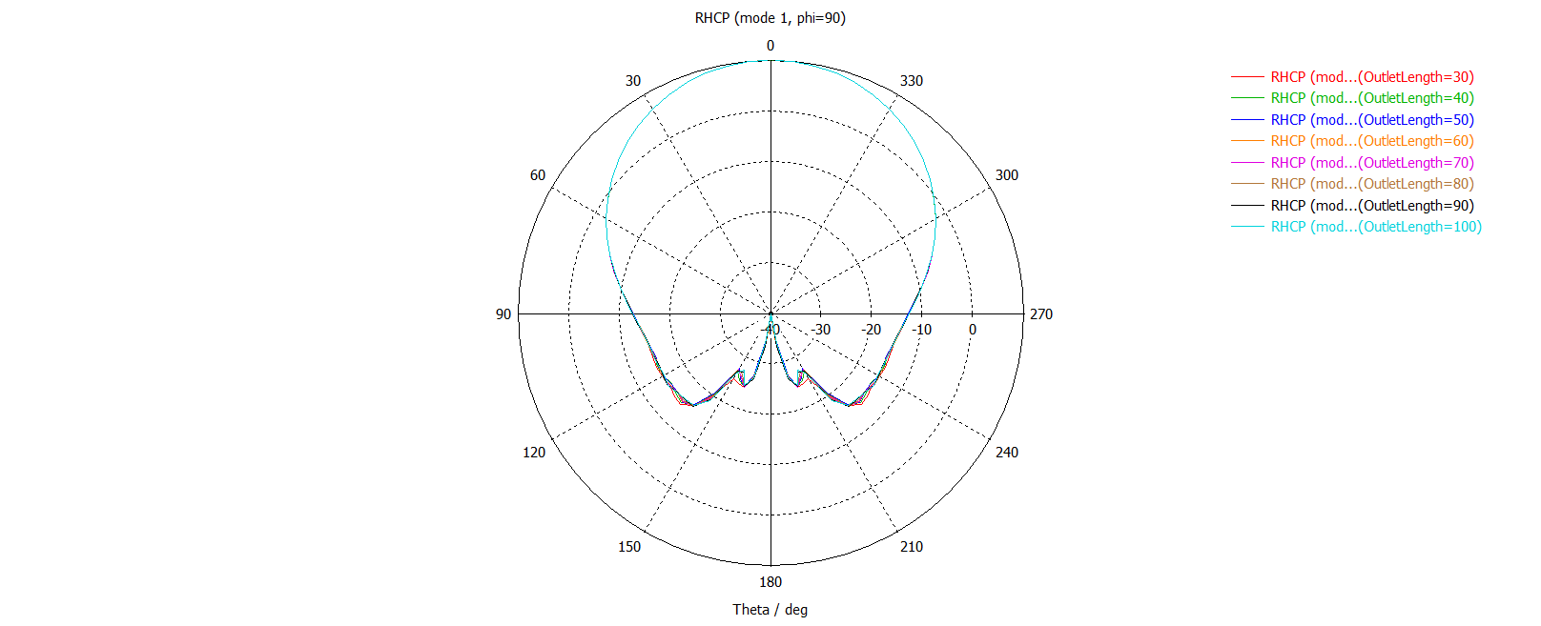
Mode 1 co-polarization (RHCP) pattern

Slide 7
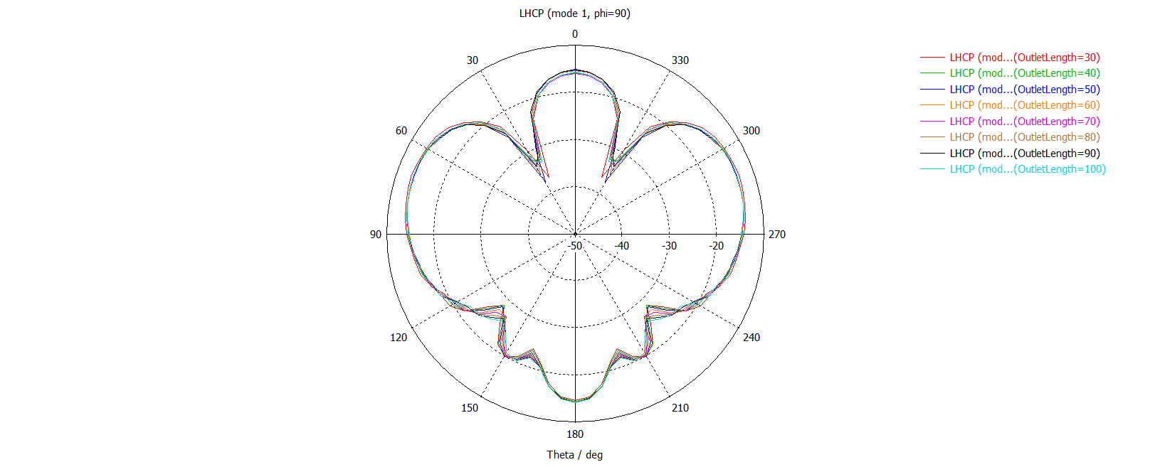
Mode 1 cross-polarization (LHCP) pattern

Slide 8
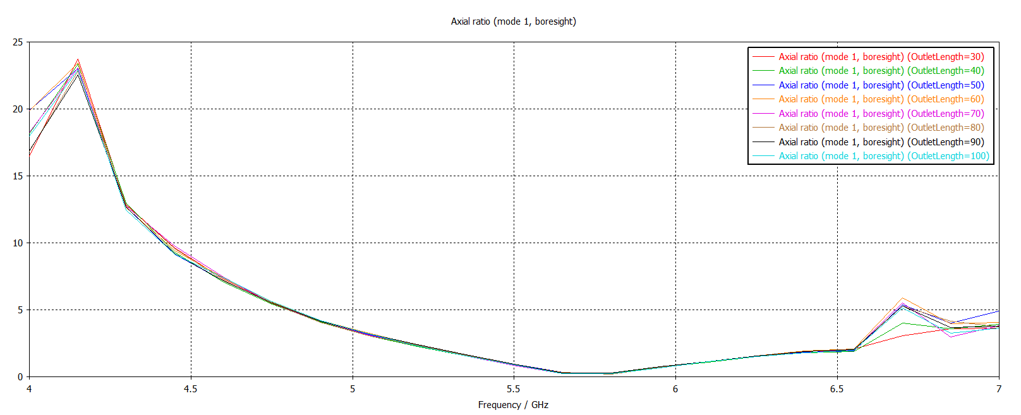
Mode 1 axial ratio

Slide 9
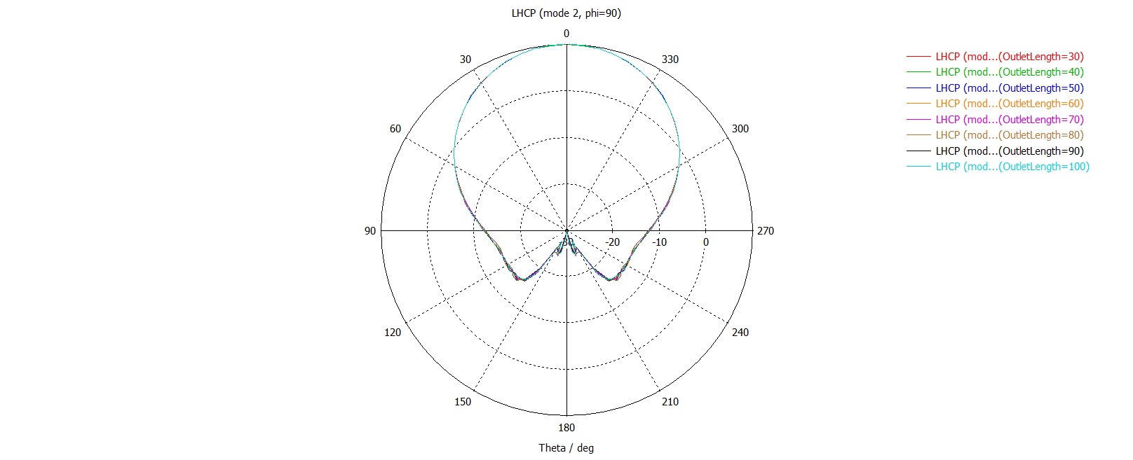
Mode 2 co-polarization (LHCP) pattern

Slide 10
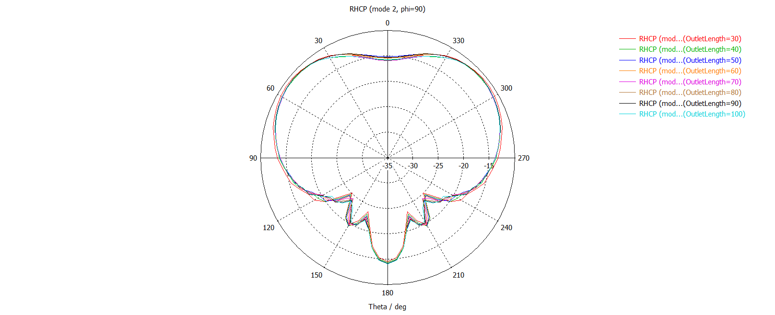
Mode 2 cross-polarization (RHCP) pattern

Slide 11
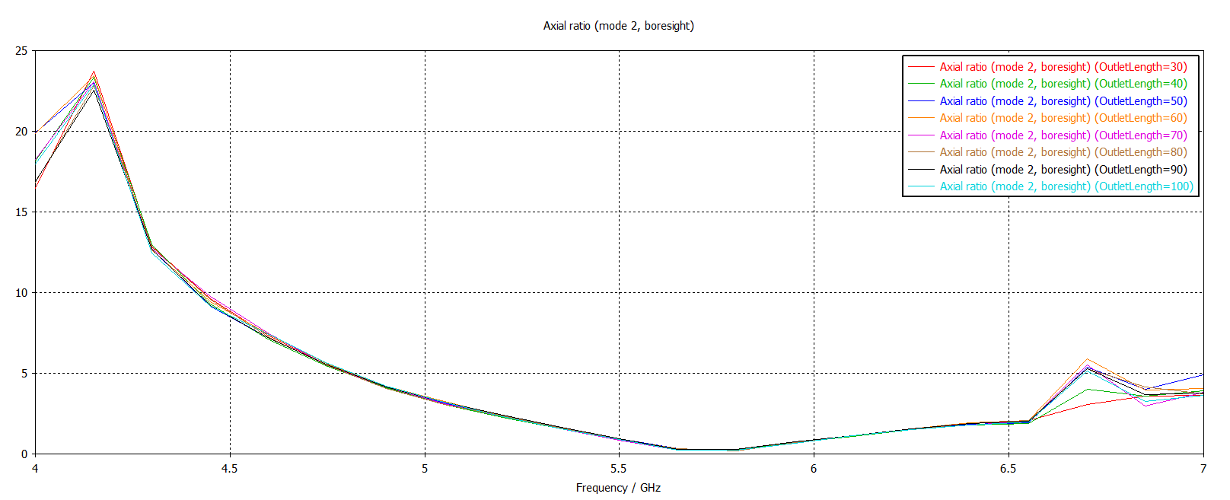
Mode 2 axial ratio

Slide 12
Part 2
Coaxial feeding structure

Slide 13
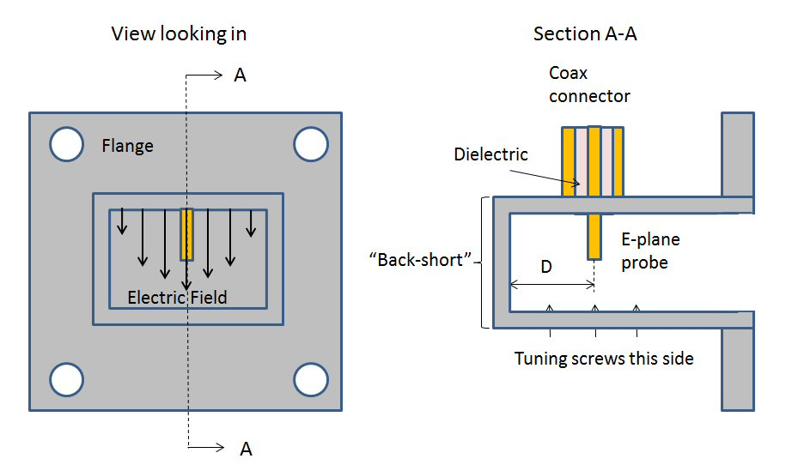
Single feed: right-angle transition
Coax inner conductor reaches into the cavity serving as an antenna
Antenna probe excites TE01 mode
Back-short reflects energy
In-phase wave combination at probe
Electric field propagates

Slide 14
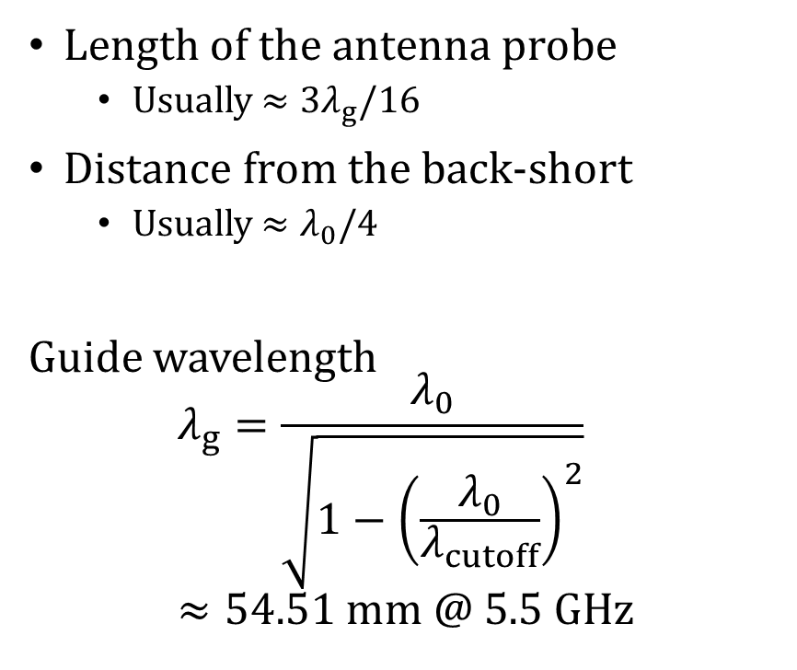
Single feed: variables
Length of the antenna probe
Usually $≈3λ_{g}/16$
Distance from the back-short
Usually $≈λ_{0}/4$
Guide wavelength $$λ_{g}=\frac{λ_{0}}{\sqrt{1−{\left(\frac{λ_{0}}{λ_{cutoff}}\right)}^{2}}} ≈54.51 mm @ 5.5 GHz$$

Slide 15
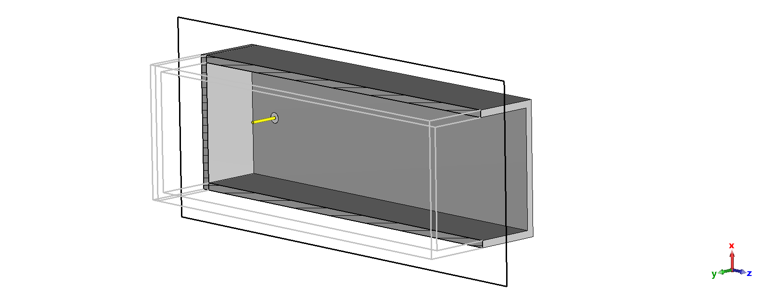
Single feed: implementation

Slide 16
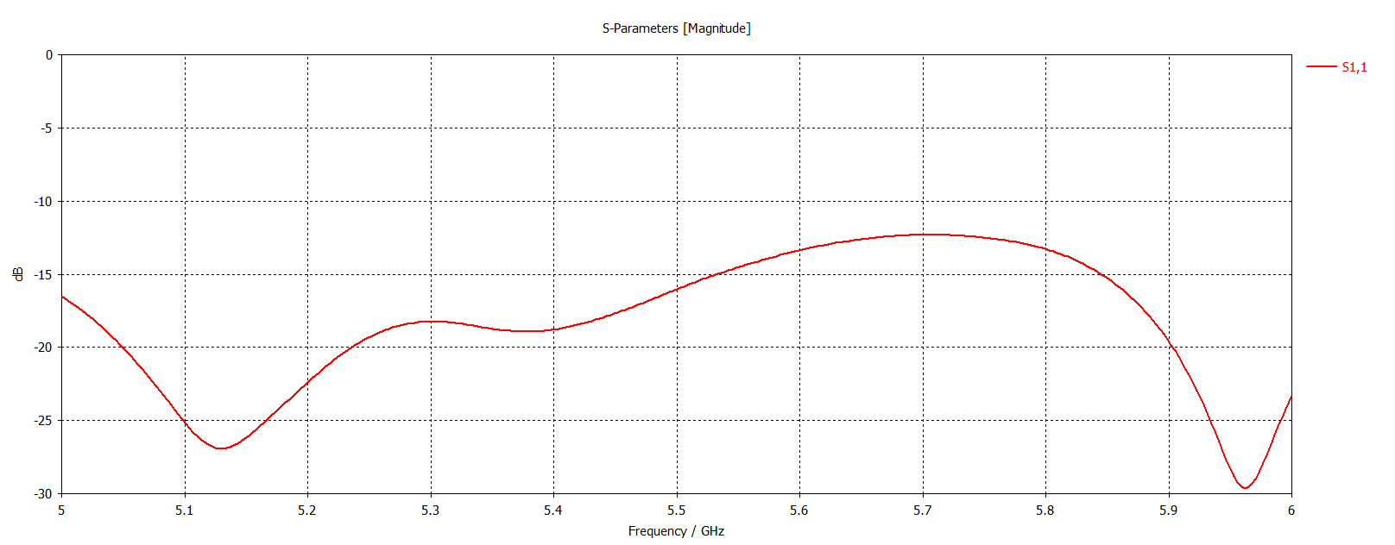
Reflection

Slide 17
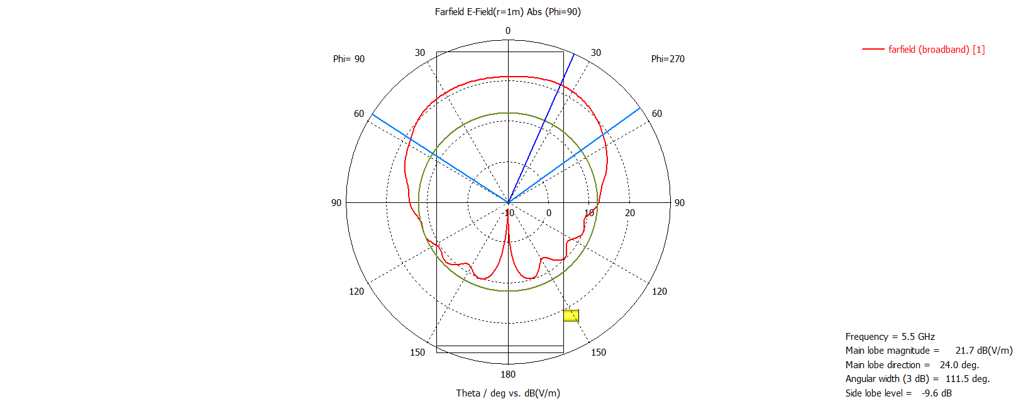
Radiation pattern

Slide 18
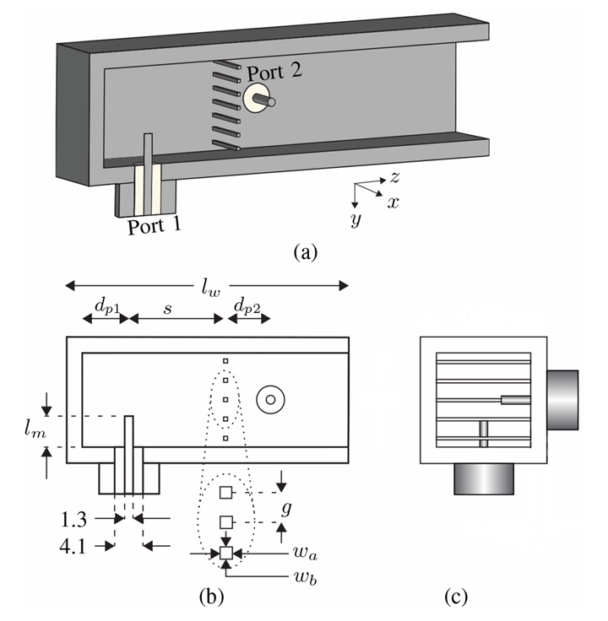
Dual feed: idea [1]
Same principal as the single feed
Two orthogonal probes separated by distance
Port 2 back-short replaced by a grating parallel to the probe
Grating ideally transparent to port 1 while shorting port 2
Helps minimize crosstalk

Slide 19
Dual feed: variables
Length of both antenna probes
Distance of port 1 from the back-short
Distance of the grating from port 1
Distance of port 2 from the grating
Diameter of the grating wires
Gap (distance) between the grating wires
Number of grating wires

Slide 20
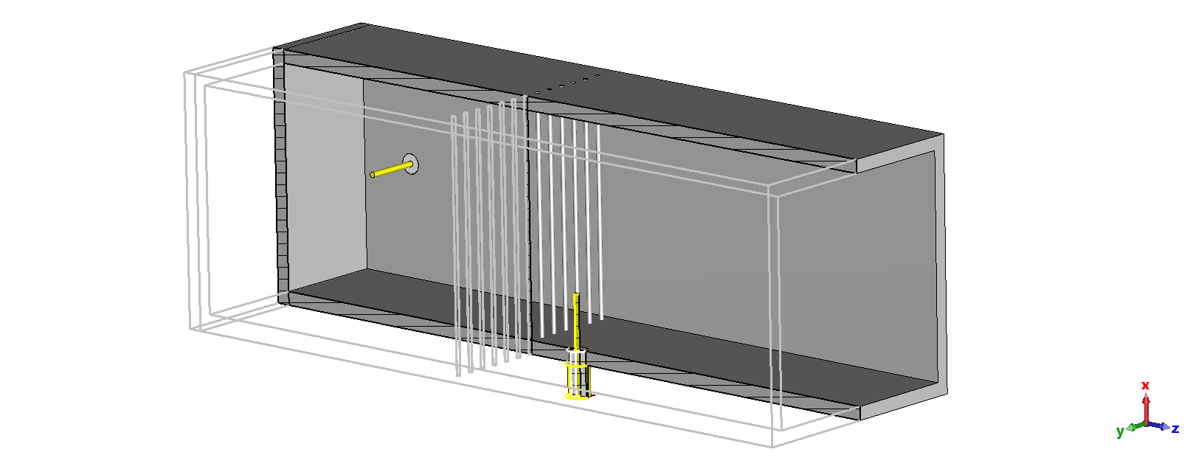
Dual feed: implementation

Slide 21
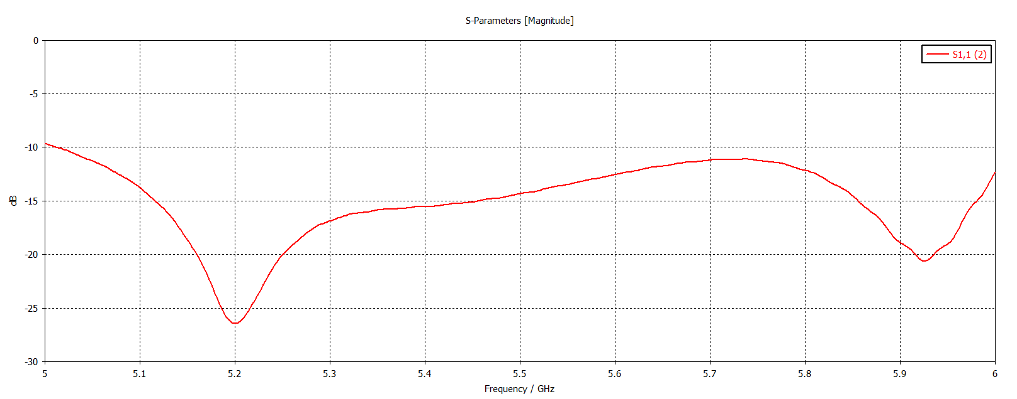
Port 1 reflection

Slide 22
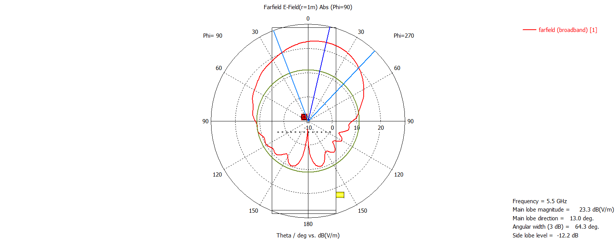
Port 1 radiation pattern

Slide 23
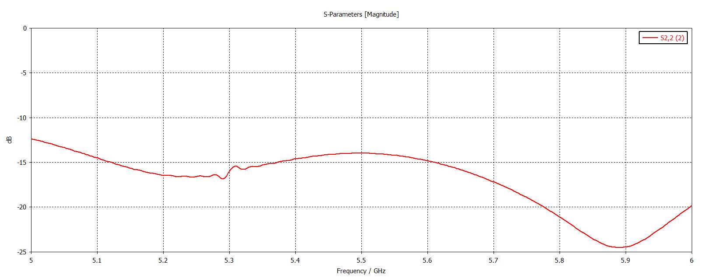
Port 2 reflection

Slide 24
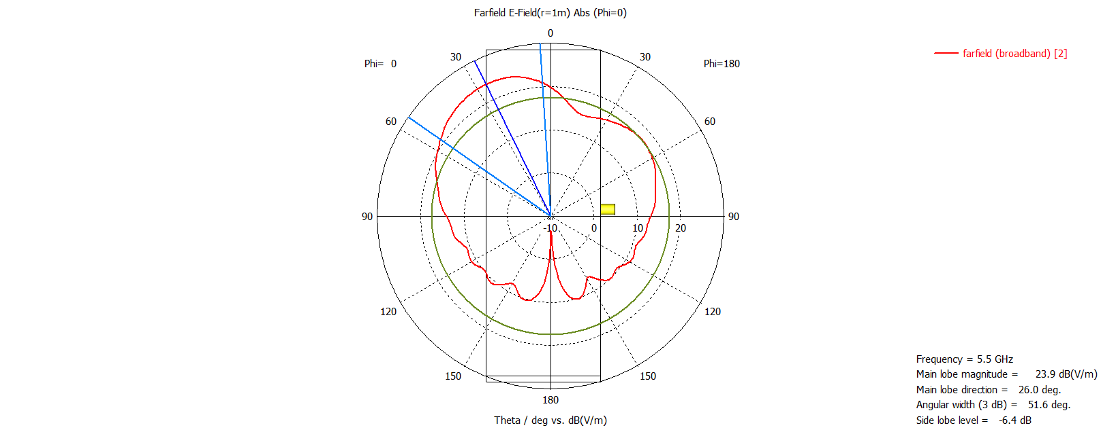
Port 2 radiation pattern

Slide 25
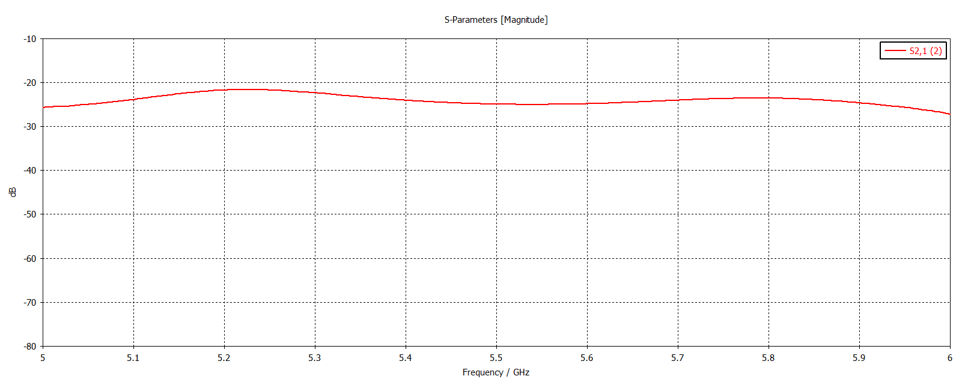
Port crosstalk

Slide 26
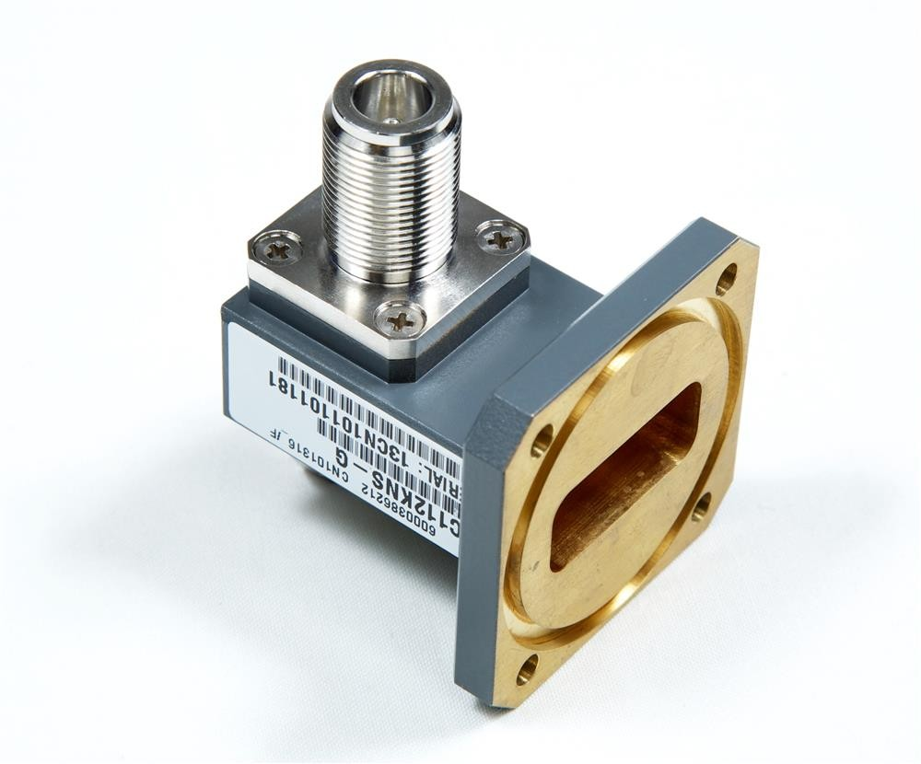
Prototype fabrication
Prototyping
Polarizer and radiation part are almost done
Feeding issues due the use of a non-standard waveguide
Optimizing the dual feed is the tricky
Idea: fabrication by parts with flanges
Conical horn, polarizer, and adapter
Single feed for the prototype measurement
Possibility to test both polarizations by rotating the adapter
Dual feed can be fabricated later

Slide 27
Conclusion
Radiation part
Open-ended waveguide radiation looks good
Now only to add a conical horn
Almost done
Dual feed
First simulations done
Very tricky
Needs a lot of optimization work

Slide 28
Thank you
for your attention

Slide 29
References
S. K. Karki, J. Ala-Laurinaho and V. Viikari, "Dual-Polarized Probe for Planar Near-Field Measurement," in IEEE Antennas and Wireless Propagation Letters, vol. 22, no. 3, pp. 576-580, March 2023, doi: 10.1109/LAWP.2022.3218731
Pictures
Microwaves101 | Waveguide to coax transitions
C137CNSG Waveguide Flange 5.85-8.2 GHz CPR137G to N-Female Transistion, MFR: Commscope (rfparts.com)

