Slide 1
Dual circularly polarized waveguide antenna
Dual feeding structure

Slide 2
Outline
Current design state
Refresher
Single feed
Dual feed
Design process
Results (WIP)
Conclusion

Slide 3
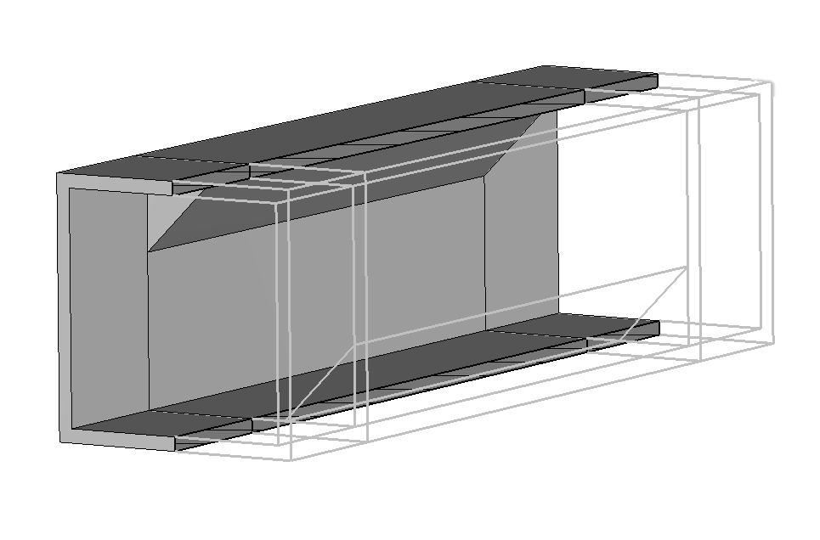
Current design state
Polarizer finished
Generates both RHCP/LHCP waves
Excited by the two fundamental modes of a square waveguide
Dual feeding structure WIP
Provides realistic excitation of the two modes

Slide 4
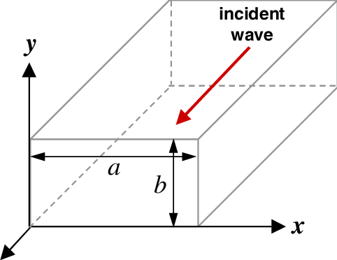

Refresher: rectangular waveguide
Guided wave description
$$E_{y}=E_{0}sin\left(k_{x}x\right)e^{i(ωt−k_{z}z)}$$
Fundamental mode
$$k_{x}=\frac{2π}{λ_{cutoff}}=\frac{π}{a}$$
Phase velocity
$$v=\frac{ω}{k_{z}}$$

Slide 5
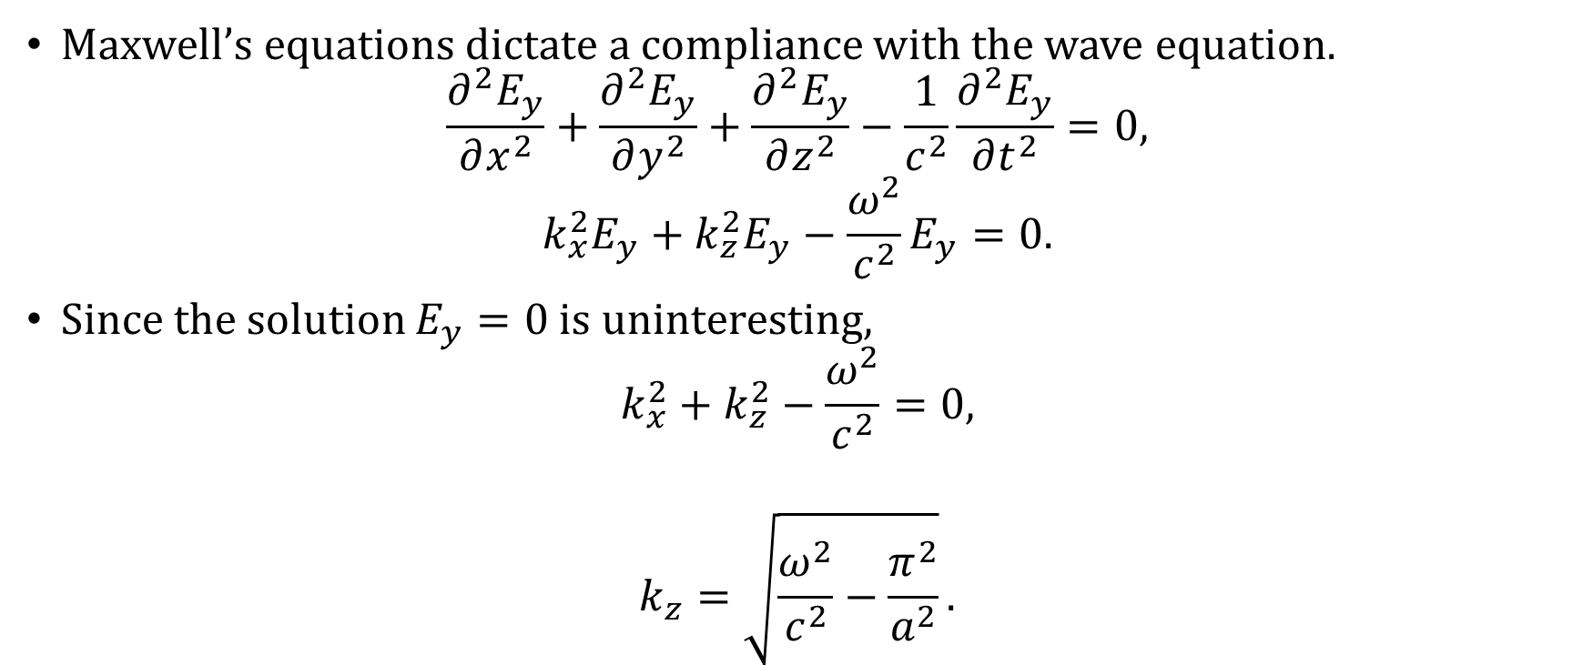
Refresher: wave equation
Maxwell’s equations dictate a compliance with the wave equation.
$$\frac{∂^{2}E_{y}}{∂x^{2}}+\frac{∂^{2}E_{y}}{∂y^{2}}+\frac{∂^{2}E_{y}}{∂z^{2}}−\frac{1}{c^{2}}\frac{∂^{2}E_{y}}{∂t^{2}}=0,$$
$$k_{x}^{2}E_{y}+k_{z}^{2}E_{y}−\frac{ω^{2}}{c^{2}}E_{y}=0.$$
Since the solution $E_{y}=0$ is uninteresting,
$$k_{x}^{2}+k_{z}^{2}−\frac{ω^{2}}{c^{2}}=0,$$
$$k_{z}=\sqrt{\frac{ω^{2}}{c^{2}}−\frac{π^{2}}{a^{2}}}.$$

Slide 6

Refresher: guide wavelength
Using $λ=2πv/ω$ and defining $λ_{g}$ so that $k_{z}=2π/λ_{g}$,
$$λ_{g}=\frac{λ_{0}}{\sqrt{1−{\left(\frac{λ_{0}}{2a}\right)}^{2}}}.$$
In our case of $f=5.5 GHz$ and $a=50 mm$,
$$λ_{0}=\frac{c}{f}≈54.51 mm,$$
$$λ_{g} ≈65.02 mm.$$

Slide 7
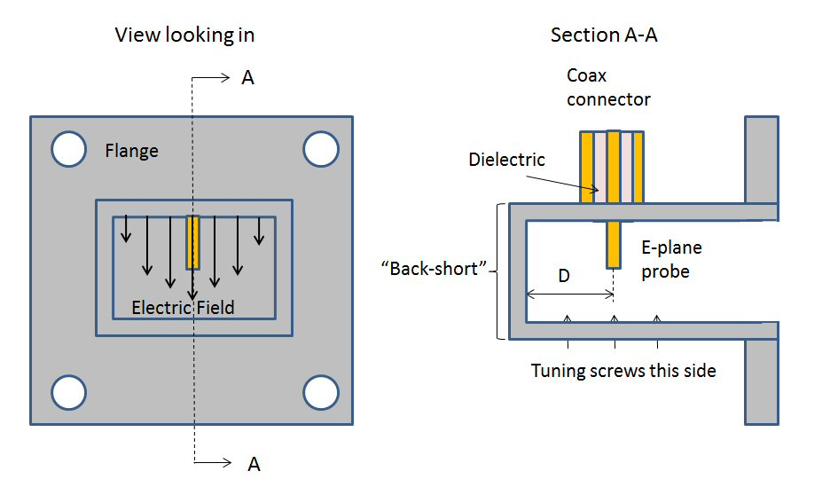
Single feed: overview
Coax inner conductor reaches into the cavity serving as an antenna
Antenna probe excites TE01 mode
Back-short reflects energy
In-phase wave combination at probe
Electromagnetic wave propagation

Slide 8
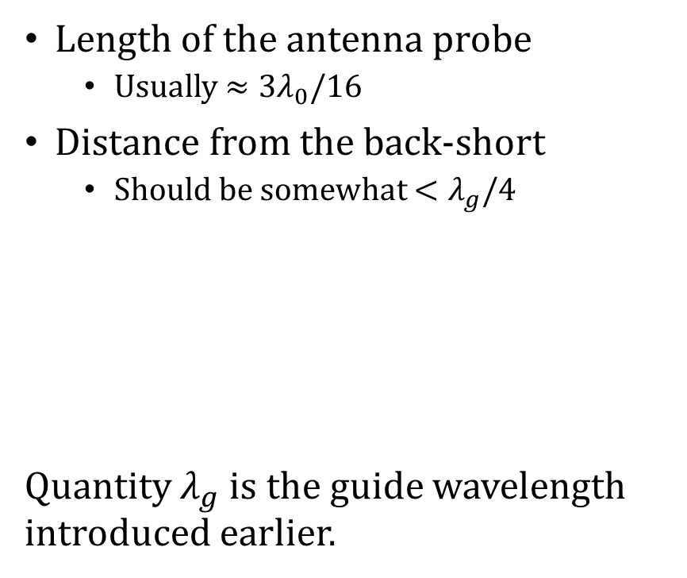
Single feed: variables
Length of the antenna probe
Usually $≈{3λ}_{0}/16$
Distance from the back-short
Should be somewhat $<λ_{g}/4$
Quantity $λ_{g}$is the guide wavelength introduced earlier.

Slide 9
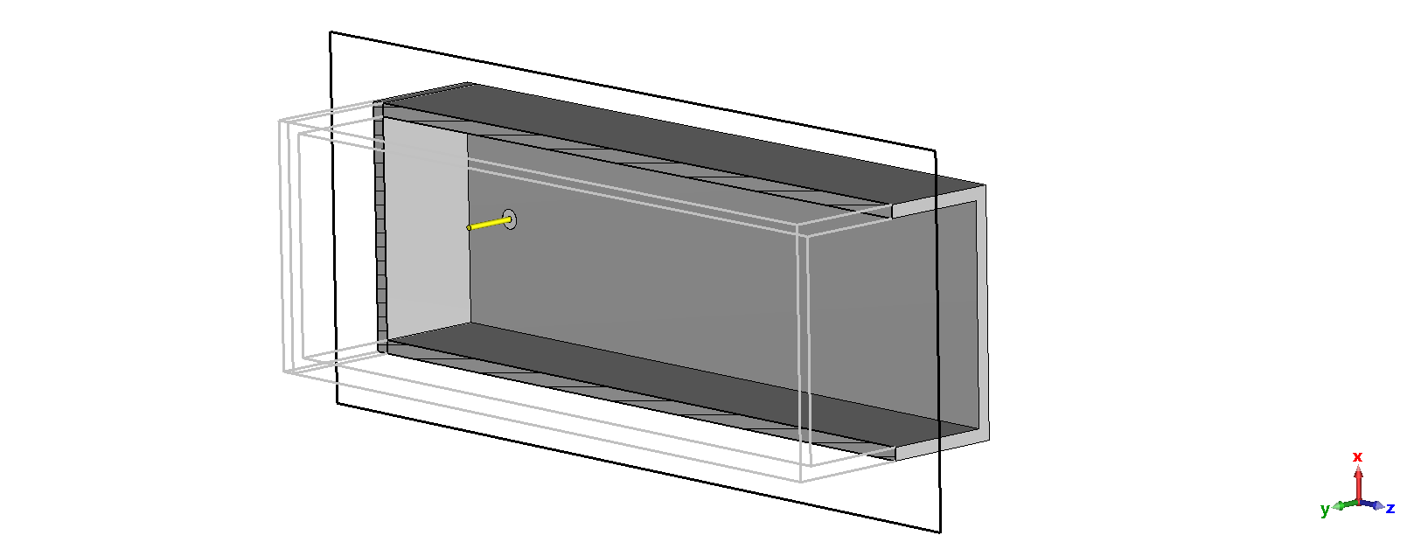
Single feed: implementation

Slide 10
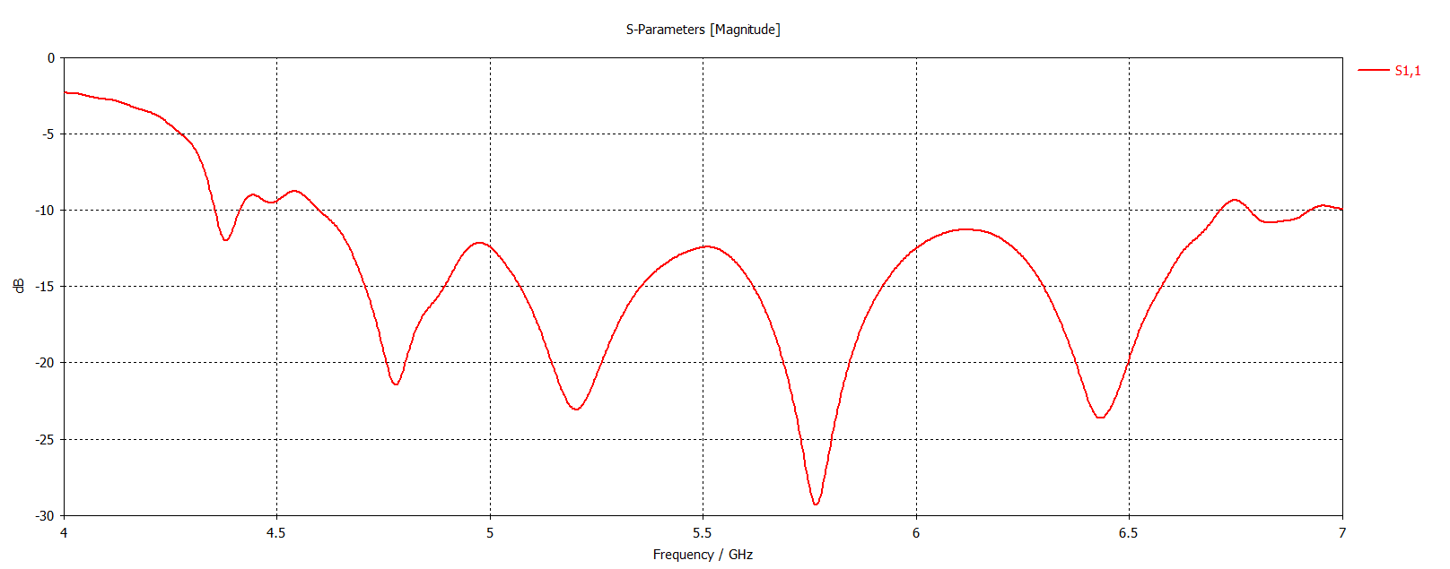
Reflection

Slide 11
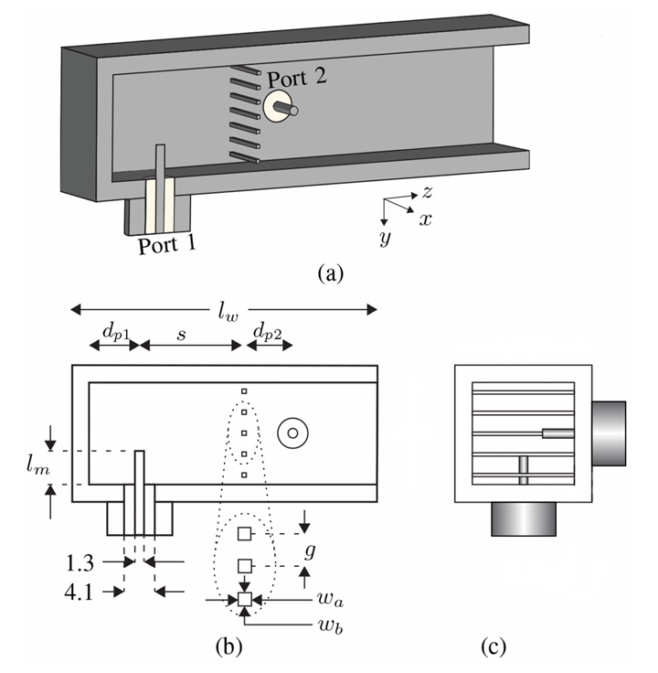
Dual feed: idea [1]
Same principal as the single feed
Two orthogonal probes separated by distance
Port 2 back-short replaced by a grating parallel to the probe
Grating ideally transparent to port 1 while a back-short for port 2
Helps minimize crosstalk

Slide 12
Dual feed: variables
Length of both antenna probes
Distance of port 1 from the back-short
Distance of the grating from port 1
Distance of port 2 from the grating
Diameter of the grating wires
Gap (distance) between the grating wires
Number of grating wires

Slide 13
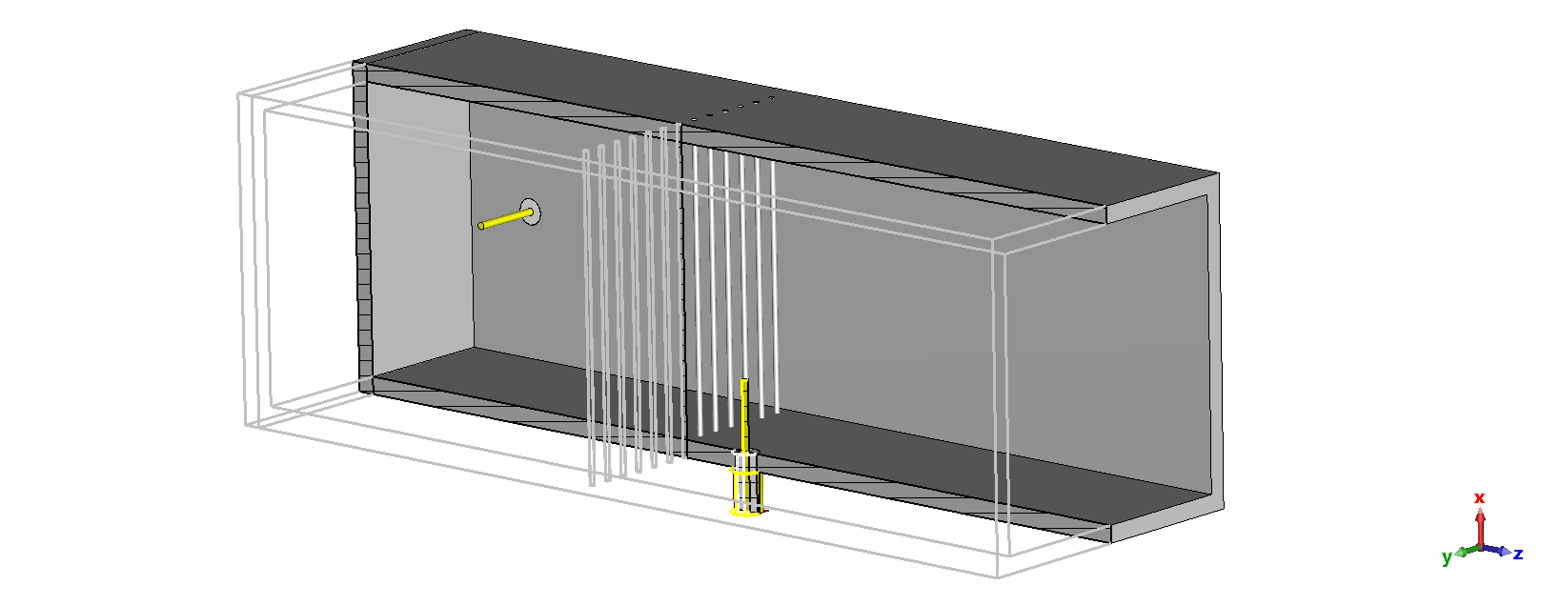
Dual feed: implementation

Slide 14
Design process
Start with just a single feed (Port 1)
Helps get an idea of optimal probe geometry
Optimize probe length and distance from back-short
Draw the grating with single feed
Grating distance from Port 1 shouldn’t affect Port 2 radiation
Optimize grating distance
Add the second feed (Port 2)
Optimize grating gap and wire count which affect both ports
Trade-off between port reflection and crosstalk

Slide 15
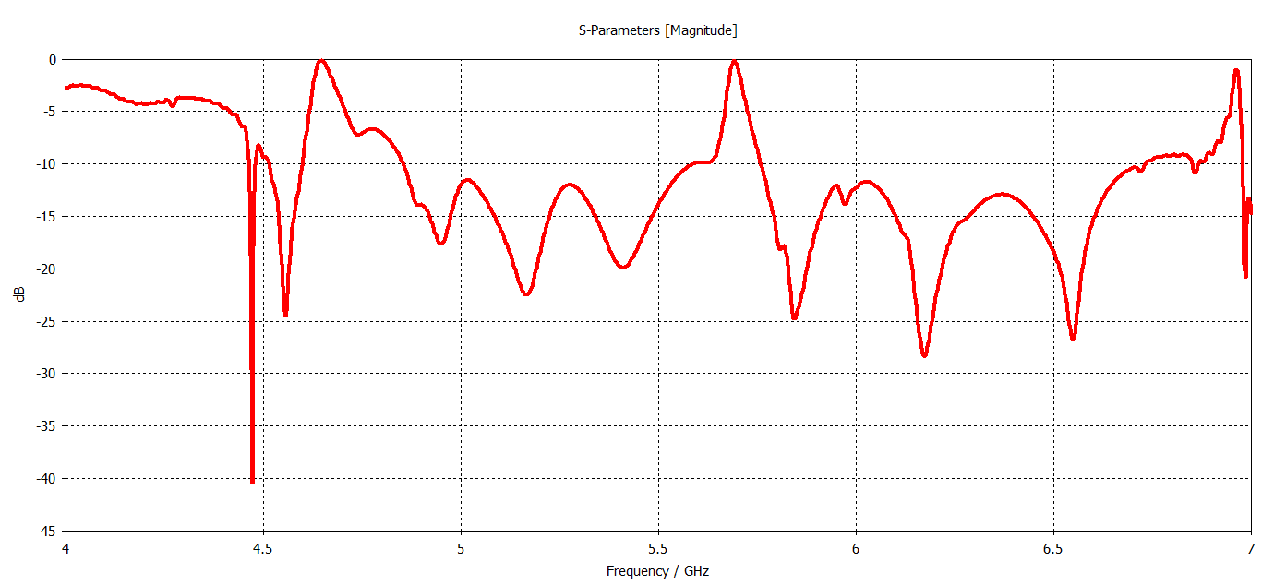
Results (WIP): Port 1 reflection

Slide 16
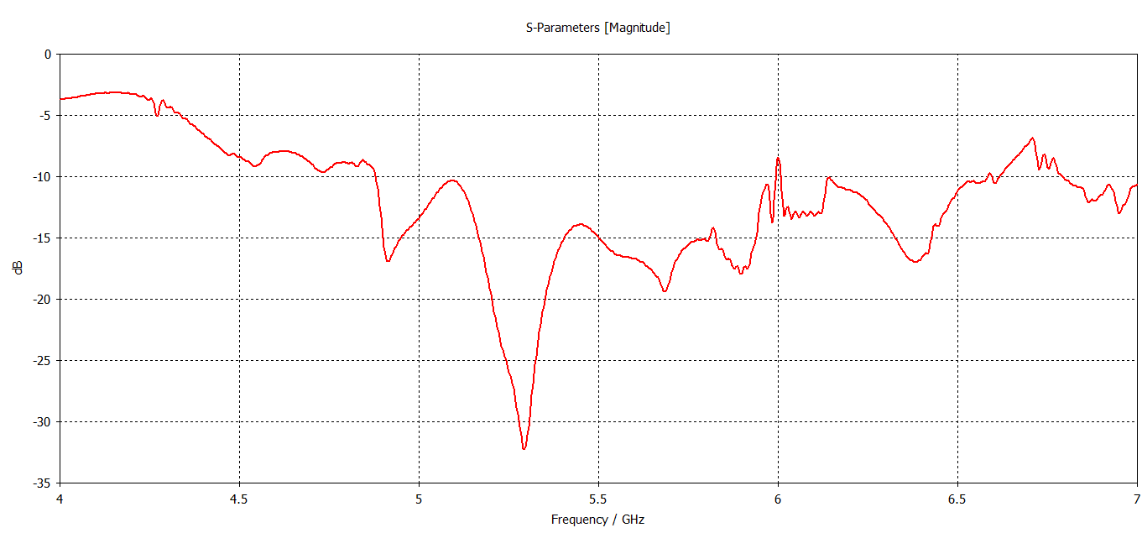
Results (WIP): Port 2 reflection

Slide 17
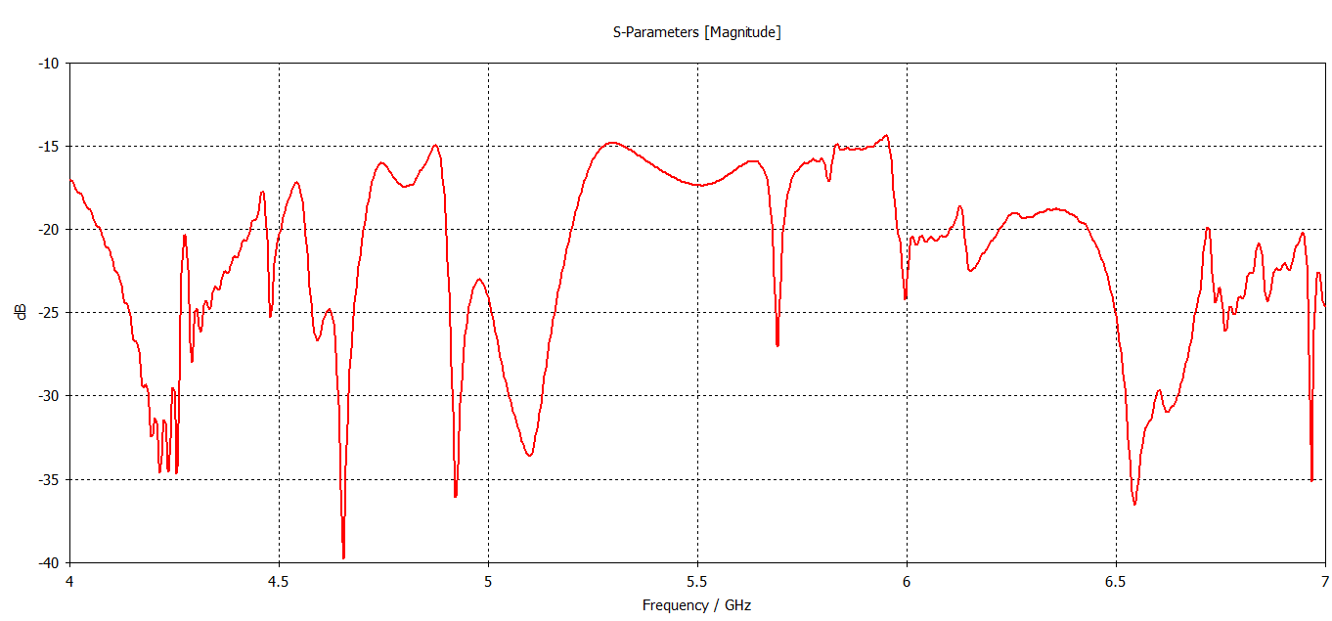
Results (WIP): Port crosstalk

Slide 18
Conclusion
Solid theoretical foundation built
Early results indicate a solution exists
Complex structure for optimization
Several points of reflection, leading to potential resonances
Difficult tuning and optimization

Slide 19
Thank you
for your attention

Slide 20
References
https://www.feynmanlectures.caltech.edu/II_24.html#Ch24-F4
S. K. Karki, J. Ala-Laurinaho and V. Viikari, "Dual-Polarized Probe for Planar Near-Field Measurement," in IEEE Antennas and Wireless Propagation Letters, vol. 22, no. 3, pp. 576-580, March 2023, doi: 10.1109/LAWP.2022.3218731
Pictures
Microwaves101 | Waveguide to coax transitions
ResearchGate | Coordinate system of rectangular waveguide

