Slide 1
Dual circularly polarized waveguide antenna
Final design

Slide 2
Outline
Conical horn design
Prototype
Functional changes
Assembly-related adjustments
Thesis
Conclusion

Slide 3
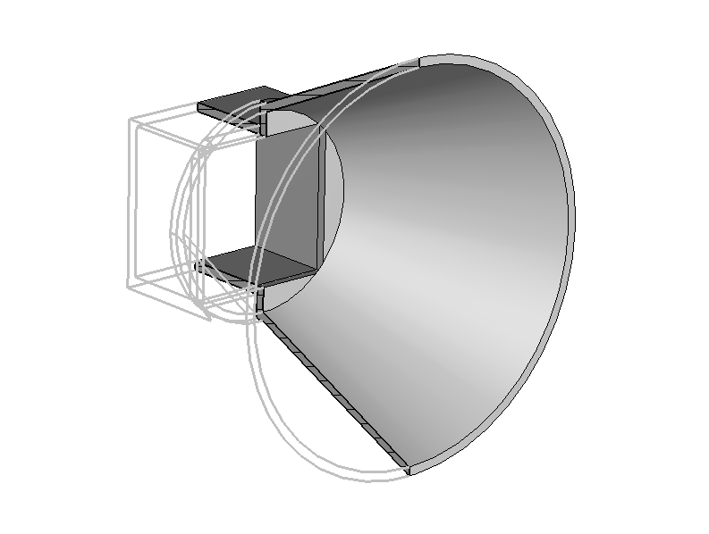
Conical horn design
Valuable theoretical design guidelines in [1]
Solution for my project
Antenna Magus?
Show pictures of the final horn
Talk about adaptation of a conical horn to a square waveguide?

Slide 4
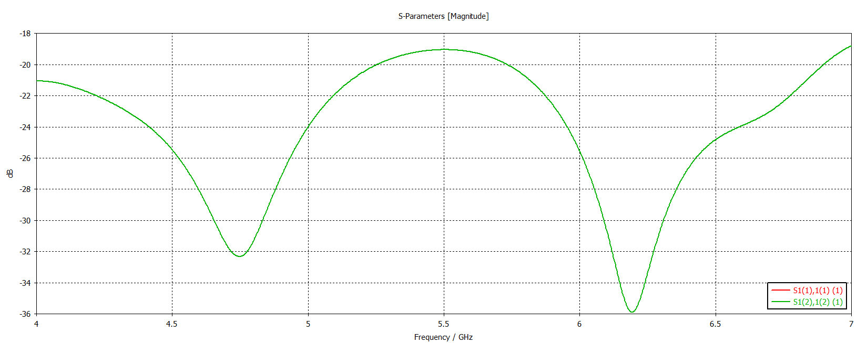
Conical horn – reflection

Slide 5
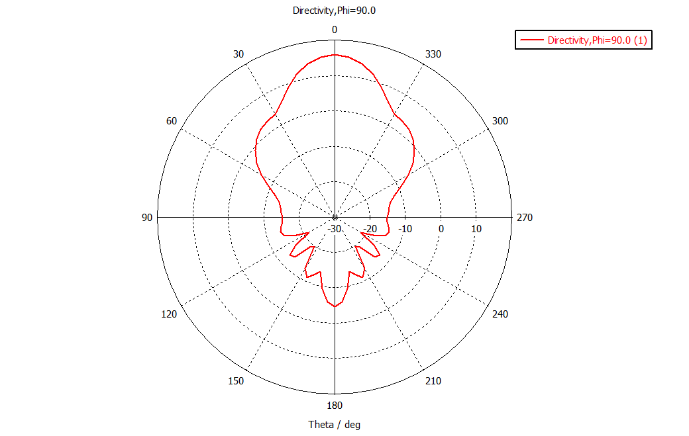
Conical horn – gain

Slide 6
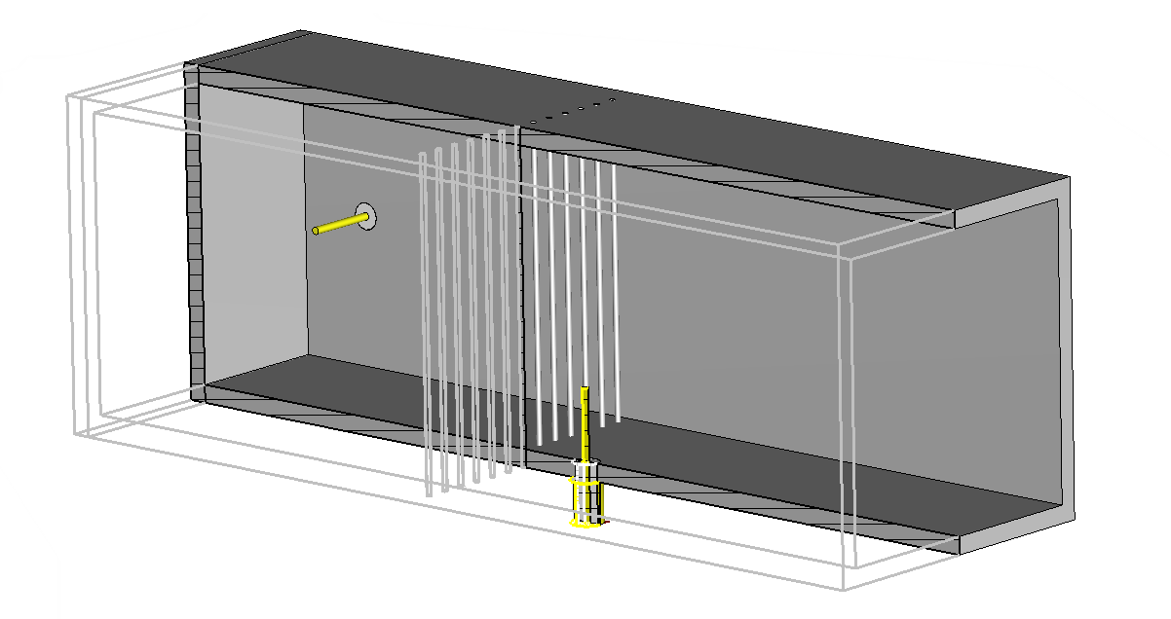
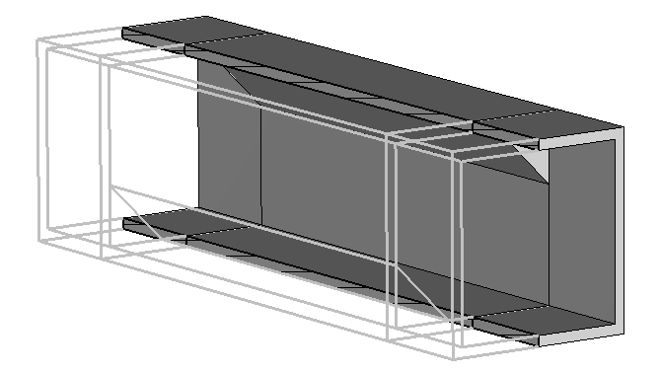
Prototype – per partes
Managed to get good simulation results piece-by-piece
Especially difficult of the dual feeding structure with grating

Slide 7
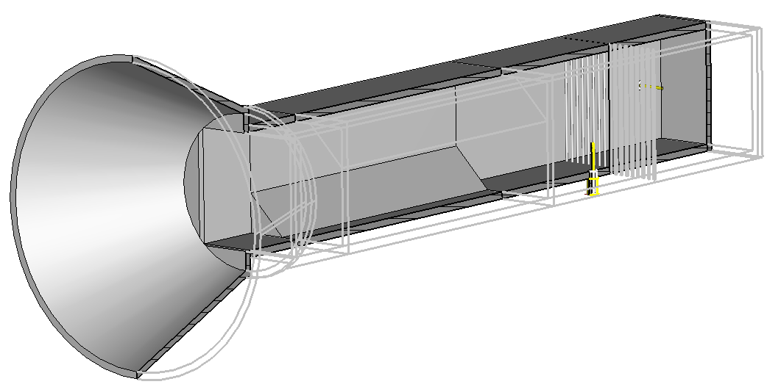
Prototype – model

Slide 8
Prototype – results
Unfortunately, performance was much worse after completion
Cause analysis
Grating causes unwanted field torsion
Newly introduced reflections increase probe coupling
Higher order modes appearance with more complex propagation geometry
Crosstalk had risen so much the grating polarizer lost its meaning

Slide 9
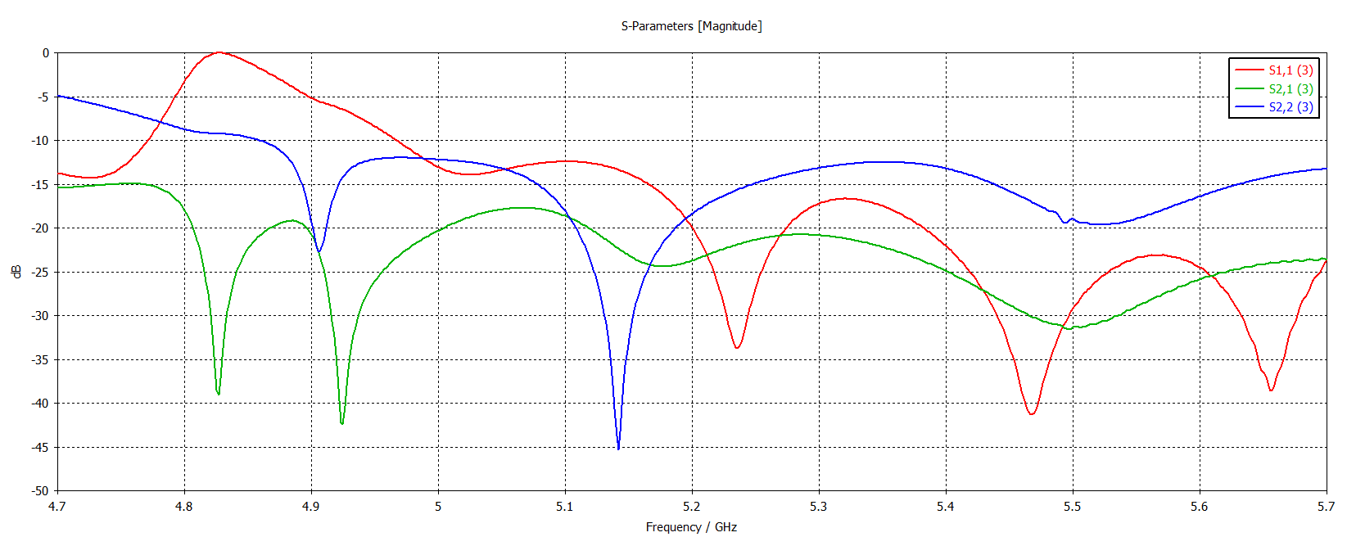
Prototype – S-parameters

Slide 10
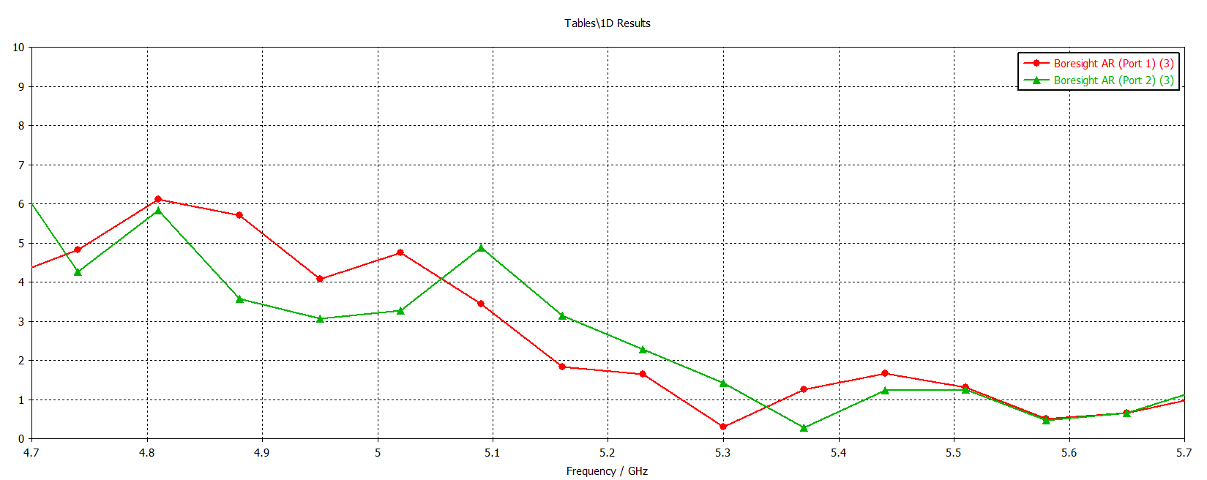
Prototype – Axial ratio

Slide 11
Functional changes
Further simulations, tweaking the geometry:
Tuning the grating geometry
Adjusting various waveguide lengths
Complete removal of grating
Turns out the crosstalk without the grating is viable!
Design MVP* was simulated for timely manufacturing
Precise simulation with over 35 million mesh cells, -50 dB energy precision
*MVP stands for Minimum Viable Product

Slide 12
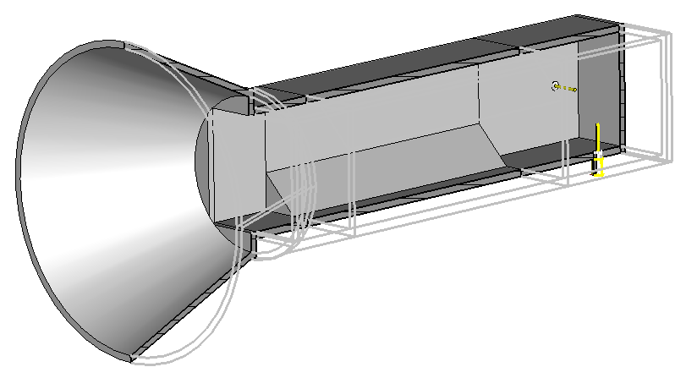
Functional changes – model

Slide 13
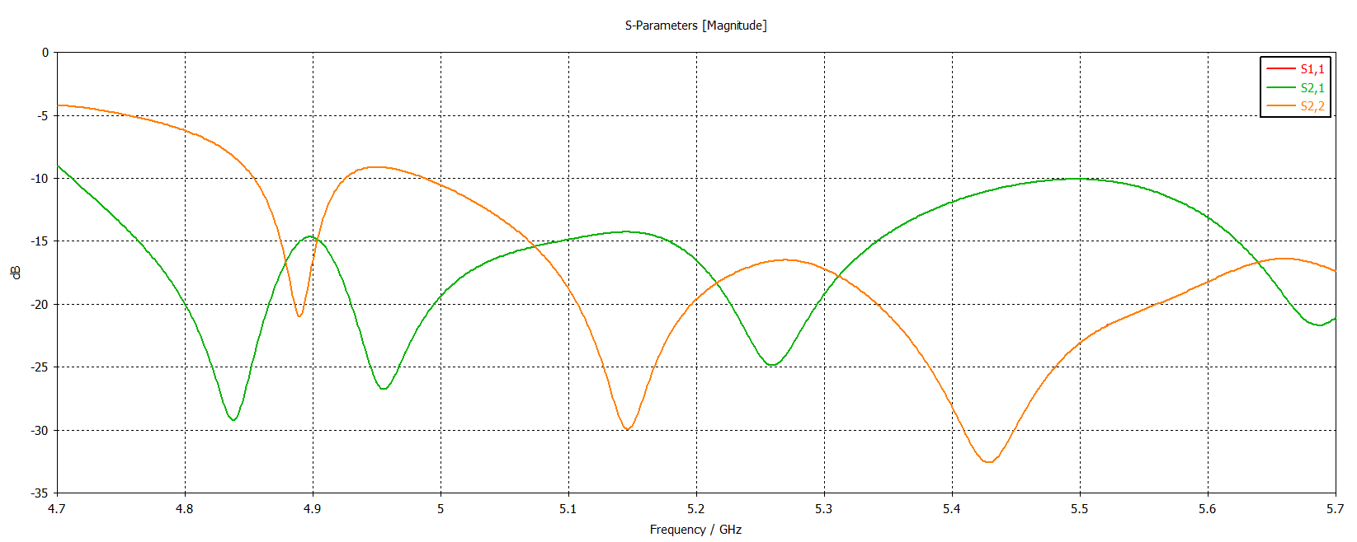
Functional changes – S-parameters

Slide 14
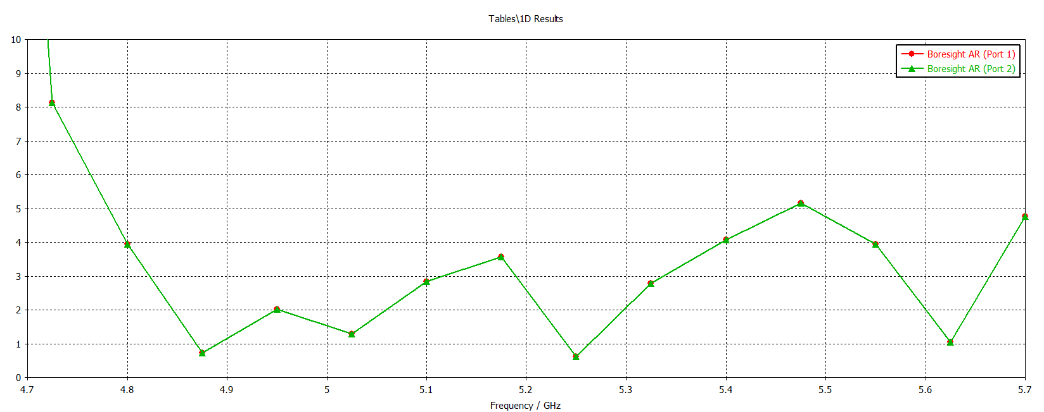
Functional changes – Axial ratio

Slide 15
Assembly-related adjustments
The fabrication company* uses CNC machining for fabrication
Division of the whole piece into 5
Horn, transition, polarizer, feed, back-short
Connected by flanges
Adjustments of the horn antenna to make it suitable for milling fabrication
While preserving inner dimensions
*Universal Microwave Technology

Slide 16
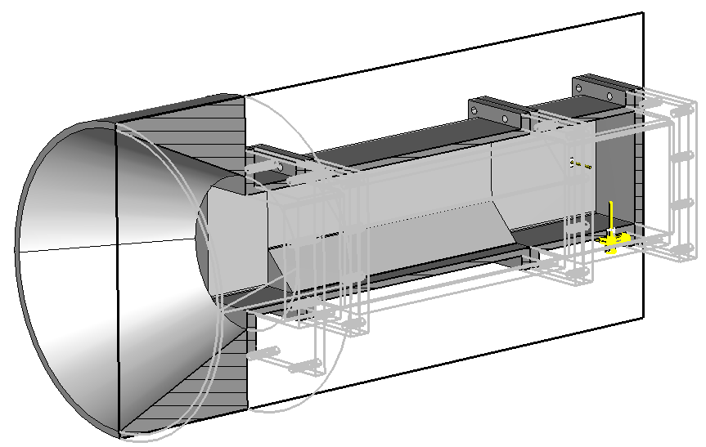
Assembly-related adjustments (final)

Slide 17
Thesis
Introduction
1 Theory of operation
2 Design process
2.1 Polarizer design
2.2 Dual feeding structure
Mention the grating polarizer variant
2.3 Horn antenna
3 Fabrication, measurement and comparison
Discuss possibility of the grating polarizer, provide simulation results
Simulation and measurement results
Conclusion

Slide 18
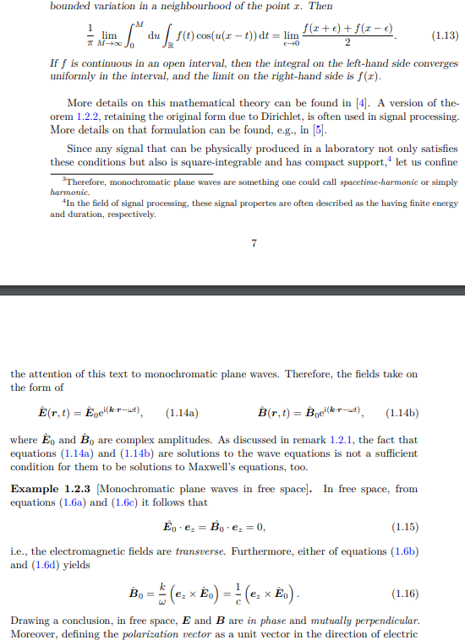
Conclusion
Design
finalized
being manufactured
In the meanwhile
Thesis text in progress
Analysis of dual feeding structure with grating

Slide 19
Thank you
for your attention

Slide 20
References
[1] N. A. Aboserwal, C. A. Balanis and C. R. Birtcher, "Conical Horn: Gain and Amplitude Patterns," in IEEE Transactions on Antennas and Propagation, vol. 61, no. 7, pp. 3427-3433, July 2013, doi: 10.1109/TAP.2013.2256453.

