Slide 1
Predicting the Likelihood of
Customer Churn
Sima Nikzad
Data Science Capstone project

Slide 2

The Problem
Customer Churn(attrition) Rate: rate at which customers, stop doing service with an entity. It is expressed as percentage of service subscriber, who discontinue their subscription within a given period of time.
XXX Bank is trying to identify the contributing factor(s) for customer churn and if this can this be avoided or predicted?

Slide 3
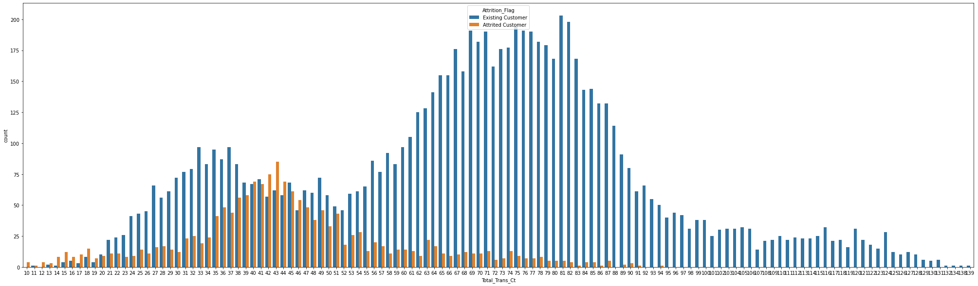
Contributing Factors
Highly Correlated
Total Number of Transaction
As we can clearly see, individual who use their credit card more often, are more likely to stay with our bank.

Slide 4
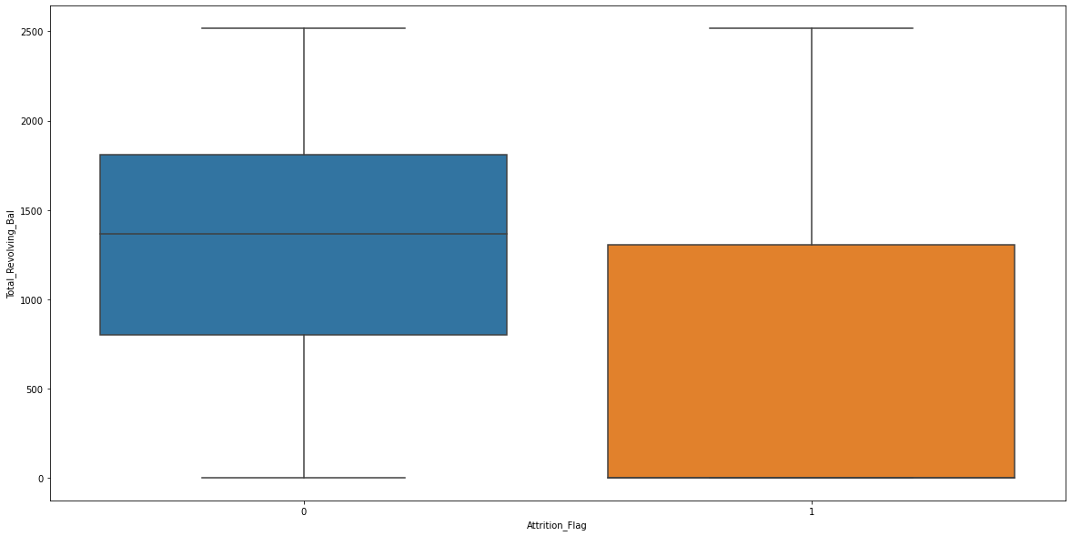
2. Total Revolving Balance
Customers with higher revolving balance are more likely to stay with our bank

Slide 5
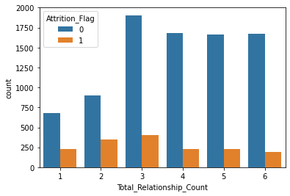
3. Total Relationship Count
Customers who are using more than two of the banks products are more likely to stay with our bank

Slide 6
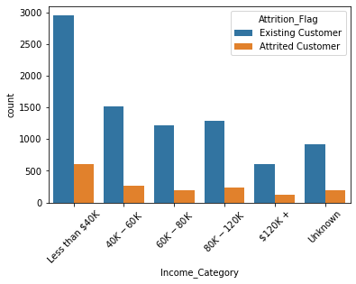
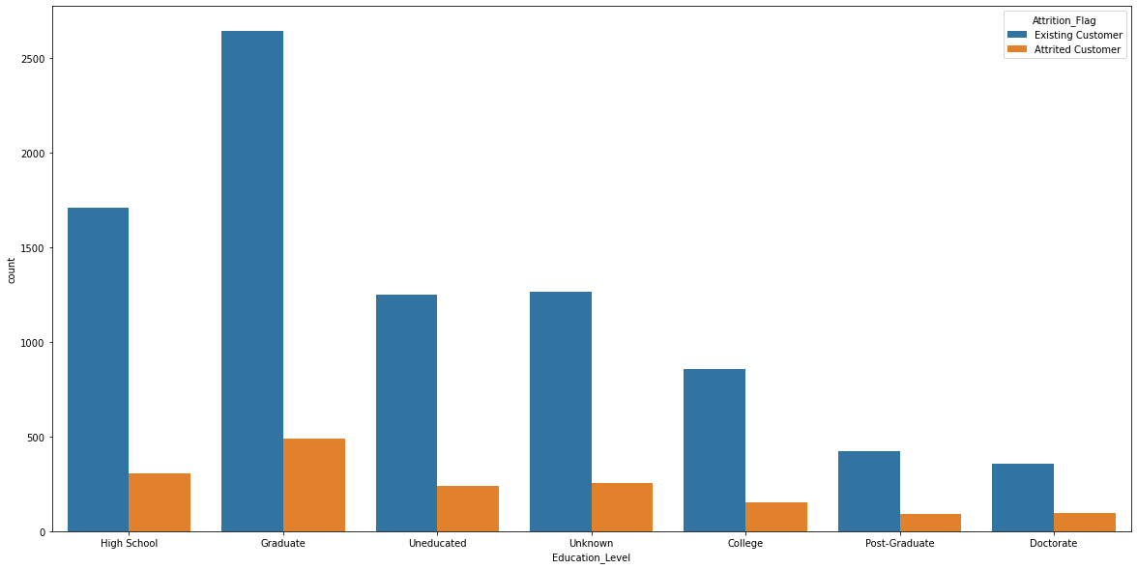
Non-Contributing Factors
Very little (if any) Correlated
Education and Income level
The majority of the bank’s customers are the ones make less than 40K and or have graduate degree

Slide 7
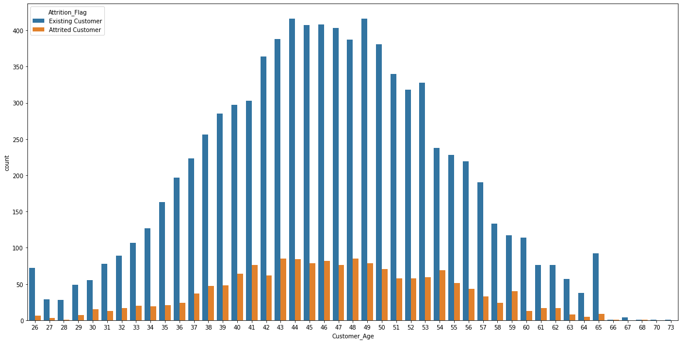
Age
Customer’s age has very little (if any) correlation with churn rate

Slide 8
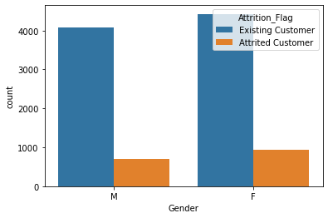
Gender
Customer Gender has no correlation with churn rate

Slide 9
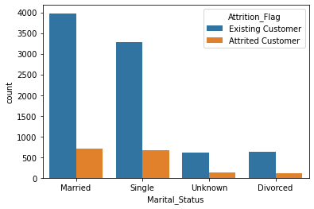
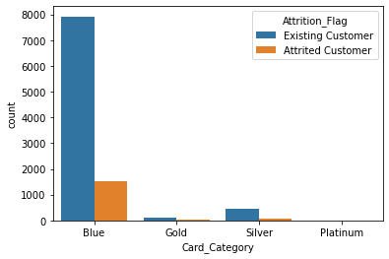
Marital Status and Type of Credit Card
The rate of customer churn is slightly higher in single individual than the married ones and
The majority of bank’s customer are the Blue card holder and since the number of all the other type of card holders are much smaller, it is unclear if type of card has any affect on churn rate

Slide 10
Machine Learning Modeling
Type : Supervised Learning
Binary Classification: 0 for Existing customer and 1 for Churned customer
Imbalance data : 15% data tagged with class 1
Tools : Python scikit Learn

Slide 11
Modeling Steps
Label Encoding
Data splitting into training and test sets (20% - 80%)
Use 3 different Classification Algorithms
Apply classification report to identify accuracy score
Create confusion matrix to find Precision and recall
Cross validation for finding best hyperparameter tuning
Classification Algorithms
Random Forest Classifier (Accuracy score of 96%)
Decision Tree Classifier (Accuracy score of 93%)
XGBClassifier (Accuracy score of 97%)
Since the last one has the best score, we will pick this model

Slide 12
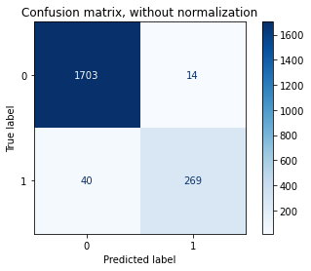
Confusion Matrix for XGBClassifier
1. The actual number of ‘existing’ that was labeled correctly by our model (dark Blue)
2. The actual number of ‘churned’ that was labeled correctly by our model (medium blue)
3. The number of ‘churned’ that was predicted falsely as ‘existing’ by our model, (light blue at bottom)
4. The number of ‘existing’ that was predicted falsely as ‘churned’ by our model, (light blue on top)

Slide 13
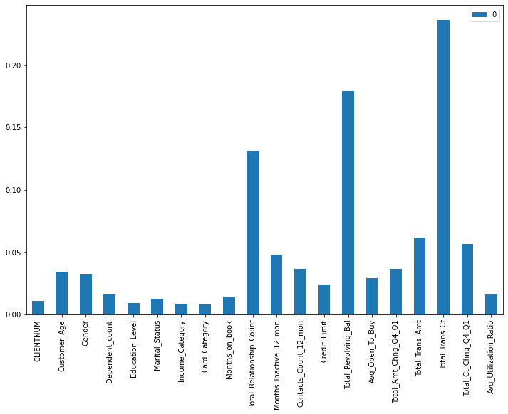
Most influential features predicted by our model
Conclusion: As we observed earlier in the visualization section, our model confirms the most important features affecting our churn rate

Slide 14
Recommendations
Based on the observed data and our model prediction, three features play the most important role in churn rate and those are:
Total number of transactions, management should find a way to motivate customers to use their credit card more often, it can be in a form of rewards, cash-back, contests ...
2. Total Revolving Balance, our data shows the customers who have more revolving balance are more likely to stay with our bank, in comparison with the ones with zero or low revolving balance. It is recommended that management find a way for customers to keep their revolving balance, the solution might be to offer zero interest on first x amount of revolving balance.
3. Total Relationship Count, this refers to the total number of bank’s products each customer is using, it is suggested that management offer ways to encourage our customers in doing more business with our bank, for example opening checking/saving account, credit cards, loans by offering them rewards, cash back, interest free credit cards.

Slide 15
Further research
There are many factors that can contribute to the churn rate, which are missing in this data, it is recommended that the future data include some/all those features as well. Those features are;
Credit card annual fee (if any)
Credit card interest Rate
Detail customer satisfaction survey, which contains all areas of customer service
Cash back/ Rewards / sign-ins bonuses (if any)
Any other data that management is confident will affect the churn rate

Slide 16
Data source
https://www.kaggle.com/sakshigoyal7/credit-card-customers

