Slide 1
Grafold: A Novel and Promising Nanostructure of Graphene
By Simanta Lahkar PHD student in Solid Mechanics SJTU

Slide 2
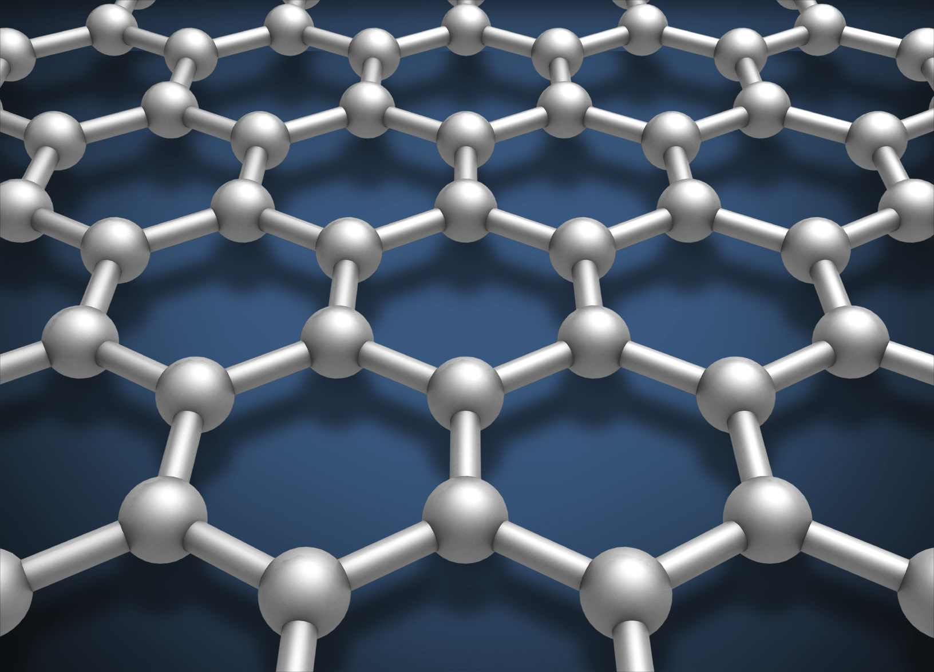
Graphene
Isolated in 2004
130 Gpa
Highly conductive
Flexible and transparent
Impermeable to most gases and liquids…

Slide 3
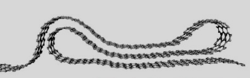
Grafolds – folded graphene structures
Research directions:
Observation/characterization of folded nanostructures
Mechanical Properties
Electronic Properties
Intercalation
Creation of Grafolds

Slide 4
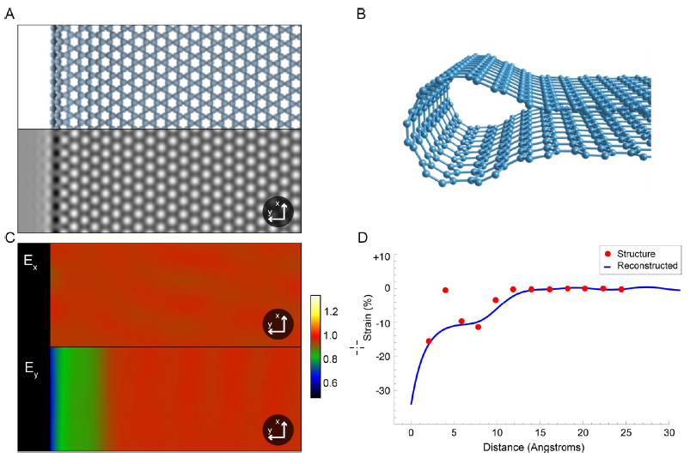
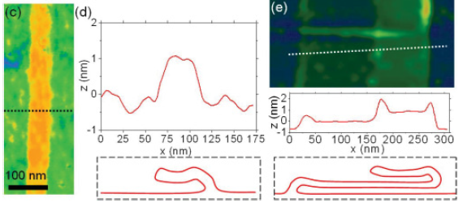
Observation
Kim et al, 2011
Ortolani et al, 2012

Slide 5
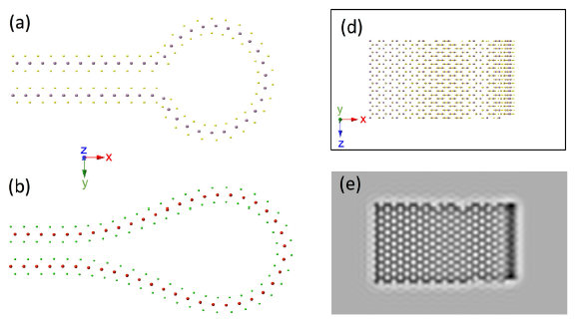
MoS₂
Wang et al, 2017

Slide 6
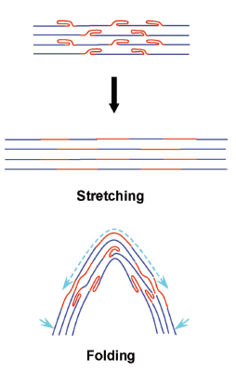
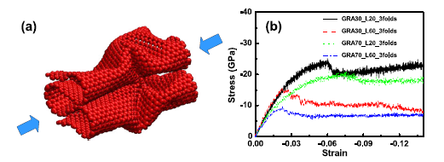
Mechanical Properties of Grafold
Zheng et al, 2011
Peng et al, 2017

Slide 7
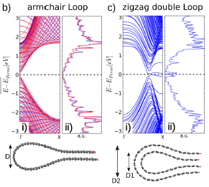
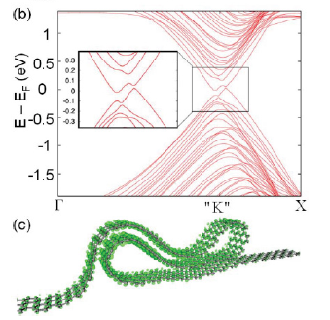
Electronic Properties of Grafold
Kim et al, 2011
Bezanilla et al, 2012

Slide 8
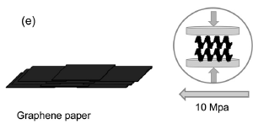
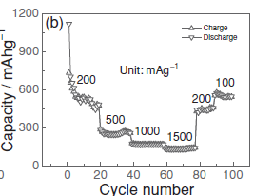
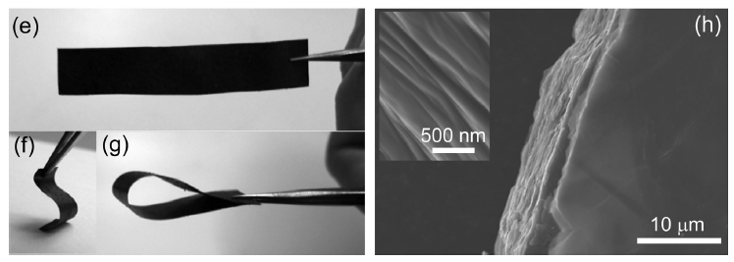
Liu et al, 2012

Slide 9
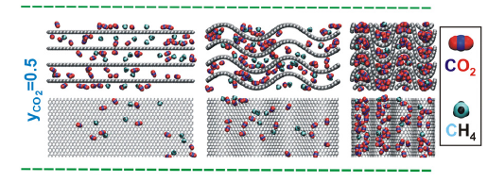
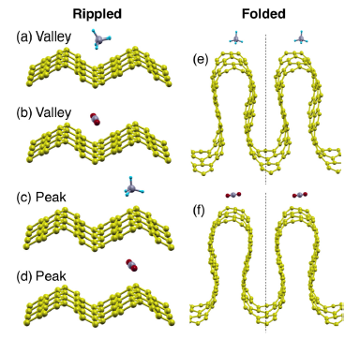
Intercallation
Furmaniak et al, 2014
Dutta et al, 2014

Slide 10
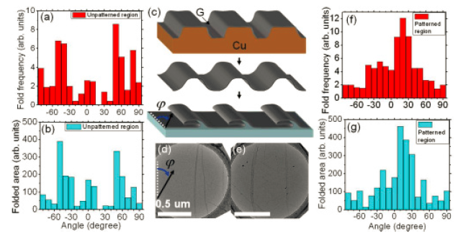
Formation
Kim et al, 2011

Slide 11
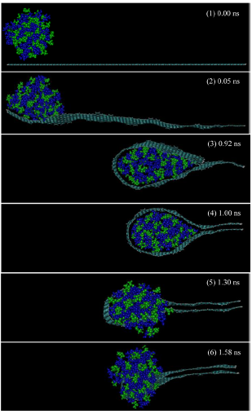
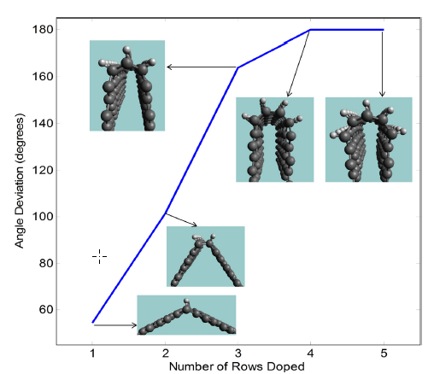
Becton et al, 2013
Atilhan et al, 2014

Slide 12
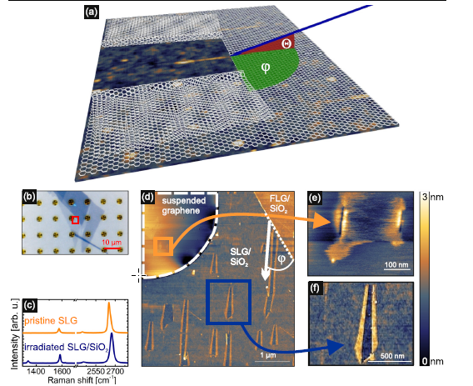
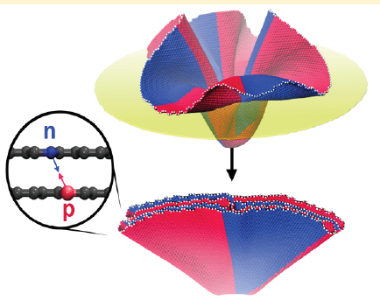
Wang et al, 2017
Ochedowski et al, 2015

Slide 13
Thank you for your attention ~

