Slide 1
python · main.py - open
1/5 Mehedi START
SPEAKER Mehedi Ashraf Simanto · opens the presentation
> Console Tic-Tac-Toe with Rule-Based AI
CSE440 · Section 01 · Group 01 · Summer 2026
$ whoami - introducing Group 01
Mehedi Ashraf Simanto
ID 2112085042 · Repo · main.py · README [START + END]
Abdur Rahman
ID 2131641042 · Menu · player validation
Md. Mazharul Islam Masum
ID 2233562042 · Board · constants · win lines
Mst. Fahmida Akter
ID 2121534642 · AI · game loop · demo video
Group 01 | Mehedi Ashraf Simanto · Md. Mazharul Islam Masum · Mst. Fahmida Akter · Abdur Rahman

Slide 2
python · goal.md
1/5 Mehedi START
SPEAKER Mehedi Ashraf Simanto · goal + approach
> Goal
> Working console Tic-Tac-Toe in Python (stdlib only)
> Two modes: vs AI and vs friend
> Safe input - bad moves never skip a turn
> Explainable AI - rules you can read in ai.py
> GitHub history that shows semester teamwork
Group 01 | Mehedi Ashraf Simanto · Md. Mazharul Islam Masum · Mst. Fahmida Akter · Abdur Rahman

Slide 3
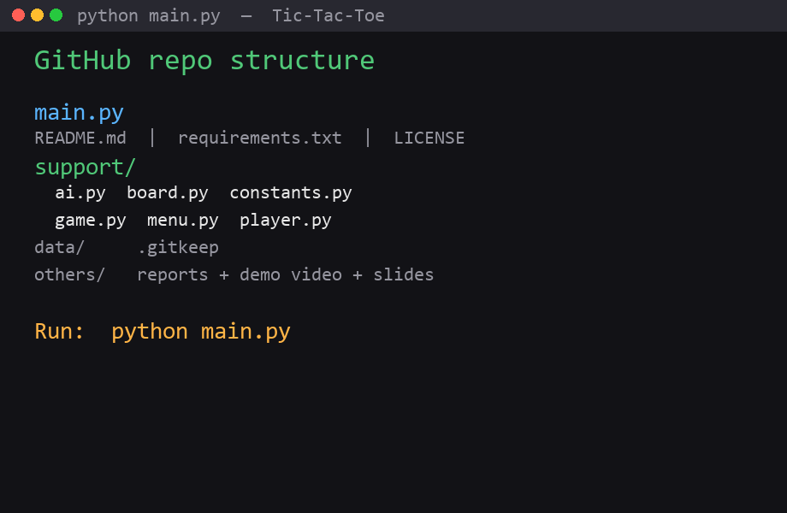
python · architecture
1/5 Mehedi START
SPEAKER Mehedi Ashraf Simanto · modular design + repo
> Approach - modular Python
> main.py starts -> menu -> game loop
> support/ = board · player · AI · game
> Flat list [0..8] maps spots 1-9
> Next: each member covers their full part once
// Mehedi hands over to Abdur Rahman (no return until the end).
Group 01 | Mehedi Ashraf Simanto · Md. Mazharul Islam Masum · Mst. Fahmida Akter · Abdur Rahman

Slide 4
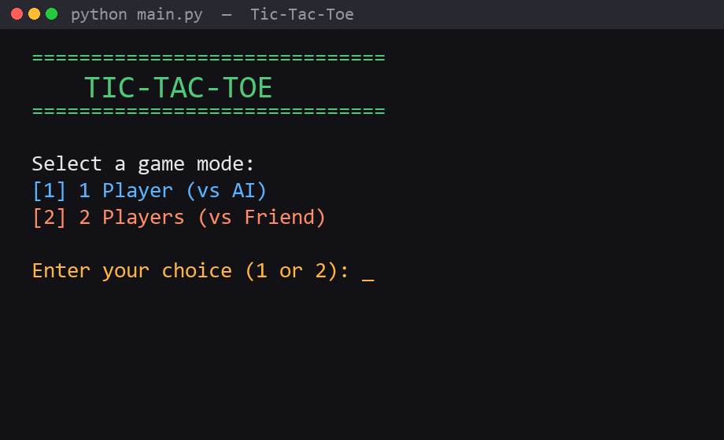
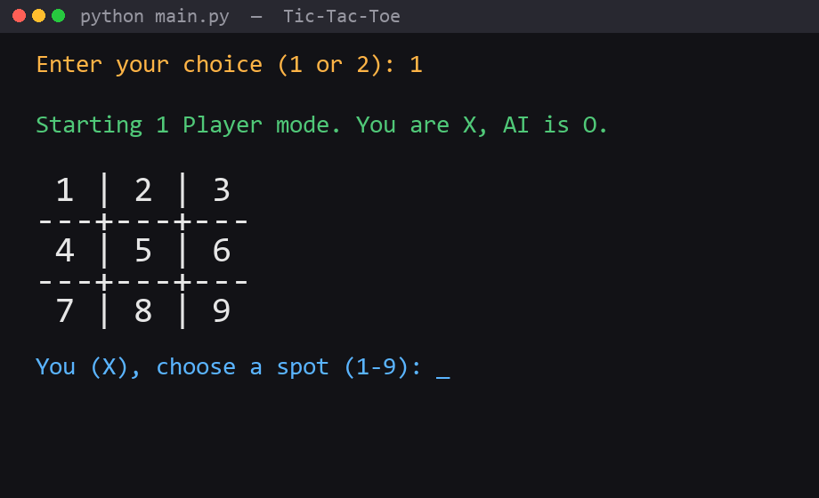
python · support/menu.py
2/5 Abdur Rahman
SPEAKER Abdur Rahman · menu · modes · validation · player.py
> Modes & Menu
menu [1] / [2]
mode 1 · You=X AI=O
Group 01 | Mehedi Ashraf Simanto · Md. Mazharul Islam Masum · Mst. Fahmida Akter · Abdur Rahman

Slide 5
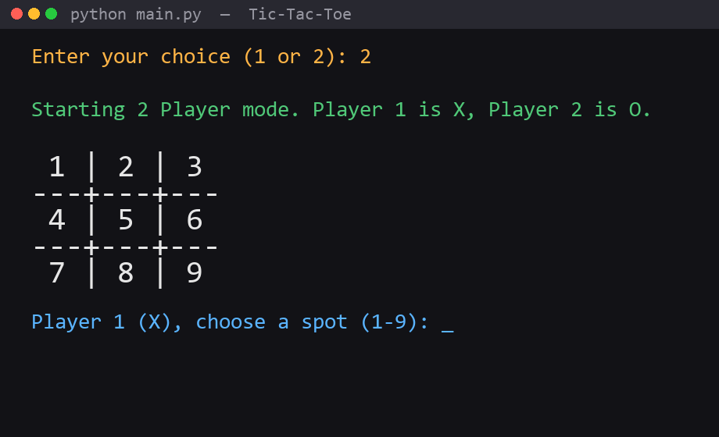
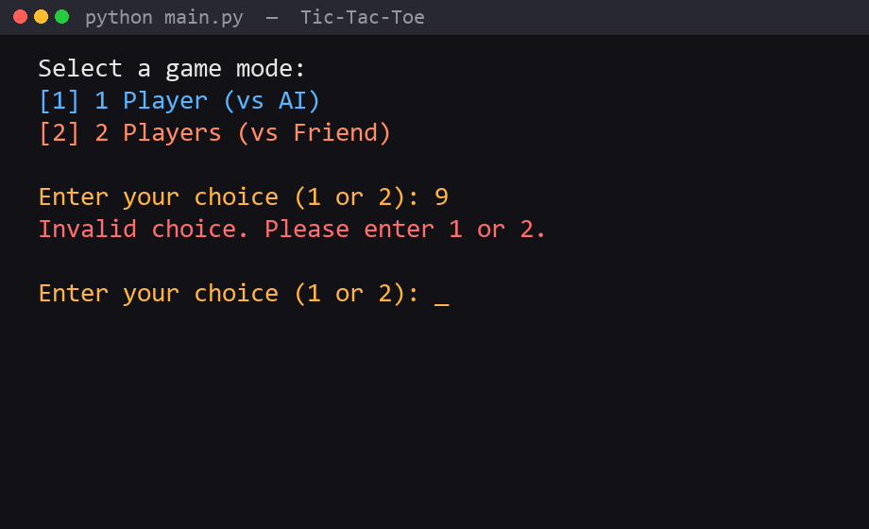
python · support/menu.py + player.py
2/5 Abdur Rahman
SPEAKER Abdur Rahman · 2-player mode + invalid input
> Two-Player Mode & Validation
mode 2 · P1=X P2=O
invalid menu -> re-prompt
Group 01 | Mehedi Ashraf Simanto · Md. Mazharul Islam Masum · Mst. Fahmida Akter · Abdur Rahman

Slide 6
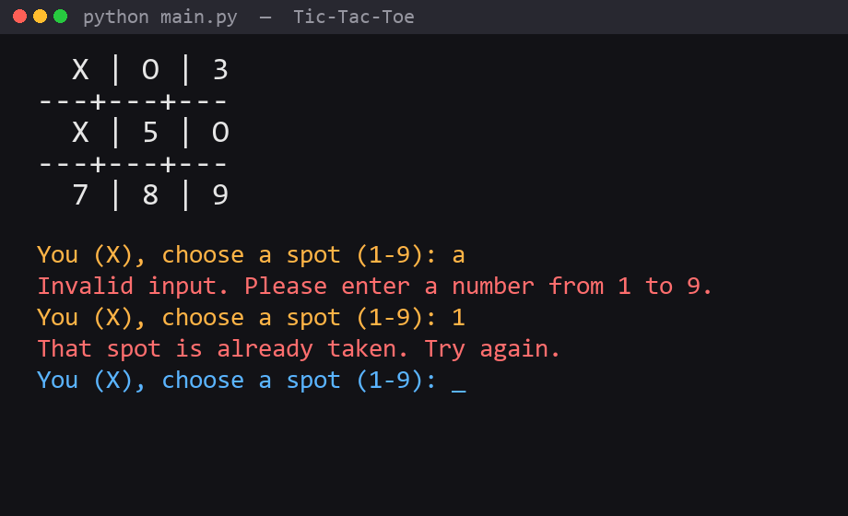
python · support/player.py
2/5 Abdur Rahman
SPEAKER Abdur Rahman · move validation - never lose a turn
> Player Input
// GitHub while speaking: main.py (entry) · menu.py · player.py -> then hand to Masum
Group 01 | Mehedi Ashraf Simanto · Md. Mazharul Islam Masum · Mst. Fahmida Akter · Abdur Rahman

Slide 7
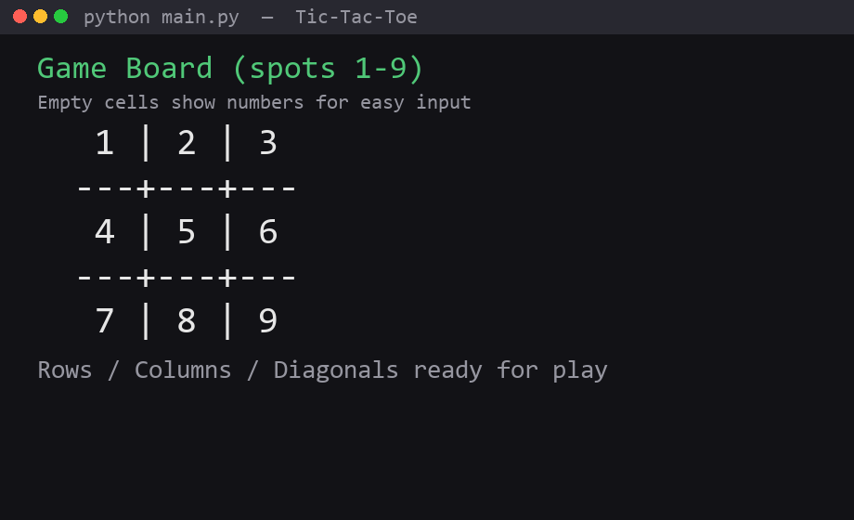
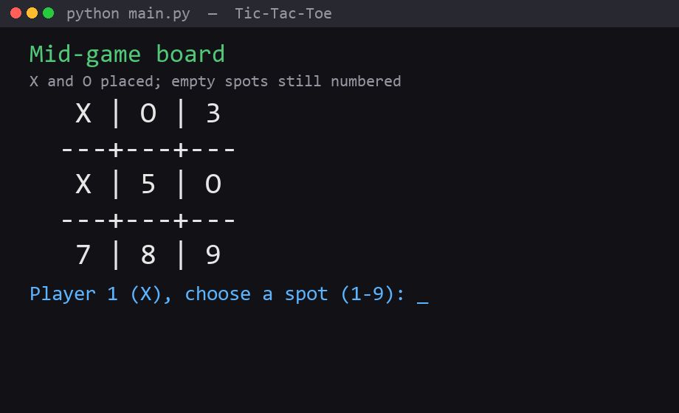
python · support/board.py
3/5 Masum
SPEAKER Md. Mazharul Islam Masum · board · rows · columns · constants
> Board Display
numbered empty board
mid-game board
Group 01 | Mehedi Ashraf Simanto · Md. Mazharul Islam Masum · Mst. Fahmida Akter · Abdur Rahman

Slide 8
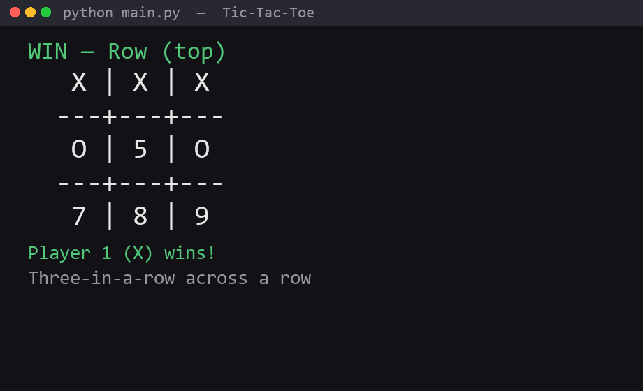
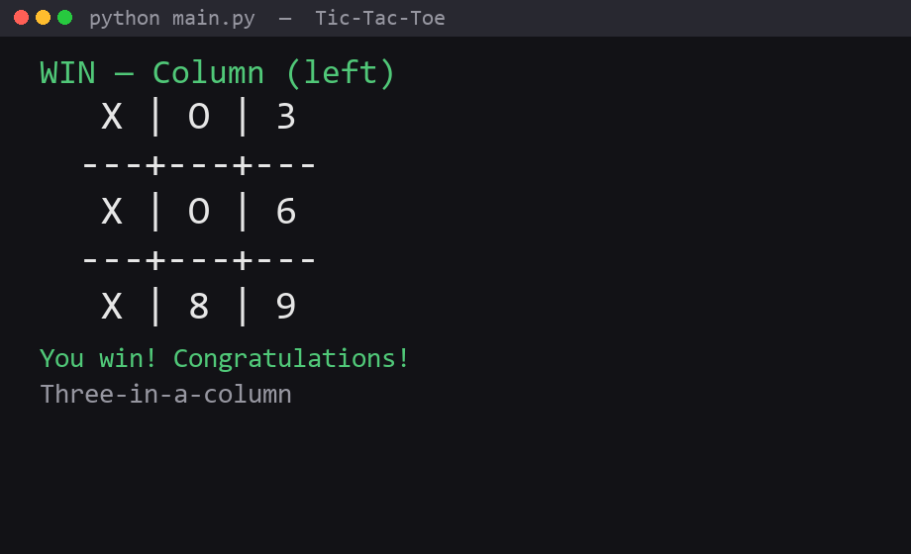
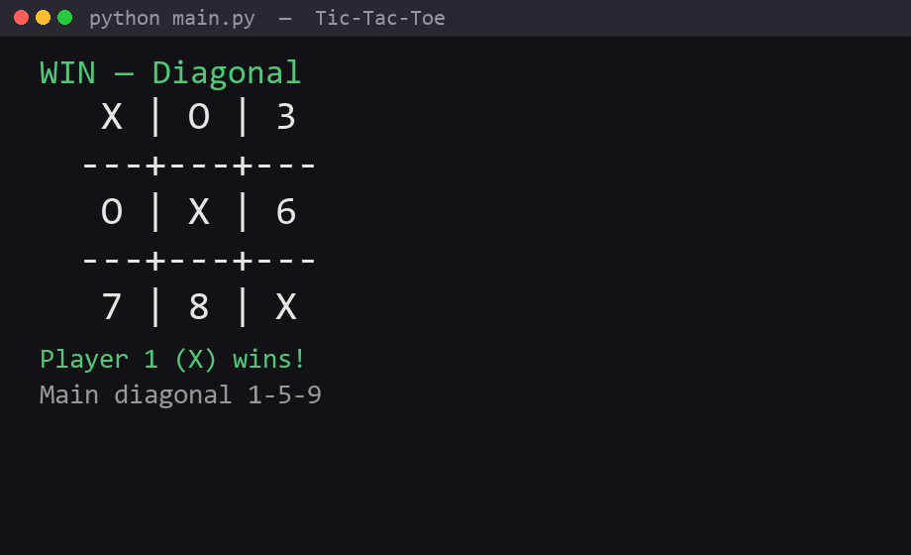
python · check_winner()
3/5 Masum
SPEAKER Md. Mazharul Islam Masum · win lines - row / column / diagonal
> Win Detection
row
column
diagonal
// GitHub while speaking: constants.py · board.py -> then hand to Fahmida
Group 01 | Mehedi Ashraf Simanto · Md. Mazharul Islam Masum · Mst. Fahmida Akter · Abdur Rahman

Slide 9
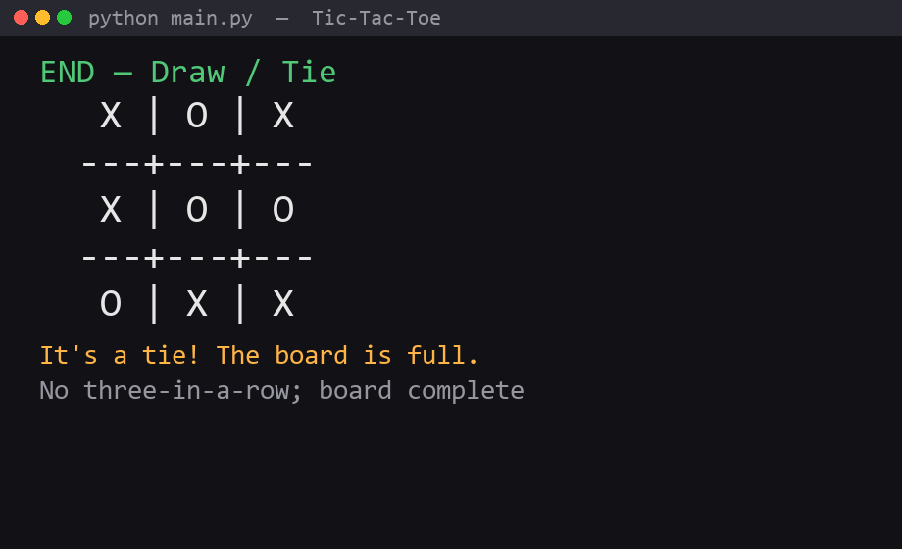
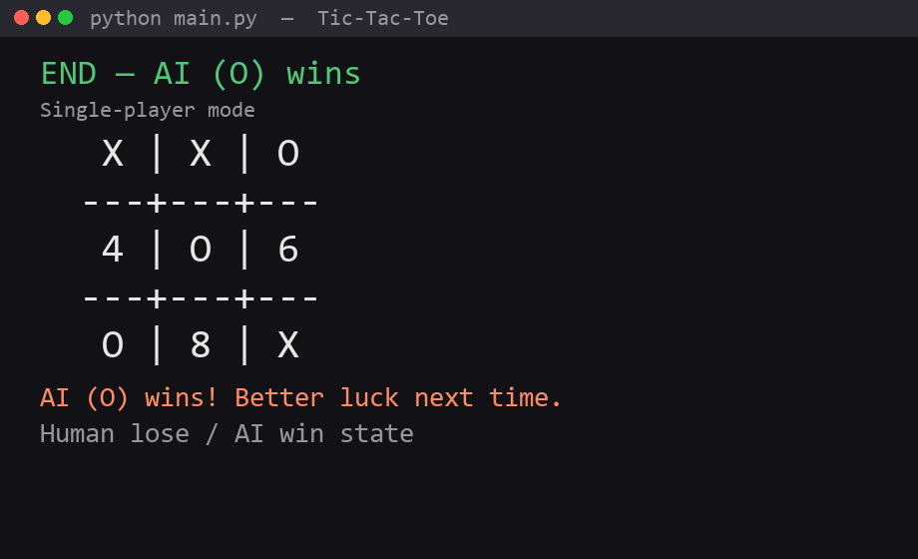
python · end_game()
4/5 Fahmida
SPEAKER Mst. Fahmida Akter · end states · AI · game loop · video
> End States - Draw / Lose / AI Win
draw / tie
AI wins / human lose
Group 01 | Mehedi Ashraf Simanto · Md. Mazharul Islam Masum · Mst. Fahmida Akter · Abdur Rahman

Slide 10
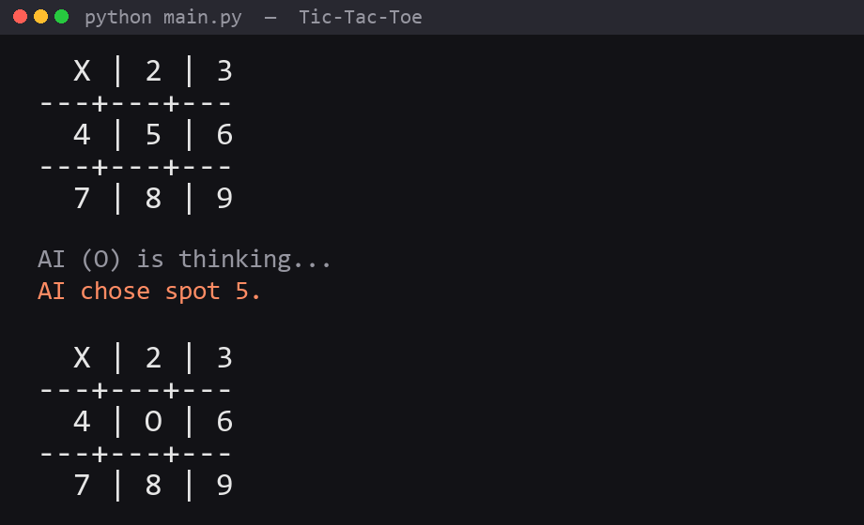
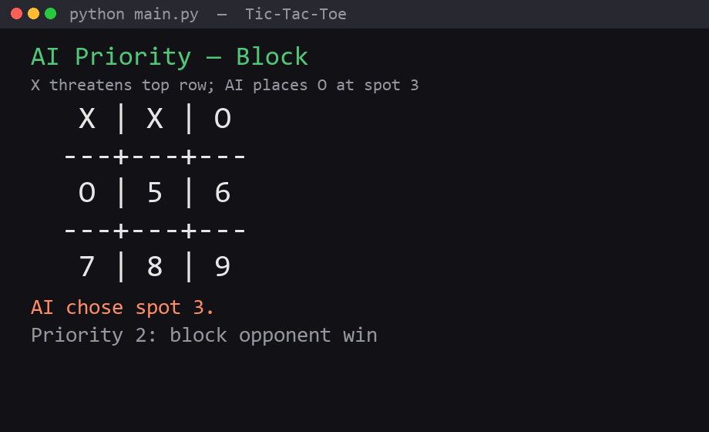
python · support/ai.py
4/5 Fahmida
SPEAKER Mst. Fahmida Akter · rule-based AI priorities
> Rule-Based AI
priority 3 · center
priority 2 · block
// 1) Win 2) Block 3) Center 4) Random · GitHub: ai.py · game.py
Group 01 | Mehedi Ashraf Simanto · Md. Mazharul Islam Masum · Mst. Fahmida Akter · Abdur Rahman

Slide 11
python · others/CSE440_Project_Video.mp4
4/5 Fahmida
SPEAKER Mst. Fahmida Akter · plays the 1-minute demo video
> 1-minute demo video
> User-view screen capture
> File: others/CSE440_Project_Video.mp4
> Do NOT run code live
> Then hand back to Mehedi
Group 01 | Mehedi Ashraf Simanto · Md. Mazharul Islam Masum · Mst. Fahmida Akter · Abdur Rahman

Slide 12
python · github - wrap up
5/5 Mehedi END
SPEAKER Mehedi Ashraf Simanto · closes - GitHub wrap + thank you
> GitHub wrap (Mehedi closes)
> Quick scroll: commit history (semester-long work)
> Confirm folders: support/ · data/ · others/
> others/ has final report PDF + demo video
> Team finished: Rahman (UI) · Masum (board) · Fahmida (AI/game)
> Thank you - we are ready for questions
// Keep closing under ~90 seconds.
Group 01 | Mehedi Ashraf Simanto · Md. Mazharul Islam Masum · Mst. Fahmida Akter · Abdur Rahman

Slide 13
python · exit(0)
5/5 Mehedi END
SPEAKER Mehedi Ashraf Simanto · thank you
> Thank you
Questions?
github.com/simanto4321/CSE440-section-01--TIC-TAC-TOE-GAME-
$ python main.py
Group 01 | Mehedi Ashraf Simanto · Md. Mazharul Islam Masum · Mst. Fahmida Akter · Abdur Rahman

