Slide 1
Cucumber Training
May. 06, 2016

Slide 2
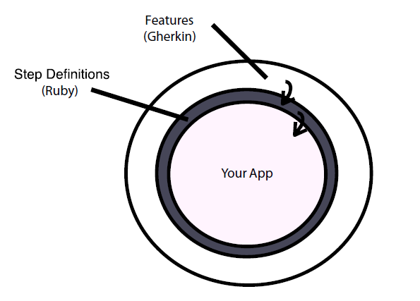
Introduction
What is cucumber?
Cucumber is a testing tool, flow owners could write automated tests to evaluate their outcome.
The main layers of a Cucumber test suite

Slide 3
Introduction
cucumber tests
a.feature
b.feature
c.feature
…
Feature: A
Feature: B
Feature: C
Feature: …
From outside
Plain language
Scenario: i
Scenario: ii
Scenario: …
Step Definitions/ .rb
Adaptor
Ruby
System
Implemnted
by your system

Slide 4
Creating a feature
lint_test.feature
Feature: Lint Test
This is the description lines, which can
include empty lines, like this one:
In fact, everything until the next Gherkin keyword is included
in the description.
Scenario: Add two numbers
Given the input "2+2"
When the calculator is run
Then the output should be "4"
Scenario:***
Naming convention:Lint Test(Feature) -> lint_test.feature(filename)
Given to set up the context where the scenario happens
When to interact with the system somehow
Then to check that the outcome of that interaction
was what we expected.

Slide 5
Creating a feature
Keywords
• Feature
• Background
• Scenario
• Given
• When
• Then
• And
• But
• *
$ /tool/pandora64/hdk-4.8.1/18/bin/cucumber test.feature –dry-run
The --dry-run switch tells Cucumber to parse the file without executing it. It
will tell you if your Gherkin isn’t valid.

Slide 6
Step Definitions
features/adding_test.feature
features/step_definitions/adding.rb
Given /^the input "([^"]*)"$/ do |input|
@input = input
end
When /^the calculator is run$/ do
@output = `ruby calc.rb #{@input}`
raise('Command failed!') unless $?.success?
end
Then /^the output should be "([^"]*)"$/ do |expected_output|
@output.should == expected_output
end
Feature: Adding Test
Scenario: Add two numbers
Given the input "2+2"
When the calculator is run
Then the output should be "4"

Slide 7
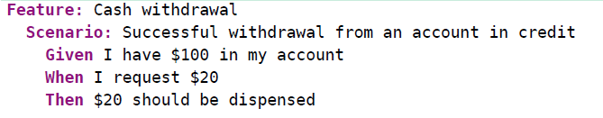


Step Definitions
Matching a step: Using regular expressions for capturing groups
Note: The keyword: Given/When/Then would be ignored in deed when cucumber scans a scenario for matching step definitions.
Capture groups
Character Classes
Mutiple capture
Given /I have \$(\S+) in my account/ do |amount|
****
end

Slide 8



Step Definitions
Matching a step: Noncapturing groups

Slide 9
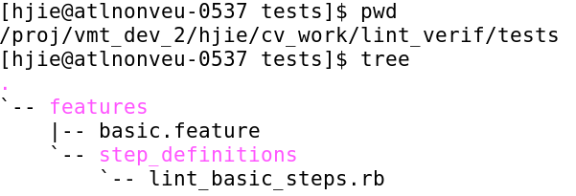
How cucumber works with a scenario?
Step 1: Create features&step_definitions, then execute command
$ pwd
/proj/vmt_dev_2/hjie/cv_work/lint_verif
$mkdir tests
$cd tests
<create .features & step_definitions. The location as below>
$/tool/pandora64/hdk-4.8.1/18/bin/cucumber features/basic.feature

Slide 10
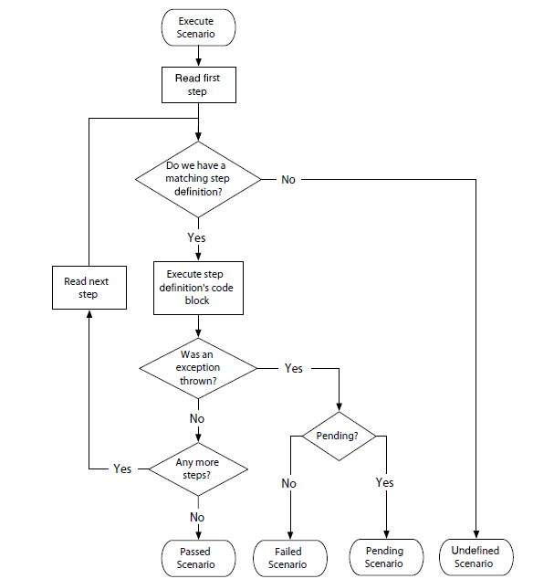
How cucumber works with a scenario?
Cucumber would end up a scenario with the following states, which help indicate the progress of your test.
Undefined
Pending
Failed
Passed

Slide 11
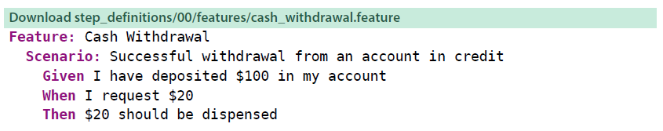
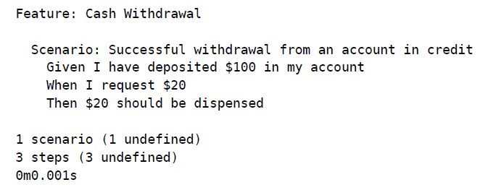
How cucumber works with a scenario?
Undefined Steps
Step definitions haven’t been written yet
so when we run this feature, we
should see the steps all come up as undefined

Slide 12
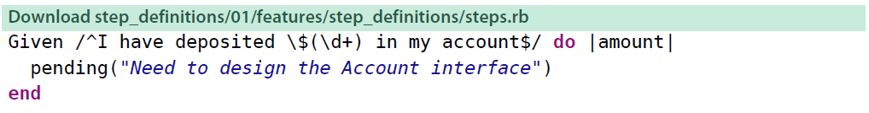

How cucumber works with a scenario?
Pending Steps
Oc
If one step definition was pending,
The scenario will be stopped.
The rest of the steps will be skipped or
marked as undefined.
Notes:
When Cucumber discovers a step definition that’s halfway through being
implemented, it marks the step as pending (yellow). Again, the scenario will
be stopped, and the rest of the steps will be skipped or marked as undefined.

Slide 13
How cucumber works with a scenario? – Example: Lint
features/lint_basic.feature
features/step_definitions/lint_basic_steps.rb
Feature: Lint Basic
Scenario: running test
Given the input filelist is /home/hjie/temp/osssys.vf.lint
When the test run for vc_lint
Then the flow passes?
Before do |scenario|
@scenario_dir = scenario.name.gsub(/\s/, '_').downcase
@feature_dir = scenario.feature.name.gsub(/\s/, '_').downcase
dir = File.join(Dir.getwd, "lint_cucumber_test", @feature_dir, @scenario_dir)
FileUtils::mkdir_p dir
@test_dir = dir
end
Given /^the input filelist is (\S+)$/ do |input|
@input = input
end
When /^the test run for vc_lint$/ do
cmd = ""
cmd << "cd #{@test_dir};"
cmd << "vc_lint.pl -t osssys -l #{@input} -no_swan -J lsf"
puts "running command: #{cmd}"
@result = system(cmd);
end
Then /^the flow passes\?$/ do
@result.should == true
end

Slide 14
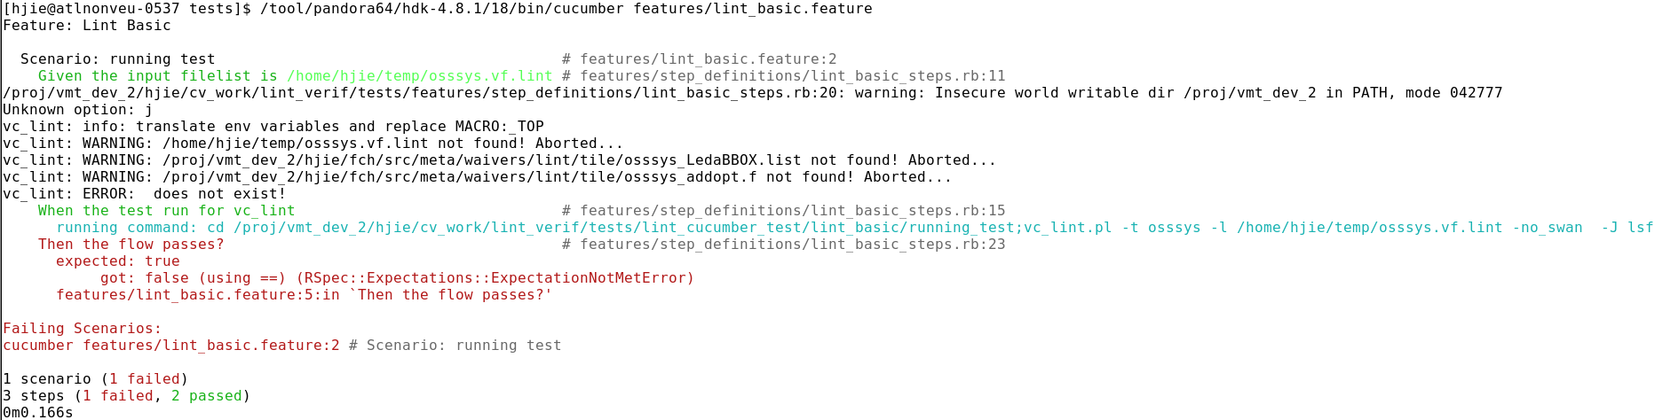
How cucumber works with a scenario? – Example: Lint
Failling Steps

Slide 15
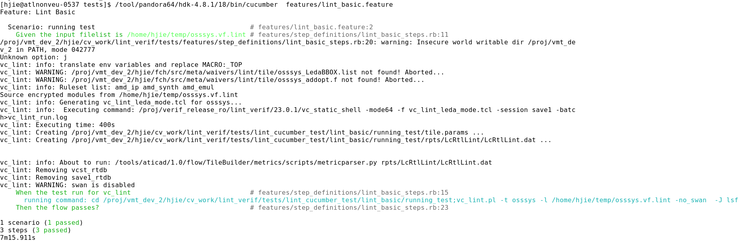
How cucumber works with a scenario? – Example: Lint
Passing Steps

Slide 16
Q&A

Slide 17
Disclaimer & Attribution
The information presented in this document is for informational purposes only and may contain technical inaccuracies, omissions and typographical errors.
The information contained herein is subject to change and may be rendered inaccurate for many reasons, including but not limited to product and roadmap changes, component and motherboard version changes, new model and/or product releases, product differences between differing manufacturers, software changes, BIOS flashes, firmware upgrades, or the like. AMD assumes no obligation to update or otherwise correct or revise this information. However, AMD reserves the right to revise this information and to make changes from time to time to the content hereof without obligation of AMD to notify any person of such revisions or changes.
AMD MAKES NO REPRESENTATIONS OR WARRANTIES WITH RESPECT TO THE CONTENTS HEREOF AND ASSUMES NO RESPONSIBILITY FOR ANY INACCURACIES, ERRORS OR OMISSIONS THAT MAY APPEAR IN THIS INFORMATION.
AMD SPECIFICALLY DISCLAIMS ANY IMPLIED WARRANTIES OF MERCHANTABILITY OR FITNESS FOR ANY PARTICULAR PURPOSE. IN NO EVENT WILL AMD BE LIABLE TO ANY PERSON FOR ANY DIRECT, INDIRECT, SPECIAL OR OTHER CONSEQUENTIAL DAMAGES ARISING FROM THE USE OF ANY INFORMATION CONTAINED HEREIN, EVEN IF AMD IS EXPRESSLY ADVISED OF THE POSSIBILITY OF SUCH DAMAGES.
ATTRIBUTION
© 2016 Advanced Micro Devices, Inc. All rights reserved. AMD, the AMD Arrow logo and combinations thereof are trademarks of Advanced Micro Devices, Inc. in the United States and/or other jurisdictions. Other names are for informational purposes only and may be trademarks of their respective owners.

