Slide 1
VRQ & VCS: X-Propagation Solution
VINCENT
MAR. 18, 2013

Slide 2

AGENDA
X-Prop Tech
VRQ X-Prop Tool
VCS X-Propagation Simulator
Project Data Review

Slide 3
X-PROP TECH

Slide 4
X-PROP TECH
Hidden X-Bugs
  The semantics of X in Verilog RTL are extremely dangerous as RTL bugs can be masked, allowing RTL simulations to incorrectly pass where netlist simulations can fail
  X-propagation technology used to solve the problems for bugs missed by RTL simulations, equivalence checking, and code coverage as well
Unknown Semantics
  X-pessimism: the condition when output of logic is ‘X’ in cases where it never could be based upon the inputs
  X-optimism: the condition when output of logic is non-’X’ value when one or more inputs are ‘X’
Sources of X
SOURCE | DESCRIPTION
Non-initialized DFF | Unknown Value From Memory or DFF
RTL Design: X Insertion | ‘X’ Insertion Coding Style by Designer
Behavior Code | Test Bench or RTL for Simulation only
 | Library Models

Slide 5
X-PROP TECH
X-Prop Solutions
  Gate Level Simulation
    Netlists have much better X-propagation than RTL, even though it can be difficult to find cases of X-Optimism in netlist simulations where there is X-Pessimism
  VRQ X-Prop Tool
    Deploy a very simplistic XResolution function that results in less code bloat and overhead at the expense of increased pessimism. The XResolution function ignores the inputs and always returns X; the properly constructed design flow greatly reduces the need for gate level simulation
  VCS X-Propagation Simulator
    The commercial EDA tool from Synopsys, provides better simulation behavior to execute all alternatives controlled by an X value, and merge the results in some prescribed manner
Avoid ‘X’ Danger
  Good RTL Coding Practice
  Remove Reachable Don’t-Care X-assignment
  Replace ‘X’ Insertion with Assertions (*)
  Avoid Un-Initialized Registers
  Enable ‘X’ Propagation

Slide 6
VRQ X-PROP TOOL

Slide 7
VRQ X-PROP TOOL
VRQ
  VRQ is modular Verilog parser that supports plugin tools to process Verilog, which is pretty close to fully compliant with the Verilog 2005 and SystemVerilog 2005 specification; however not all tools support all constructs.
X-Prop Plugin
  The utility cause the Verilog code (ASTs) to be instrumented such that X's are properly propagated by Verilog simulation tools. It is used to reduce the simulation differences between gate level representations and RTL
  X Process
INSTRUMENTATION | DESCRIPTION
IF-ELSE | Enable/Disable ‘if/else’ construct X-Propagation
CASE | Enable/Disable ‘case’ construct X-Propagation
ASSIGNMENT/ Bit Select | Enable/Disable bit select construct X-Propagation

Slide 8
VRQ X-PROP TOOL
X-Prop Plugin (Con’d)
  X Process
INSTRUMENTATION |  | DESCRIPTION
ASSIGNMENT | Part Select | Enable/Disable multiple bits select construct X-Propagation
 | Array with Index | Enable/Disable array index construct X-Propagation
Ternary |  | Enable/Disable ternary construct X-Propagation
Clock Enable |  | Enable/Disable clock (single/both edge)X-Propagation

Slide 9
VCS X-PROPAGATION SIMULATOR

Slide 10
VCS X-PROPAGATION SIMULATOR
VCS
  Synopsys functional verification solution popular used in IC industry, provides high performance simulation engines, constraint solver engines, Native Testbench (NTB) support, broad SystemVerilog support, verification planning, coverage analysis and closure, and an integrated debug environment
X-Prop Feature
  The simulation semantics of conditional constructs that the standard Verilog RTL prescribes for indeterminate ‘X’ control expressions are insufficient to accurately model uninitialized registers and power-on reset.
  X-Prop Merge Mode
MERGE MODE | DESCRIPTION
X-Merge Mode | process condition in kind of x-pessimism method (some like VRQ)
T-Merge Mode | process ‘X’ like actual hardware which evaluates all branches and merge possible result together
V-Merge Mode | traditional Verilog semantics

Slide 11
VCS X-PROPAGATION SIMULATOR
X-Prop Feature (Con’d)
  X Process
INSTRUMENTATION | DESCRIPTION
VRQ Alignment | VCS X-Prop covers most of VRQ ‘X’ recognitions (see table in VRQ slides)
Flip Flop Recognition | once need a X-propagation simulation to correctly simulate flip-flops

Slide 12
PROJECT DATA REVIEW

Slide 13
PROJECT DATA REVIEW
Discrete GPU
 | CATALOG | VRQ | VCS X-Prop | NOTE
Pre-Process | X pollution/ file | 4143 | 0 | Vrq process files statically before simuation
 | CPU Time | ~ 13 min | 0 | -
compilation | X pollution/ module | 3802 | 3802 | VCS Compile
 | X pollution/ block | - | 42210 | VCS Xprop report
 | X pollution/ assignment | - | 420778 | VCS Xprop report
 | CPU Time | NA (exception thrown) | ~26 min | No exception thrown with VCS Xprop
Simulation | CPU Time | NA | NA | Failed on X-Prop assertion
Additional Flow Deployment | DJ/ RGB | extra flow/mutators | non | VCS X-Prop no additional flow dependency
 | LEC | extra support for drop2cad | non | -
 | Lint | extra flow/mutators | non | -
 | Coverage Harvesting | extra support | NA | VCS X-Prop cannot work with normal code coverage

Slide 14
PROJECT DATA REVIEW
APU
 | CATALOG | VRQ | VCS X-Prop | NOTE
Pre-Process | X pollution/ file | 4143 | 0 | Vrq process files statically before simuation
 | CPU Time | ~ 12 min | 0 | -
compilation | X pollution/ module | 2857 | 3802 | VCS Compile
 | X pollution/ block | - | 42210 | VCS Xprop report
 | X pollution/ assignment | - | 420778 | VCS Xprop report
 | CPU Time | ~20 min | ~26 min | No exception thrown with VCS Xprop
Simulation | CPU Time | ~52 min | NA | Failed on X-Prop assertion
Additional Flow Deployment | DJ/ RGB | extra flow/mutators | non | VCS X-Prop no additional flow dependency
 | LEC | extra support for drop2cad | non | -
 | Lint | extra flow/mutators | non | -
 | Coverage Harvesting | extra support | NA | VCS X-Prop cannot work with normal code coverage

Slide 15
BACKUP

Slide 16

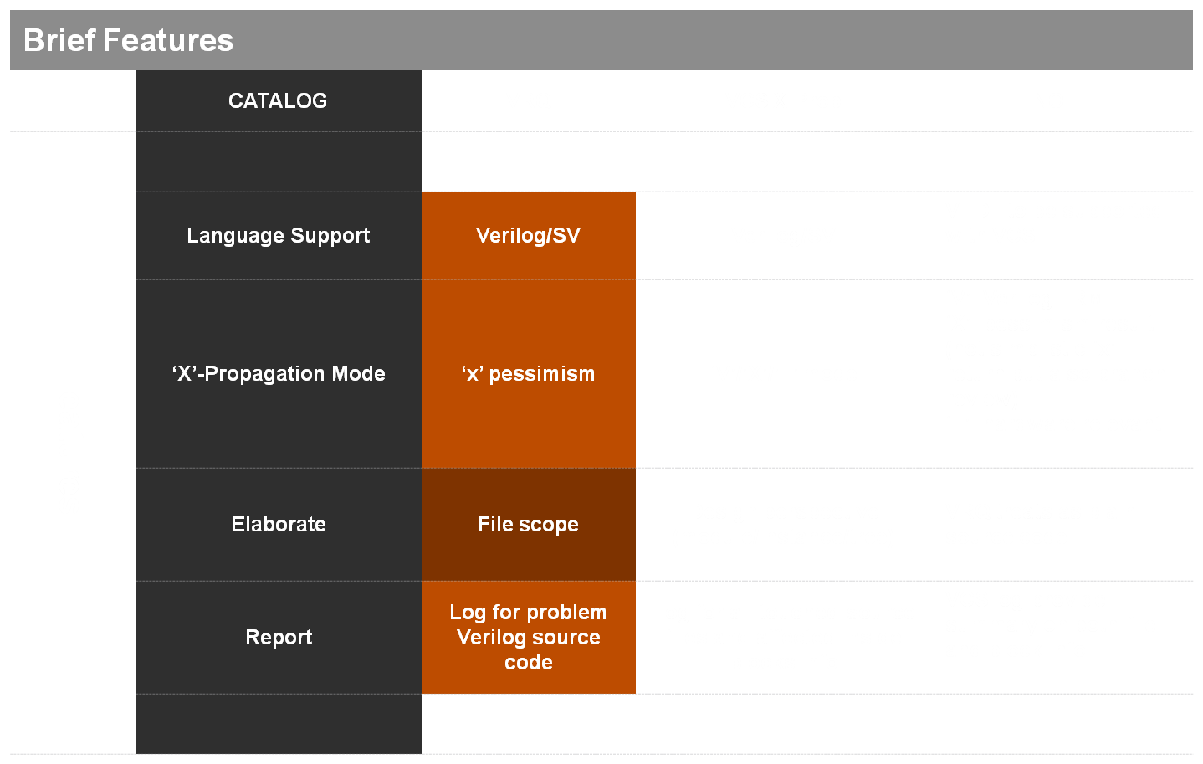
X-PROP TECH OVERVIEW
*improvable*
*not good*

Slide 17
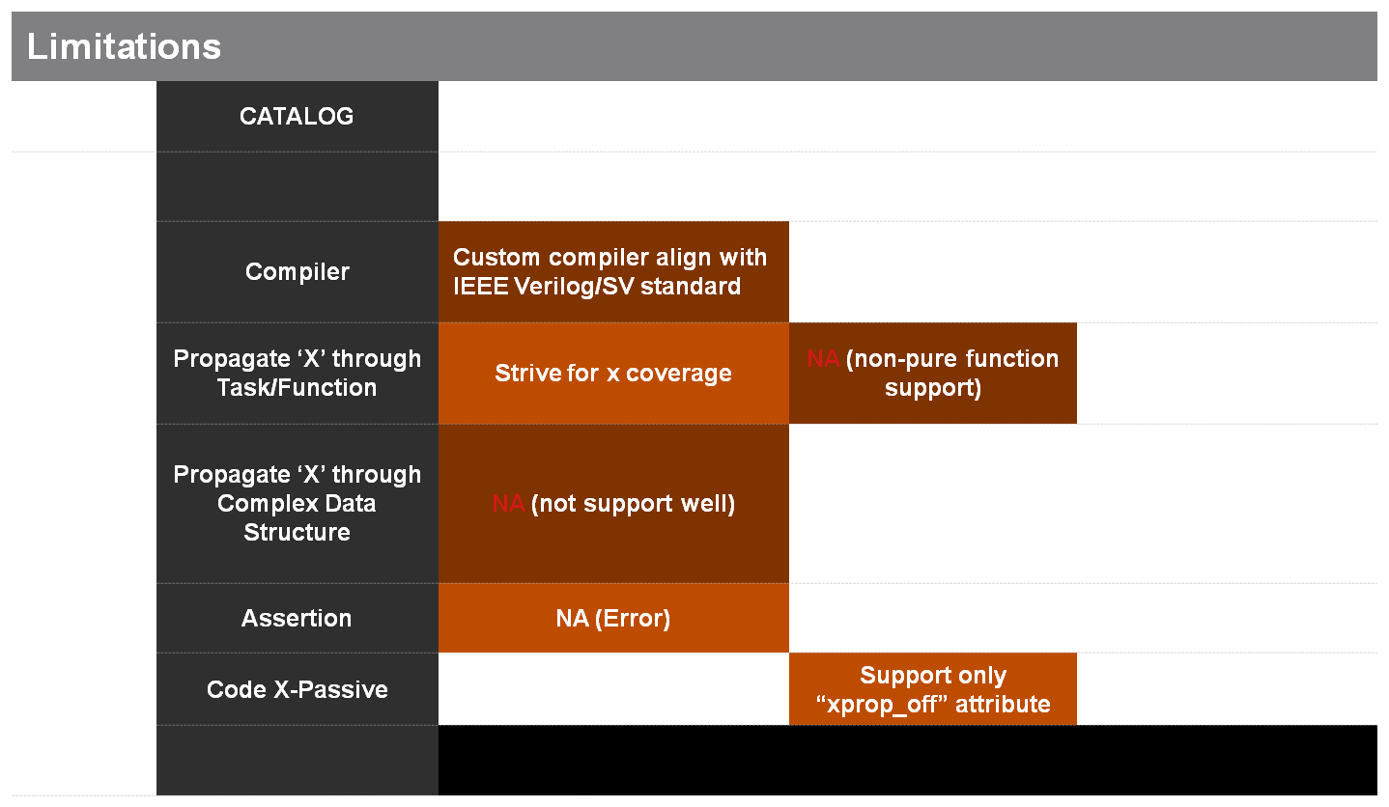
X-PROP TECH OVERVIEW
*improvable*
*not good*

Slide 18
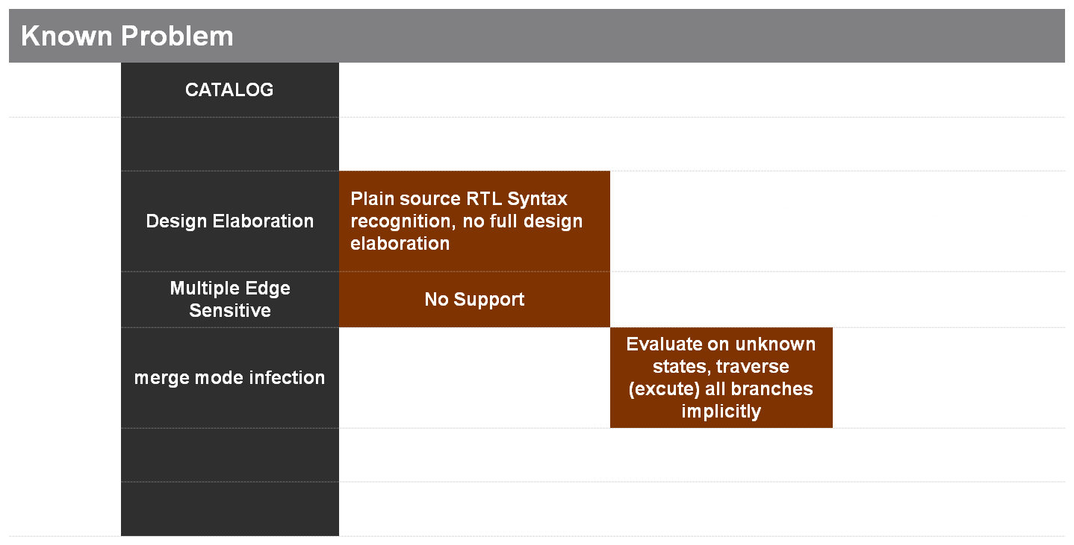
X-PROP TECH OVERVIEW
*improvable*
*not good*

Slide 19
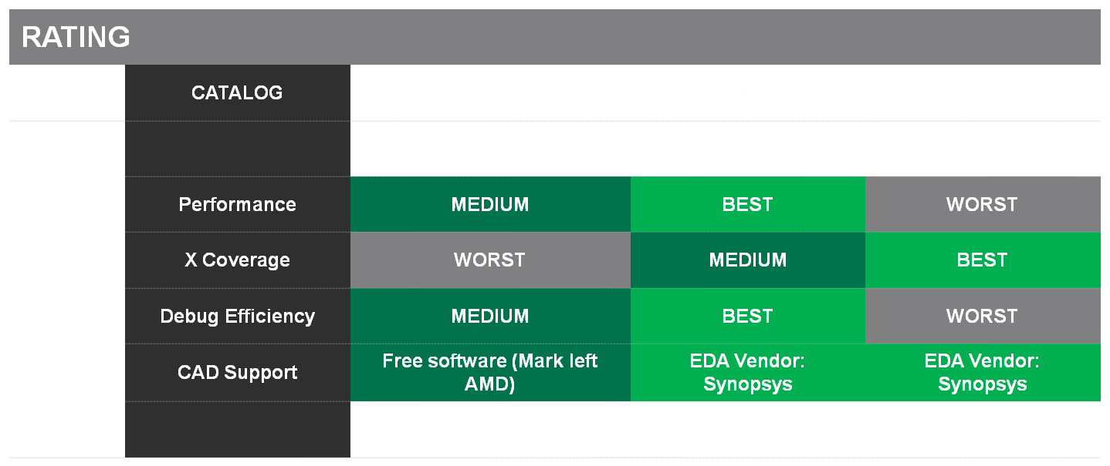
X-PROP TECH OVERVIEW
WORST
MEDIUM
BEST

