Slide 1
ECE 454/750: Distributed Computing Tutorial 1: Thrift Start
TA: Hua Fan
h27fan@uwaterloo.ca
May 12, 2015 05:30-06:20, QNC 2502
Materials derived from thrift web site: thrift.apche.org

Slide 2
Outline
In this tutorial we will discuss:
Slides and source code available: https://ece.uwaterloo.ca/~h27fan/ece454_750/tut1.tar.gz
RPC example
Thrift install
Write .thrift file(IDL)
Generate code from .thrift
Implement simple server and client
Run on same machine /different machines
cross-compile to java 1.6

Slide 3
RPC(remote procedure call)
int add(int a, int b){
Return a+b;
}
int sum=add(2+7);
Remote server
Add(2 + 7)
Local Client
Return:9
Notes:
Why need RPC?
RPC can access the resource of the remote server, such as DB, CPU resource.
For example, what if the local client don’t support a specific “ADD”

Slide 4
Thrift
Open sourced in April 2007 by Facebook.
Communication and data serialization across languages
Steps of writing thrift RPC applications:
1. Write a .thrift file. (Define interface)
2. Using .thrift file to generate source code. (Use code to generate code)
3. Implement your client request and server side handler.
Notes:
This tut focus on how to use RPC, other than implement.

Slide 5
Outline
In this tutorial we will discuss:
Slides and source code available: https://ece.uwaterloo.ca/~h27fan/ece454_750/tut1.tar.gz
RPC example
Thrift install
Write .thrift file(IDL)
Generate code from .thrift
Implement simple server and client
Run on same machine /different machines
cross-compile to java 1.6

Slide 6
Step 0: Install Thrift
Download: http://apache.mirror.vexxhost.com/thrift/0.9.2/thrift-0.9.2.tar.gz
Install instruction: http://thrift.apache.org/docs/BuildingFromSource
Build java lib: cd your_thrift_path/thrift-0.9.2/lib/java ; ant
Copy the tutorial src to your_thrift_path/thrift-0.9.2/tutorial/
eceubuntu: /usr/bin/thrift (0.9.1)
Note: files under your home directory is shared among ecelinuxs and eceubuntu
Notes:
Ecelinux has not install thrift. But not necessary for running code.

Slide 7
Step 1: Write .thrift file
namespace java tutorial
struct Item {
1: i32 key
2: string value
}
service Myservice {
i32 add(1:i32 num1, 2:i32 num2),
Item getItem(1: i32 key),
bool PutItem(1: Item item)
}
Notes:
Fields can be declared "optional", which ensures they will not be included in the serialized output if they aren't set.

Slide 8
Interface Definition Language (IDL)
Available types
bool Boolean, one byte
byte Signed byte
i16 Signed 16-bit integer
i32 Signed 32-bit integer
i64 Signed 64-bit integer
double 64-bit floating point value
string String
binary Blob (byte array)
map<t1,t2> Map from one type to another
list<t1> Ordered list of one type
set<t1> Set of unique elements of one type
Notes:
Thrift Tutorial:https://git-wip-us.apache.org/repos/asf?p=thrift.git;a=blob_plain;f=tutorial/tutorial.thrift

Slide 9
IDL(cont.)
Comments: shell-style (#), C-style (// , /**/)
Include other thrift files: i.e include "shared.thrift“
Typedef: C-style
Define constants: i.e const i32 INT32CONSTANT = 9853
Enums: C-style
Exception : struct can also be exception
Service: Services can inherit from another service using the extends keyword

Slide 10
Step 2: Generate from .thrift
Cmd: thrift --gen java tutorial.thrift
Generate:
gen-java/tutorial/Item.java
gen-java/tutorial/Myservice.java

Slide 11
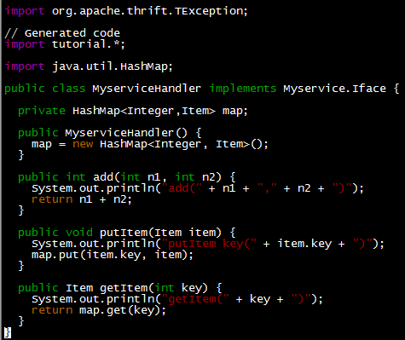
Step 3: Implement server and client

Slide 12
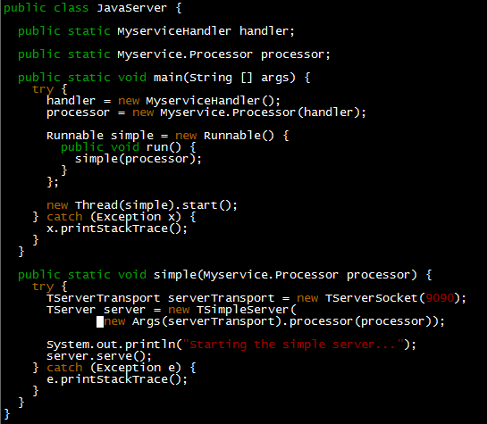
Server-side

Slide 13
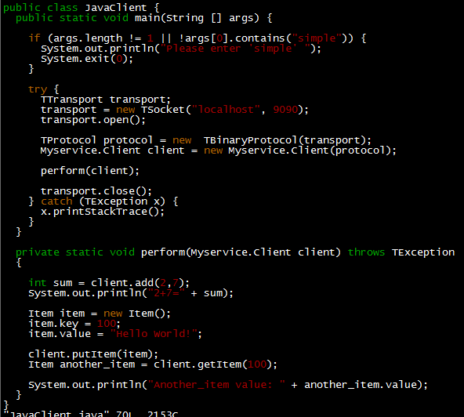
Client-side

Slide 14


Task 1: Run on eceubuntu
eceubuntu compile and run: ant tutorial
Ecelinux: cannot run the thrift IDL compiler because thrift is not installed, but able to run thrift clients and servers if appropriate jars are included in the classpath.(libthrift.jar is complied under your_thrift_path/thrift-0.9.2/lib/java)

Slide 15

Task 2: cross-compile to java 1.6
Problem:
Eceubuntu: java 1.7
Ecelinux: java 1.6
Compile to java 1.6
Solution:
Add source="1.6" target="1.6" under project/target/javac in the build.xml file

Slide 16
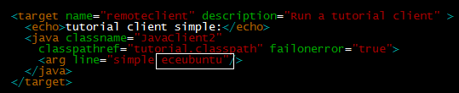
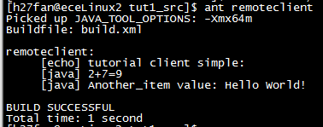
Task 3: Run on different machines
Host name form args line, other than hard-coded.
Delete depends=“compile”, as compiled in eceubuntu
Client running on ecelinux2:

