Slide 1
ECE 454/750: Distributed Computing Tutorial 2: Advanced Thrift
TA: Hua Fan
h27fan@uwaterloo.ca
May 19, 2015 05:30-06:20, QNC 2502

Slide 2
Outline
In this tutorial we will discuss:
Slides and source code available: https://ece.uwaterloo.ca/~h27fan/ece454_750/tut2.tar.gz
Tutorial 1: review
Tutorial 2: set up
RPC review
Generated code analysis
Task 1: Multi-threading servers
Task 2: Async Client
Task 3: Multi-threaded client
Task 4: Experiment small worker number

Slide 3
Tutorial 1: review
tar xzvf thrift-0.9.2.tar.gz
tar xzvf tut1.tar.gz
cp -r tut1_src thrift-0.9.2/tutorial/
cd thrift-0.9.2/lib/java && ant
cd ../../tutorial/tut1_src/ && ant
Notes:
Demo these steps.
Don’t spend too much time
explain to the class what “&&” means.

Slide 4
Tutorial 2: set up
tar xzvf thrift-0.9.2.tar.gz
tar xzvf tut2.tar.gz
cp -r tut2_src thrift-0.9.2/tutorial/
cd thrift-0.9.2/lib/java && ant
cd ../../tutorial/tut1_src/ && ant
cp log4j.properties build

Slide 5
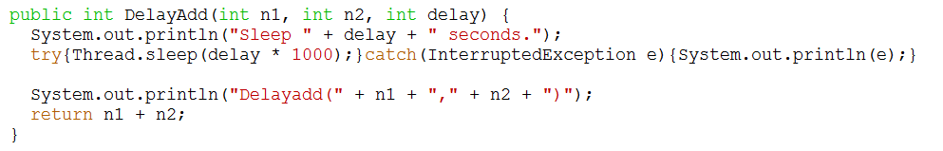
Set up(cont.)
Another RPC used today:
// delay by sleep in seconds, before return.
i32 DelayAdd(1:i32 num1, 2:i32 num2, 3:i32 delay_s)

Slide 6
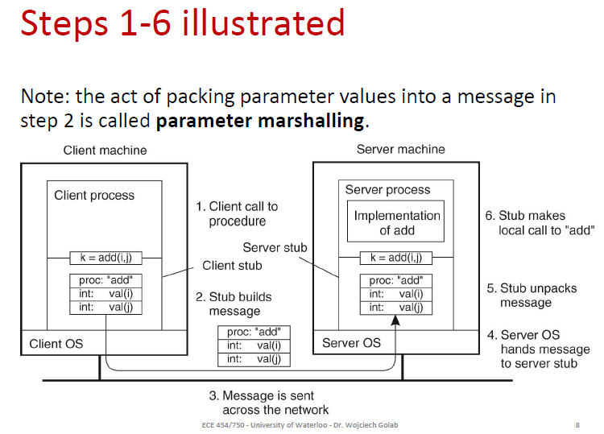
RPC review(lecture slide)
Notes:
1.The client procedure calls invokes the client stub using an ordinary procedure call.
2.The client stub builds a message and calls its local operating system.
3.The client’s OS sends the message to the remote OS.
4.The remote OS delivers the message to the server stub.
5.The server stub unpacks the parameters and calls the server.
6.The server does the work and returns the result to the server stub.
Client stub: send message, receive message
Server stub: receive message, process, send message

Slide 7

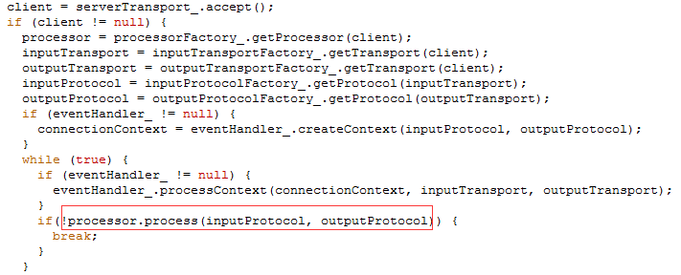
Analysis gen-java/tutorial/Myservice.java
Client class takes the role of client stub
Server takes the role of Server stub, which get message then call processor
TSimpleServer
Notes:
Code snippet from lib/java/……./server/TSinpleServer.java

Slide 8

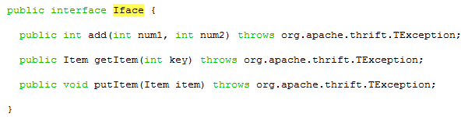
Analysis (cont.)
Processor will call handler
Handler Implements your procedures!
MyserviceHandler.java
Myservice.java

Slide 9
Naming rules
Service name: as defined in .thrift file.
Interface name: Service_name.Iface or .AsyncIface
Synchronous client name: Service_name.Client
Asynchrounous client name : Service_name.AsyncClient
Processor: Service_name.Processor
Notes:
AsyncIface has one addition parameter, a callback object.

Slide 10
Outline
In this tutorial we will discuss:
Slides and source code available: https://ece.uwaterloo.ca/~h27fan/ece454_750/tut2.tar.gz
Tutorial 1: review
Tutorial 2: set up
RPC review
Generated code analysis
Task 1: Multi-threading servers
Task 2: Async Client
Task 3: Multi-threaded client
Task 4: experiment small worker number

Slide 11
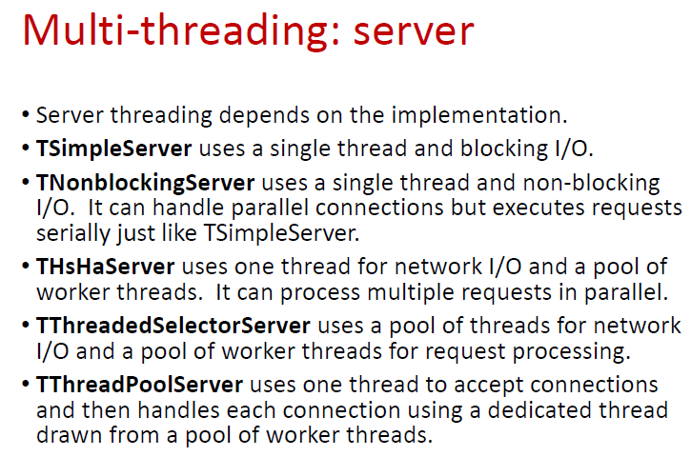
Review thrift servers(from lecture slide)
https://github.com/m1ch1/mapkeeper/wiki/Thrift-Java-Servers-Compared
Notes:
TSimpleServer accepts a connection, processes requests from the
“connection until the client closes the connection,”
and goes back to accept a new connection. Since it is all done in a single thread with blocking I/O, it can only serve one client connection, and all the other clients will have to wait until they get accepted. TSimpleServer is mainly
” used for testing purpose.”
Don't use it in production!
TNonblockingServer The
“select() call returns”
when one ore more connections are ready to be accepted/read/written. But still one thread to execute.
THsHaServer (Half-Sync/Half-Async server) comes into picture. It uses a single thread for network I/O, and a separate pool of worker threads to handle message processing.

Slide 12
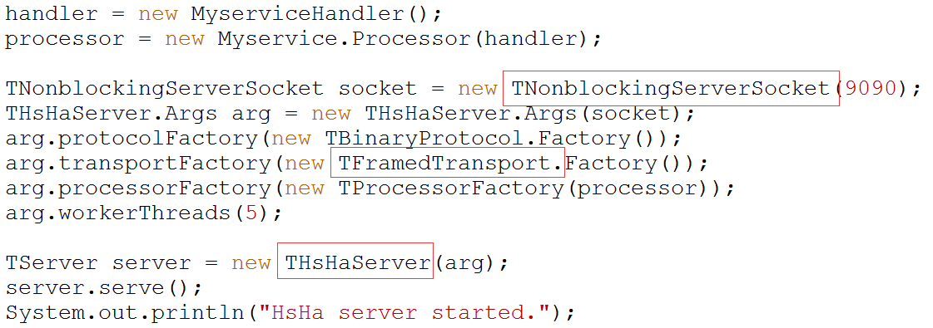
Task 1: Multi-threading servers THsHaServer
Notes:
Simple server:
TServerTransport serverTransport = new TServerSocket(9090);
TServer server = new TSimpleServer(
new Args(serverTransport).processor(processor));
TServerSocket vs nonblocking serversocket
why TFramedTransport is needed and what are its benefits.
Document : TFramedTransport is a buffered TTransport that ensures a fully read message every time by preceding messages with a 4-byte frame size.
must use TFramedTransport to get it to work with an async client. NO document found, but experiment shows that.
arg.workerThreads(5);
To set number of worker threads.

Slide 13
Review async client(from lecture slides)

Slide 14
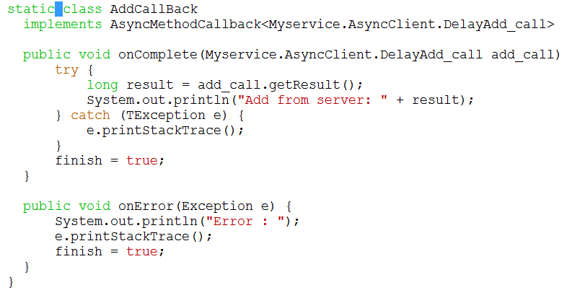
Task 2: Async Client
Callback object: implement onComplete, onError
Callback template type: procedure FUNCTION => FUNCTION_call
Notes:
Use a flag to denote program finish.
FUNCTION_call generated in Myservice.java
“finish” should be declared as a volatile variable.

Slide 15
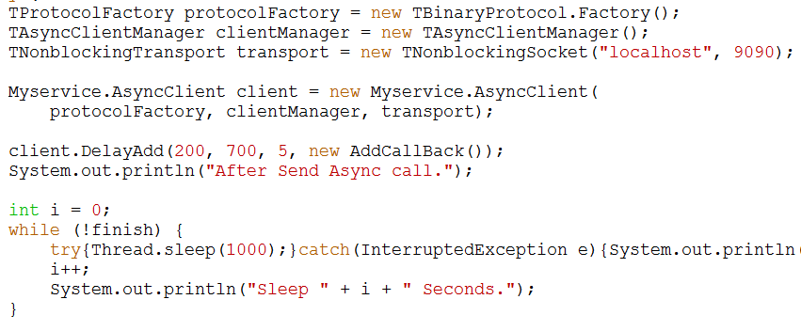
Async Client (cont. )
Notes:
Use while sleep wait for finish

Slide 16
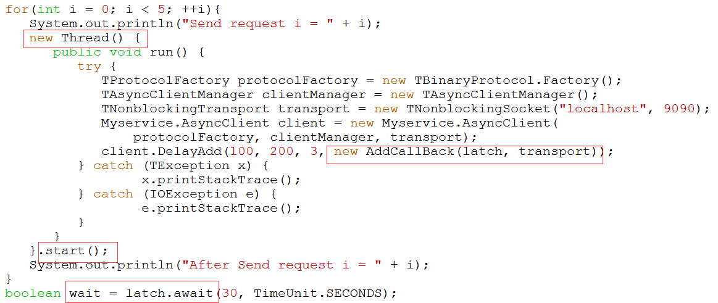
Task 3: Multi-threaded client
static CountDownLatch latch = new CountDownLatch(5);
Notes:
Use latch to wait for all client finish.

Slide 17
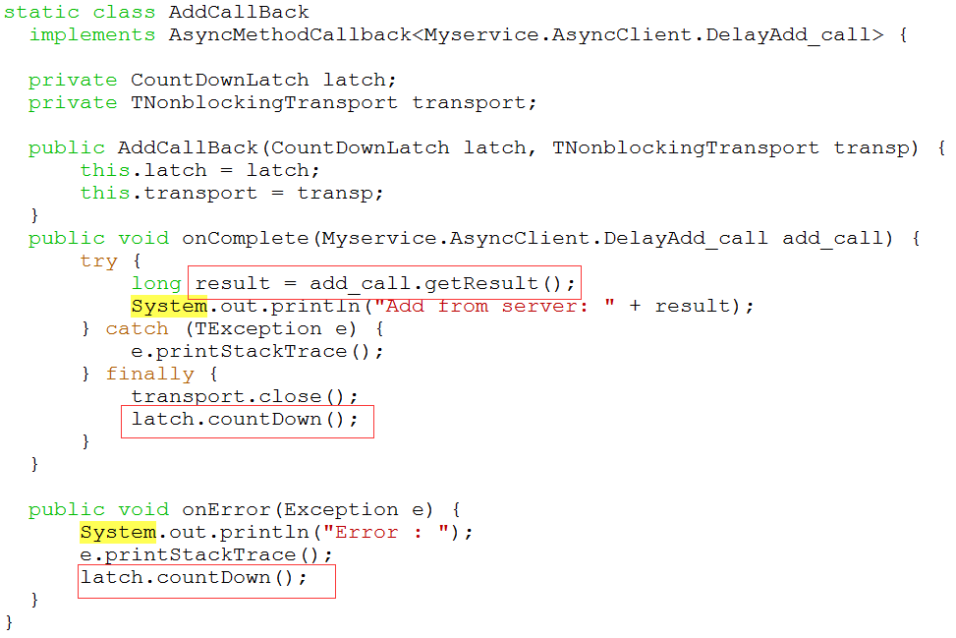
Multi-threaded client(cont.)
Notes:
Run server thread >= 5

Slide 18
Task 4: experiment small worker number
Set worker thread = 2, while 5 client threads concurrent calling
Demo
Notes:
Why?
All request received by only 2 worker to execute(by handler)
Other request are queued

