Slide 1
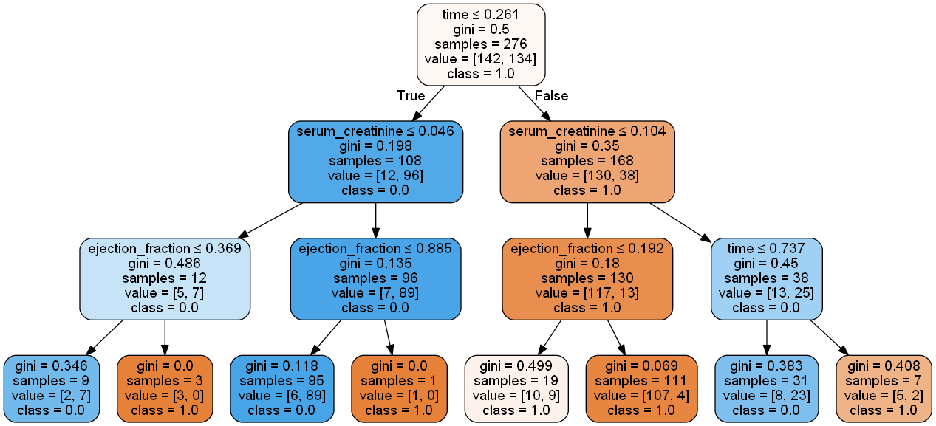
time_1: [[75.514]] ; time_2: [[205.938]] ; ef_1: [[72.525]] ; ef_2: [[27.48]] ; ef_3: [[38.985]] ; sc_1: [[0.9094]] ; sc_2: [[1.4256]]
75.514
0.9094
1.4256
38.985
72.525
27.48
205.93

