Slide 1

Online Retail Industry
Group- 13
Data MINING
MGSC 5126-22

Slide 2
Introduction
As per Adobe Digital Economy Index, UK shoppers spent around £110.6. billion online in 2022.
01
There is a sudden shift from traditional shopping to online shopping.
02
This increased the customer-centric business intelligence.
03

Slide 3
Literature Review
Data-driven approaches have critical role in understanding shopping behaviours and customer segmentation.
Leveraging market basket analysis, RFM model-based segmentation, data mining techniques, and precision marketing strategies enables retailers to gain a competitive edge, enhance customer experiences, and achieve sustainable growth.

Slide 4
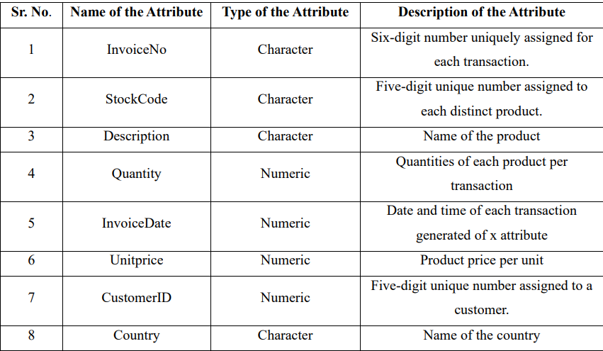
Methodology
Dataset Overview

Slide 5
Pre-processing steps
Load necessary files( reading excel file, data manipulation)
Load dataset and Explore the dataset to understand its structure, such as the columns available and the first few rows of data
Common pre-processing steps include handling missing values, removing duplicate records, and possibly creating new features that could be useful for analysis.
Removing duplicates and creating new feature.

Slide 6
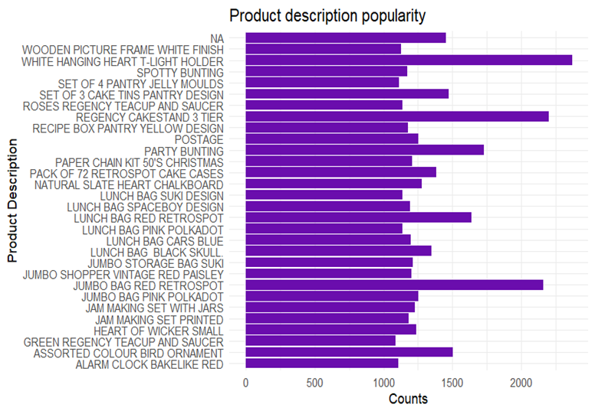
Result and Discussion

Slide 7
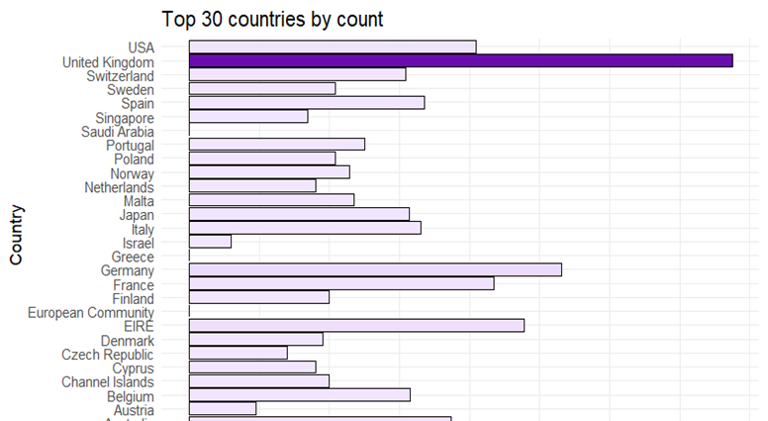
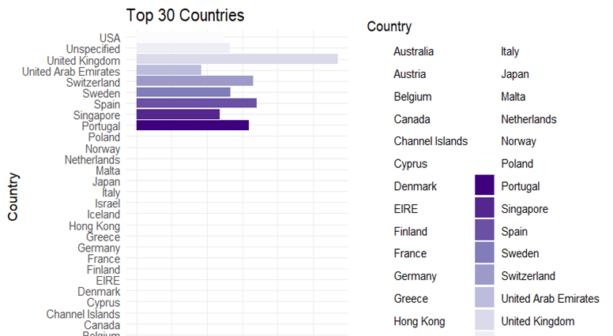
Sales and Return among countries

Slide 8
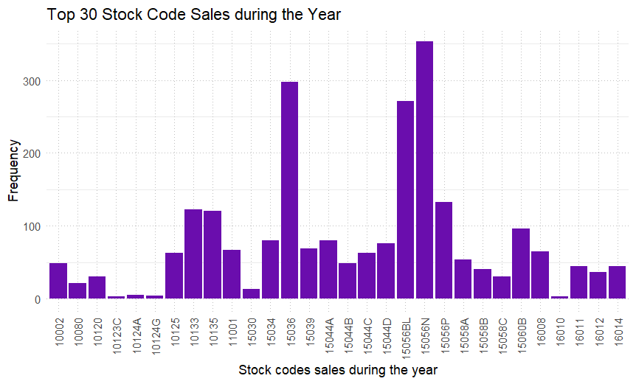
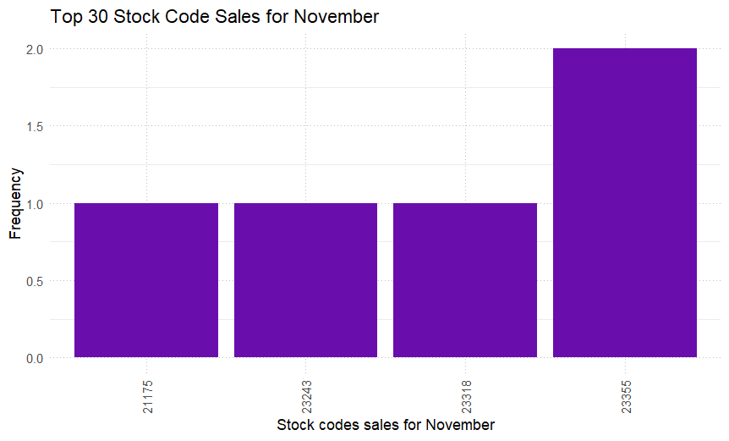
Stock Code in November / Stock Code of Year

Slide 9
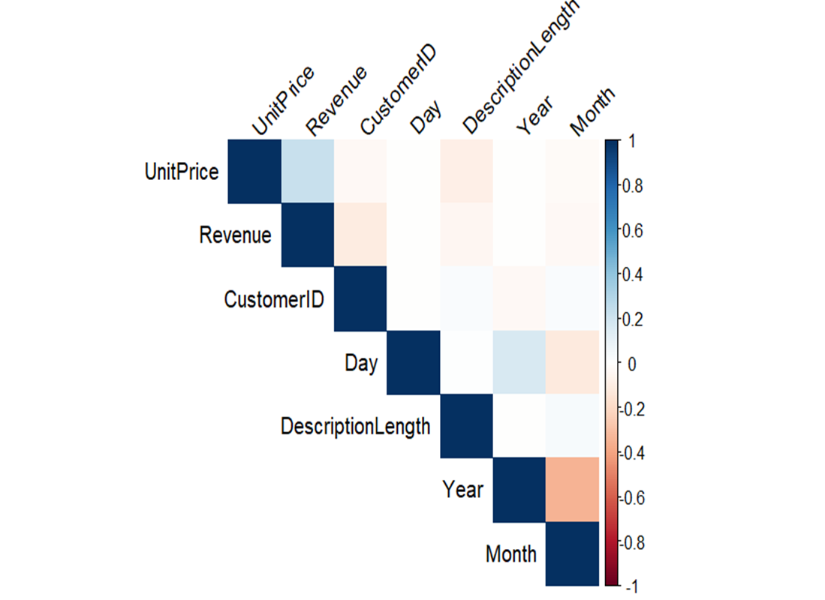
Plot Correlation Matrix
Thus, we can see by correlation matrix how month is related to revenue of the product and its unit price

Slide 10

Conclusion
Using data-driven strategies, online retailers can unlock new opportunities for personalized customer engagement, targeted marketing campaigns, and revenue optimization.

Slide 11
THANK YOU

