Slide 1
Delay or Latency Data from 6 Sites

Slide 2
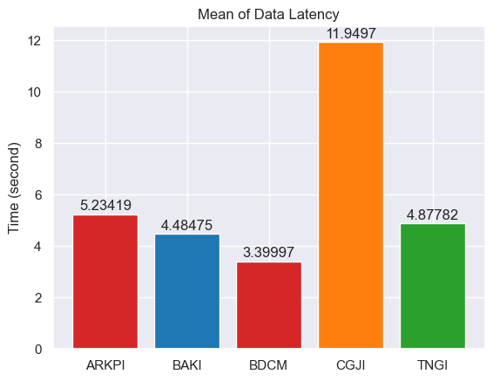
Rata-rata Latency per Site
Site YOGI memiliki rata-rata latency 33.56 jam

Slide 3
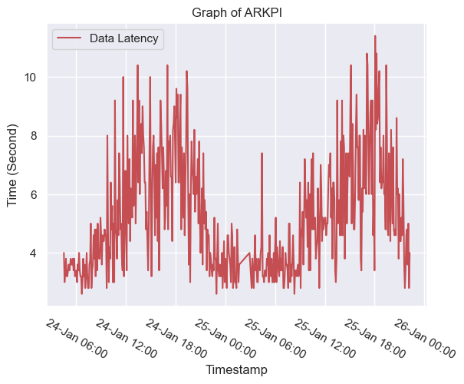
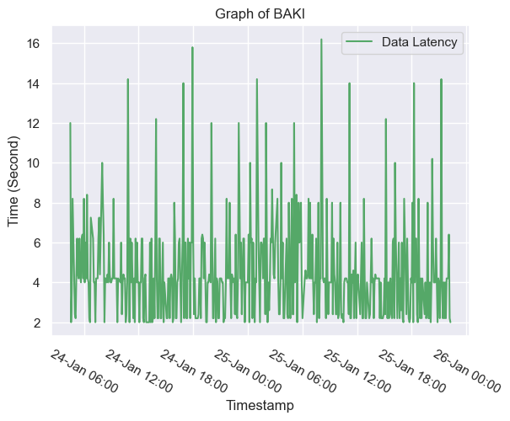
Grafik Latency

Slide 4
