Slide 1
ICLR2020
强化学习相关

Slide 2
ORAL
-RL相关 15/48

Slide 3
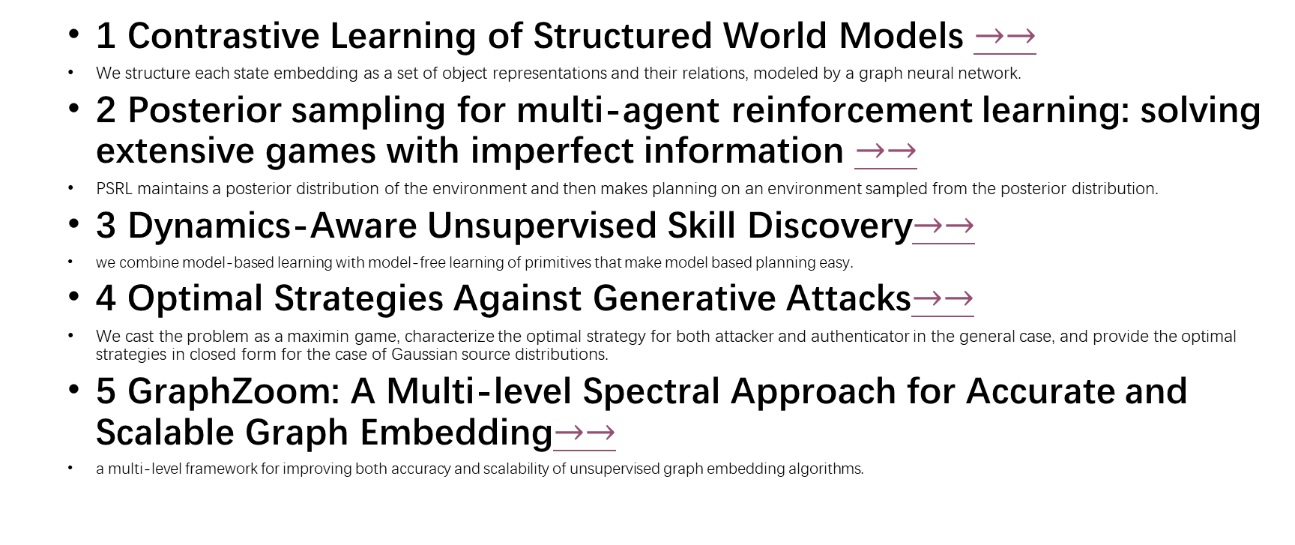
List_oral
1 Contrastive Learning of Structured World Models $→→$
We structure each state embedding as a set of object representations and their relations, modeled by a graph neural network.
2 Posterior sampling for multi-agent reinforcement learning: solving extensive games with imperfect information $→→$
PSRL maintains a posterior distribution of the environment and then makes planning on an environment sampled from the posterior distribution.
3 Dynamics-Aware Unsupervised Skill Discovery$→→$
we combine model-based learning with model-free learning of primitives that make model based planning easy.
4 Optimal Strategies Against Generative Attacks$→→$
We cast the problem as a maximin game, characterize the optimal strategy for both attacker and authenticator in the general case, and provide the optimal strategies in closed form for the case of Gaussian source distributions.
5 GraphZoom: A Multi-level Spectral Approach for Accurate and Scalable Graph Embedding$→→$
a multi-level framework for improving both accuracy and scalability of unsupervised graph embedding algorithms.

Slide 4
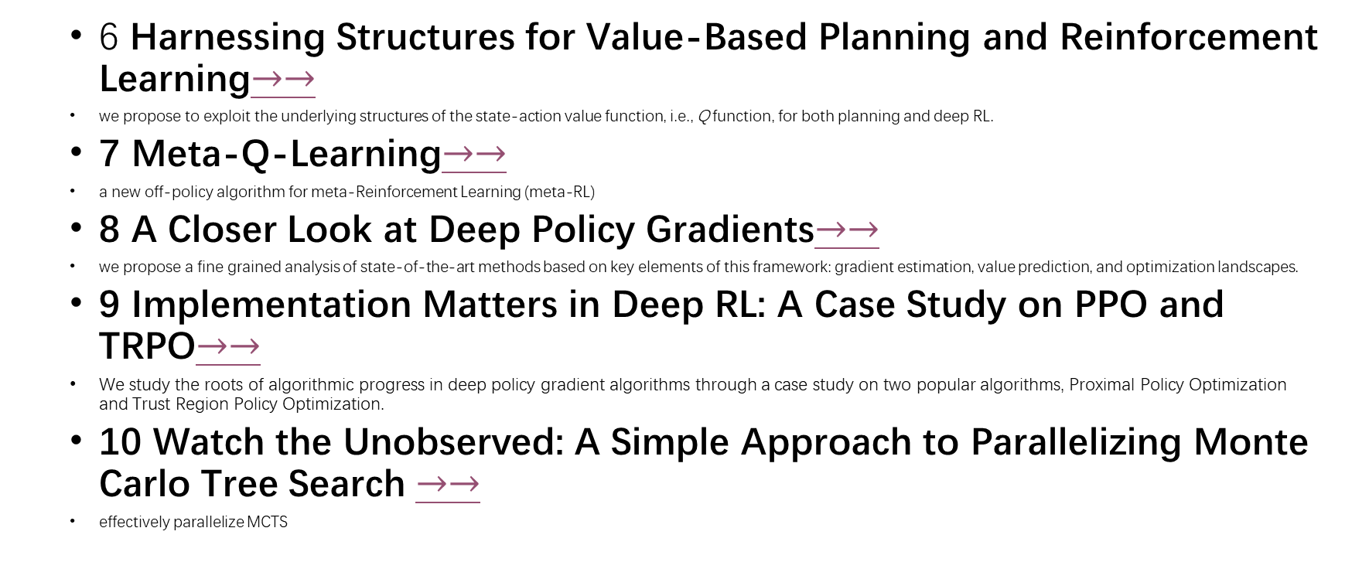
List_oral
6 Harnessing Structures for Value-Based Planning and Reinforcement Learning$→→$
we propose to exploit the underlying structures of the state-action value function, i.e., Q function, for both planning and deep RL.
7 Meta-Q-Learning$→→$
a new off-policy algorithm for meta-Reinforcement Learning (meta-RL)
8 A Closer Look at Deep Policy Gradients$→→$
we propose a fine grained analysis of state-of-the-art methods based on key elements of this framework: gradient estimation, value prediction, and optimization landscapes.
9 Implementation Matters in Deep RL: A Case Study on PPO and TRPO$→→$
We study the roots of algorithmic progress in deep policy gradient algorithms through a case study on two popular algorithms, Proximal Policy Optimization and Trust Region Policy Optimization.
10 Watch the Unobserved: A Simple Approach to Parallelizing Monte Carlo Tree Search $→→$
effectively parallelize MCTS

Slide 5
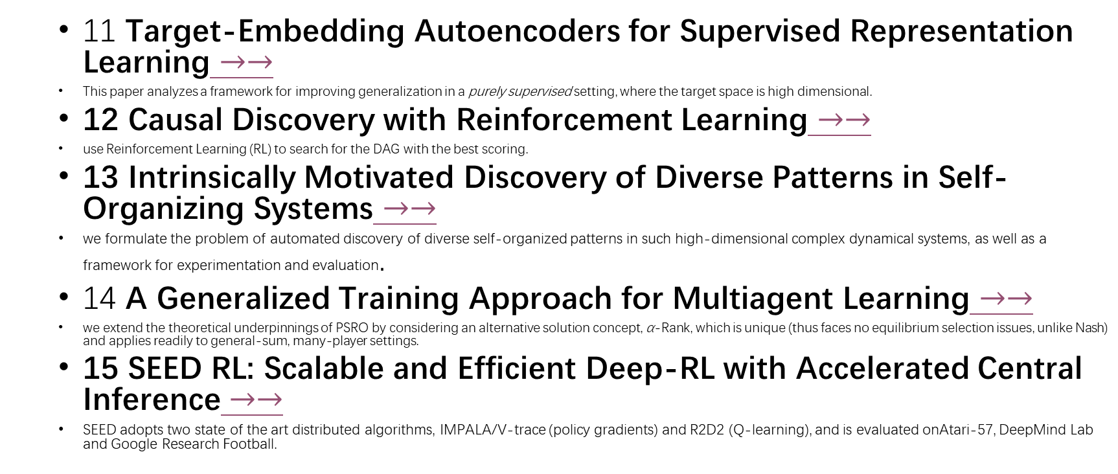
List_oral
11 Target-Embedding Autoencoders for Supervised Representation Learning $→→$
This paper analyzes a framework for improving generalization in a purely supervised setting, where the target space is high dimensional.
12 Causal Discovery with Reinforcement Learning $→→$
use Reinforcement Learning (RL) to search for the DAG with the best scoring.
13 Intrinsically Motivated Discovery of Diverse Patterns in Self-Organizing Systems $→→$
we formulate the problem of automated discovery of diverse self-organized patterns in such high-dimensional complex dynamical systems, as well as a framework for experimentation and evaluation.
14 A Generalized Training Approach for Multiagent Learning $→→$
we extend the theoretical underpinnings of PSRO by considering an alternative solution concept, α-Rank, which is unique (thus faces no equilibrium selection issues, unlike Nash) and applies readily to general-sum, many-player settings.
15 SEED RL: Scalable and Efficient Deep-RL with Accelerated Central Inference $→→$
SEED adopts two state of the art distributed algorithms, IMPALA/V-trace (policy gradients) and R2D2 (Q-learning), and is evaluated onAtari-57, DeepMind Lab and Google Research Football.

Slide 6
POSTER
RL相关

Slide 7

List_oral
1 On Bonus Based Exploration Methods In The Arcade Learning Environment $→→$

Slide 8
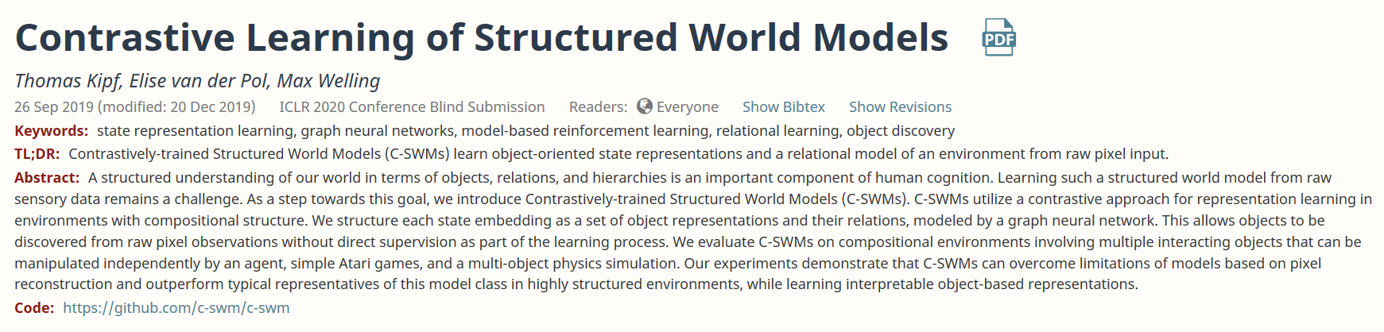
https://openreview.net/forum?id=H1gax6VtDB
Code: https://github.com/c-swm/c-swm
Paper: Contrastive Learning of Structured World Models
Back to list

Slide 9
Abstract
We structure each state embedding as a set of object representations and their relations, modeled by a graph neural network.
Contrastive approach:
目标：学习环境的组织结构

Slide 10
Introduction
从场景的对象，属性，关系，进行分析推理
场景的结构化描述
While most methods in this area require some form of human annotation for the extraction of objects or relations, several recent works study the problem of object discovery from visual data in a completely unsupervised or self-supervised manner (Greff et al.,2017; Nash et al., 2017; van Steenkiste et al., 2018; Janner et al., 2019; Xu et al., 2019; Burgess et al., 2019; Greff et al., 2019; Engelcke et al., 2019).
查之

Slide 11
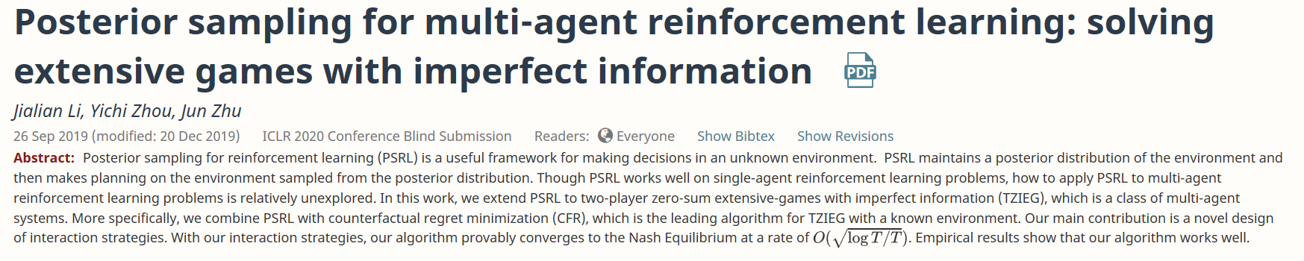
https://openreview.net/forum?id=Syg-ET4FPS
Paper : Posterior sampling for multi-agent reinforcement learning: solving extensive games with imperfect information
Back to list

Slide 12
Abstract
PSRL maintains a posterior distribution of the environment and then makes planning on an environment sampled from the posterior distribution.

Slide 13
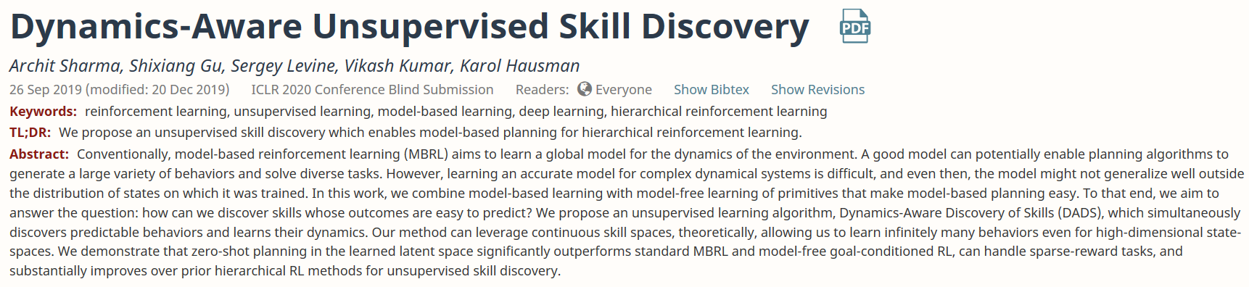
Model based planning
https://openreview.net/forum?id=HJgLZR4KvH
Paper: Dynamics-Aware Unsupervised Skill Discovery
Back to list

Slide 14
Abstract
we combine model-based learning with model-free learning of primitives that make modelbased planning easy.

Slide 15
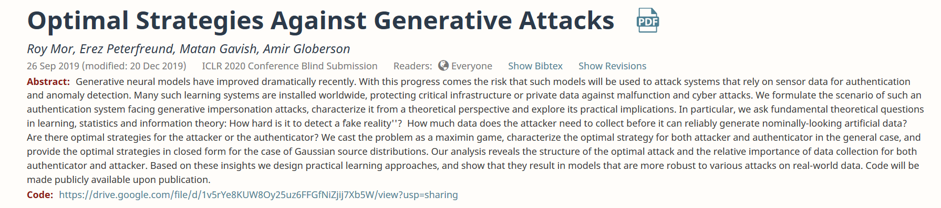
生成对抗
https://openreview.net/forum?id=BkgzMCVtPB
Code: https://drive.google.com/file/d/1v5rYe8KUW8Oy25uz6FFGfNiZjij7Xb5W/view?usp=sharing
Paper ： Optimal Strategies Against Generative Attacks
Back to list

Slide 16
Abstract
We cast the problem as a maximin game, characterize the optimal strategy for both attacker and authenticator in the general case, and provide the optimal strategies in closed form for the case of Gaussian source distributions.

Slide 17
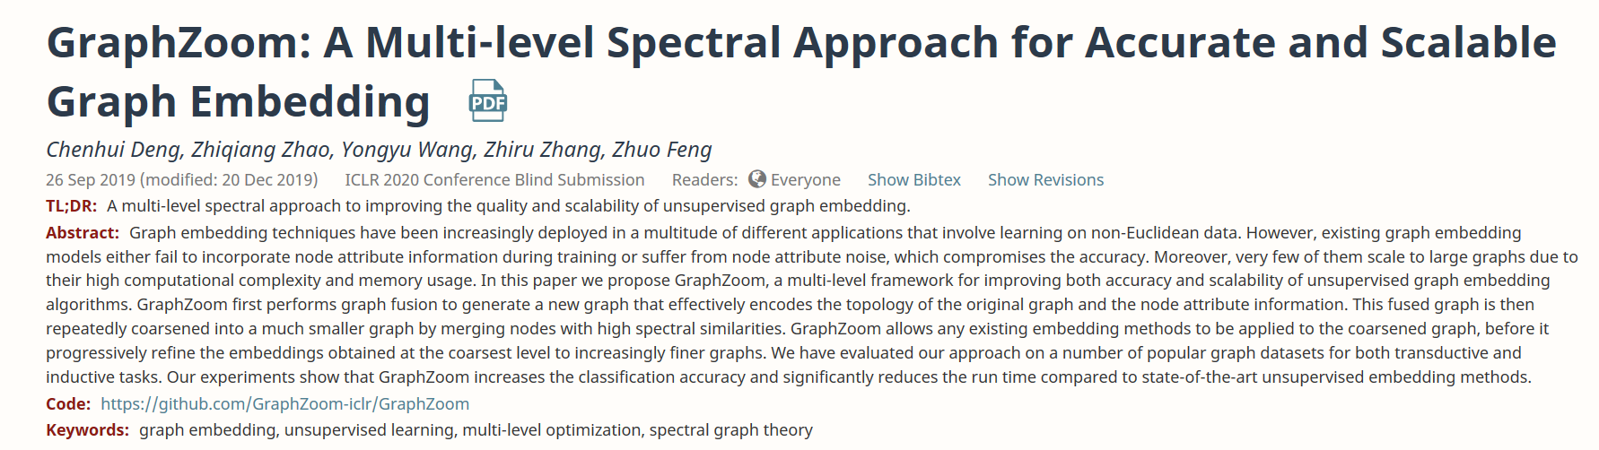
https://openreview.net/forum?id=r1lGO0EKDH
Code: https://github.com/GraphZoom-iclr/GraphZoom
Paper: GraphZoom: A Multi-level Spectral Approach for Accurate and Scalable Graph Embedding
Back to list

Slide 18
Abstract
a multi-level framework for improving both accuracy and scalability of unsupervised graph embedding algorithms.

Slide 19
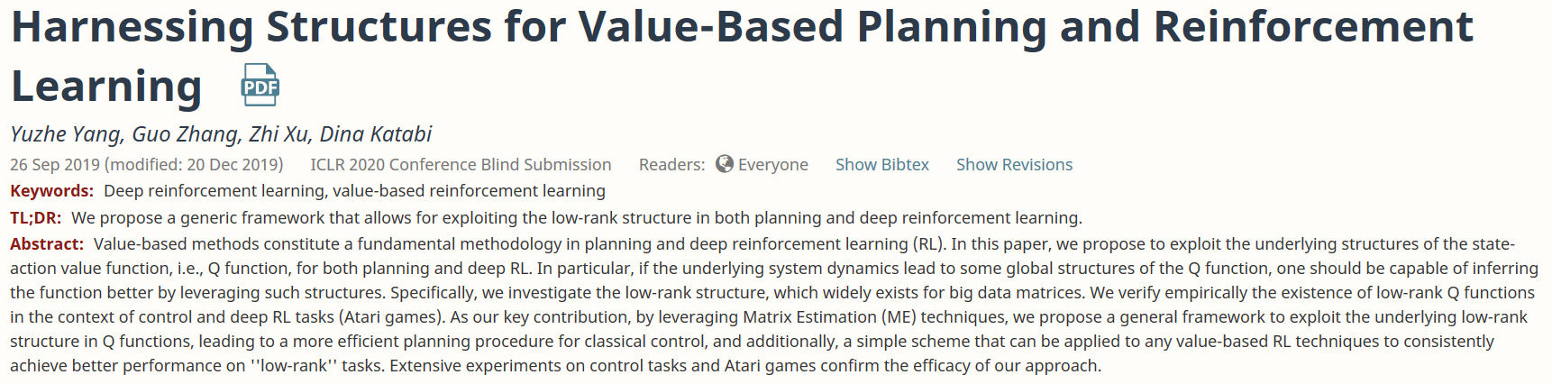
https://openreview.net/forum?id=rklHqRVKvH
Paper: Harnessing Structures for Value-Based Planning and Reinforcement Learning
Back to list

Slide 20
Abstract
we propose to exploit the underlying structures of the state-action value function, i.e., Q function, for both planning and deep RL.

Slide 21

https://openreview.net/forum?id=SJeD3CEFPH
Paper: Meta-Q-Learning
Back to list

Slide 22
Abstract
a new off-policy algorithm for meta-Reinforcement Learning (meta-RL)

Slide 23
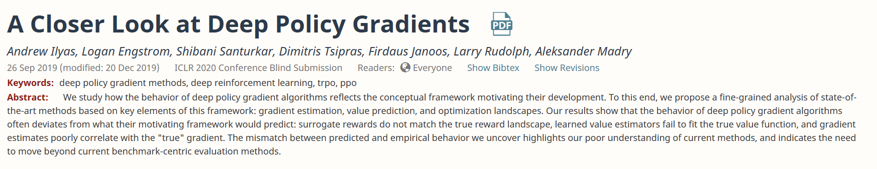
https://openreview.net/forum?id=ryxdEkHtPS
Paper: A Closer Look at Deep Policy Gradients
Back to list

Slide 24
Abstract
we propose a finegrained analysis of state-of-the-art methods based on key elements of this framework: gradient estimation, value prediction, and optimization landscapes.

Slide 25
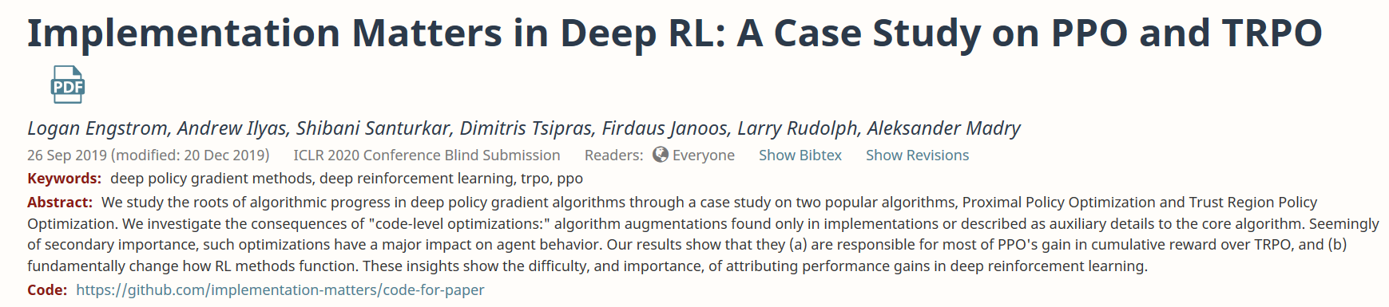
https://openreview.net/forum?id=r1etN1rtPB
Code: https://github.com/implementation-matters/code-for-paper
Paper: Implementation Matters in Deep RL: A Case Study on PPO and TRPO
Back to list

Slide 26
Abstract
We study the roots of algorithmic progress in deep policy gradient algorithms through a case study on two popular algorithms, Proximal Policy Optimization and Trust Region Policy Optimization.

Slide 27
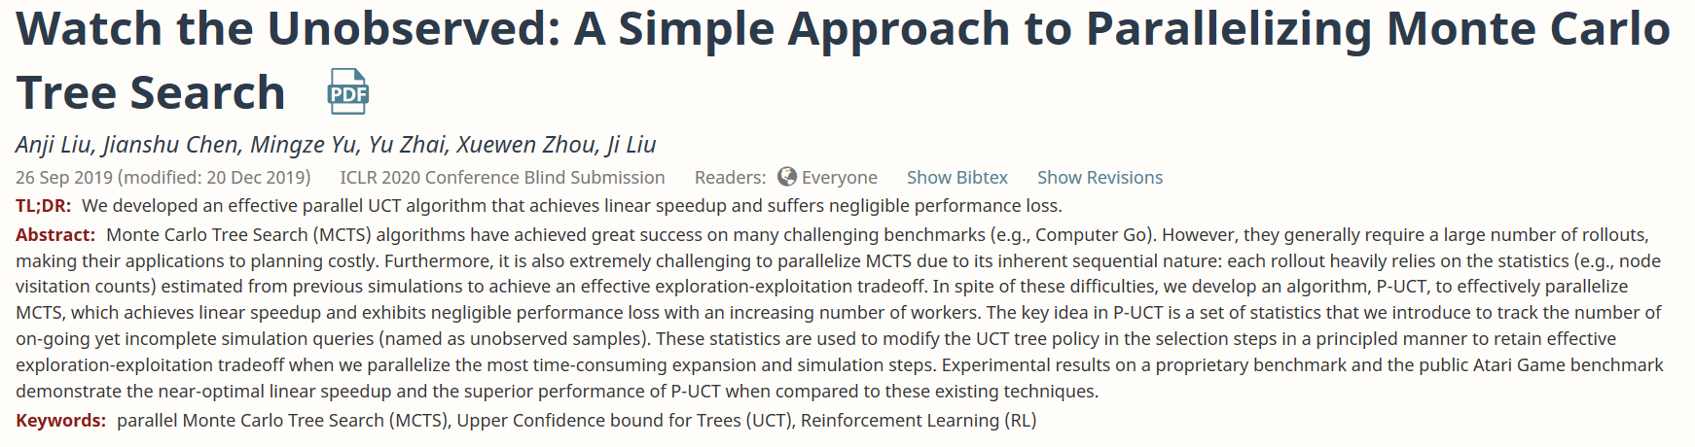
https://openreview.net/forum?id=BJlQtJSKDB
Paper: Watch the Unobserved: A Simple Approach to Parallelizing Monte Carlo Tree Search
Back to list

Slide 28
Abstract
effectively parallelize MCTS

Slide 29
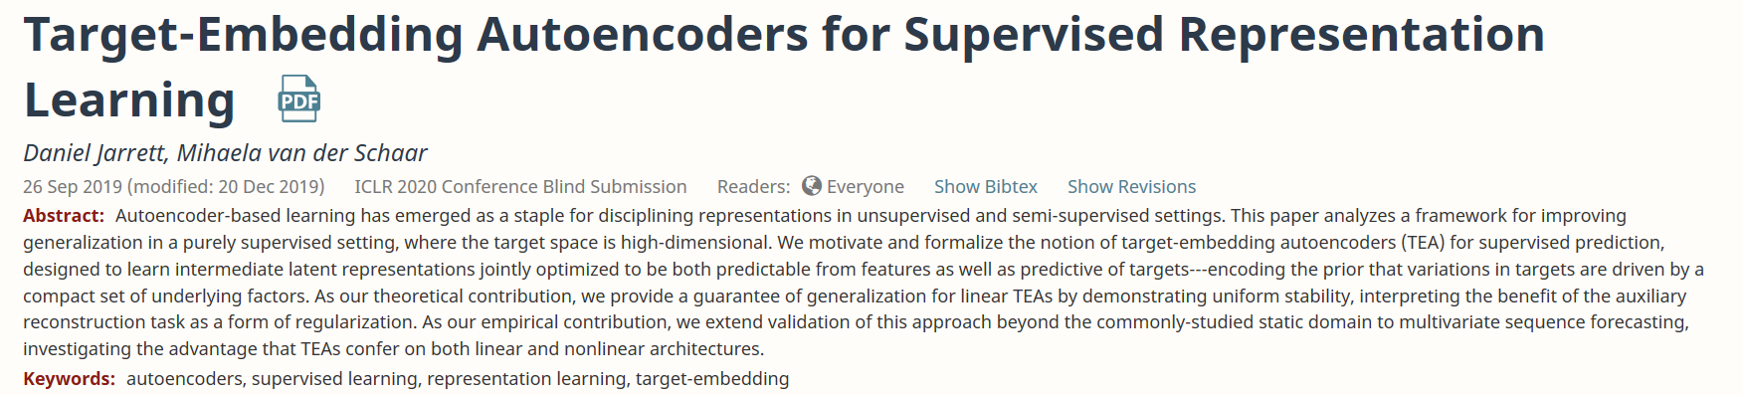
https://openreview.net/forum?id=BygXFkSYDH
Paper: Target-Embedding Autoencoders for Supervised Representation Learning
Back to list

Slide 30
Abstract
This paper analyzes a framework for improving generalization in a purely supervised setting, where the target space is high dimensional.

Slide 31
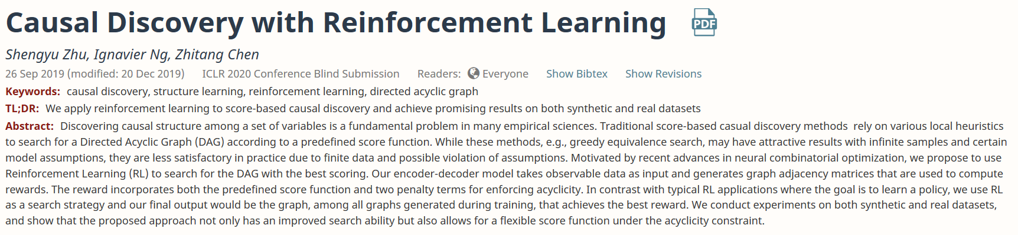
https://openreview.net/forum?id=S1g2skStPB
Paper: Causal Discovery with Reinforcement Learning
Back to list

Slide 32
Abstract
use Reinforcement Learning (RL) to search for the DAG with the best scoring.

Slide 33
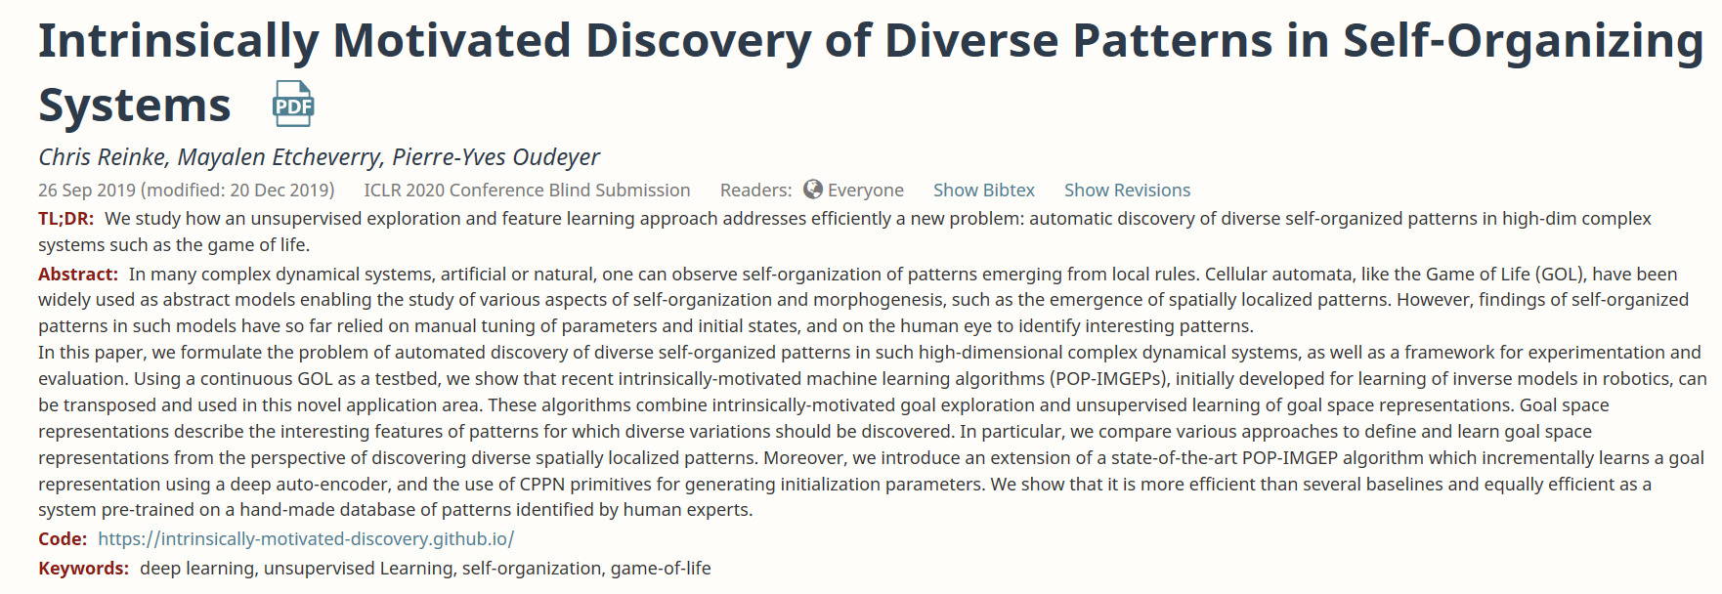
https://openreview.net/forum?id=rkg6sJHYDr
Code: https://intrinsically-motivated-discovery.github.io/
Paper: Intrinsically Motivated Discovery of Diverse Patterns in Self-Organizing Systems
Back to list

Slide 34
Abstract
we formulate the problem of automated discovery of diverse self-organized patterns in such high-dimensional complex dynamical systems, as well as a framework for experimentation and evaluation.

Slide 35
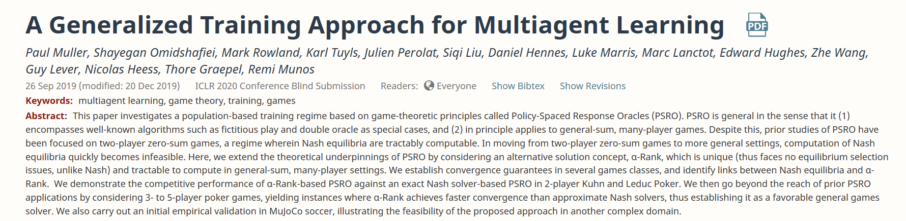
https://openreview.net/forum?id=rkg6sJHYDr
Code: https://intrinsically-motivated-discovery.github.io/
Paper: A Generalized Training Approach for Multiagent Learning
Back to list

Slide 36
Abstract
we extend the theoretical underpinnings of PSRO by considering an alternative solution concept, α-Rank, which is unique (thus faces no equilibrium selection issues, unlike Nash) and applies readily to general-sum, many-player settings.

Slide 37
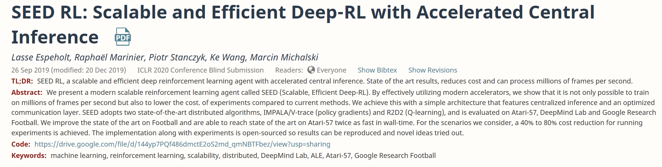
https://openreview.net/forum?id=rkgvXlrKwH
Code: https://drive.google.com/file/d/144yp7PQf486dmctE2oS2md_qmNBTFbez/view?usp=sharing
Paper: SEED RL: Scalable and Efficient Deep-RL with Accelerated Central Inference
Back to list

Slide 38
Abstract
SEED adopts two state of the art distributed algorithms, IMPALA/V-trace (policy gradients) and R2D2 (Q-learning), and is evaluated onAtari-57, DeepMind Lab and Google Research Football.

Slide 39
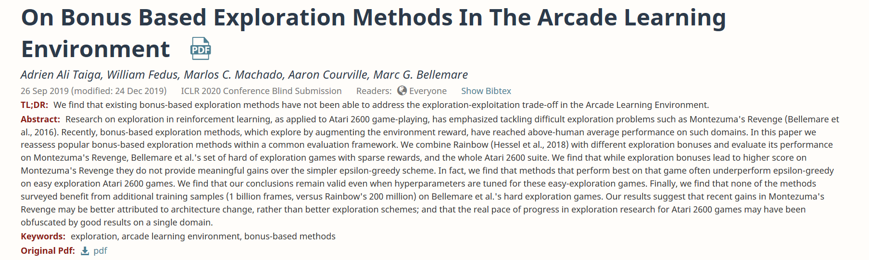
Paper: On Bonus Based Exploration Methods In The Arcade Learning Environment
https://openreview.net/forum?id=BJewlyStDr&noteId=BJewlyStDr
Back to list

Slide 40
Abstract

