Slide 1
群体行为分析综述
主要参考：
Li T, Chang H, Wang M, et al. Crowded scene analysis: A survey[J]. IEEE transactions on circuits and systems for video technology, 2015, 25(3): 367-386.
赵炜琪. 监控场景下群体行为分析研究[D].中国科学院大学,2017
J. C. S. Jacques, S. R. Musse, and C. R. Jung, “Crowd analysis using computer vision techniques,” IEEE Signal Process. Mag., vol. 27, no. 5, pp. 66–77, Sep. 2010.
.Zhan, D. N. Monekosso, P. Remagnino, S. A. Velastin, and L.-Q. Xu, “Crowd analysis: A survey,” Mach. Vis. Appl., vol. 19, nos. 5–6, pp. 345–357, 2008.
.
Notes:
为什么讲这个综述？两个原因，第一个是前几天投了篇文章，然后被以各种理由各种reject，其中几个评审意见都关注的就是related work 和实验对比部分，这里借着组会的机会对所研究的问题做一个总结；第二个原因，也希望大家对我的工作有一个全面的了解，能在遇到相关的文章或者idea的时候能提供一些借鉴和帮助。

Slide 2
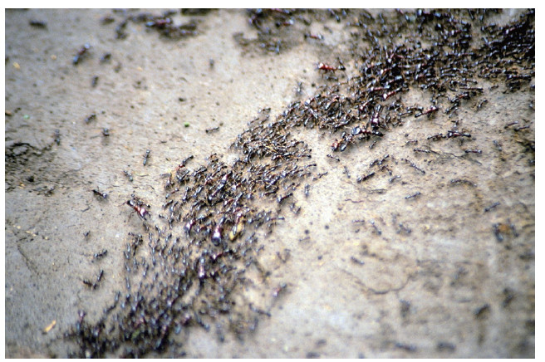
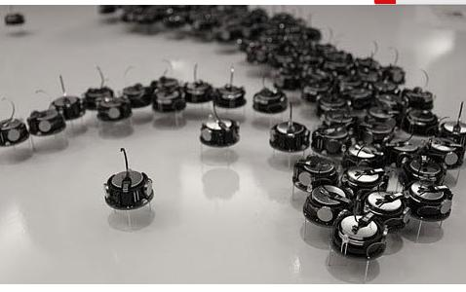
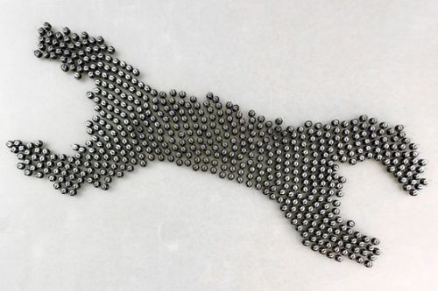
什么是群体行为？
The crowd has been defined as a large group of individuals in the same physical environment, sharing a common goal [1].
Notes:
特定的物理环境中，大量个体行为的集合。这里的行为在大多数环境中是指有一定目的的运动。做参考文献列表，提这些的目的并不是要研究它们，只是这些研究领域会有一些共同的特质，所以，彼此的方法上可能会有借鉴，希望有关注到的能够共同交流。我们主要的研究对象还是专注于监控视频的。

Slide 3
群体行为分析的主体：
生命体：人群、蚁群、蜂群、神经信号等的行为分析；
非生命体：社交网络的分析、智能体群组的控制、宏观经济分析调控；
二者的结合：人机协同行为的分析与控制
计算机视觉
监控场景下的人群行为分析
Notes:
随着对群体中个体的定义不同，应用场景也会有很多的不同。

Slide 4
监控场景下的人群行为分析
分析要素有哪些？1.作为视频，被看做是数据点的模式识别；
2.作为生物群体，有社会属性和自然属性
社会属性中包含了人与人的关系，人与环境的关系
自然属性中包含了各种表观信息形状颜色等
Notes:
可以考虑跟后面的应用场景换一下

Slide 5
什么是群体行为？是计算机视觉与认知科学的交叉,
The crowd has been defined as a large group of individuals in the same
physical environment, sharing a common goal [39].
应用场景有哪些？监控、社交网络、神经信号传播、蚁群蜂群、
智能体群组的控制、宏观经济分析调控
分析要素有哪些？1.作为视频，被看做是数据点的模式识别；
2.作为生物群体，有社会属性和自然属性
社会属性中包含了人与人的关系，人与社会的关系
自然属性中包含了各种表观信息形状颜色等
监控场景的应用有哪些？异常行为检测（anomaly detection）
行为分析（motion analysis）
密度估计（）
群体计数
群体行为的仿真与控制
主要思路：
主要方法有哪些？针对的任务是什么？

Slide 6
Real-world Applications of crowded scene analysis:
Crowd flux statistics 人群流量统计
Visual Surveillance:
Congestion analysis 拥堵分析
[2,3]
Anomaly detection 异常检测
[4]
Crowd management: the crowded scene analysis can be used to develop crowd
management strategies and assist the movement of the
crowd or individuals, to avoid the crowd disasters and ensure
the public safety[5,6]
Public Space Design : The analysis of crowd dynamics and its relevant ﬁndings can
provide some guidelines for public space design, and therefore
increase the efﬁciency and safety of train stations, airport
terminals, theaters, public buildings, and mass events in the future.[7,8]
Entertainment: the establishment of mathematical models can provide more accurate
simulation, which can be used in computer games, ﬁlm, and
television industries.Some recent works have been proposed to
synthesize crowd videos with realistic microscale behavior .[9]
群体中智能体的控制：在生物与人造智能体共存的环境中实现群体协调和控制
Notes:
介绍一些实际应用，最好能在各个文章中找到相关应用场景的图片, 文献【21~28】,[7,8]感觉意义不大可以删了

Slide 7
接下来进入研究方法的综述

Slide 8
Video analysis & Scene understanding
crowd Scene understanding
extreme clutters, severe occlusions, and ambiguities
Object detection
难点1.the mechanics of human crowds are complex because a crowd exhibits both dynamics and psychological charac-teristics, which are often goal directed.
tracking
难点2.the specific crowd behaviors needed to be detected and classified may be both rare and subtle , and in most surveillance scenarios, these behaviors have few examples to learn.
Behavior recognition
crowd Scene understanding
Feature extraction
Segmentation
Model learning
Notes:
删除

Slide 9
Video analysis & Scene understanding
Object detection
tracking
crowd Scene understanding
Behavior recognition
Feature extraction
Segmentation
Model learning

Slide 10
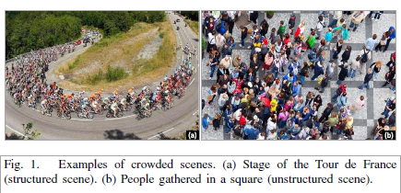
crowd Scene 分两类 (有图为证)
structured :the crowd moves coherently in a common direction, the motion direction
does not vary frequently, and each spatial location of the scene contains only
one main crowd behavior over the time.
Unstructured: participants move in different directions at different times, and each
spatial location contains multiple crowd behaviors.
Notes:
场景本身的分类：有两种：structured unstructured
任务分类： 有两种：宏观任务；微观任务

Slide 11
crowd Scene 分两类
At the macroscopic level, we are interested in the global motions of a mass of
people, without concerning the movements of any individual;
at the microscopic level, we concern the movements of each individual pedestrian
and do analyze according to the collective information of them.
Notes:
按任务分类：两种，配图

Slide 12
Models in Crowd Dynamics (群体动力学模型)
the study of how and where crowds form and move above the critical density level [41],
and how individuals in the crowd interact with each other to inﬂuence the crowd status.
computational modeling
of crowd behavior
continuum-based approach： medium- and high-density crowds
the crowd is treated as a physical ﬂuid with particles
[43,44] ,thus a lot of analytical methods from statistical
mechanics and thermodynamics are introduced
Macroscopic level
agent-based approach：low-density crowds
individuals in the crowd are considered as
autonomous agents which actively sense the
[41,45] environment and make decisions according to
some predefined rules
microscopic level
SFM
Notes:
背景介绍，群体动力学，是一个从社会学和心理学引入的理论，建模的两种方式，一种是机理建模，另一种是实验建模，,这个是机理建模的部分,[44]要重点瞅瞅（图多）

Slide 13
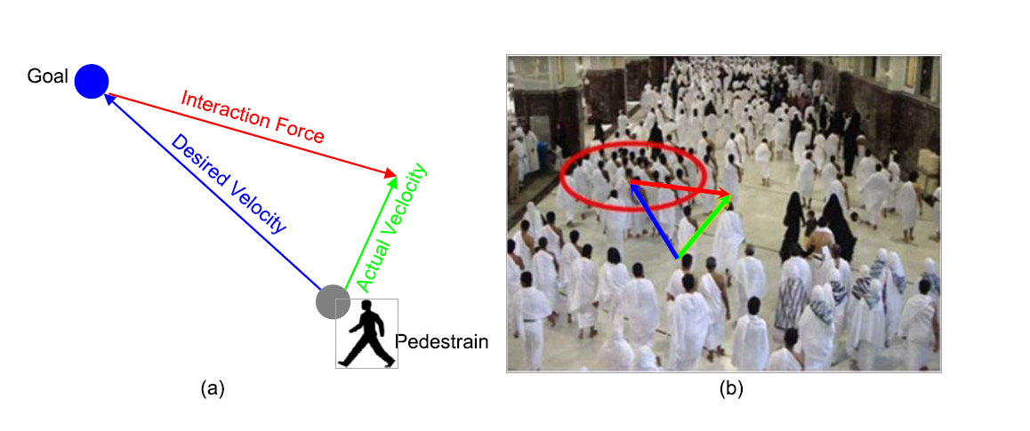
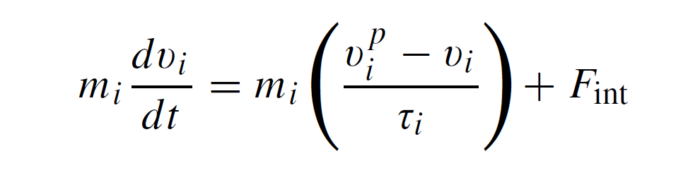
Social Force Model（SFM）
Notes:
用一个式子表示这种个体之间的作用关系以及个体与场景之间的作用关系，int 表示interaction ，p 表示purpose ，F=ma ;有一定的使用场景，一就是人群不能太密集，至少要能区分出个体，二是相机视角，研究目标不能有过多的遮挡。

Slide 14
以上是来自其他领域的知识，接下来要讨论视觉领域的建模和应用方法；
大部分视觉方法的步骤都是
crowd Scene understanding
Feature extraction
Segmentation
Model learning

Slide 15
Motion representation in crowded scenes
ﬂow-based features: extracted densely on the pixel level.
local spatiotemporal features: local information from (2-D) patches or 3-D cubes.
trajectory/tracklet: compute the individual tracks
Deep learning based feature：encode video by auto-coder and LSTM
Notes:
主流的特征有三种,外加一种deeplearning 特征

Slide 16
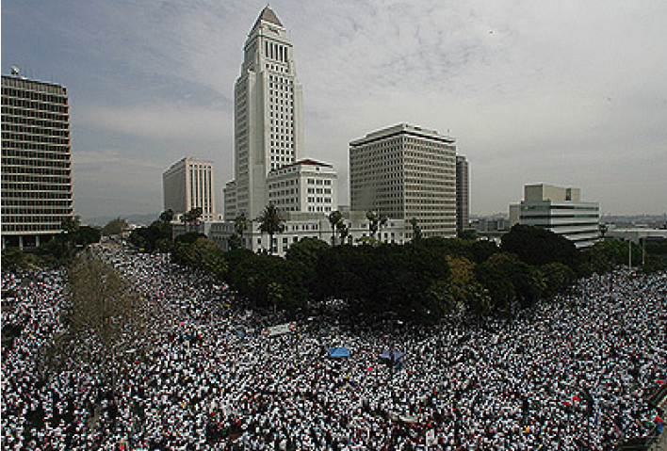
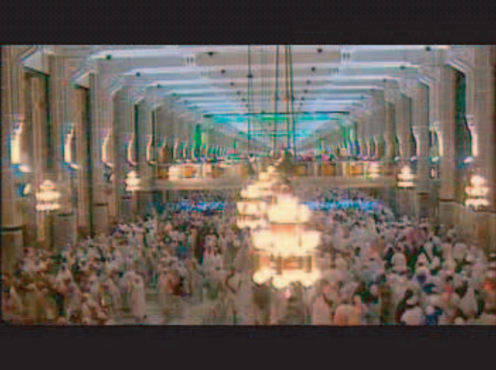
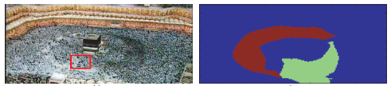
ﬂow-based features
high-density crowded scenes, tracking is difﬁcult and unfeasible
Optical Flow,
Particle Flow, spatial changes are ignored, and time delay is significant.
Streak Flow,
Notes:
适用于人流密度大，无法准确区分个体轨迹，多数用来研究整体问题,(插图一幅【53】,[12])，关注于场景中有哪些行为模式，对高密度群体进行行为模式的分割，而不关心这些模式具体由那个个体完成。【13】中对它们三个进行了对比。

Slide 17
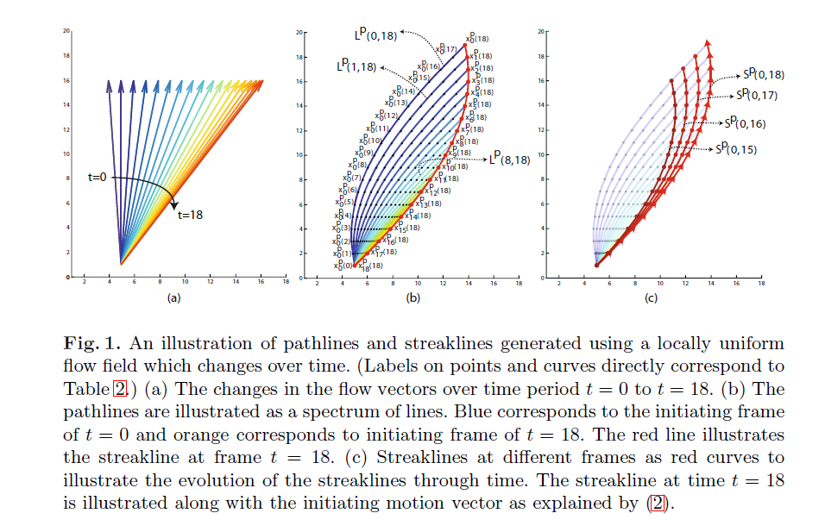

Slide 18
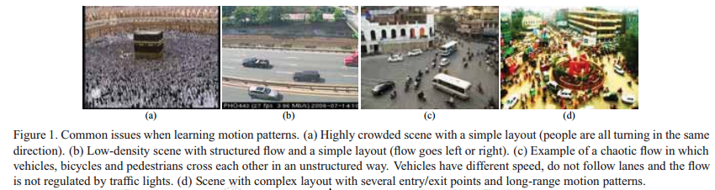
local spatiotemporal features:
exploit the dense local motion patterns created by the subjects,
and model their spatio-temporal relationships to represent the
underlying intrinsic structure they form in the video
Spatiotemporal Gradients:
Motion Histogram:
Notes:
图来自【19】

Slide 19
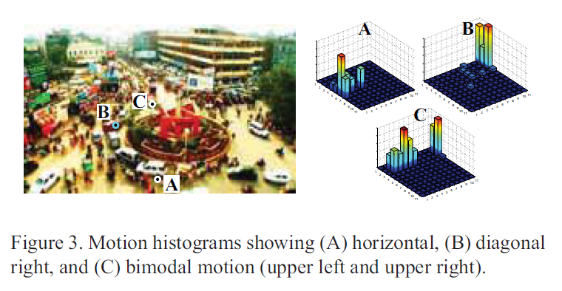
Notes:
对每个点计算各个帧的光流统计量，作为特征，也有很多的改进版本，不做详细介绍

Slide 20
trajectory/tracklet:
more semantic
A tracklet is a fragment of a trajectory obtained by the tracker within a short period.
Notes:
轨迹特征更具语义性，所以用的人比较多，但是也存在问题，就是个体间遮挡严重时，我们跟踪变得很困难，所以更多的人把研究的目标转向了片段轨迹的研究，片段轨迹的定义如下：
片段轨迹有两类方法，一种是把它连起来；一种是通过轨迹所经过的区域进行聚类。

Slide 21
Multi-Channels CNN:
3D CNN:
Slicing CNN :
LSTM:输入是轨迹
Auto encoder:
Notes:
Deep learning feature，大部分针对异常行为检测，即将视频分为正常帧和异常帧两类，并不关心正常帧中具体，有什么样的行为模式,因此需要解决的就是时序的引入问题

Slide 22
评：
1.For outdoor scenes, often with wide field of view but low resolution for each target
aim to analyze the holistic crowd motion trends
optical ﬂow
2.For indoor scenes, he resolution of a single target is high enough and the crowd density may not be so high.
analyzing activities or semantic regions
object trajectories or tracklet-based features
3.crowd density is high with severe occlusion
Various local spatio-temporal features could be considered.
4. Auto encoder : abnormal detection

Slide 23
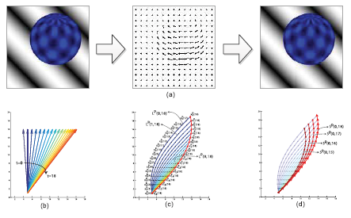
Motion representation in crowded scenes
ﬂow-based features: extracted densely on the pixel level.
high-density crowded scenes, tracking is difﬁcult and unfeasible
Optical Flow,
Particle Flow, spatial changes are ignored, and time delay is significant.
Streak Flow,
local spatiotemporal features: local information from (2-D) patches or 3-D cubes.
exploit the dense local motion patterns created by the subjects,
and model their spatio-temporal relationships to represent the
underlying intrinsic structure they form in the video
Spatiotemporal Gradients:
Motion Histogram:
trajectory/tracklet: compute the individual tracks
more semantic
A tracklet is a fragment of a trajectory obtained by the tracker within a short period.
Notes:
这页太挤，要删除

Slide 24
1.For outdoor scenes, often with wide field of view but low resolution for each target
aim to ana-lyze the holistic crowd motion trends
optical ﬂow
2.For indoor scenes, he resolution of a single target is high enough
and the crowd density may not be so high.
analyzing activities or semantic regions
object trajectories or tracklet-based features
3.crowd density is high with severe occlusion
Various local spatio-temporal features could be considered.

Slide 25
CROWD MOTION PATTERN analysis
In the crowded scene analysis, it is highly desirable to analyze the motion patterns and obtain some high-level interpretation.
motion pattern: a spatial region of the scene that has a high degree of local similarity of
the speed, as well as flow direction within the region and otherwise outside
Flow Field Model-Based Segmentation
Similarity-Based Clustering
Probability Model-Based Clustering
Notes:
对行为模式进行定义，并展示图片，分析方法有一下三类

Slide 26
Flow Field Model-Based Segmentation
Lagrangian particle dynamic[12]
Lagrangian coherent structures (LCS) [57]
earn dominant motion patterns in videos[54]
local–translational domain segmenta-tion (LTDS) model [67].
streakline framework [13]
Wang et al. [55] improved the streakline framework with a highly accurate variational model [56].
Notes:
各种方法之间会有进化关系，重点要说出各个算法关注的点在哪里，有什么优势

Slide 27
Similarity-Based Clustering
motion features
grouped into similar cat-egories
semantic regions
longest common sub-sequence (LCSS) [73]
coherent filtering [70]
Metatracking[19]

Slide 28
Probability Model-Based Clustering
In contrast to the simple averaging optical ﬂow methods, the use of an probability model allows for long-term analysis of a scene. Moreover, it can capture both the overlapping behaviors at any given location in a scene and the spatial dependencies between behaviors. Finally, the statistical model can incorporate a priori knowledge on where, when and what types of activities occur.
diffusion maps embedding [75]
GMM[3]
RFT+MRFs[7][8]
Two-level LDA[71]:At the first level, single-agent motion patterns are modeled as
distributions over pixel-based features. At the second level, interaction
patterns are modeled as distributions over single-agent motion patterns.
Then, LDA is applied to discover both single-agent motion patterns and
interaction patterns in the video.
Notes:
希望详细介绍

Slide 29
Summary

Slide 30
CROWD MOTION PATTERN SEGMENTATION
In the crowded scene analysis, it is highly desirable to analyze the motion patterns and obtain some high-level interpretation.
motion pattern: a spatial region of the scene that has a high degree of local similarity of
the speed, as well as flow direction within the region and otherwise outside
Flow Field Model-Based Segmentation
Lagrangian particle dynamic[12]
Lagrangian coherent structures (LCS) [57]
earn dominant motion patterns in videos[54]
local–translational domain segmenta-tion (LTDS) model [67].
streakline framework [13]
Wang et al. [55] improved the streakline framework with a highly accurate variational model [56].
Similarity-Based Clustering
motion features
grouped into similar cat-egories
semantic regions
longest common sub-sequence (LCSS) [73]
coherent filtering [70]
Metatracking[19]
Probability Model-Based Clustering
Notes:
Segmentation 的目的是什么？（这里就应该是模式的识别而不是分割的意思，后面一章的crowd behavior recognition 实际更多像是一种预测，）

Slide 31
Crowd behavior recognition
Holistic Approach
treats the crowd as a single entity
[21] low-level motion features→ direction and magnitude models of crowds→ used
a region-based segmentation algorithm to generate different motion patterns→ crowd events
[14] a scene is represented by a grid of particles initializing a dynamical system
deﬁned by the optical ﬂow.
[20] exploring both appearance of crowd behaviors and interaction among pedestrians.
the local fluctuation for specific pixels→ spatiotemporal variation matrix→ the
force among pedestrians is modeled with shear force in the matrix.→ clustering
neighboring pixels with similar spatiotemporal features → codebook → LDA
Object-Based Approach
treats the crowd as a collection of individuals
abnormal events
[79] used hierarchical Bayesian models to connect three elements in visual surveillance:
low-level visual features, simple atomic activities, and interactions.

Slide 32
Crowd anomaly detections
Global Anomaly Detection
Global anomaly detection aims to distinguish the abnormal states of crowd from normal ones.
Local Anomaly Detection
vision-based approaches
extract visual features and construct a set of clusters to represent several possible event patterns.
a) Hidden Markov model:
b) Dynamic texture model:
c) Bag-of-words model:
d) Sparse representation model;
e) Manifold learning model:
physics-inspired approaches
a) Flow field model:
b) Social force model:
c) Crowd energy model:

Slide 33
Crowd video dataset
Notes:
大部分算法都是场景相关的，要根据不同的场景选用不同的算法，接下来介绍一下数据集，以及可能适合的算法有哪些

Slide 34
Reference
[1]S. R. Musse and D. Thalmann,” A model of human crowd behavior: Group inter-relationship and collision detection analysis”,in Proc. Comput. Animation Simulation, 1997, pp. 1389-1396.
[2]H. Su, H. Yang, S. Zheng, Y. Fan, and S. Wei, “The large-scale crowd behavior perception based on spatio-temporal viscous ﬂuid ﬁeld,” IEEE Trans. Inf. Forensics Security, vol. 8, no. 10, pp. 1575–1589, Oct. 2013.
[3]Y. Benabbas, N. Ihaddadene, and C. Djeraba, “Motion pattern extrac-tion and event detection for automatic visual surveillance,” J. Image Video Process., vol. 2011, Jan. 2011, Art. ID 163682.
[4]R. Mehran, A. Oyama, and M. Shah, “Abnormal crowd behavior detection using social force model,” in Proc. IEEE Int. Conf. Comput. Vis. Pattern Recognit., Jun. 2009, pp. 935–942.
[5]A. Johansson, D. Helbing, H. Z. Al-Abideen, and S. Al-Bosta, “From crowd dynamics to crowd safety: A video-based analysis,” Adv. Com-plex Syst., vol. 11, no. 4, pp. 497–527, 2008.
[6]B. Krausz and C. Bauckhage, “Loveparade 2010: Automatic video analysis of a crowd disaster,” Comput. Vis. Image Understand., vol. 116, no. 3, pp. 307–319, Mar. 2012.
[7]J. D. Sime, “Crowd psychology and engineering,” Safety Sci., vol. 21, no. 1, pp. 1–14, 1995.
[8]T. Kretz, A. Grünebohm, and M. Schreckenberg, “Experimental study of pedestrian ﬂow through a bottleneck,” J. Statist. Mech., Theory Experim., vol. 2006, no. 10, pp. 100–114, 2006.
Notes:
参考文献列表

Slide 35
[9] M. Flagg and J. M. Rehg, “Video-based crowd synthesis,” IEEE Trans. Vis. Comput. Graph., vol. 19, no. 11, pp. 1935-1947, Nov. 2013..
[43]R. L. Hughes, “A continuum theory for the ﬂow of pedestrians,” Transp. Res. B, Methodol., vol. 36, no. 6, pp. 507–535, 2002.
[44]A. Treuille, S. Cooper, and Z. Popovi ,”Continuum crowds,”ACM Trans. Graph., vol. 25, no. 3, pp. 1160-1168, 2006.
[45]D. Helbing and P. Molnár, “Social force model for pedestrian dynamics,” Phys.Rev.E, vol. 51, no. 5, pp. 4282–4286, 1995.

