Slide 1
Proxy Contract
This walktrough tutorials covers the basics of using a proxy contract.
Proxy contract allows to save gas at deployment time.

Slide 2
Introduction
This document has been heavily inspired from
https://blog.gnosis.pm/solidity-delegateproxy-contracts-e09957d0f201
Please check it out ;)

Slide 3
Rationale
Storing contract code at creation time can cost up to:
200 * max_byte_code_length gas
200 * 24576 = 4915200
4915200 * 10 gwei = 49152000 gwei = 0.049152 ether = 9 EUR
see https://github.com/ethereum/EIPs/blob/master/EIPS/eip-170.md for more infos on max_byte_code_length.

Slide 4
Proxy Contract
Using Proxy Contract pattern allows to save gas at deployment time.
Useful when a lot of instances of the same contract require to be deployed.

Slide 5
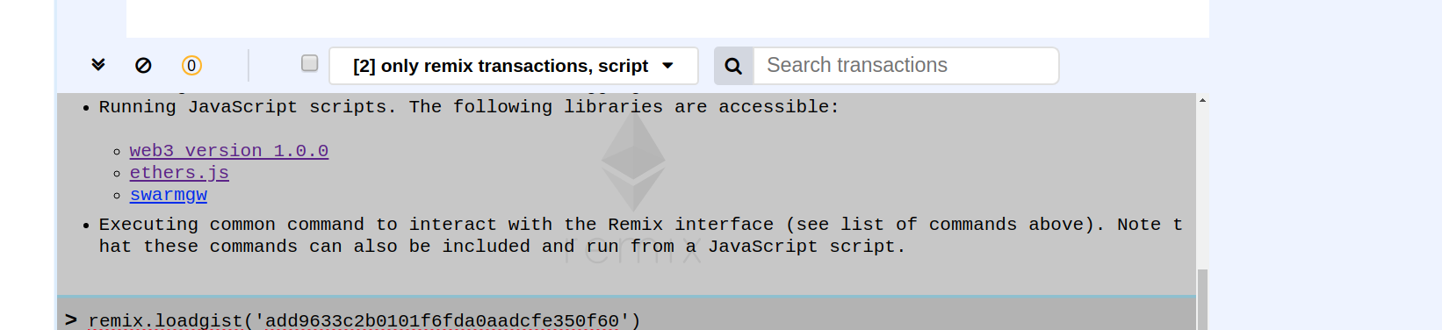
Let’s Start to Proxy the AwardToken
Load the AwardToken code by running the command:
remix.loadgist('add9633c2b0101f6fda0aadcfe350f60')

Slide 6
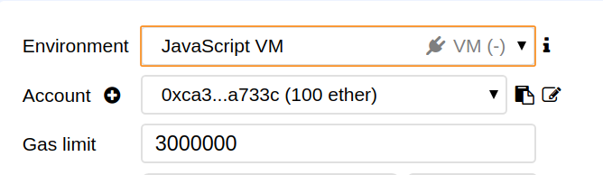
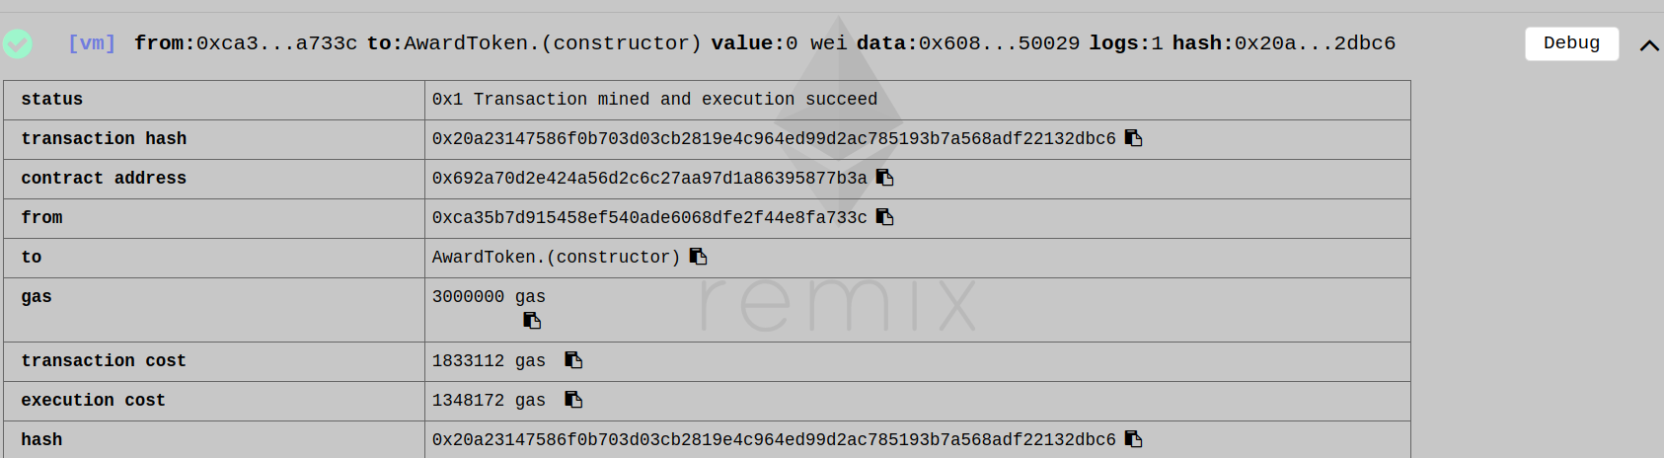
Deploy AwardToken
Deploy the contract on the JavaScript VM. The transaction cost should be around:
1833112 gas * 10 gwei * 0.000000001 = 0,01833112 eth = 3,7 euros

Slide 7
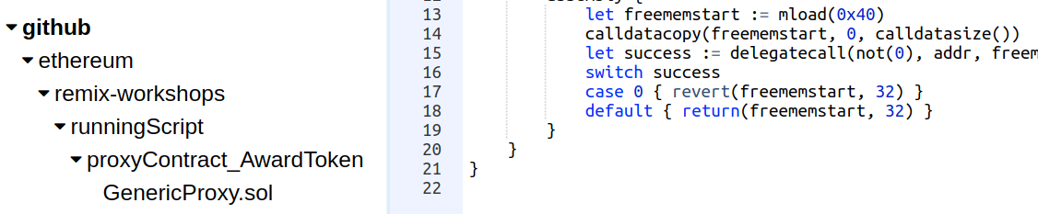
Loading a generic proxy
By running in the console
remix.loadurl('https://github.com/ethereum/remix-workshops/runningScript/proxyContract_AwardToken/GenericProxy.sol')
This solidity contract is not directly usable and we need to add some modifications.

Slide 8
Generic Proxy?
The plan is to deploy the generic proxy and link it to the AwardToken.
We keep the same functionality but with less code to deploy and more gas saved.
- Instead of implementing all the function of AwardToken, we use the anonymous function to forward the call to the AwardToken code -

Slide 9
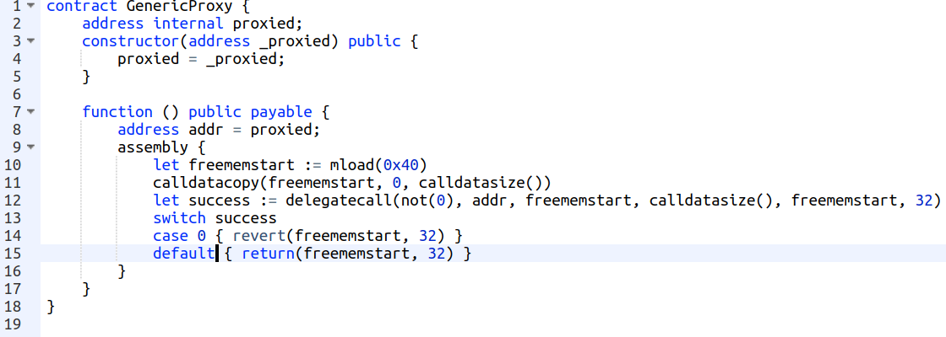
Generix Proxy
The forwarding happens line 12. see “delegatecall”.
We call the code of AwardToken (which is stored at “proxied”)
While keeping the same context (msg.sender and storage)

Slide 10
Generic Proxy
Create a new file in the browser explorer (Proxy.sol for instance) and paste the code of the generic proxy to it.
We can “theorically” use it as it is by deploying this proxy contract with the address of an AwardToken:
Forwarding call will work but unfortunately the Proxy contract is not usable.

Slide 11
Storage layout
The reason is that the state declaration of both contracts (Proxy and AwardToken) are completely different.
We have one state variable of type address for the proxy contract and an ERC20 like state declaration for the AwardToken.

Slide 12
Storage layout
Forwarding call is a necessary first step, but forwarding call does not change anything on the storage declaration.
They both get “merged” in a single messy state.
We need to tell the Proxy how the AwardToken state looks like ;)

Slide 13
Storage layout
For doing that, the easiest way is to create a data contract (contract representing the state):
Create a file named AwardTokenData.sol, and write a contract named AwardTokenData
Copy the state (including events) from the AwardToken contract to AwardTokenData contract.
Don’t forget that AwardToken is an ERC20Mintable and will require some import:

Slide 14
Storage layout
Make the GenericProxy (we can rename it AwardTokenProxy now) and AwardToken inheriting from AwardTokenData.

Slide 15
Initialization
An important issue remain.
If we deploy the AwardTokenProxy now, we would not execute the AwardToken constructor. AwardTokenProxy does not inherit AwardToken.
The solution is to simply put the AwardToken constructor code to the AwardTokenProxy constructor – in our case the assignment of “quantity”

Slide 16
Initialization
Generally if the master contract has input parameters, the common way is to map variable;
e.g if the master contract is
The constructor of the Proxy contract is going to be:

Slide 17
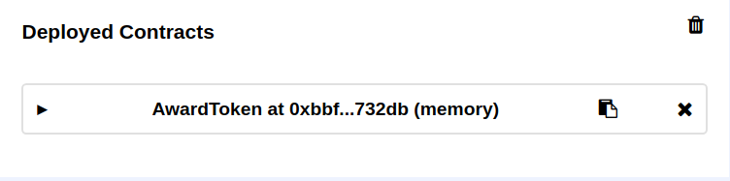
Deploy
Now that’s it!
Compile and deploy AwardToken - this is our master contract.

Slide 18
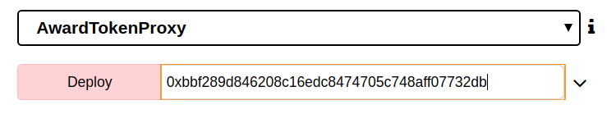
Deploy
Deploy AwardTokenProxy - using the master contract address
it should cost around 924496 gas.
924496 gas * 10 gwei * 0.000000001 = 0,00924496 ETH = 1.85 EUR

Slide 19
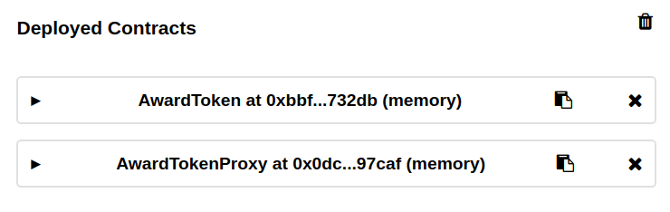
Deploy

Slide 20
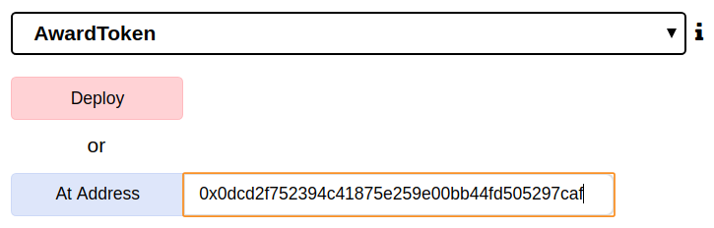
Deploy
Use the “At Address” action to access the proxy as the AwardToken.

Slide 21
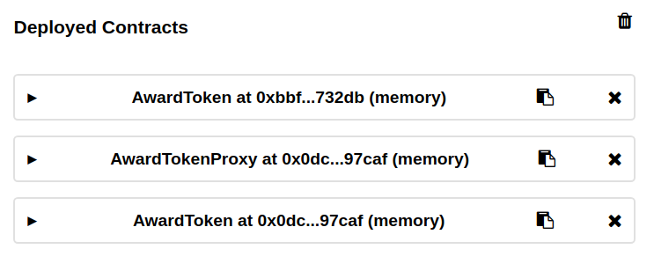
Deploy

Slide 22
Deploy
Alternatively, we can use a script to deploy the Proxy:
execute from the console:
remix.loadurl(‘https://github.com/ethereum/remix-workshops/runningScript/proxyContract_AwardToken/global.js')
remix.execute('github/ethereum/remix-workshops/runningScript/proxyContract_AwardToken/global.js')
That’s a generic JavaScript script which setup all you need for logging the deployment result in a file and deploy a contract

Slide 23
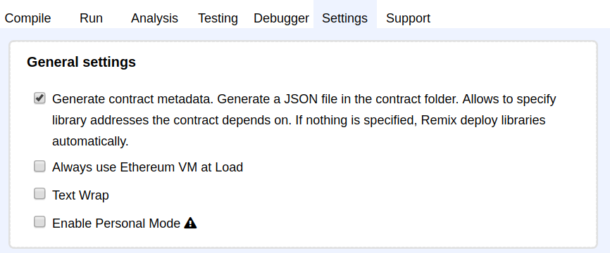
Deploy
For Deploying, we need the abi and bytecode accessible from the script. In Settings tab, check the “Generate contract metadata” option

Slide 24
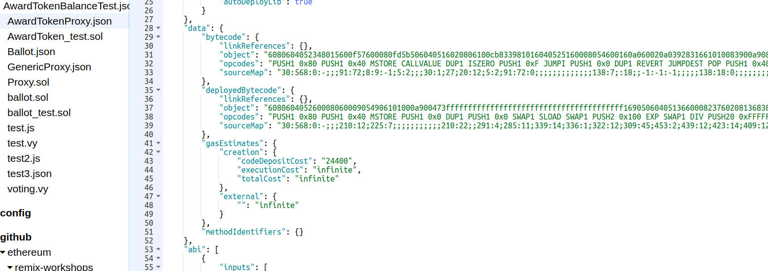
Deploy
Recompile the AwardTokenProxy
AwardTokenProxy.json is then created and contains all we need to deploy

Slide 25
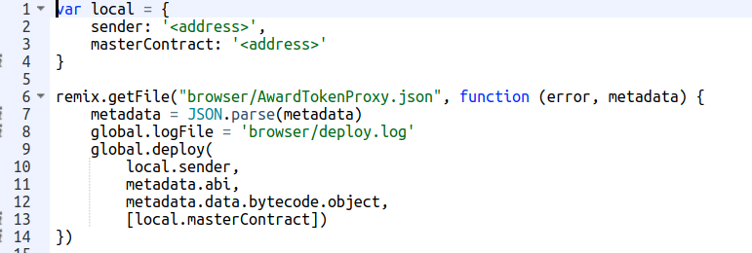
Deploy
Ultimately, we load the script that will actually deploy
remix.loadurl(‘https://github.com/ethereum/remix-workshops/runningScript/proxyContract_AwardToken/deploy.js’)

Slide 26
Deploy
And run remix.execute() first on global.js then on deploy.js
you can check the deployment log in browser/deploy.log

Slide 27
You will find a lot more information in this great blog post:
https://blog.gnosis.pm/solidity-delegateproxy-contracts-e09957d0f201

