Slide 1
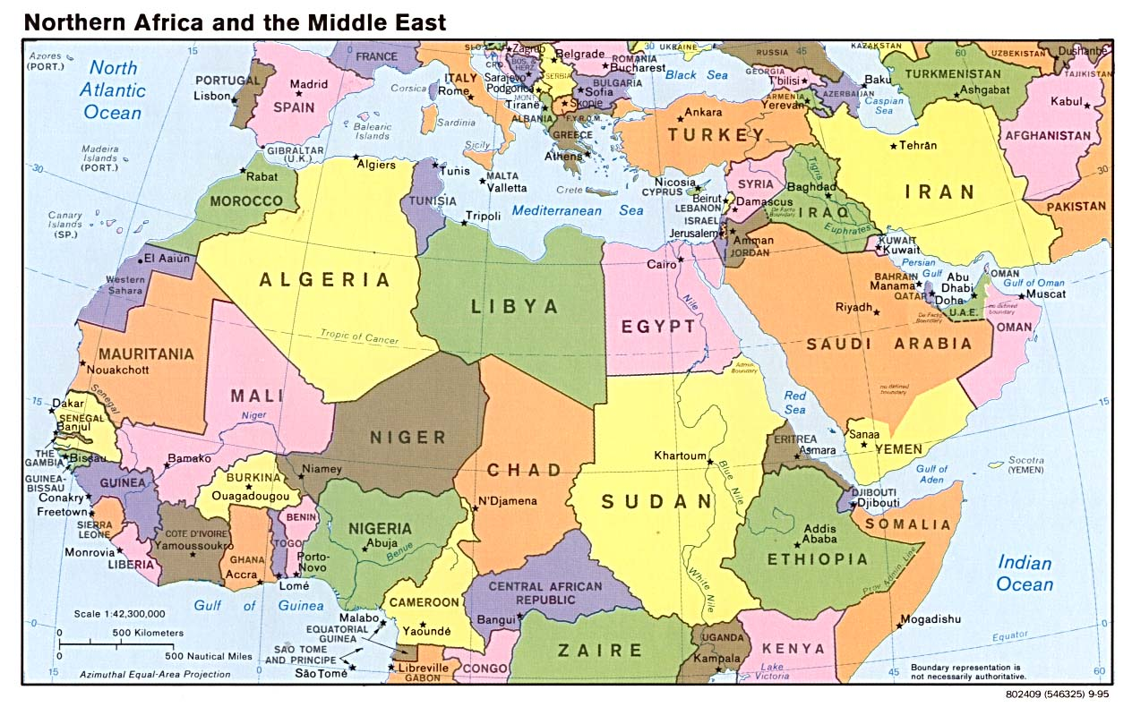
English presentation : by SID-LAKHDAR Riyane

Slide 2
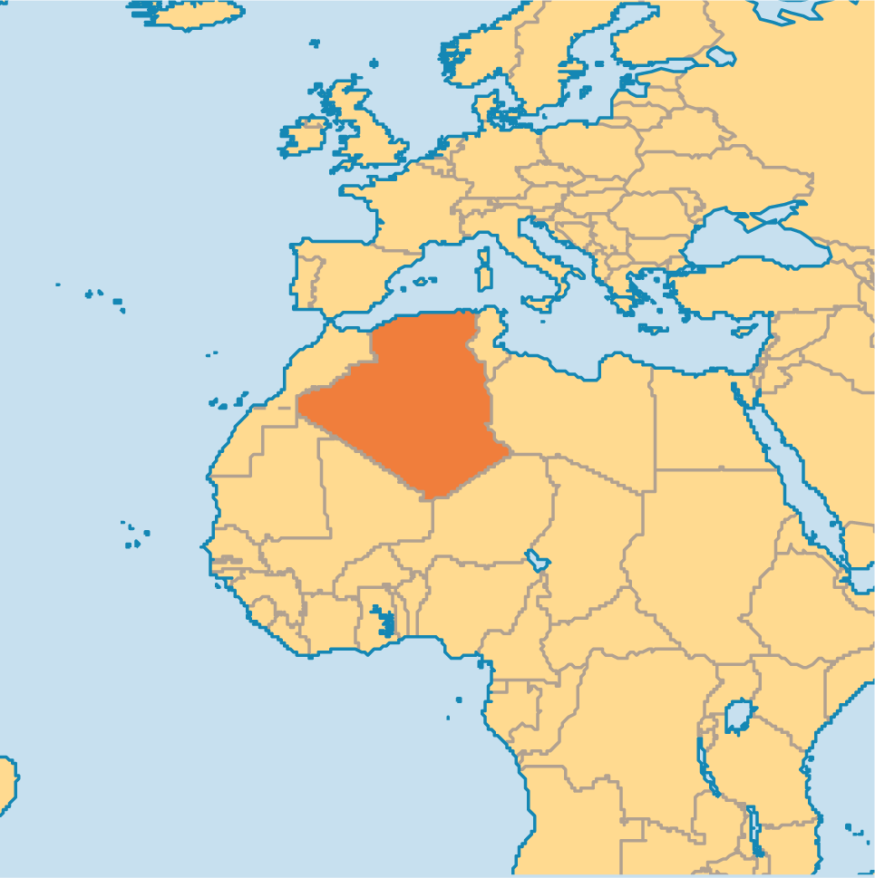
Algeria: between current troubles and future perspective

Slide 3
Algeria: between current troubles and future perspective
Algerian geography: attractiveness and disadvantage
A history and a population looking forward

Slide 4
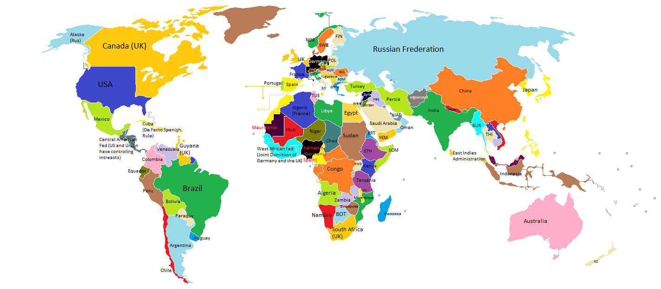
Algeria : a point in the center of the world

Slide 5
Natural resources
Third most important oïl producer in the world in 2013 : 2 173 thousands barrels per day.
Sixth most important gas producer in the world in 2013 : 48 thousands of billions cubic meters.
Main data source : CIA World Fact Book

Slide 6
A young and well educated population
In 2013, more than 65 % of the population was under than 25 years old.
More than 50 % of the populations may read and write at least 2 languages.
Main data source : CIA World Fact Book

Slide 7
