Slide 1
Image Enhancement
Additional Computer Exercise for Team 5
By
PASHEVICH Alexander
And
SID-LAKHDAR Riyane

Slide 2
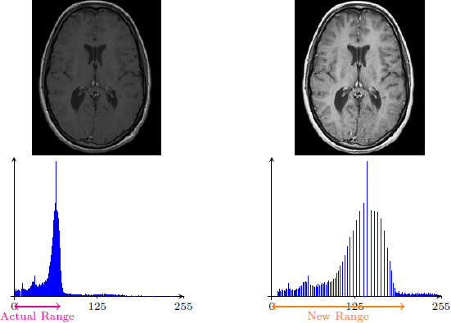
Contrasting

Slide 3
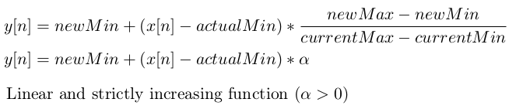
Principle of the method

Slide 4
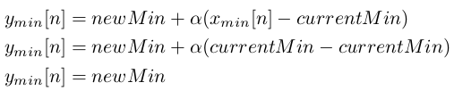
Principle of the method:
Lower bound

Slide 5
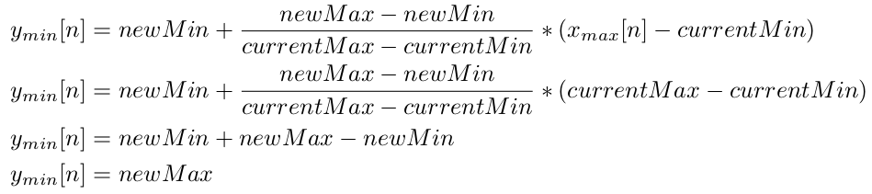
Principle of the method:
Upper bound

Slide 6
Principle of the method:
[currentMin, currentMax]
[newMin , newMax]
Linear spread

Slide 7
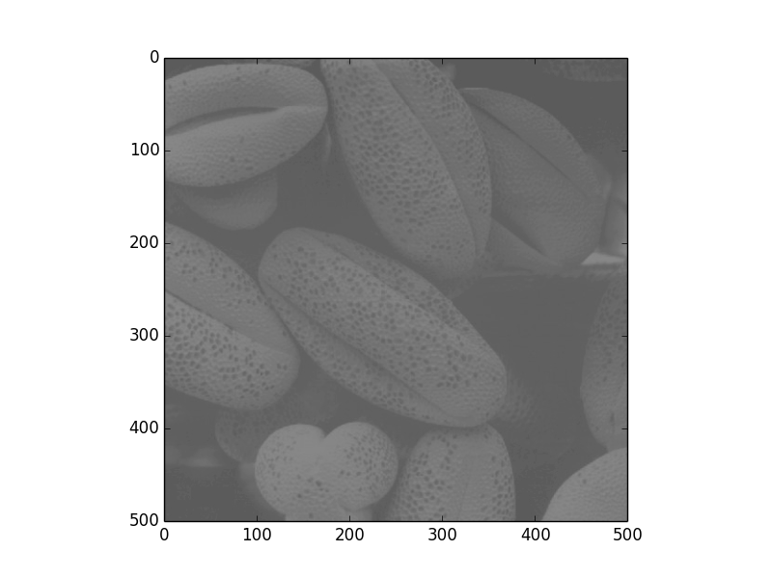
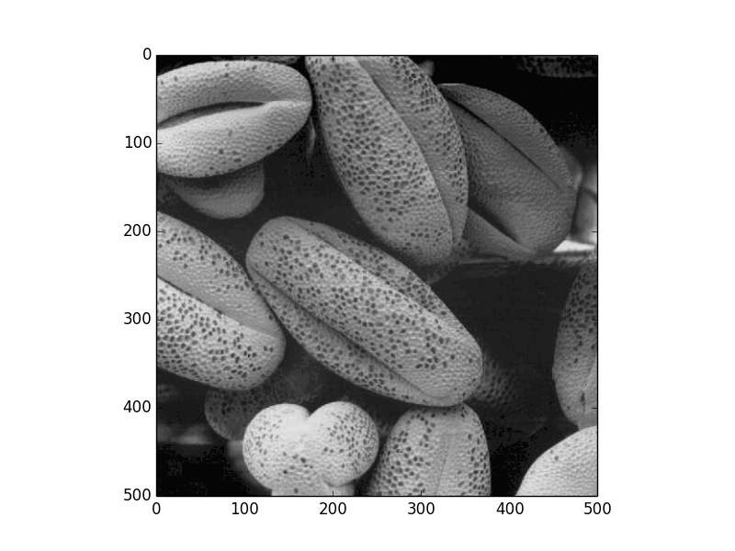
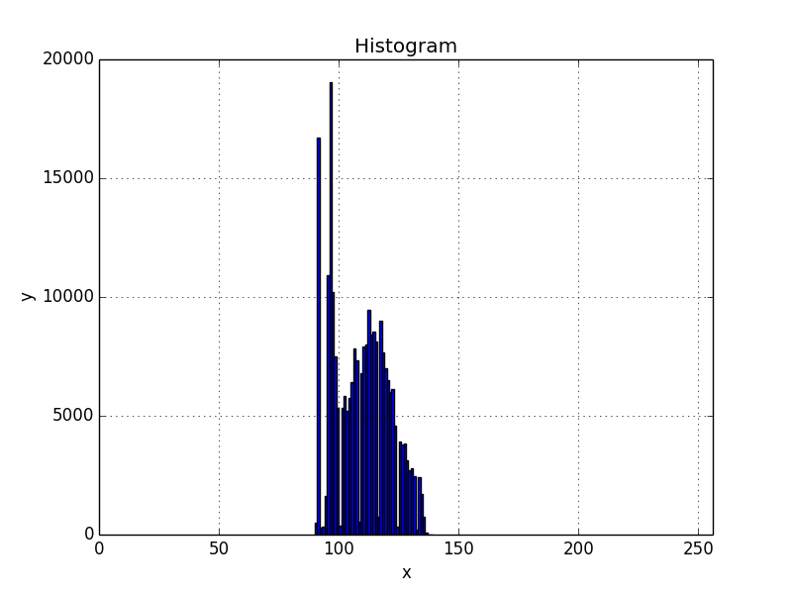
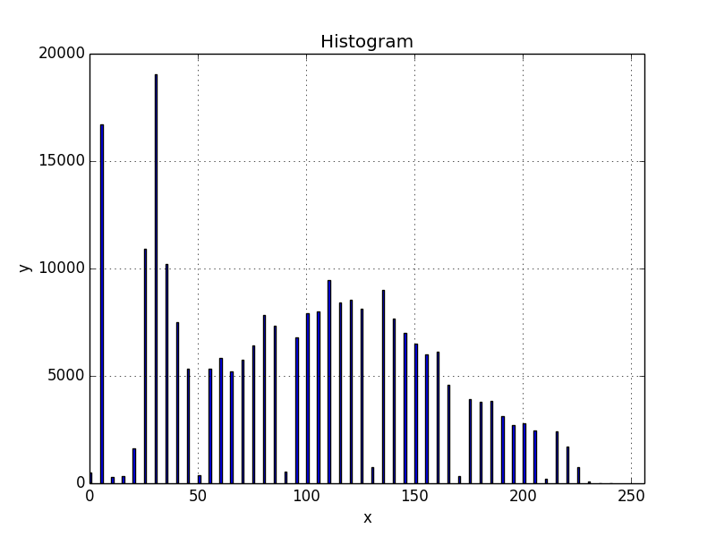
Results (pollen)

Slide 8
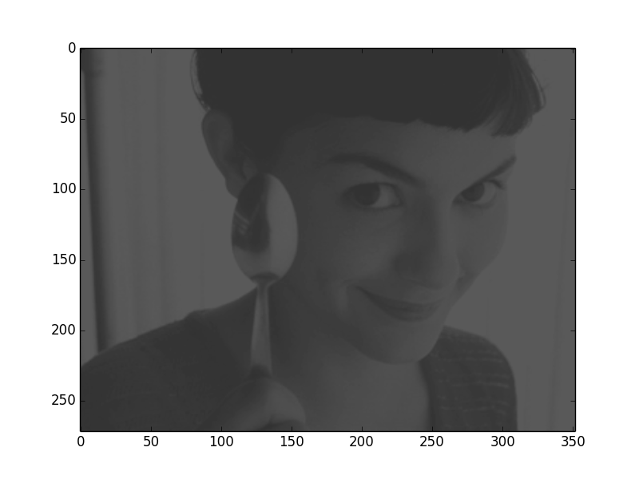
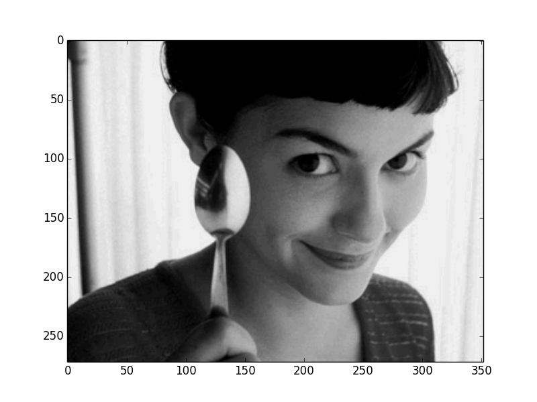
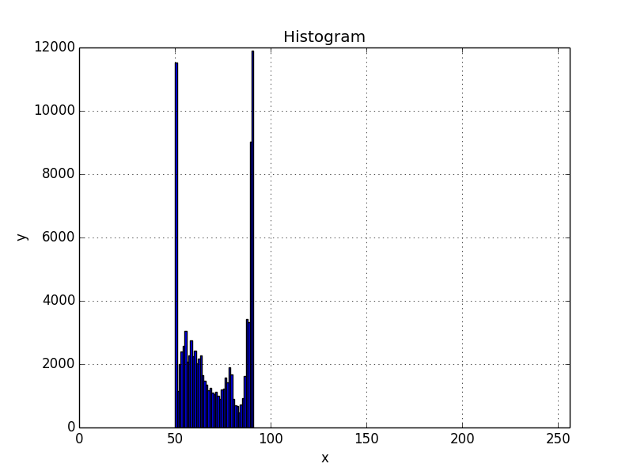
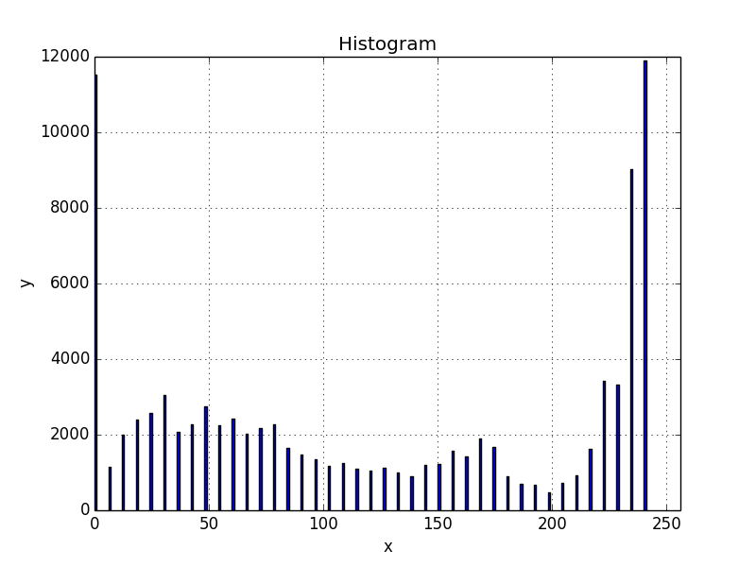
Results (amelie)

Slide 9
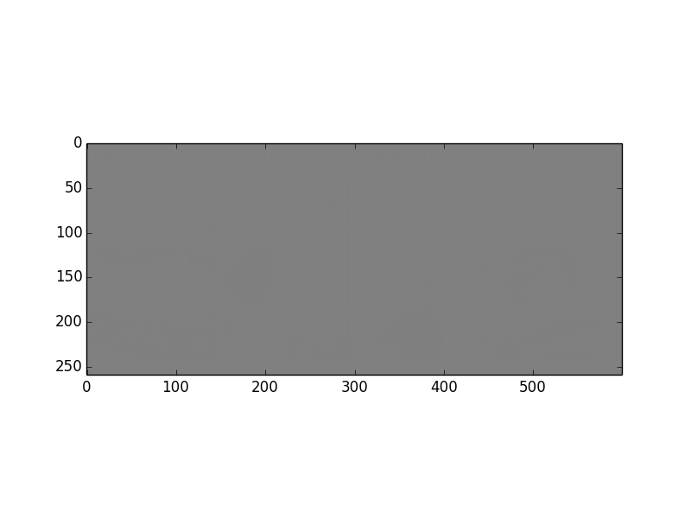
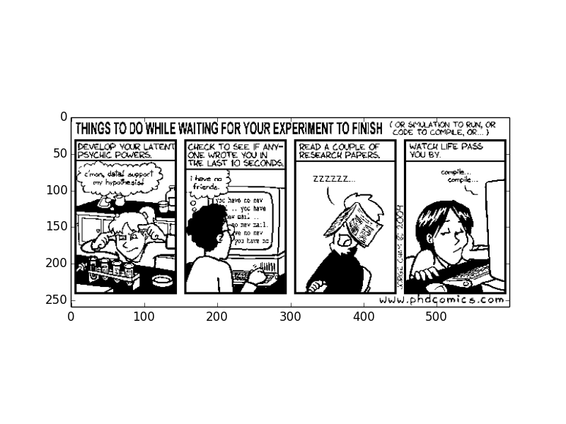
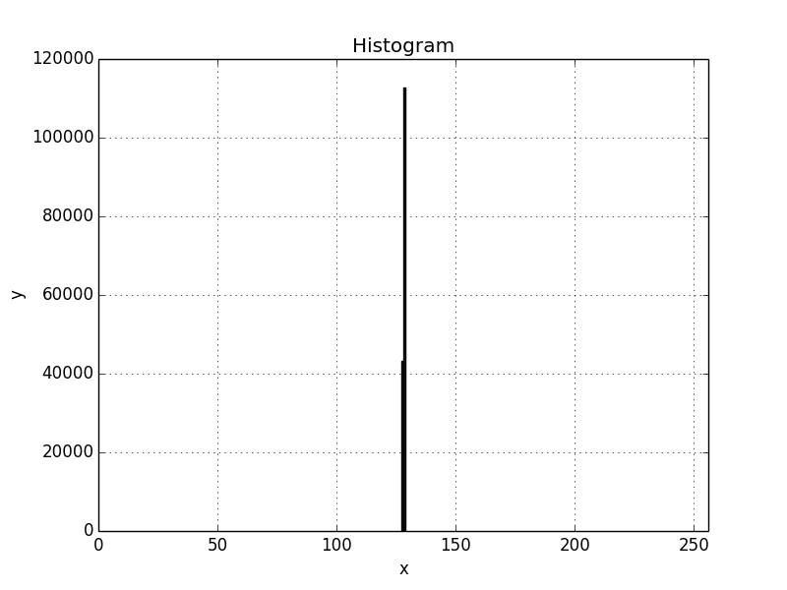
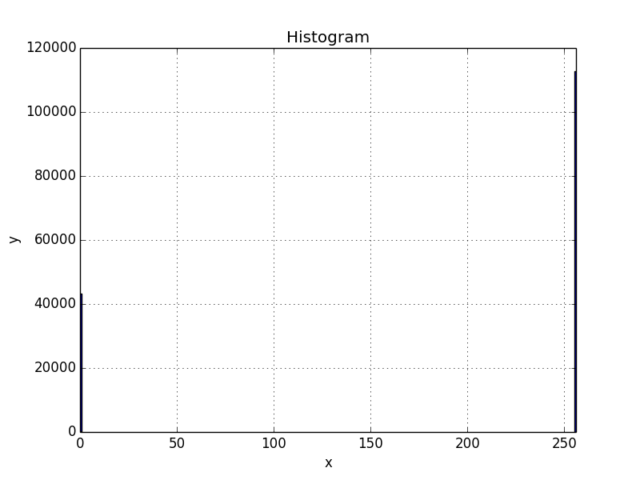
Results (mystery)

Slide 10
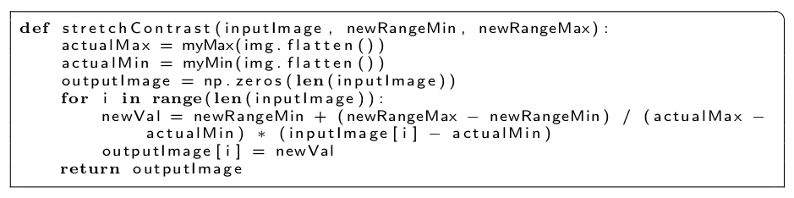
Advantages of this method
Extremely simple to implement

Slide 11
Advantages of this method
Very efficient: complexity C(n) = O(n)
May be applied no matter the picture encoding used

Slide 12
Thanks

