Slide 1
GL - 2 Requirements engineering
Lydie du Bousquet
Lydie.du-bousquet@imag.fr
In collaboration with J.-M. Favre, I. Parissis, Ph. Lalanda, Y. Ledru

Slide 2
Schedule
What / Who / Why … requirement engineering
Serious game
More about Requirement specification
Home work
Read (and learn) about requirement elicitation

Slide 3


Slide 4
Who is concerned by requirement engineering?
WHO?

Slide 5

People
WHO?
The customer side
pays for the product and usually decides the requirements
The supplier/provider side produces a product for a customer
The User operates or interacts directly with the product may be different from the customer

Slide 6
WHAT?
What are requirements?
What is requirement engineering?

Slide 7
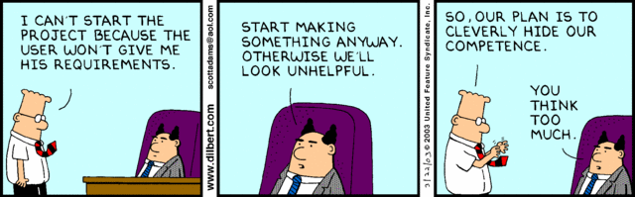
Need to know the requirements to be able to build the program
WHAT?

Slide 8
Requirements are statements of
WHAT?
what the system must do,
how it must behave,
the properties it must exhibit,
the qualities it must possess, and
the constraints that the system and its development must satisfy

Slide 9
Requirements engineering Objectives
WHAT?
Find out the needs and constraints of the customers
Specify them in a dedicated document
Call for
Tenders
Analysts
Requirement
engineering
Requirement
documents
Stakeholders

Slide 10
Requirements engineering Objectives
WHAT?
Call for tender
first expression of the customer’s needs and constraints
basis for a bid for a contract
Stakeholders
All the people having an interest in the project
Customer side: users, experts, managers, sales men ...
Supplier side: sales men, development teams, architects, managers, strategist
Requirements
Come from the customer side
Written by customer, supplier, or both in a Software Requirements Specification document (SRS)

Slide 11
WHY?
Why requirement engineering?

Slide 12
Requirements Engineering
WHY?
The hardest single part of building a software system is deciding precisely what to build. . .

Slide 13

Deciding precisely what to build is hard
WHY?

Slide 14
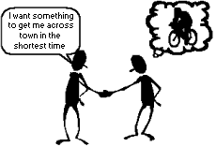
Deciding precisely what to build…
WHY?
Customer may don’t know precisely what he want
Needs may change
There may be conflict
Problem may be difficult to be understood
Customer and supplier may speak different languages
Many different kind of information

Slide 15

Requirements Impact
WHY?
Legal impact
Basis of the contract between customer and supplier
Economic impact
Cost of correcting wrong requirements
Relevance of the marketed product
Social impact
Wrong requirements may cause disasters
Usage impact
Acceptance or rejection of a software

Slide 16
How?
How is organized Requirement engineering?

Slide 17
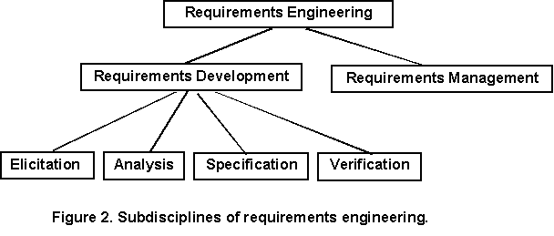
How is organized Requirement engineering?
How?
http://www.processimpact.com/articles/telepathy.html

Slide 18
Requirement development
How?
How is organized Requirement Engineering?
Elicitation
Analysis
Spec.
Verif.

Slide 19
Requirement elicitation
Elicitation
Analysis
Spec.
Verif.
Learning and understanding the needs of the users
To avoid confusion between stakeholders and analyst
Understand the application domain
Identifying the source of requirements
Analyzing the stakeholders
Selecting techniques, approaches and tool to use
Eliciting the requirements
4 types of methods
Conversational
Observational
Analytic
Synthetic

Slide 20
Requirement elicitation -2 Difficulties
Elicitation
Analysis
Spec.
Verif.
Users are not fully aware of what they will obtain
They may not make de difference between
What they need and what they have
What they want and what they need
They may not want to work on the problem
They may use specific language
They may forgot some important information

Slide 21
Requirement elicitation -3 Example of communication problem
The user request to change an incorrect algorithm on the existing system
Analyst: “How often this algorithm is used ?”
User: “Never”
So the request is ignored
Of course, the reason why the algorithm is not used is because it is incorrect!
Be careful to rapid conclusion
Be careful not to decide for the user

Slide 22
Requirement analysis
Elicitation
Analysis
Spec.
Verif.
Analyze the results of elicitation
are the answers consistent?
identify trouble spots/conflicts
identify limits?
identify most important requirements?
Possibly iterate over elicitation again
Conflict resolution

Slide 23
Requirement specification
Elicitation
Analysis
Spec.
Verif.
Process of writting down the requirements
No standard nor methods
From informal to formal
Functional and non-functional
Software Requirements Specification document (SRS)
Detailed after

Slide 24
Requirement verification
Elicitation
Analysis
Spec.
Verif.
Process of checking that the result is OK
Unitary: only one thing by requirement
Complete: no missing information
Consistent: no contradiction among requirements
Unambiguous: objective facts, comprehensible, …
Prioritized: level of importance is given
Traceable: source/reason/links are documented
Verifiable: can be checked at the end
…

Slide 25
WHEN?
When requirement engineering?

Slide 26
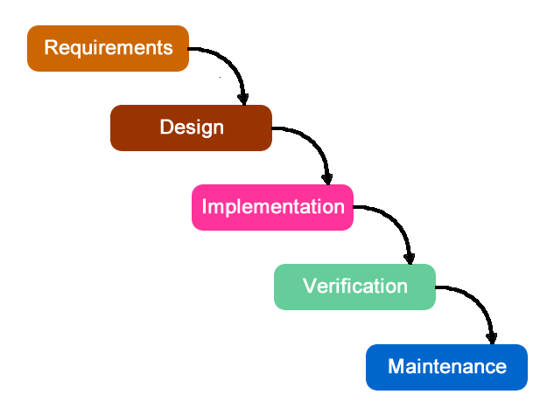
Requirements influence all the software activities
WHEN?
Design
Architecture
Detailed design
Implementation
Validation
Acceptance, ...

Slide 27
Requirement and life cycle
WHEN?
Requirement
validation
Requirement
evolution
Requirement
definition
Specification
Design
Coding
Deployment
Requirement engineering

Slide 28
Requirement evolution and traceability
WHEN?
User requirement may evolve (will)
Should be taken into account
Possible if the initial elicitation work, analysis and validation has been carefully carried out
Impacts should be evaluated
Possible only if traceability mechanisms
Tool can help to automate the links among the requirements

Slide 29
Schedule
What / Who / Why … requirement engineering
Serious game
More about Requirement specification
Exercises
Express requirements for CyberVideo
Read (and learn) about requirement elicitation

Slide 30
Schedule
What / Who / Why … requirement engineering
Serious game
More about Requirement specification
Exercises
Express requirements for CyberVideo
Read (and learn) about requirement elicitation

Slide 31
Requirement Specification
How is organized Requirement Engineering?
> Requirements development

Slide 32
What is a requirement?
Requirement Specification
Express what customers want or need
A « need » is something mandatory that we must have
A « want » is nice to have but not always mandatory
A requirement can be
A goal
A provided function
A quality
A property (domain, organization)
A constraint

Slide 33

Functional requirements
Requirement Specification > functional requirement
Services provided by the system
Description of the expected function or behavior
A general property
Expected UI
Example (Software library)
The software has to manage books borrowing
The checkout function starts by reading the subscriber card
A subscriber has to pay 20 euros per year
A subscriber is defined by his name, age, etc.
All needed information have to be displayed in a single window

Slide 34

Functional requirements – Davis, 93
Requirement Specification > functional requirement
An object
A client is identified by his name, age and address
A functionality
A client can borrow up to 5 books
A state
A book is available, borrowed or lost
Several of them together

Slide 35
Objects – Davis, 93
Requirement Specification > functional requirement
Entity clearly identified
Concept related to the software
Requirements specify the objects:
Name and meaning
Structure
Scope
Library Example
A client is identified by his name, age and address
A book is defined by its title and author(s)

Slide 36
Functions – Davis, 93
Requirement Specification > functional requirement
Activity clearly defined in the domain
Tasks, services, processes
Related to the software
Requirements specify the functions:
Name
Interface, data
Behavior
Demanded ressources
Library Example
Book checkout: to borrow a book, the client has first to show his library card and then the book

Slide 37
State – Davis, 93
Requirement Specification > functional requirement
Characterize the situation of an entity
Can be expressed as a predicate
Can change over the time
Influence the behavior of the entity
Requirements specify the states
All possible states
Transitions
Possible properties
Library Example
A book is available, borrowed or lost

Slide 38
Objects, functions, states
Requirement Specification > functional requirement
Requirements may established relations among objects, functions and states
A client can borrow a book when he has paid his bill and has less than 5 borrowed books
Analysis methods focuses on single aspect
Object
Function
States

Slide 39
Capturing functional requirements Example of questions – Pfleeger
Requirement Specification > functional requirement
Functions
What does the system should do?
When?
Several functional modes?
Appropriate responses to stimuli ?
Data
Format?
How long should be?

Slide 40
Non-functional requirements Constraints
Requirement Specification > non-functional requirement
A constraint under which a software operates or is developed
Process
Tools
Standards
Domain
Usage
Regulation / Law
Development
COTS (OS, middleware, …)
Methods
Context
Existing applications
People

Slide 41
Non-functional requirements Constraints
Requirement Specification > non-functional requirement
Example (Software library)
UML must be used for the modeling phase (at design)
An architectural design document must be provided
The system must use Oracle for persistency functions
Java annotations may be used for development
No historic is maintained for subscribers
The system must interface with legacy systems
Process
Development
Domain
Context

Slide 42
Non-functional requirements Qualities
Requirement Specification > non-functional requirement
External or internal qualities of
the provided functions
the global system
Includes
Security, Logging
Storage, Configuration
Performance, Cost
Interoperability, Flexibility
Accessibility, Disaster recovery
Must be quantified (to be evaluated)

Slide 43
Non-functional requirements Qualities
Requirement Specification > non-functional requirement
What about… ?
“The system should be easy to use”
“The system should be robust and quick”

Slide 44
Non-functional requirements Qualities
Requirement Specification > non-functional requirement
What about… ?
“The system should be easy to use”
“The system should be robust and quick”
Different interpretation
Source of conflict
=> Need to quantify the NF-requirements

Slide 45
Non-functional requirements Qualities
Requirement Specification > non-functional requirement
Example (Software library)
Book checkout must be made in less than 1 minute
Any function must be done in less than 2 minutes
Backtracking must always be possible when borrowing a book
The software system must be available 6 days a week

Slide 46
Example
Requirement Specification > non-functional requirement
First formulation
The system should be easy to use for a experimented user and should be organized to limit the number of errors.
Second formulation
A user with 5 years of experience should be able to use the system after 2 hour long formation.
After the formation, the average number of errors made by a user should not be more than 2 by day.

Slide 47
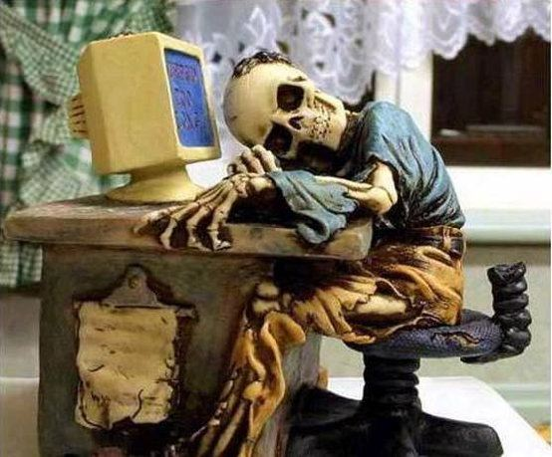
Performance
Requirement Specification > non-functional requirement
Quality perceived by users (external)
Requirements to be specified
Number of transactions per second
Arrival rate of inputs
Refreshing time
Response time for a given pattern of events
What to do when expected quantities are exceeded
Failure, ignorance of additional inputs, degraded services

Slide 48

Usability
Requirement Specification > non-functional requirement
Quality perceived by users (external)
Requirements to be specified
Provided UI
Error messages
keyboard shortcut
Backtrack possibilities
Techniques to help users and to improve confidence
Amount of expected training
Facilities to avoid misuses

Slide 49
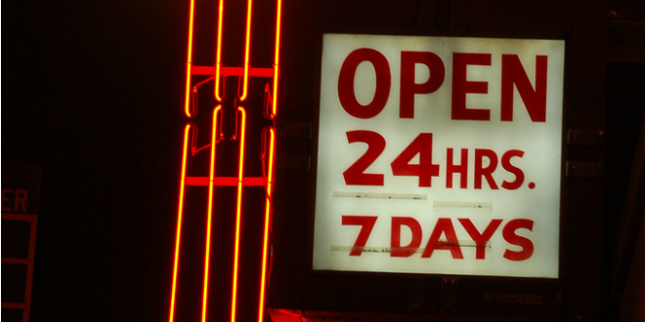
Availability & Reliability
Requirement Specification > non-functional requirement
Quality perceived by users (external)
Requirements to be specified
Max. number of bug per Kline during integration
Min. duration without a problem
Is there a time to perform maintenance?
Maximum time allowed for restarting the system
Must backup copies be stored at a different location?
Must the system detect and isolate fault
Difficult to asses !

Slide 50

Security
Requirement Specification > non-functional requirement
Quality perceived by users (external)
Requirements to be specified
Must access to the system or information be controlled?
Should each user’s data isolated from the data of each other?
Should user programs be isolated from other programs and from the operating system?
Should precautions be taken against theft or vandalism

Slide 51

Maintenability
Requirement Specification > non-functional requirement
Quality perceived by engineers (internal)
Requirements to be specified
When and in what ways might the system be changed in the future?
How easy should it be to add features to the system?
How easy should it be to port the system from one platform (computer, OS) to another

Slide 52
Schedule
What / Who / Why … requirement engineering
Serious game
More about Requirement specification
Exercises
Express requirements for CyberVideo
Read (and learn) about requirement elicitation

Slide 53
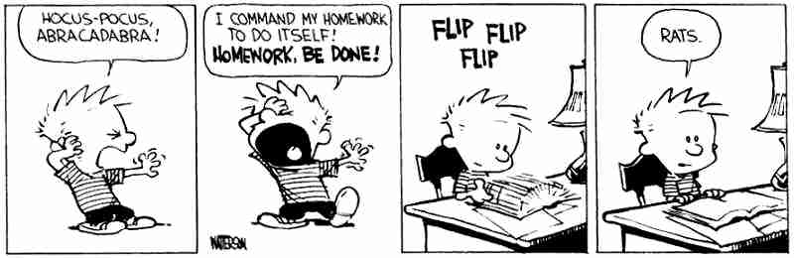
Exercises
Express some requirements about CyberVideo
Functional
Non-Functional

Slide 54
Exercise
Read (and learn) about requirement elicitation

Slide 55
For the final evaluation
You should know
Challenges and issues of requirement engineering
Advantages and limits of the different requirement elicitation methods
You should be able to
Identify incorrect formulation of NF requirement
Propose an alternative formulation

