Slide 1

NachOS
Advanced implementation
Operating Systems. M1-MOSIG
Alisa Patotskaya, Claude Goubet, Riyane Sid-Lakdar, Udhayan Venugopal, Yulia Patotskaya

Slide 2
Console work
Multithreading
Virtual Memory
File system
Networking
Improve Console Usability Multi Thread access Synchronization
Protected access to shared resources Data safety
Provide virtual address space abstraction Increasing the size of memory Security of the processes
Directory tree - Browsing & manipulating Security
Manage inter machine communication over an reliable physical communication channel
What’s NEW?

Slide 3
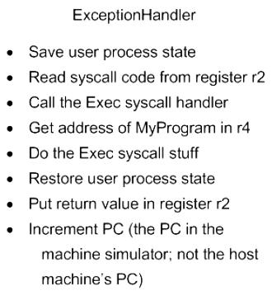
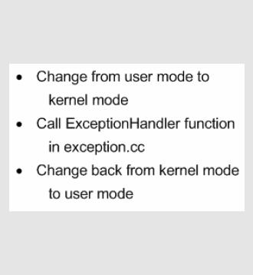
User Mode
Kernel Mode
User Program
…
Exec( “putStri.cc” );
Start.s
MAKE
Machine Simulator Mode
User Code (After Make)
Put Pointer to "putStr.cc" in R4
Put Exec syscall in R2
Execute SYSCALL instruction ...

Slide 4
I/O System Calls
GetChar()
Reads char from input stream
GetString()
Reads char in a string
GetInt()
Reads string and type casts as int type
PutChar()
Writes char to the output stream
PutString()
Writes char in a string
PutInt()
Writes int type casted from char
GetCharInt()

Slide 5
Provide reliable multiple threads access to shared resources
Console
File stream
Protect memory mechanism
Multithreading. Synchronization
Semaphores
Locks
Condition variables

Slide 6
Multithreading. Synchronization.
Semaphores
Console Input/Output ('readAvail', 'writeDone')
Implicitly used in each sync method
Condition variables
Thread Join ; Halt
Locks
Console Input/Output - to protect reading and writing operations as they are not atomic
Thread Join ; Halt

Slide 7
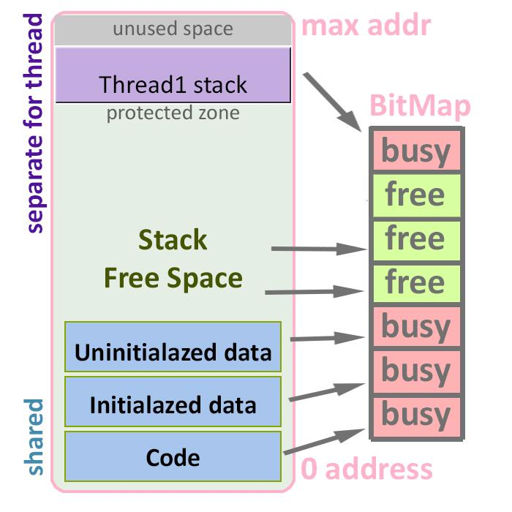
Multithreading. Thread allocation.
Features:
Same address space shared by several threads
Mapping of the free regions of address space
Independent thread stack
Bounded thread stack to protect the whole address space

Slide 8
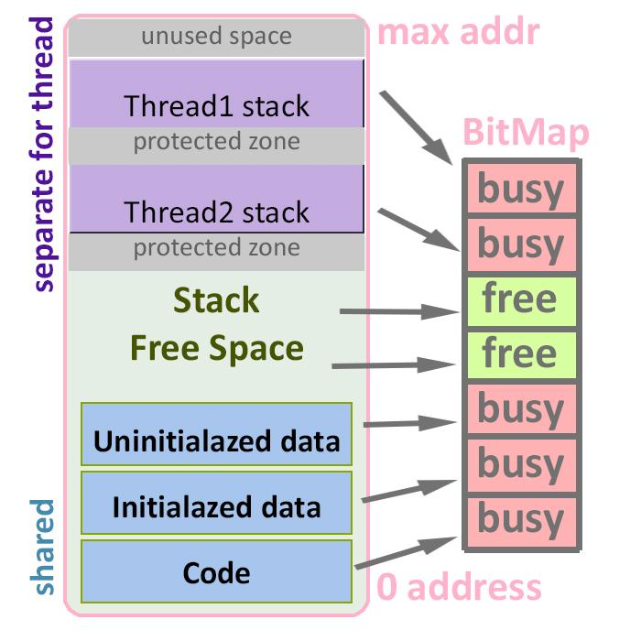
Multithreading. Thread allocation.
Features:
Same address space shared by several threads
Mapping of the free regions of address space
Independent thread stack
Bounded thread stack to protect the whole address space

Slide 9
Problems of Thread concept
Run out of space. Modern applications have big needs in memory.
Fragmentation
Internal. Address space contain unused regions.
External. Removing of useless regions creates free chunks of different size.
Security problem of shared address space

Slide 10
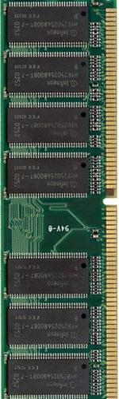
Address Mapping
Virtual memory
Physical memory
Page
0.000 0.001 0.002
0.003 0.004 0.005
0x00000 0x0ab42
0x01287 0x0a345 0x00324 0x00534
Frame
Frame provider Finds free memory as:
First free
Last free
Random free
Block free
Page
Frame
Page
Frame
Page
Frame
Page
Frame
Page
Frame

Slide 11
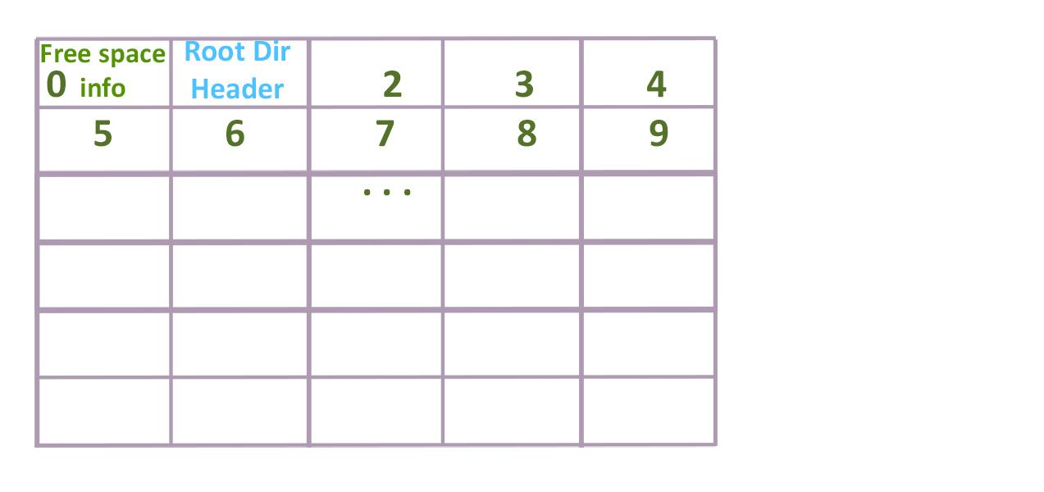
File System
Disk structure is based on bitmap 0 - Free space 1 - Root Directory

Slide 12
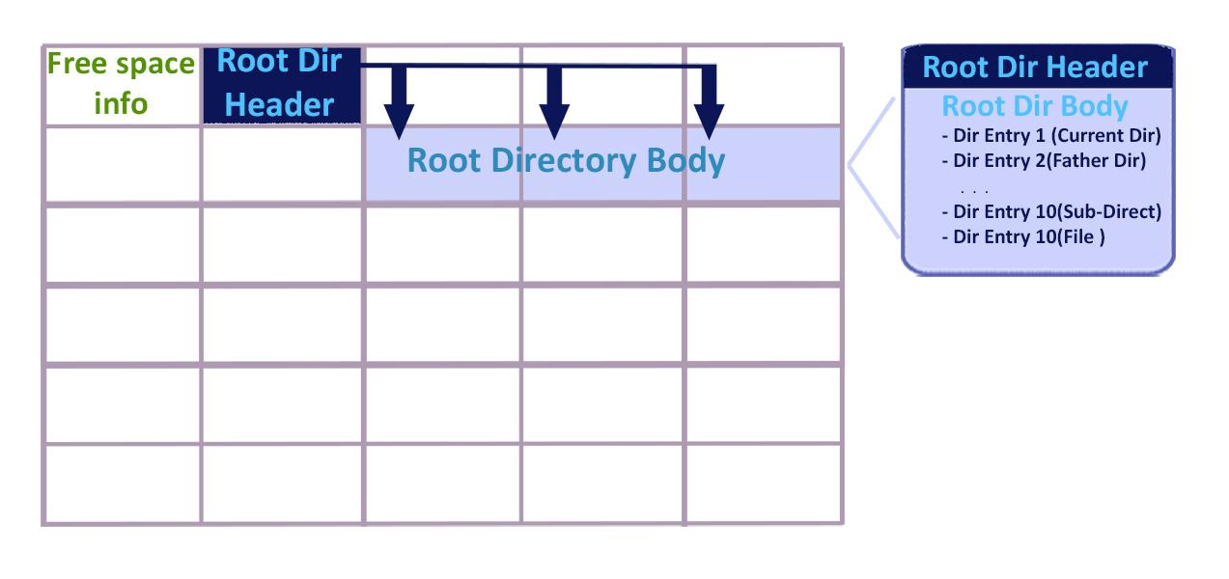
File System

Slide 13
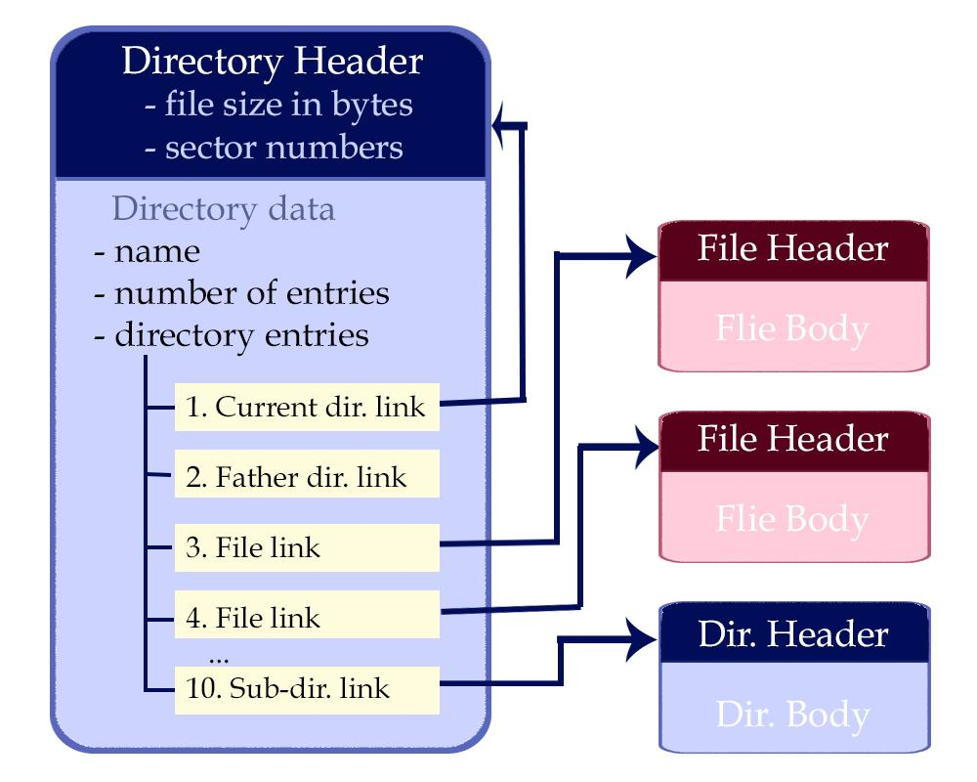
File System. Sub-directory
Flag IsSubDir in entry says if file or sub-directory

Slide 14
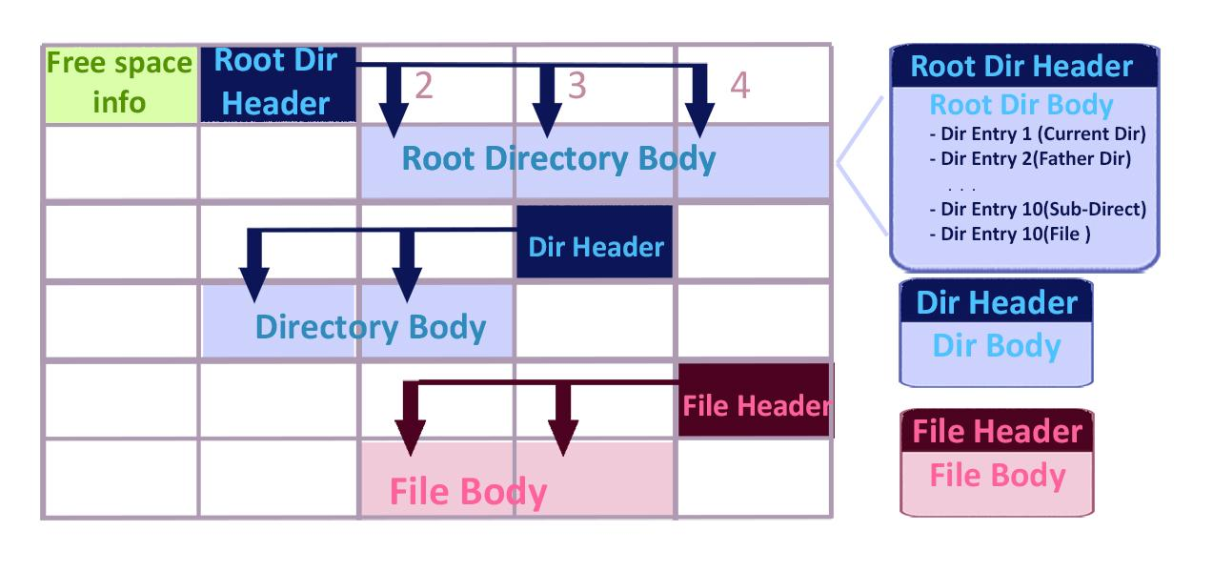
File System. Sub-directory
Flag isSubDir in entry shows if file or sub-directory

Slide 15
File System. Increase the File Size
FileHeader
int NumBytes int NumSectors
IndirectLink
int indirectLink
int doubleIndirect
data sector
data sector
data sector
…..
data sector
data sector
data sector
data sector
data sector
…..
data sector
data sector
32
28
(28*32*32)/8 + (32*32*32)/8 = 7680 Bytes

Slide 16
File System. Increase the File Size
FileHeader
IndirectLink
NumBytes NumSectors
IndirectLink
32
indirectLink
doubleIndirect
DoubleIndirect
32
IndirectLink
32
28
32
(28*32*32)/8 + (32*32*32)/8 +(32*32*32*32)/8 = 138752 Bytes

Slide 17
File System. List of Open files IOpen Files Table
ID OpenFile *
Table is attribute of Thread
Open ID (0-9) Allows to Thread open up to 10 files
0 Pointer to OpenFile 1 object … 9
But what for Multi Threading?....

Slide 18
File System. Access Rules
Thr1 Read Thr2 Write Thr2 Write
Thr1 Read Thr2 Read Thr2 Read
Thr1 Write Thr2 Write/ Thr2 Write/Read Read
Thr1 - Thr2 Write Thr2 Write
Mode Disk Sector Num
Defined in FileSystem object
Add and Check in the table is atomic
Read / Each file Write contains sector

Slide 19

Networking
Communication between machines M - Messages A - Acknowledgements
M+A A SENDER RECEIVER
Problem has no solution (theoretically proved)
Needs to generate a unique acknowledgement key for each message
Multithreaded system (adapt the user synchronisation)

Slide 20
Networking
Communication between machines M - Messages A - Acknowledgements
M+A
M+A SENDER RECEIVER A
Problem has no solution (theoretically proved)
Needs to generate a unique acknowledgement key for each message
Multithreaded system (adapt the user synchronisation)

Slide 21
Console work
Multithreading
Virtual Memory
File system
Networking
Improve Console Usability Multi Thread access Synchronization
Protected access to shared resources Data safety
Provide virtual address space abstraction Increasing the size of memory Security
Directory tree Browsing & manipulating with files and directories Security
Reliable protocol to send data between machines
Features

Slide 22
./nachos-thank-you
|

