Slide 1
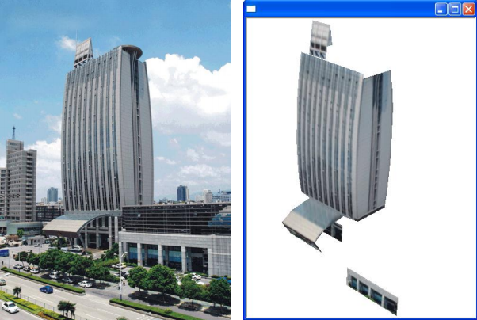
Semi-Automatic 3D Reconstruction of Piecewise Planar Building Models From Single Image
Chen Feng¹ | Fei Deng² | Vineet R. Kamat¹
PhD Student | Associate Professor | Associate Professor
¹Construction Engineering and Management Program Department of Civil and Environmental Engineering University of Michigan ²School of Geodesy and Geomatics, Wuhan University
28 October 2010

Slide 2
Outline
Background
Traditional Single View Reconstruction (SVR)
General Schema
Vanishing Point Calibration
Reconstruction Using Constraints
Semi-Automatic SVR
Assumptions
General Schema
Experiment Results

Slide 3
Background : What if…
Scenarios
User have only one picture of the scene
User have a painting that satisfies central projection
This requires a reconstruction algorithm that
Needs only one image (Multiple View Reconstruction)
No need for special devices (Structural light)
Relatively large applicability
One possible solution : Single View Reconstruction (SVR)

Slide 4
Outline
Background
Traditional Single View Reconstruction (SVR)
General Schema
Vanishing Point Calibration
Reconstruction Using Constraints
Semi-Automatic SVR
Assumptions
General Schema
Experiment Results

Slide 5
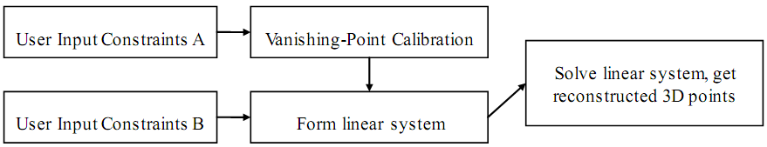
Traditional SVR : General Schema
Constraints A are usually parallel constraints
Constraints B are mainly coplanar constraints
Notes:
Parallel constraints: are used for camera calibration using vanishing points
Coplanar constraints: are used to form a set of linear equations to be used for reconstruction

Slide 6
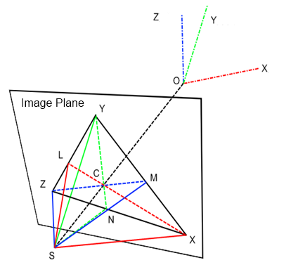
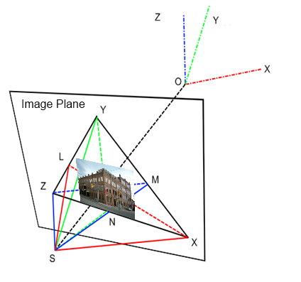
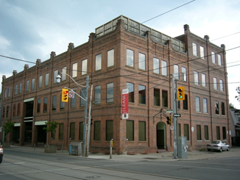
Traditional SVR : Vanishing Point Calibration
If 3 orthogonal VPs are found, the camera's intrinsic parameters i.e. focal length f, principle point x0, y0 can then be determined.
Notes:
Vanishing Point (VP): is the intersection point of a group of image lines whose 3D correspondent lines are parallel to each other.
This means a VP in image plane corresponds to a 3D direction.
e.g. Think of a image of railway tracks, typically they will intersect
Othogonal: Three VPs whose 3D correspondent directions are perpendicular to each other, then we say they are 3 orthogonal VPs.

Slide 7
Traditional SVR : Reconstruct Through Constraints
Mathematically, the SVR problem can be seem as an optimization problem
However, there are infinite number of solutions for the above equation, so constraints are needed
Typical constraints used:
Coplanarity
Parallelogram
Notes:
First equation: X is the world 3D point to be reconstructed, x if the measured image point, K is the camera intrinsic parameter matrix, f is the projection function.
Think like this, once the camera is calibrated, any point on image plane corresponds to a ray in space connecting that point with camera’s projection center. Then, to reconstruct this point, the only unknown is the distance between that camera center and this point. If we know the distance, we can easily find it along that ray. However, WITHOUT any constraint, this point can be anywhere along that ray.
In order to use coplanarity constraint, the normal direction of the plane relative to the camera coordinate system has to be specified MANUALLY
For users convenience, we propose Parallelogram constraint so no normal information needed

Slide 8
Outline
Background
Traditional Single View Reconstruction (SVR)
General Schema
Vanishing Point Calibration
Reconstruction Using Constraints
Semi-Automatic SVR
Assumptions
General Schema
Experiment Results

Slide 9

Semi-Auto SVR : Assumptions
No radial distortion
Camera calibration matrix has the following form:
Camera coordinate system is the world coordinate system
We can always find 3 directions perpendicular to each other in a building scene and their corresponding VPs in the image
Notes:
The fixed form of calibration matrix/ intrinsic parameter matrix means the only unknown here is focal length
Those assumptions are easy to be satisfied in building scenes

Slide 10
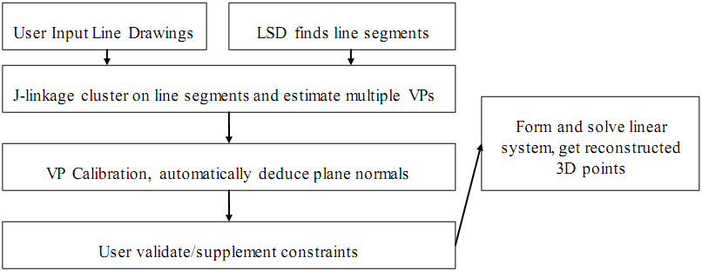
Semi-Auto SVR : General Schema
Notes:
INPUT: The only input our proposed method required is a line drawing of the building’s outline
LSD: is line segments detector, it finds line segments efficiently, newly proposed
J-linkage: automatically classify those line segments according to their intersection points with others, thus achieve VP calibration
Normal deduction: Using J-linkage VP calibration we can also automatically GUESS the plane normal, according to the line segments direction we get

Slide 11
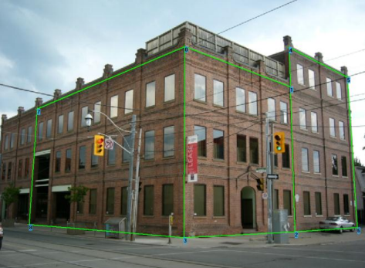
Semi-Auto SVR : User Input
Notes:
Draw an outline, algorithm will automatically analyze coplanar constraints (polygons)

Slide 12
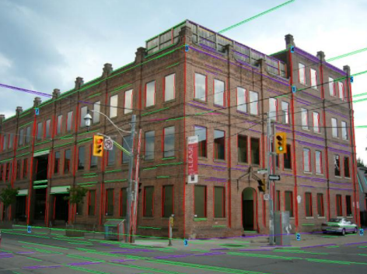
Semi-Auto SVR : LSD + J-linkage
Notes:
Green lines, Red lines and Purple lines are 3 group of orthogonal lines, thus 3 orthogonal VPs

Slide 13
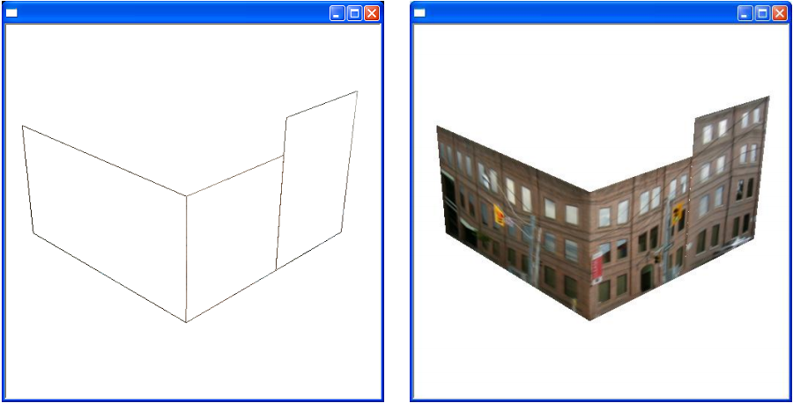
Semi-Auto SVR : Result (1)

Slide 14
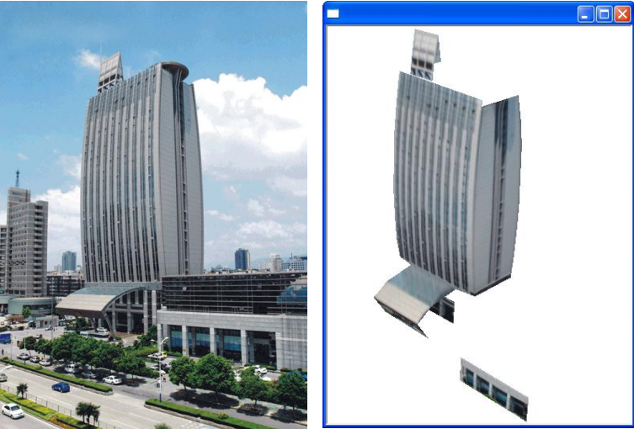
Semi-Auto SVR : Result (2)
Notes:
This model we use piecewise planar approximation to handle the curve surface: it is decomposed into pieces of plane structures

Slide 15
Selected References
Caprile, B. and Torre, V. (1990). “Using vanishing points for camera calibration.” International Journal of Computer Vision, 4, 127-139.
Sturm, P. and Maybank, S. J. (1999). “A method for interactive 3d reconstruction of piecewise planar objects from single images.” British Machine Vision Conference, Nottingham, England, 1999.
Grossmann, E. and Santos-Victor, J. (2005). “Least-squares 3D reconstruction from one or more views and geometric clues.” Computer vision and image understanding, 99, 151-174.

Slide 16
END
Any Questions?
Thank You!

