Slide 1
Homework #1
Program
Implement Knuth-Morris-Pratt Algorithm (KMP) to find the input pattern.
If find return the index If not find return -1
Give two inputs string S and pattern P, search the pattern P in S. Example
Case 1:
Input: helloworld, hello
Output: 0 Case 2:
Input: helloworld, hi
Output: -1

Slide 2
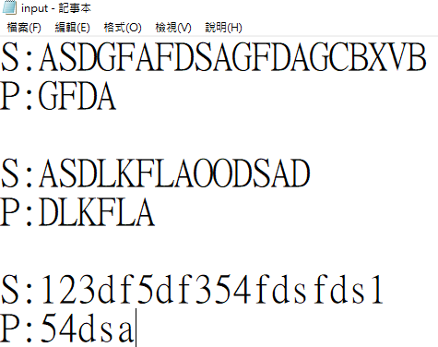
Homework #1
Input
Please use fstream to read the input file “input.txt”. Input format:
S : string P : pattern
Example:
Testbench 1
S : string
P : pattern
Testbench 2
S : string P : pattern
…
Testbench 3

Slide 3
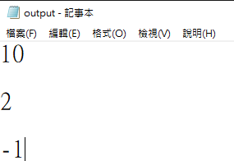
Homework #1
Output
Please output the results to the output file “output.txt”. Output format:
Example:
The result of the testbench 1 The result of the testbench 2 The result of the testbench 3
…

Slide 4
Homework #1
Language
Please use C++ language to implement your program.
Please upload your source code as well as executable file to Moodle. e.g., KMP_E12345678.cpp and KMP_E12345678.exe
Your student ID Your student ID

