Slide 1
Homework 4 (Due date: 2024/4/9)
13.1.5
13.1.6
13.1-7
13.2-4
13.3-2
13.3-3
14.1-2
14.1-6
14.2-1
14.2-5
14.3-3
14.3-4
14.4-1
14.4-4
14.5-2
Program exercise: Write programs in C, C++, or Python to
  Implement the various operations of Red-Black trees in Section 13.1, 13.2, and 13.3. Read “input.txt” which has the same format as homework 1 and construct a Red-Black tree. Implement a pre-order traversal operation to print information (key, color) of each node.
  Implement the Matrix-Chain-Order algorithm.
Homework.4

Slide 2
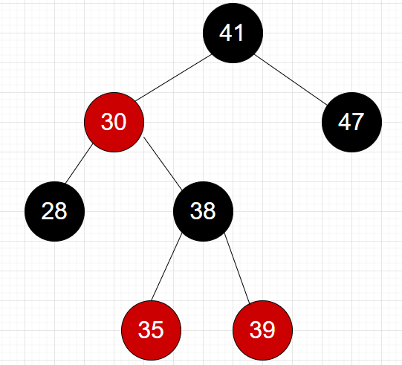
Problem 1: Red black tree output Example
Pre-order traversal:
output.txt :
line 1: 41 black
line 2: 30 red
line 3: 28 black
line 4: 38 black
line 5: 35 red
line 6: 39 red
line 7: 47 black
Homework.<number>

Slide 3
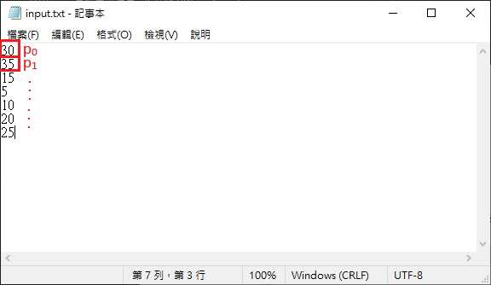
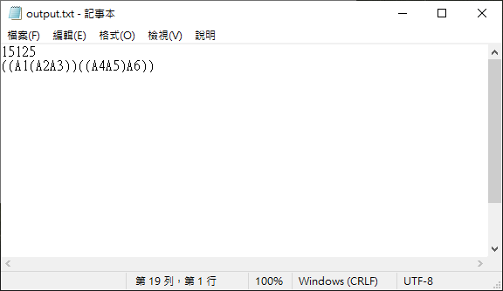
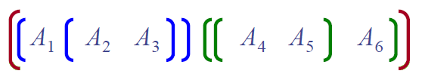
Problem 2: Matrix-Chain-Order Algorithm
Example:
matrix
dimension
A₁
(p₀) 30 × 35 (p₁)
A₂
35 × 15 (p₂)
A₃
15 × 5 (p₃)
A₄
5 × 10 (p₄)
A₅
10 × 20 (p₅)
A₆
20 × 25 (p₆)
Optimal solution:
(1) 15125 scalar multiplications
(2)
Homework.<number>

Slide 4



File Organization
Use the similar submission style you were requested for Homework #3.
For the program exercise problem 1 and 2., the input file and output file names must be “input.txt” and “output.txt”. You don’t need to hand them in.
Please follow the file hierarchy and the naming rules specified below.
E240XXXXX_hw4_v1.tar (.zip)
E240XXXXX_hw4_v1
E240XXXXX_hw4_hand.pdf
E240XXXXX_hw4_prog.pdf
Program Files
(Augmented Red-Black Tree/Matrix-Chain Order Algorithm)

