Slide 1
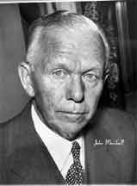
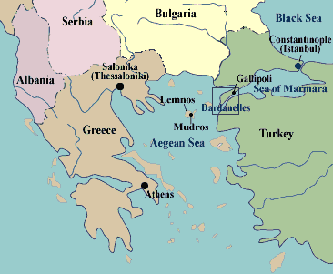
The Marshall Plan aided Western Europe.
  Greece and Turkey not the only countries who needed aid from U.S.
    World War II left many countries in ruins.
    Secretary of State, George Marshall argued that the U.S. needed to do something fast.

Slide 2


Slide 3
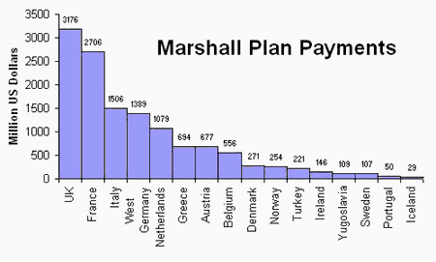
The Marshall Plan aided Western Europe.
Marshall presented a plan to offer extensive economic aid to all nations of Europe in June 1947. (Speech)
  16 W. European countries received almost $13 Billion in economic aid.
  E. Europe including the U.S.S.R. invited to participate.
    Only Yugoslavia accepted.

Slide 4
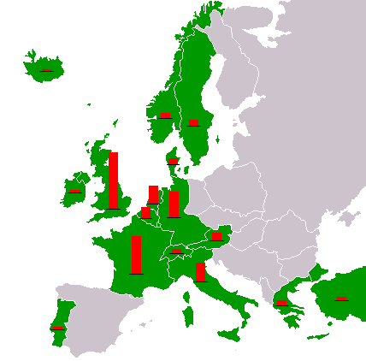

The Marshall Plan aided Western Europe.
Marshall Plan proved to be a great success.
  Within 4 years, countries receiving aid saw a 41% higher industrial production than on the eve of WWII.
  Countries were stabilized and exports were rising rapidly.

Slide 5
The Marshall Plan aided Western Europe.
U.S. benefited.
  U.S. govt. bought foods and goods from farms to be sent to Europe.
    U.S. farms and factories raised production to record levels.
  U.S. economy continued its wartime boom without faltering.
  W. Europeans became great consumers of American exports.

Slide 6
End of Notes Review Game
What was the name of the Secretary of State in 1945?
What was the reason that Marshall cited as the reason why all of Europe needed aid and not just Turkey and Greece?
How many countries received aid? How much total was given out by the United States?
What was the only Eastern European country to receive aid?
Was the Marshall Plan successful? What statistics can you cite?
Why would you say that the United States benefited from giving out aid?

Slide 7
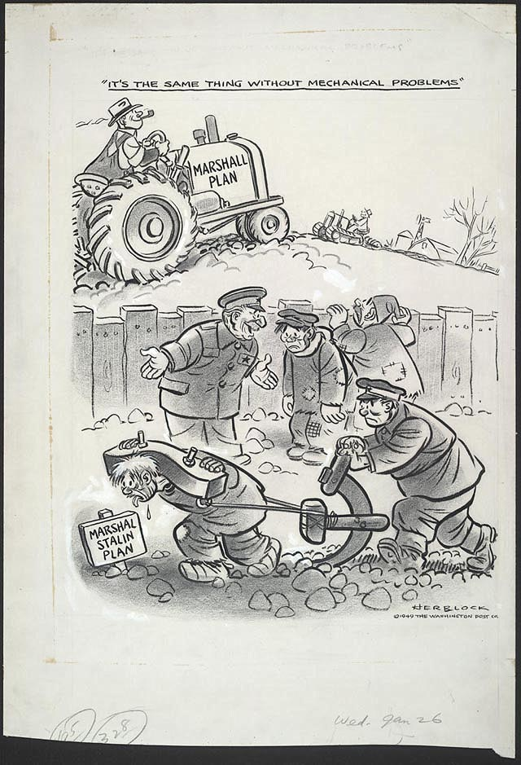
What is the message that the artist is trying to send?

Slide 8
Websites
Speech by George C. Marshall at Harvard University, June 15, 1947 Speech by George C. Marshall at Harvard University, June 15, 1947

