Slide 1
ITIV – Mini projet
Barras Simon, Rojas David, Steiger Damien

Slide 2
Context
Python with opencv
Merge images
Rebuild a plane
Compute homography

Slide 3
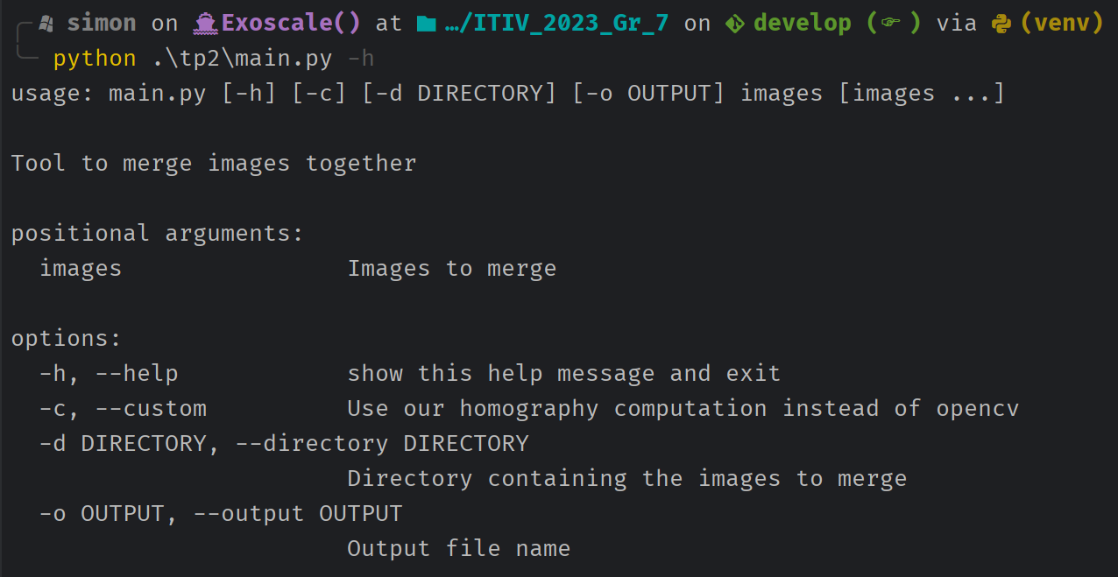
Our application

Slide 5
Our application
Image to add
Base image

Slide 6
Our application
Base image
Image to add

Slide 7
Our application
Base image
Image to add

Slide 8
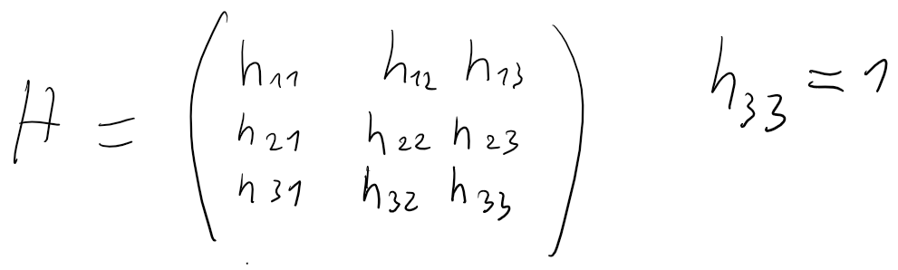
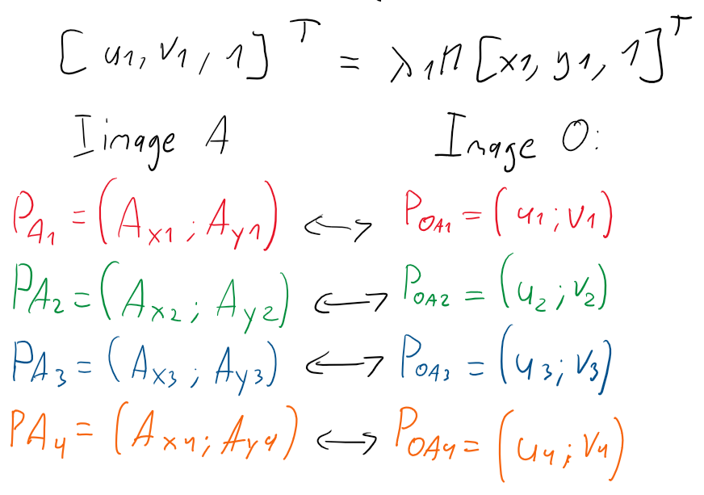
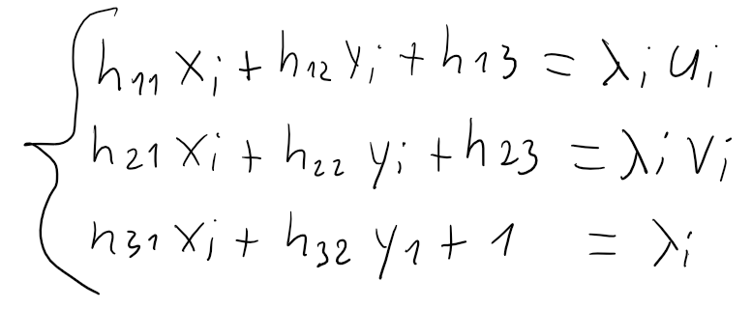
Homography
Projective transformation

Slide 9
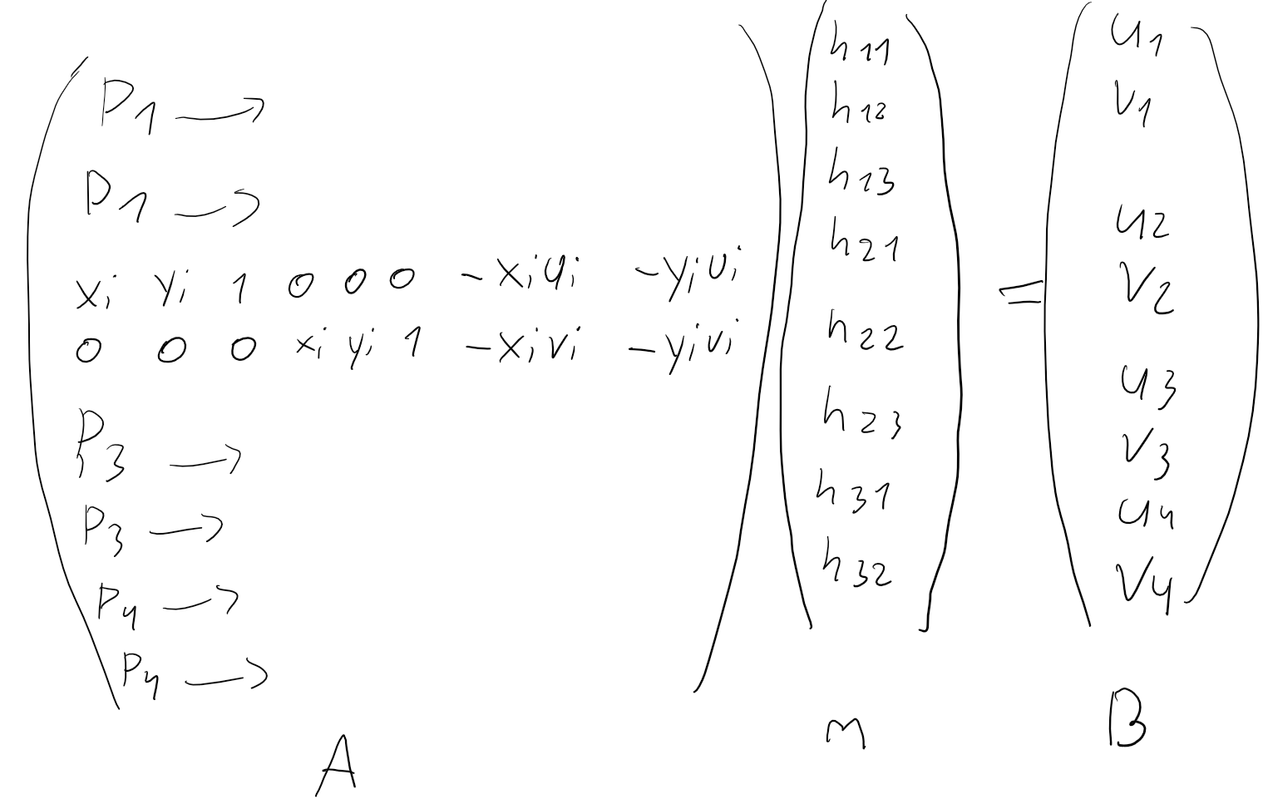
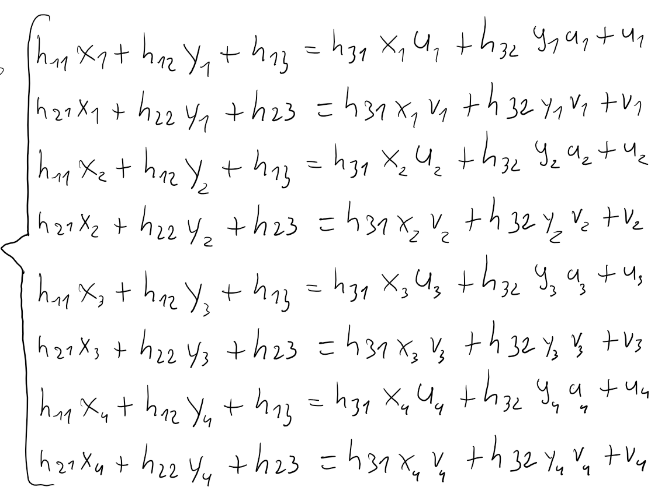
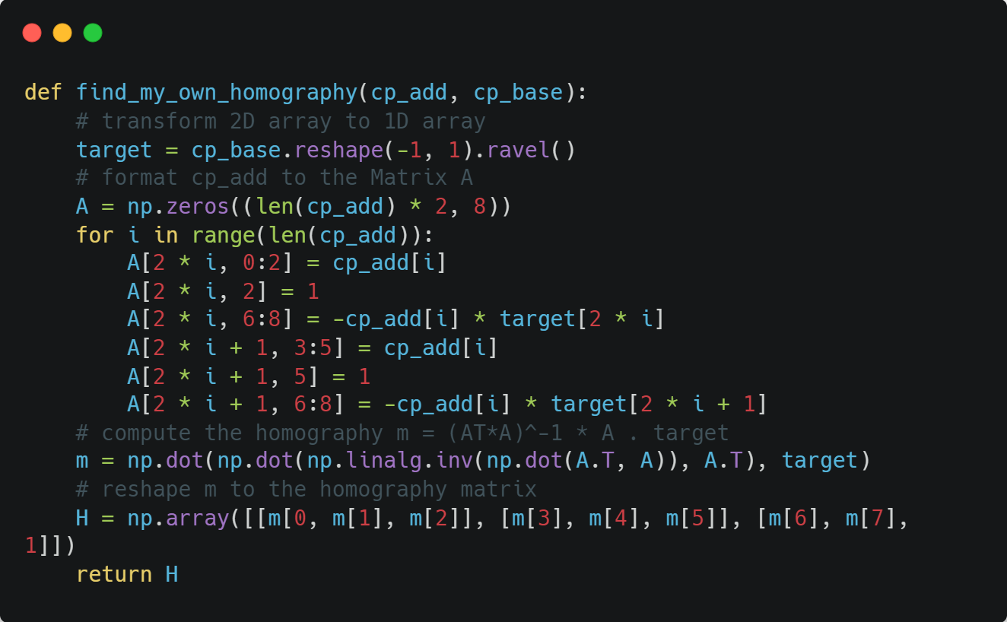
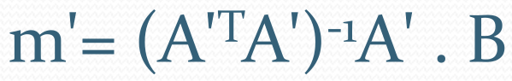
Homography

Slide 10
Todo
Documentation
Clean code
Increase UX with logs and commands

Slide 11
Organizations
Separate by method
Work when we have time
Simon
Work on the procedure to merge images
Our own homography computation
Add program arguments
Damien
Basis method
Selection of points on images + reset initial images
Demo method
David
First attempt at our own homography computation

Slide 12
Conclusion
Interesting
Original
Good project size

