Slide 1
◉ AudiGene
SEE. HEAR. UNDERSTAND DNA.
WHAT IF A MUTATION
COULD BE HEARD?
AudiGene connects sequence comparison, sonification and AI explanation in one workflow.
SEQUENCE
VARIANT
FREQUENCY
AUDIO
AI EXPLANATION
A biological event becomes a synchronized perceptual event.
AUDIGENE • AGENTIC BIOINFORMATICS • COMPARATIVE SONIFICATION
01

Slide 2
◉ AudiGene
SEE. HEAR. UNDERSTAND DNA.
01 • THE PROBLEM
Sequence data tells us WHAT changed. AudiGene asks: can we experience WHERE it changed?
Traditional sequence views separate alignment, plots, audio and interpretation. AudiGene links them.
CONVENTIONAL VIEW
AUDIGENE
ATGCCTGACGTTACGGTAC
G
E
N
E
A
One event. Four synchronized views.
ATGCCTGATGTTACGGTAC
G
E
N
E
B
POSITION
FREQUENCY
The difference exists — but the user must mentally connect position, variant, graph and interpretation.
WAVEFORM
EXPLANATION
The design target: reduce the cognitive gap between detecting a sequence difference and understanding it.
AUDIGENE • AGENTIC BIOINFORMATICS • COMPARATIVE SONIFICATION
02

Slide 3
◉ AudiGene
SEE. HEAR. UNDERSTAND DNA.
02 • SCIENTIFIC ENGINE
The sonification is grounded in a published 2017 methodology — with provenance preserved.
Paper-derived rules are separated from AudiGene interpretations and product innovations.
01
02
03
04
05
Nucleotide Chroma
DNA Chords
Nucleotide Rhythm
DNA Walking
Codon Walking
A / C / G / T → pitch
C-major chord structure
rhythmic encoding
transition → interval
codon-aware progression
PROVENANCE
PAPER_EXACT
PAPER_QUALITATIVE
PAPER_DERIVED
AUDIGENE_INTERPRETATION
MAPPING EXAMPLE
A → 262 Hz C → 330 Hz G → 392 Hz T → 523 Hz
100 ms events • equal temperament
AUDIGENE • AGENTIC BIOINFORMATICS • COMPARATIVE SONIFICATION
03

Slide 4
◉ AudiGene
SEE. HEAR. UNDERSTAND DNA.
03 • AGENTIC ARCHITECTURE
AI orchestrates the investigation. Deterministic modules perform the scientific transformations.
This separation is the key to making the prototype explainable, testable and competition-grade.
INPUT
VALIDATE
ALIGN
DIFFERENCES
SONIFY
EXPLAIN
FASTA / sequences
biological format
sequence relationship
substitution / indel
event → frequency
LLM over evidence
AI LAYER
DETERMINISTIC CORE
OBSERVABILITY
Claude 3.5 Sonnet
Analysis + event timeline
Every event has a position + cause
Agentic orchestration + natural-language explanation
Unit-testable scientific transformations
The user can trace what the agent did.
AUDIGENE • AGENTIC BIOINFORMATICS • COMPARATIVE SONIFICATION
04

Slide 5
◉ AudiGene
SEE. HEAR. UNDERSTAND DNA.
04 • THE EXPERIENCE
The same biological event is rendered across the timeline — and the playhead keeps every modality synchronized.
This is the moment to stop presenting slides and demonstrate the live system.
SYNCHRONIZED TIMELINE
POS 10
ATGCCGTTACTGACGTTA
A
ATGCCGTGACTGACGTTA
B
POSITION
FREQUENCY
WAVEFORM
SPECTRUM
sequence alignment
mapped pitch
rendered audio
frequency content
AUDIGENE • AGENTIC BIOINFORMATICS • COMPARATIVE SONIFICATION
05

Slide 6
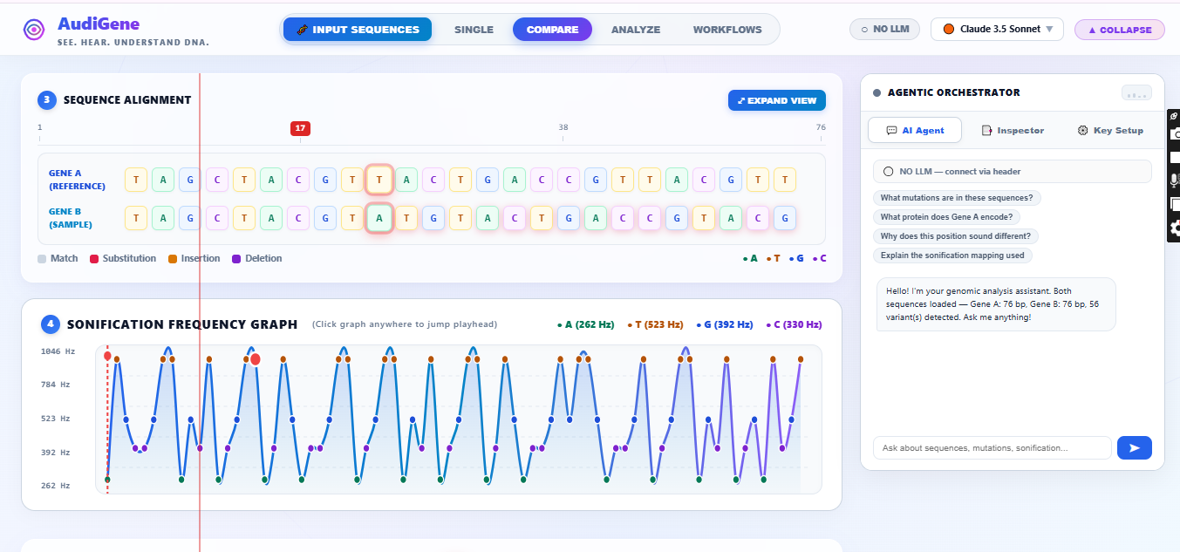
◉ AudiGene
SEE. HEAR. UNDERSTAND DNA.
05 • LIVE PROTOTYPE + IMPACT
Don't tell the judges it works. Let them watch one sequence difference become an explanation.
A 90-second demonstration is enough: validate → compare → play → pause → ask the AI.
LIVE DEPLOYMENT
audigene- tau.vercel.app
OPEN LIVE PROTOTYPE ↗
DEMO SCRIPT
01 Load two sequences
02 Validate the input
03 Compare + detect differences
04 Press PLAY
05 Pause on the red playhead
06 Ask: “Why did I hear that?”
THE PROMISE • See the difference. Hear the difference. Understand the difference.
AUDIGENE • AGENTIC BIOINFORMATICS • COMPARATIVE SONIFICATION
06

