Slide 1
Machine Learning-Based Structural Analysis
of Disease-Associated TP53 Mutations
A reproducible pipeline: ClinVar variants → structural features → trained classifier → live HTML predictor
Simbisai Chinhema · Bioinformatics · 2026
Academic research prototype — NOT a clinical diagnostic tool
TP53 Mutation Analysis · Research prototype — not a clinical tool · 1

Slide 2
PROBLEM STATEMENT
Why TP53, and what problem are we solving?
TP53 encodes tumor protein p53, a tumor-suppressor transcription factor. Missense variants in its core DNA-binding domain are among the most common cancer-associated mutations.
Core question: can a reproducible pipeline link curated TP53 variant annotations to quantitative sequence/structural features — and learn that association with machine learning?
Why TP53: canonical 393-aa isoform fully verifiable (UniProt P04637) · structured core domain (~94–292) with experimental structures (PDB 2OCJ) · rich curated labels in ClinVar.
Ground rule: association, never causation — structural deviation alone never proves pathogenicity.
TP53 Mutation Analysis · Research prototype — not a clinical tool · 2

Slide 3
OBJECTIVES & RESEARCH QUESTIONS
All five questions answered with evidence
Objectives: verify WT sequence → validate WT structure vs experiment → curate variants → build real mutant proteins → engineer leak-free features → train & audit → serve a live predictor.
RQ1 — WT sequence reproducible? YES: 393/393 (100%) vs live UniProt P04637.
RQ2 — AlphaFold WT matches experiment? YES: 0.37–0.67 Å CA-RMSD over 194 core residues vs 2OCJ (consistency — templates enabled).
RQ3 — Variant effects measurable? YES: 388 mutants built; WT-vs-mutant windows + demo table.
RQ4 — Features inform classification? YES (prototype): held-out F1 0.88 / ROC-AUC 0.94.
RQ5 — Top features? WT pLDDT context, Zn-distance, core/position flags (association only).
TP53 Mutation Analysis · Research prototype — not a clinical tool · 3

Slide 4
TECH STACK
Small, reproducible, no over-engineering
Data: NCBI ClinVar E-utilities (live fetch) · UniProt P04637 · RCSB PDB 2OCJ · AlphaFold Server models.
Compute: Python 3 · pandas · scikit-learn (logistic regression + random forest, seed 42) · NumPy Kabsch superposition · matplotlib (every figure generated, none hand-drawn).
App: stdlib http.server backend loading the real model.joblib · single index.html + canvas 3D viewer (no frameworks, no fake predictions).
Reproducibility: one command per stage (README § How to Run) · scaler-in-Pipeline (no leakage) · provenance CSVs · results docs generated from artefacts.
TP53 Mutation Analysis · Research prototype — not a clinical tool · 4

Slide 5
END-TO-END PIPELINE
Completed WT work reused — nothing rebuilt
Stage A — WT baseline (reused): TP53 CDS → verified 393-aa WT → 5 AlphaFold models → 2OCJ overlap validation.
Stage B — Variants (new): ClinVar 4034 records → 388 labelled missense (VCV-traceable) → 388 real mutant protein sequences.
Stage C — Learning (new): 21 leak-free features → stratified 80/20 split → baselines → held-out audit (all 388 predicted, 12 mistakes analysed).
Stage D — Product (new): model.joblib → predict.py → HTML dashboard (verdict + 3D residue view + cohort results).
Every number shown originates from the pipeline — results docs are generated from artefacts, never hand-copied.
TP53 Mutation Analysis · Research prototype — not a clinical tool · 5

Slide 6
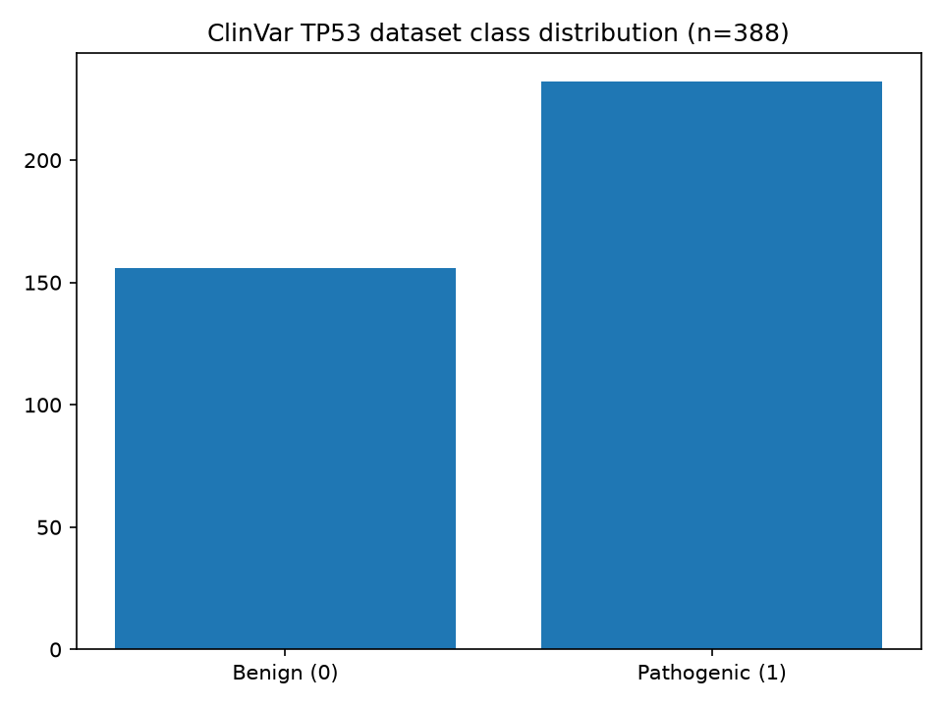
DATA I — WT BASELINE + VARIANT DATASET
Traceable: no invented mutations
WT: 393 aa, 100% identity to live P04637 · core pLDDT 97.89 (model_4) · 2OCJ X-ray 2.05 Å, residues 96–289.
Variants: n = 388 (232 pathogenic / 156 benign) · 0 duplicates · 0 missing · positions 4–393.
Excluded with logged counts: 2512 non-missense · 609 VUS · 454 conflicting · 11 unclassified (no silent label mixing).
Includes expert-panel hotspots R175H, R248Q/W, R273H, G245S, Y220C · benign control P72R.
TP53 Mutation Analysis · Research prototype — not a clinical tool · 6

Slide 7
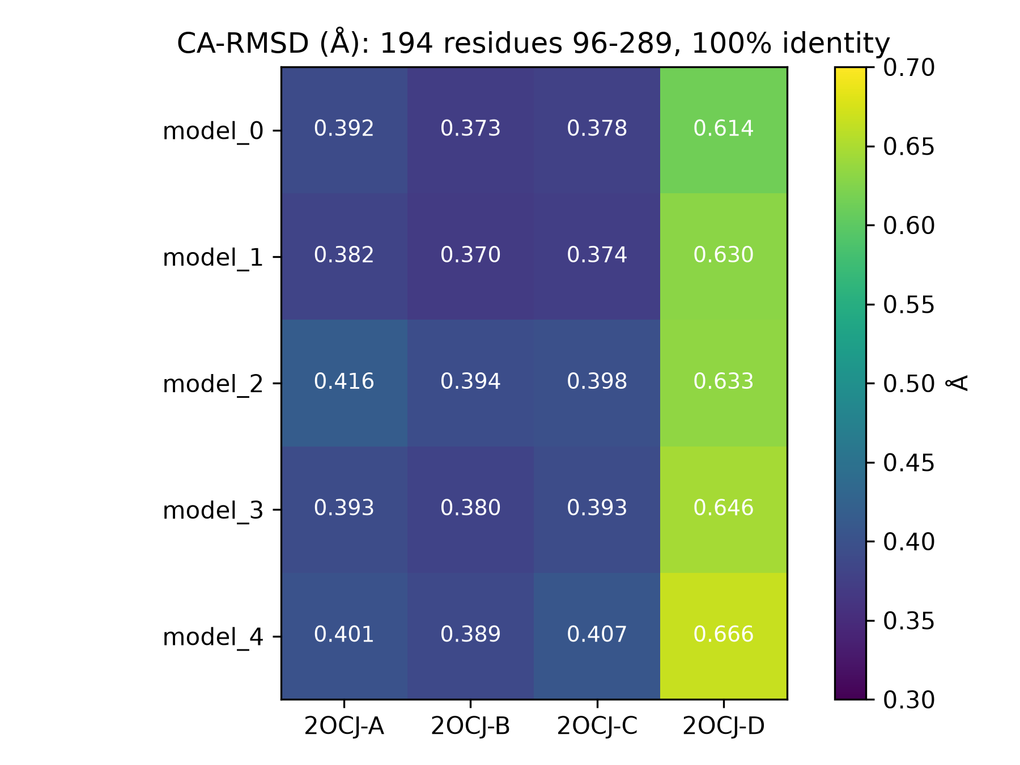
DATA II — STRUCTURAL VALIDATION
Experiment vs prediction, honestly caveated
2OCJ covers the core only (96–289): all comparisons restricted to the 194-residue overlap at 100% identity.
Result: 0.37–0.67 Å CA-RMSD, all 5 models × chains A–D — sub-angstrom core agreement.
Caveat on record: templates (5XZC/6RZ3/4QO1/2WGX) were enabled → consistency, not blind validation; termini unbenchmarked.
Biology reused as features: per-position pLDDT, UniProt domain, Zn-ligand distance, literature DNA-contact flag.
TP53 Mutation Analysis · Research prototype — not a clinical tool · 7

Slide 8
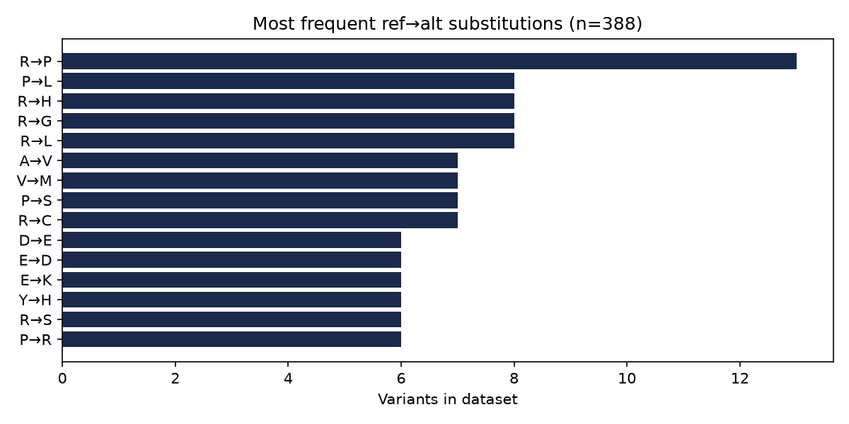
RESULTS I — 388 REAL VARIANT PROTEINS
Exact mutant sequences, WT-verified
Each mutant = verified WT with exactly one validated substitution · all 393 aa · all 388 sequences unique (MD5 ledger).
Example R175H window: WT HMTEVVRRCPHHERC → mutant HMTEVVRHCPHHERC (position 175).
Example R248Q window: WT SCMGGMNRRPILTII → mutant SCMGGMNQRPILTII (charge −1, Grantham 47.4).
No mutant 3D structure is claimed — exact sequences only; re-prediction is future work.
TP53 Mutation Analysis · Research prototype — not a clinical tool · 8

Slide 9
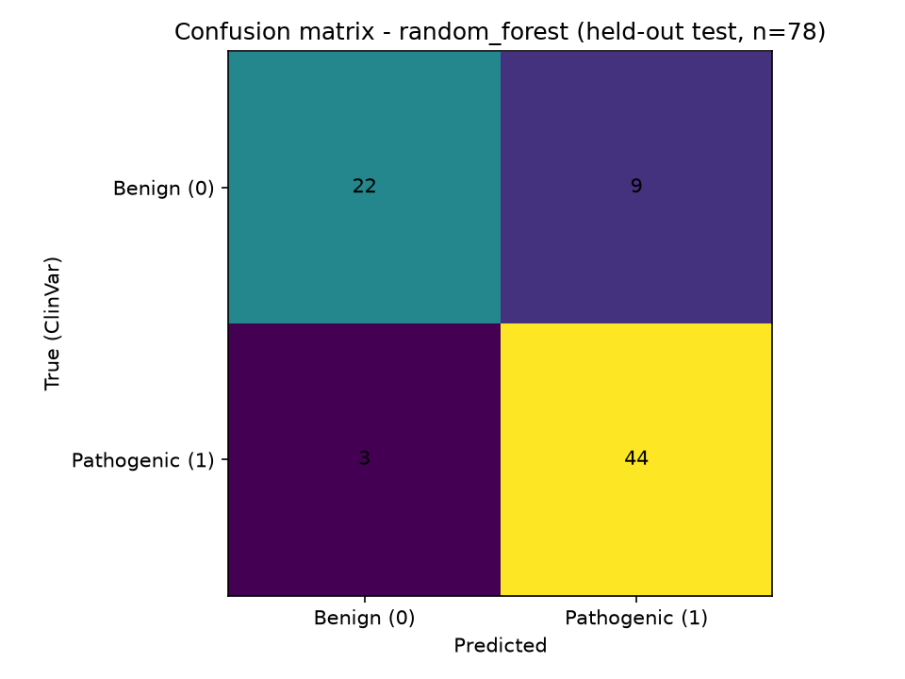
RESULTS II — MODEL & HELD-OUT EVALUATION (N = 78)
Real metrics, small-data caveats stated
Random forest (selected): acc 0.846 · prec 0.830 · rec 0.936 · F1 0.880 · ROC-AUC 0.937 (CV-F1 0.930±0.021).
Logistic regression: acc 0.744 · F1 0.800 · ROC-AUC 0.835 · confusion (RF): TN=22 FP=9 FN=3 TP=44.
Top features: plddt_at_pos, plddt_window5, dist_to_zn, pos_norm, in_core — pathogenic missense enriches in the ordered core (expected biology).
Limit: n=388 prototype; position carries hotspot signal → position-aware split + independent test = future work.
TP53 Mutation Analysis · Research prototype — not a clinical tool · 9

Slide 10
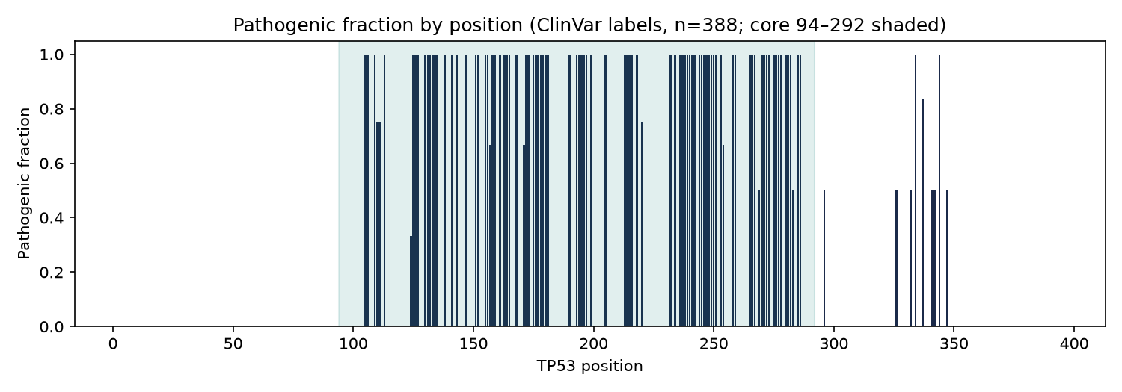
RESULTS III — FULL-COHORT AUDIT & HONEST ERRORS
All 388 predicted, 12 mistakes explained
All 388 variants predicted; test metrics reproduce exactly (acc 0.8462 / F1 0.88) — same split, no cherry-picking.
Pathogenic labels concentrate in the ordered core; benign outside it — the model learns this real enrichment.
Errors cluster where the pattern breaks: e.g. p.E326V (pathogenic, outside core, p=0.06) · p.M160I (benign, core, p=0.94).
Full audit: results/machine_learning/all_predictions.csv · error table: results/mutations/variant_proteins.md.
TP53 Mutation Analysis · Research prototype — not a clinical tool · 10

Slide 11
LIVE DEMONSTRATION — HTML PREDICTOR
Real model, real predictions — try it now
Start: python3 dashboard/server.py → http://127.0.0.1:8000 (model preloads in ~20 s).
Type R 175 H → Pathogenic-associated (0.99) · R 248 Q → 0.99 · R 273 H → 0.96 · Y 220 C → 0.97.
Type P 72 R → Benign-associated (0.00) — the benign control.
Each result shows: verdict + probability meter · domain / pLDDT / Grantham context · interactive 3D WT structure with the residue highlighted · pLDDT charts · full cohort audit with clickable mistakes.
Invalid input (wrong ref, pos 999, alt = ref) → clean error message, never a stack trace.
TP53 Mutation Analysis · Research prototype — not a clinical tool · 11

Slide 12
LIMITATIONS, FUTURE WORK & TAKEAWAY
Honest science, reproducible repository
Limitations: n=388 germline ClinVar only · no mutant structure re-prediction · no clinical validity · PyMOL cartoons pending.
Next: multi-source data (COSMIC / IARC / cBioPortal) · mutant structure prediction · position-aware splits · independent test set · calibration.
Takeaway: a fully reproducible WT → variant-protein → feature → ML → dashboard pipeline with real evaluation — RQ1–RQ5 answered at prototype scope.
Reproduce: README § How to Run (10 commands) · questions welcome.
TP53 Mutation Analysis · Research prototype — not a clinical tool · 12

