Slide 1
RESEARCH UPDATE · NOVEMBER 2026
TP53 Pathogenicity Classification
Dataset Expansion · Fair 3-Model Benchmark · Kaggle Deployment
n = 388 → 818 ClinVar missense variants · Extra Trees / Random Forest / CatBoost under one protocol
21 leak-free features · seed 42 · test set never used for selection · GitHub + Kaggle reproducible
Simbisai Chinhema
Repository: github.com/simbisaichinhema/TP53-Sequence-Structure-and-Machine-Learning-
Kaggle: kaggle.com/simbisaichinhema/tp53-mutation-analysis
Research prototype
NOT a clinical tool

Slide 2
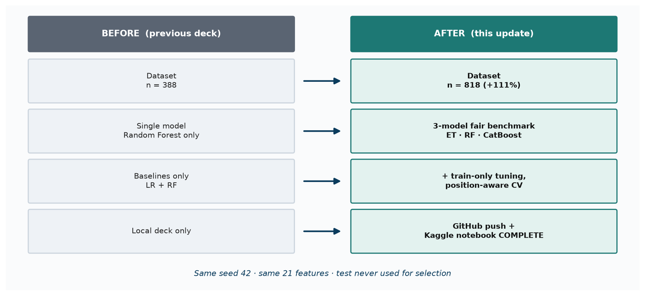
UPDATE SUMMARY
What changed in this update
02
DATASET
DEFAULT MODELS
FAIR PROTOCOL
DEPLOYMENT
818
3
5-fold
Live
405 P / 413 B
+111% vs 388
ET · RF · CatBoost
(top CV ROC-AUC)
CV on train only
seed 42, 654/164
GitHub main
Kaggle run COMPLETE
TP53 Mutation Analysis · research prototype — not a clinical tool

Slide 3
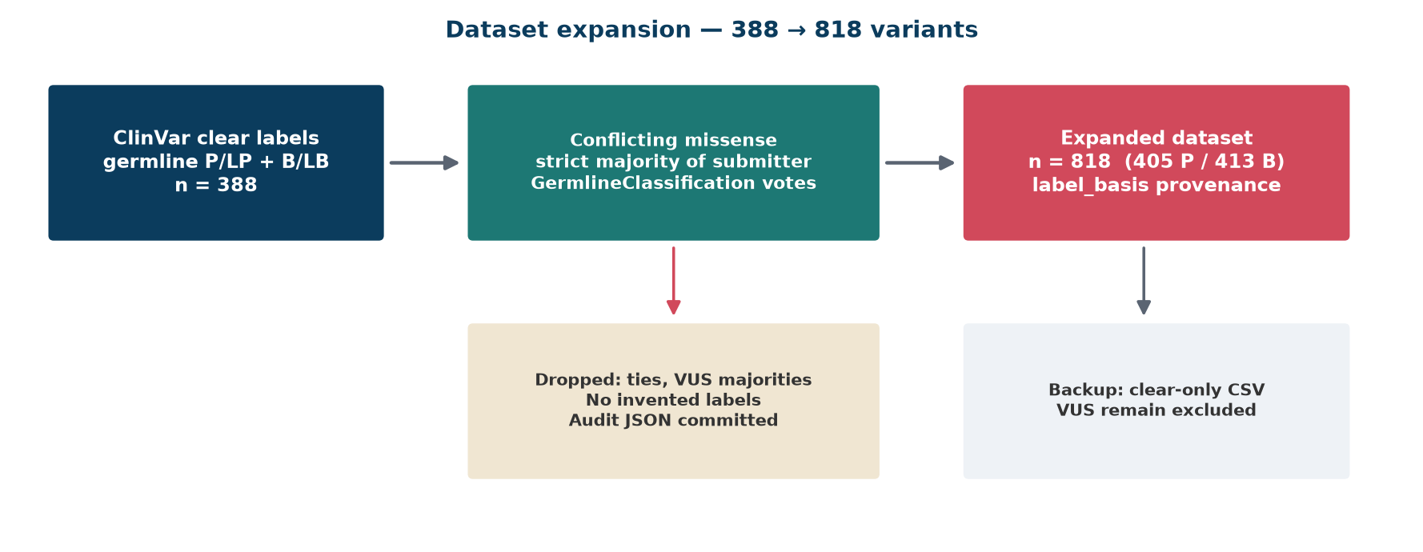
DATA I
Dataset expansion — conflict-majority without inventing labels
03
Cohort | n | Pathogenic | Benign | Label basis
Before (clear ClinVar only) | 388 | — | — | germline_clinvar
Conflict-majority added | +430 | — | — | germline_conflict_majority
After (this update) | 818 | 405 | 413 | both, provenance kept
Rules (no fabrication)
• VUS never given a label
• Ties / VUS majorities dropped
• Only strict majority of submitter
GermlineClassification votes
• Audit: clinvar_conflict_resolution.json
Split (seed 42): train 654 / test 164 · features rebuilt from the frozen 21-column matrix
TP53 Mutation Analysis · research prototype — not a clinical tool

Slide 4
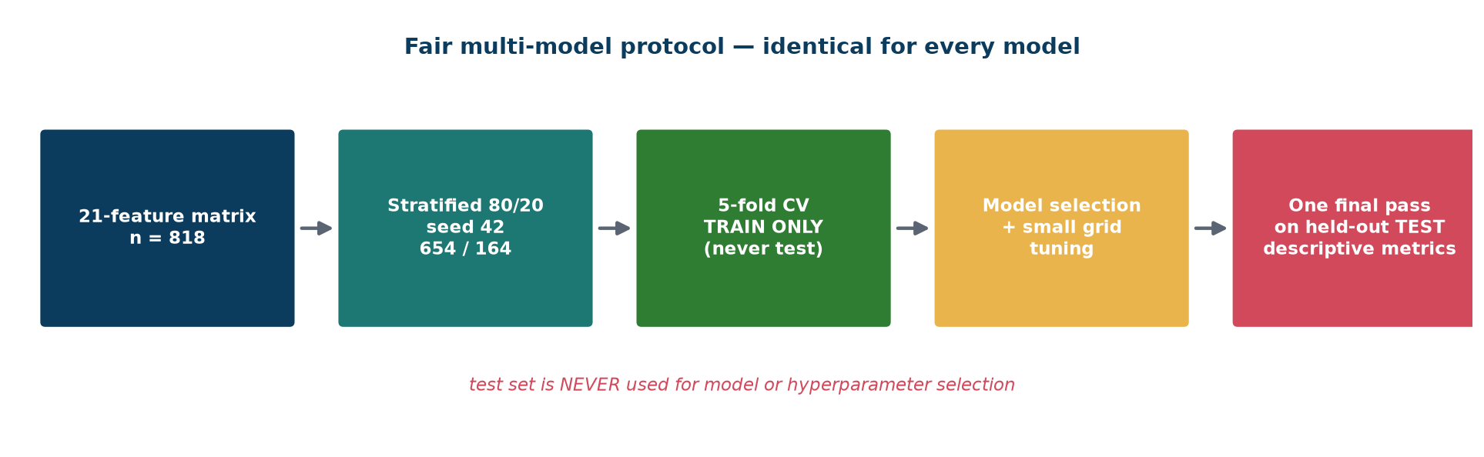
METHODS
One fair protocol for every model
04
Invariant | Setting
Feature matrix | same 21 columns (tp53_features.csv) for all models
Split | stratified 80/20, seed 42 → train 654 / test 164
Cross-validation | 5-fold stratified, TRAIN partition only
Preprocessing | StandardScaler inside Pipeline (linear/SVM only)
Class imbalance | balanced class weights or sample weights per fold
Selection | mean CV ROC-AUC on train; test used once, descriptively
Why this matters
Any model can look good on a
lucky split. Holding the test set
out of all selection decisions
makes the side-by-side table
an honest comparison — not a
leaderboard of overfits.
TP53 Mutation Analysis · research prototype — not a clinical tool

Slide 5
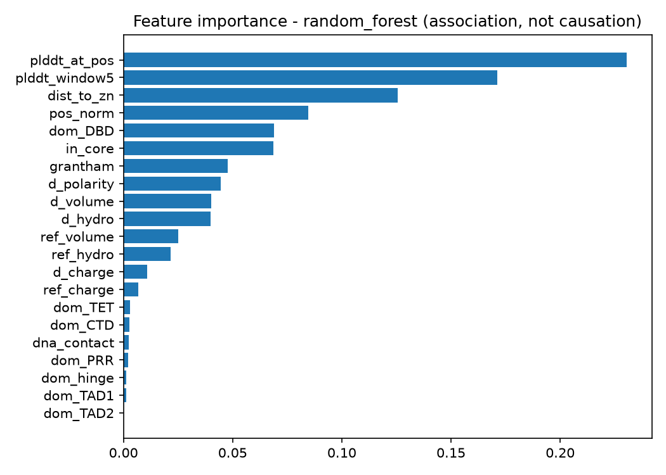
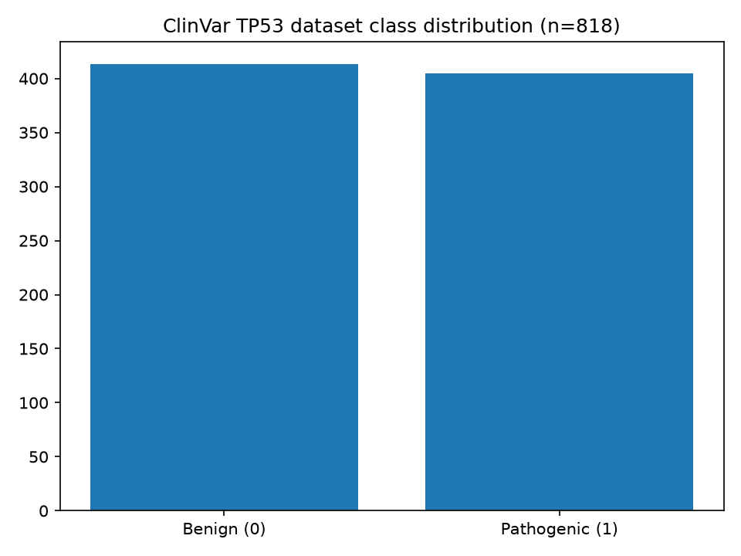
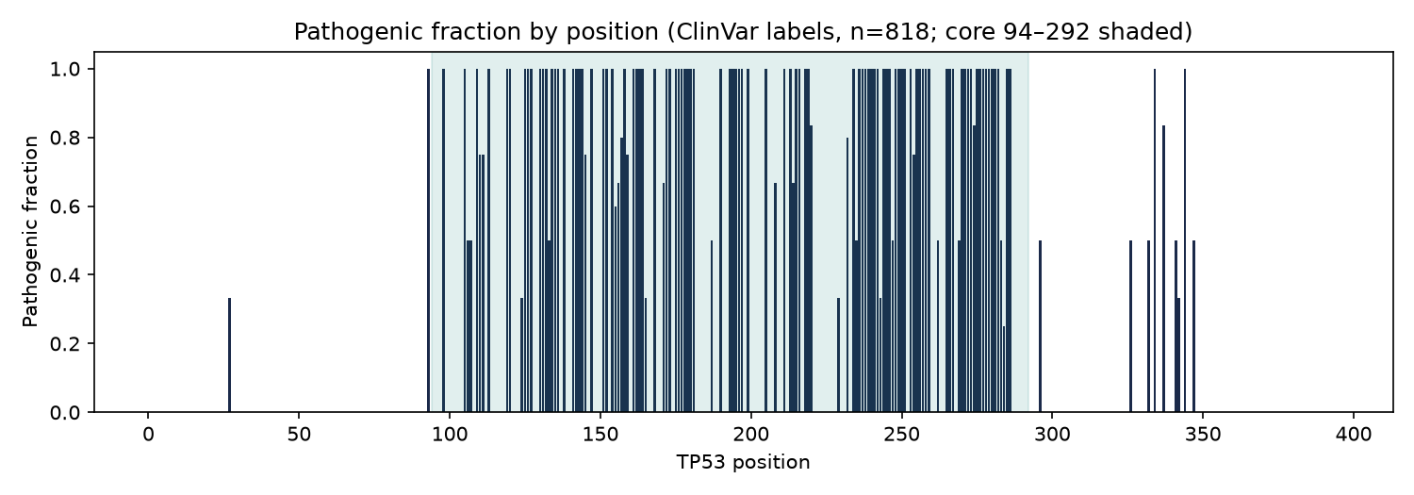
FEATURES
21 leak-free sequence & structural features
05
Grouped: domain flags (TAD/DBD/TET/…) · Grantham + AA property deltas · Zn-ligand distance · WT pLDDT context · DNA-contact flag · normalized position.
Importance = association only (random-forest Gini), not causation.
TP53 Mutation Analysis · research prototype — not a clinical tool

Slide 6
RESULTS I
Side-by-side — held-out test metrics (n = 164)
06
Model | Acc | F1 | ROC-AUC | PR-AUC | MCC | CV ROC-AUC | TN/FP/FN/TP
Extra Trees | 0.884 | 0.886 | 0.949 | 0.948 | 0.770 | 0.949±0.013 | 71/12/7/74
Random Forest | 0.890 | 0.893 | 0.946 | 0.939 | 0.783 | 0.948±0.016 | 71/12/6/75
CatBoost | 0.878 | 0.875 | 0.956 | 0.958 | 0.756 | 0.948±0.020 | 74/9/11/70
Baseline train.py comparison (same split, same features):
Baseline | Acc | F1 | ROC-AUC | CV F1 | Confusion
Logistic Regression | 0.842 | 0.857 | 0.917 | 0.848±0.039 | [[60,23],[3,78]]
Random Forest | 0.884 | 0.886 | 0.945 | 0.884±0.038 | [[71,12],[7,74]]
Winner by test ROC-AUC: CatBoost (0.956)
Winner by test F1: Random Forest (0.893)
Winner by accuracy: Random Forest (0.890)
How to read this table
• Every row uses the identical feature matrix, split and CV folds — no model gets an easier job.
• Selection criterion = mean CV ROC-AUC on TRAIN only (highlighted row). Test columns are descriptive.
• Range across the three models is small (ΔROC-AUC ≤ 0.011): they are statistically close on n = 164;
report them together rather than declaring a single champion from one split.
TP53 Mutation Analysis · research prototype — not a clinical tool

Slide 7
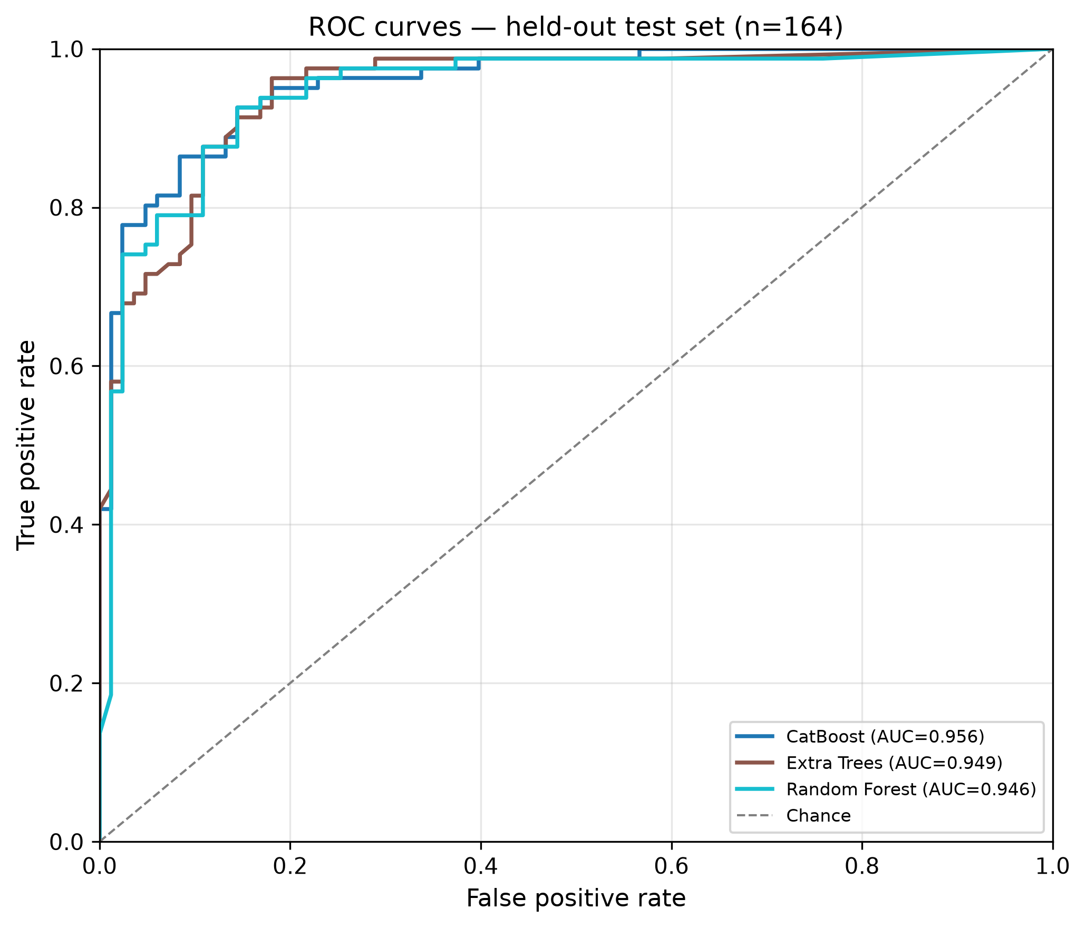
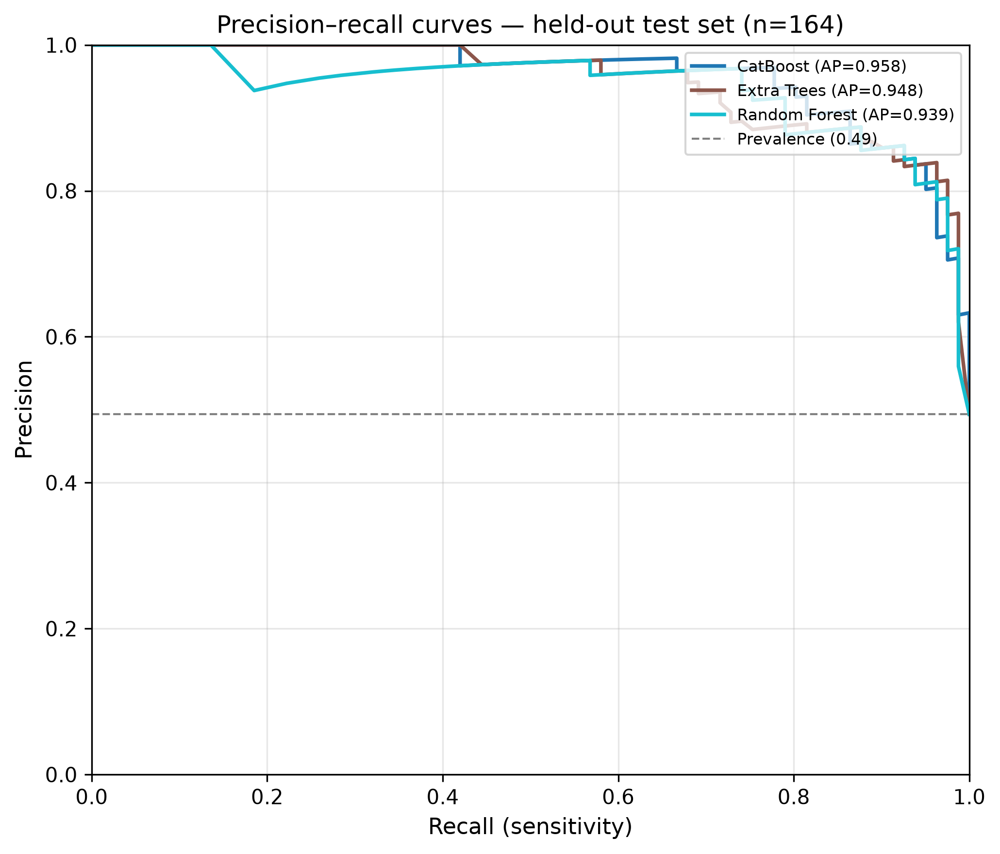
RESULTS II
ROC and precision–recall curves (held-out test)
07
All three curves sit high and tight (test ROC-AUC 0.946–0.956). PR-AUC is the more honest
metric on near-balanced classes (405/413): CatBoost leads PR-AUC, RF leads accuracy/F1,
Extra Trees leads train CV — the ordering depends on the metric, so all three are reported.
TP53 Mutation Analysis · research prototype — not a clinical tool

Slide 8
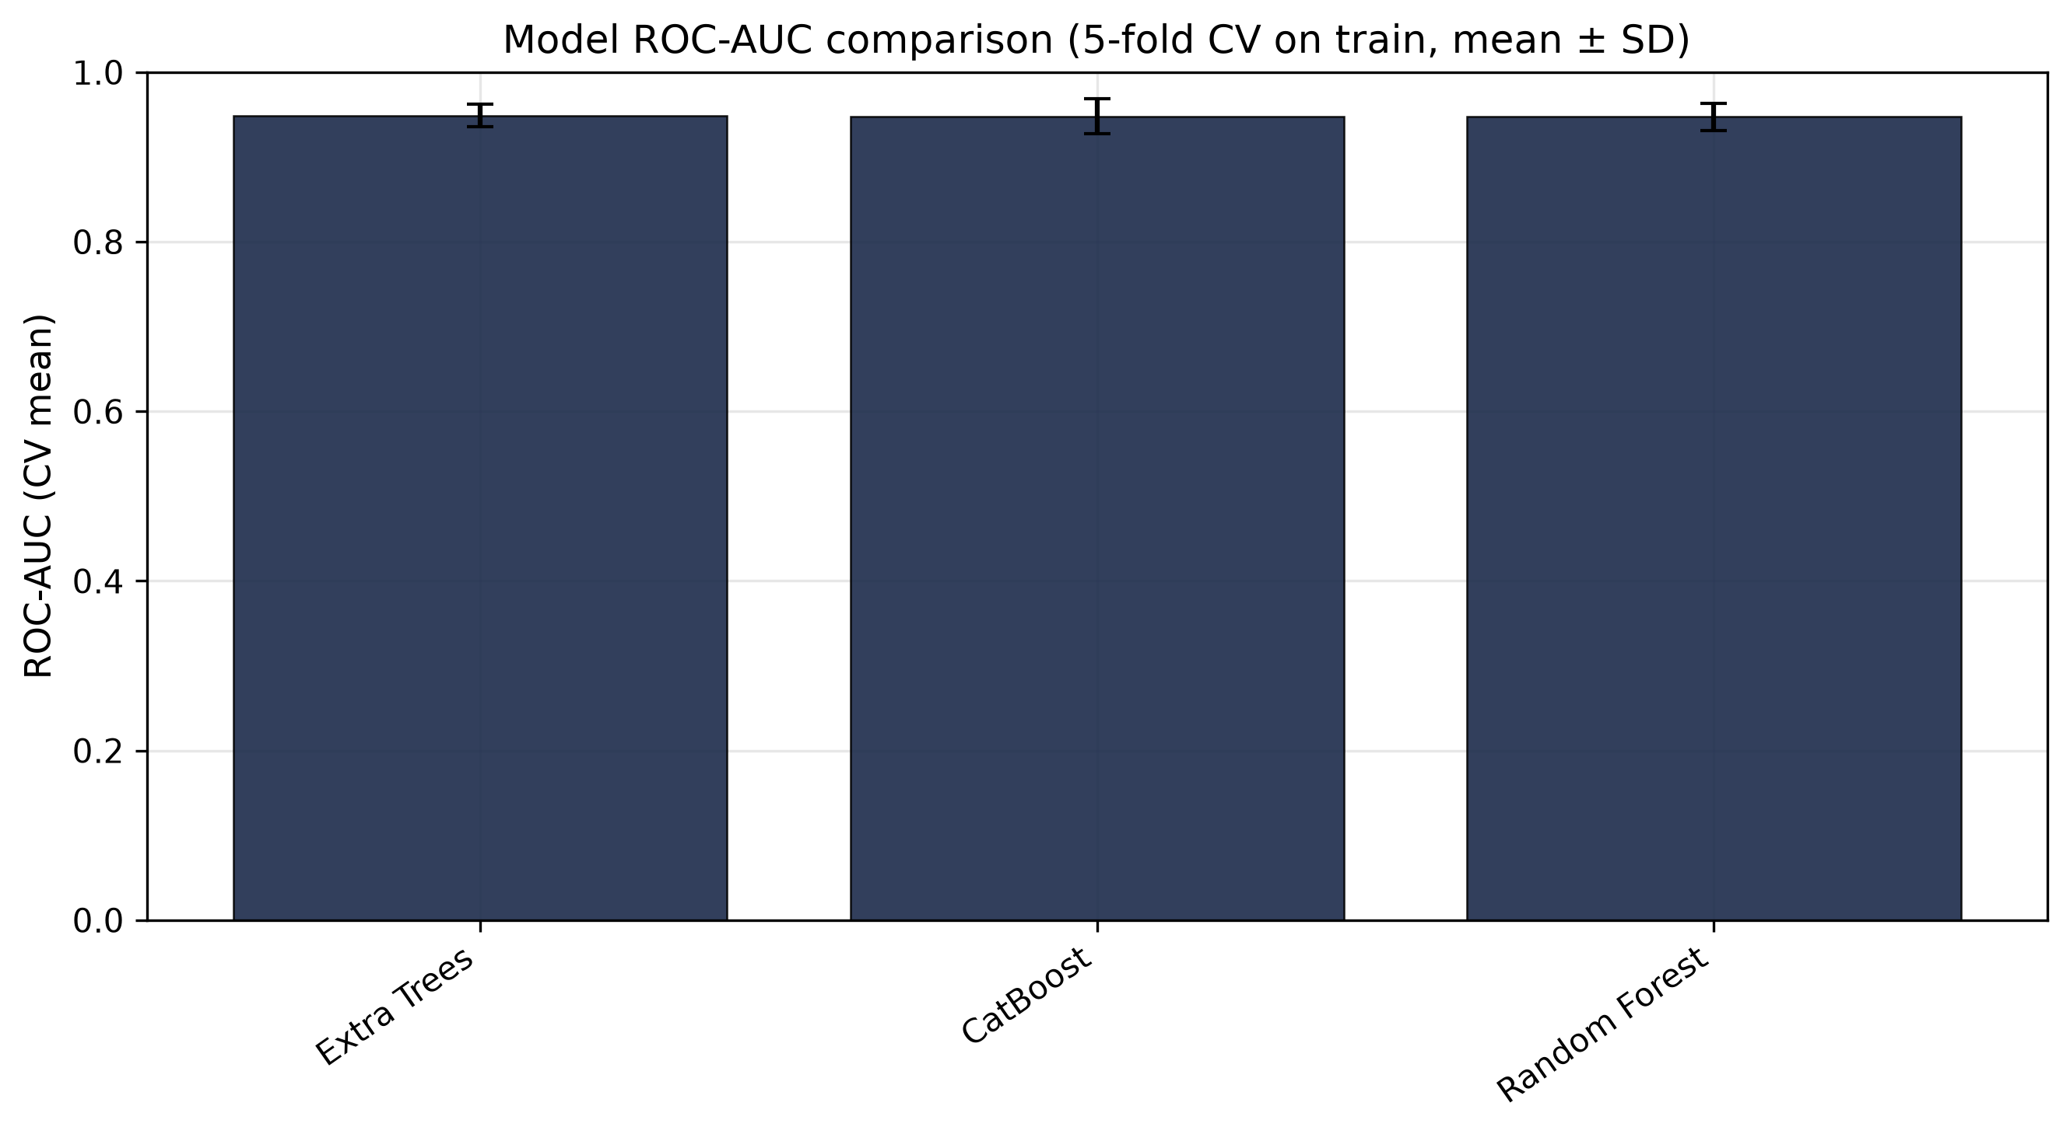
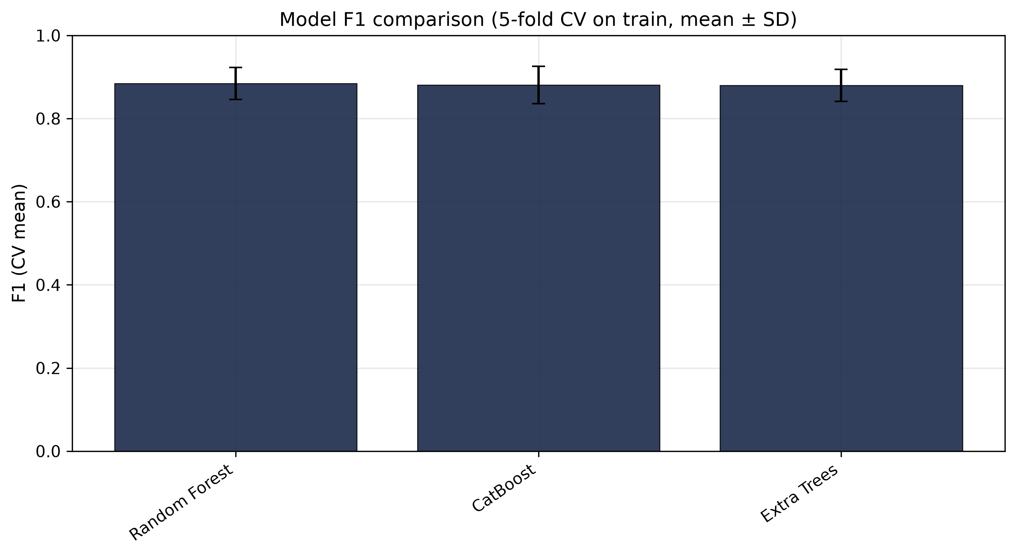
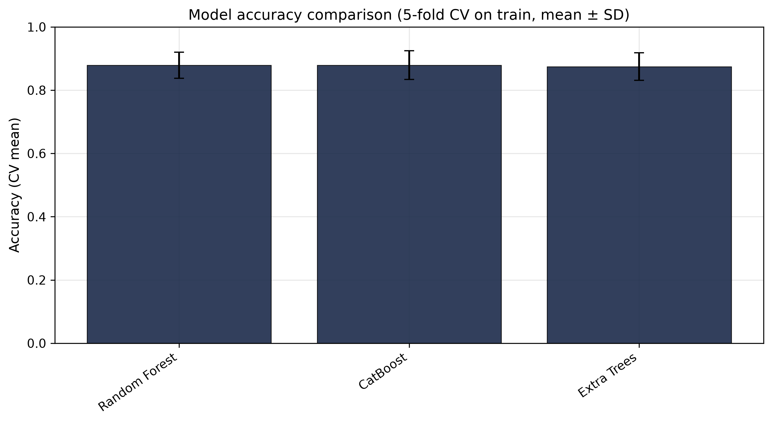
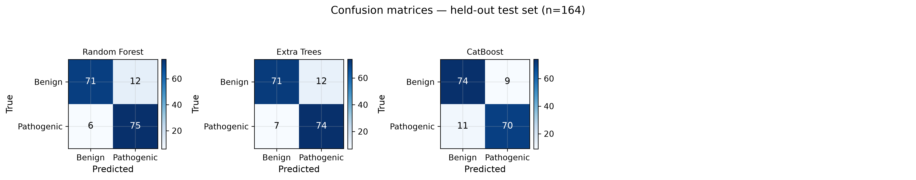
RESULTS III
Metric bars & confusion matrices
08
TP53 Mutation Analysis · research prototype — not a clinical tool

Slide 9
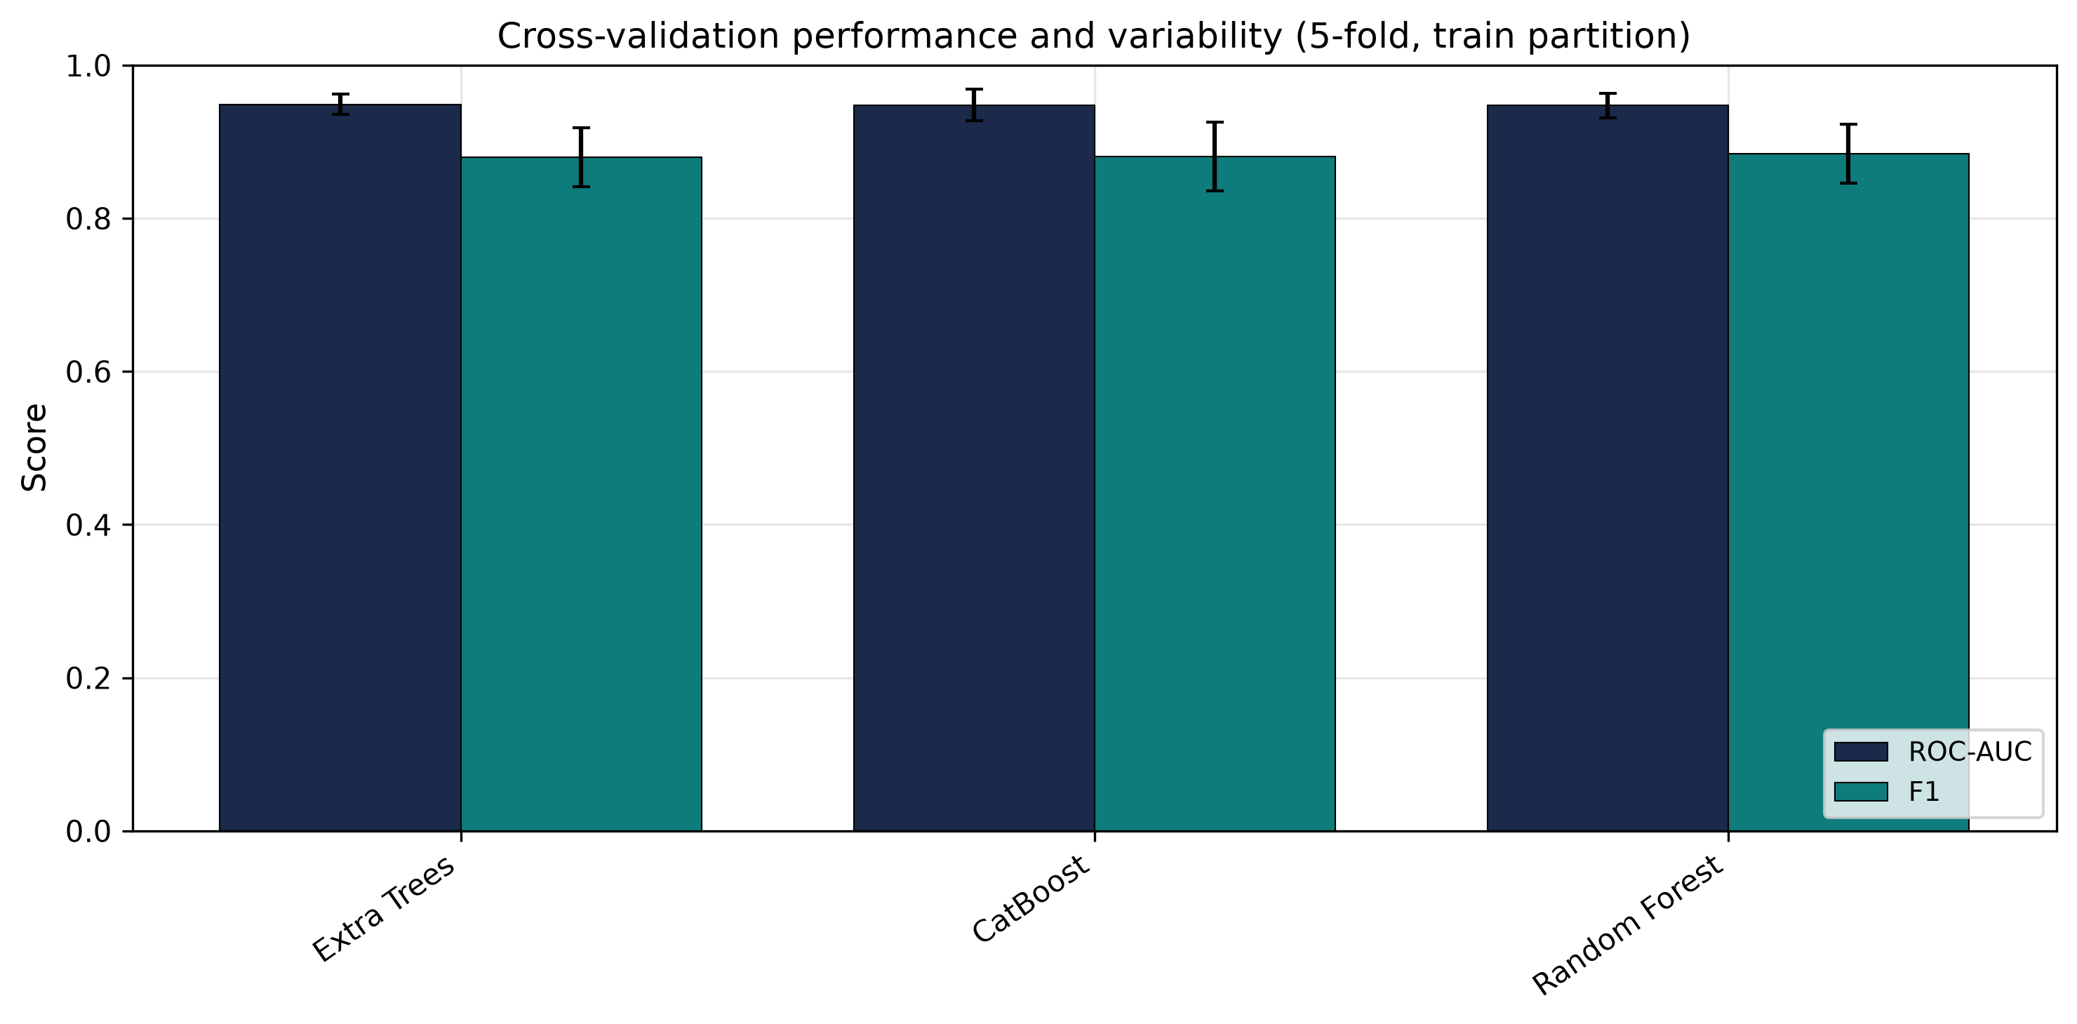
RESULTS IV
Cross-validation stability (train, 5 folds)
09
Model | CV F1 | CV ROC-AUC | CV MCC
Extra Trees | 0.880±0.038 | 0.949±0.013 | 0.753±0.083
Random Forest | 0.884±0.038 | 0.948±0.016 | 0.763±0.080
CatBoost | 0.881±0.045 | 0.948±0.020 | 0.761±0.089
Interpretation
• SD ≈ 0.014–0.020 on ROC-AUC:
folds agree — ranking is stable.
• F1 SD ≈ 0.04: some folds are
harder (class mix), as expected
on n ≈ 523 train rows/fold.
• Small spread between models
(≤ 0.001 CV AUC) ⇒ differences
on the test set are within noise;
keep all three in the report.
TP53 Mutation Analysis · research prototype — not a clinical tool

Slide 10
RESULTS V
Train-only hyperparameter tuning
10
Model | CV AUC base | CV AUC tuned | Test AUC base | Test AUC tuned | Test F1 base | Test F1 tuned | Δ test F1
Extra Trees | 0.949 | 0.949 | 0.949 | 0.949 | 0.886 | 0.886 | +0.000
Catboost | 0.948 | 0.950 | 0.956 | 0.956 | 0.875 | 0.876 | +0.0015
Random Forest | 0.948 | 0.949 | 0.946 | 0.945 | 0.893 | 0.893 | +0.000
Search protocol
• Small grids, 5-fold CV on TRAIN only
• Test never queried during search
• Baseline and tuned artefacts stored separately
Best hyperparameters found
• extra_trees: max_depth=None, min_samples_leaf=1, n_estimators=400
• catboost: depth=6, iterations=300, learning_rate=0.05
• random_forest: max_depth=12, min_samples_leaf=1, n_estimators=600
Honest result: tuning changed almost nothing
Δ test F1 = 0.000 for RF/ET; CatBoost +0.0015.
Default hyperparameters were already near the
grid optimum on this n — the grid is deliberately
small to avoid overfitting a 654-row train set.
Takeaway: model choice (family) matters more
than micro-tuning on a cohort this size.
TP53 Mutation Analysis · research prototype — not a clinical tool

Slide 11
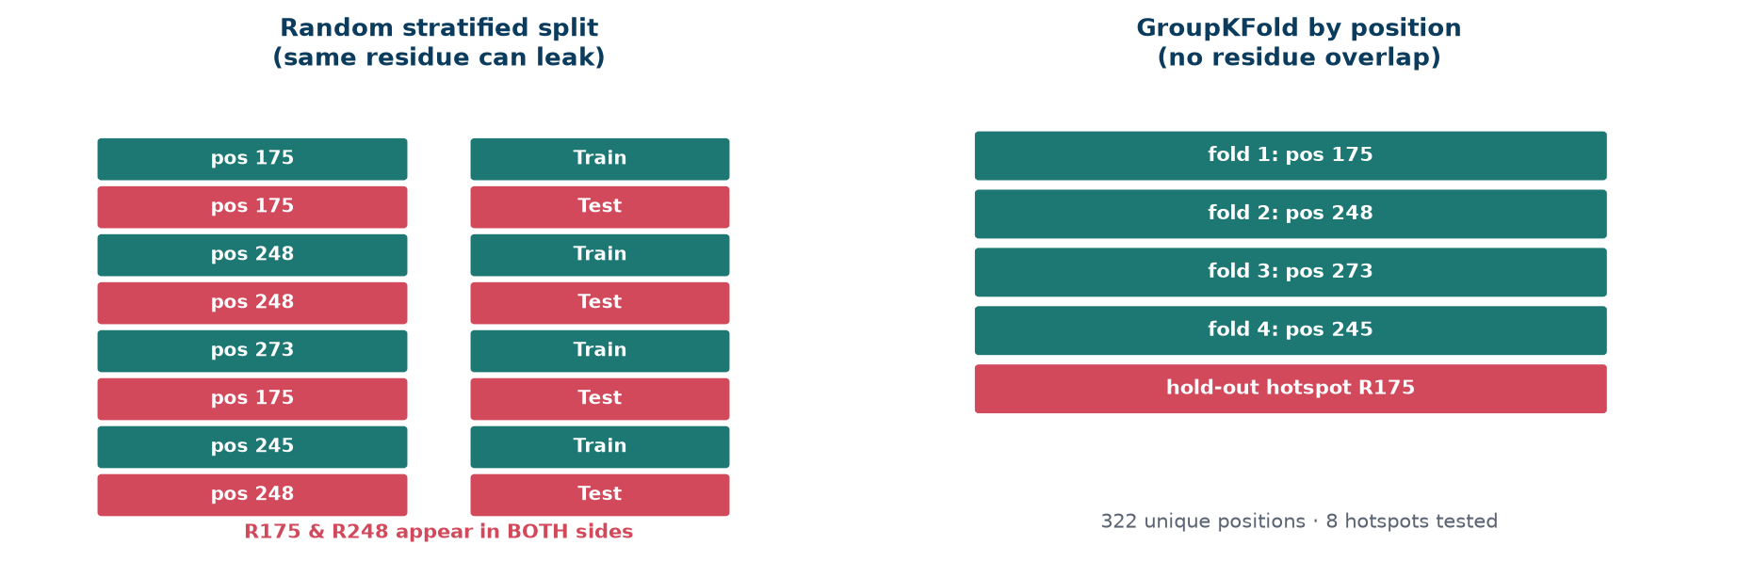
RESULTS VI
Position-aware validation — the leakage check
11
Model | Random-split test AUC | GroupKFold AUC | Δ (AUC) | GroupKFold F1
Extra Trees | 0.949 | 0.914±0.025 | -0.035 | 0.838±0.031
Random Forest | 0.946 | 0.920±0.025 | -0.026 | 0.847±0.037
CatBoost | 0.956 | 0.922±0.024 | -0.035 | 0.831±0.035
What the drop means
Grouping by residue removes
same-position leakage — AUC falls
by ~0.02–0.03 but stays ~0.91–0.92.
Hotspot leave-one-out scores
(n = 1–6 variants) are high-variance
and must not be read as clinical
performance.
322 unique positions · 8 hotspots (R175, G245, R248, R249, Y220, R273, R280, R282).
Conclusion: reported random-split metrics are slightly optimistic — stated as a limitation.
TP53 Mutation Analysis · research prototype — not a clinical tool

Slide 12
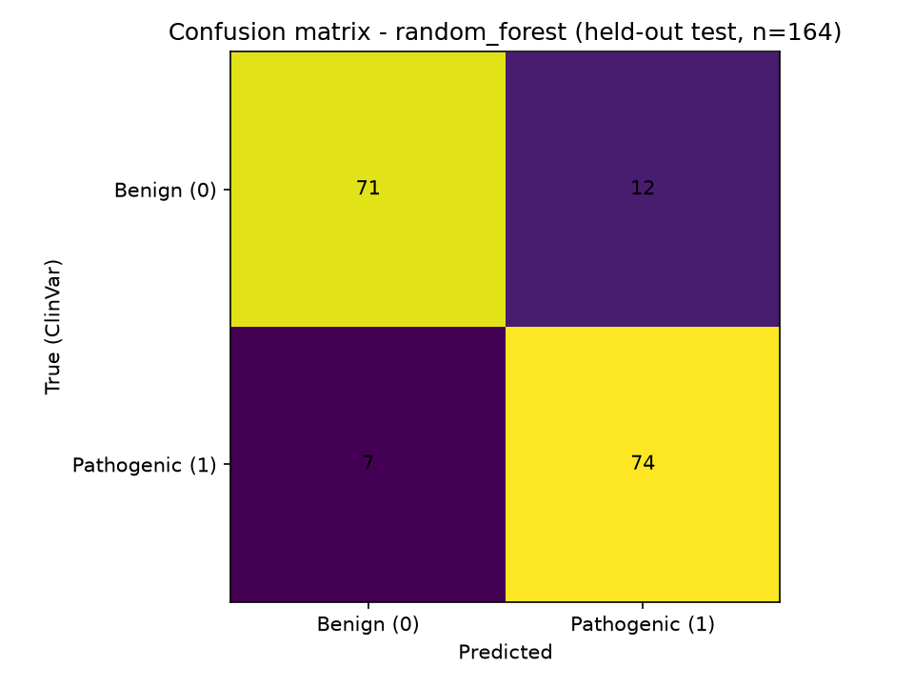
RESULTS VII
Full-cohort audit & honest error list
12
TEST ACCURACY
TEST F1
TEST ROC-AUC
MISCLASSIFIED
0.8902
0.8929
0.9452
18
n = 164 held out
reproduces metrics.json
baseline RF
of 818 predicted
First 6 test-set mistakes (all 18 listed in evaluation.md):
Variant | ClinVar class | Split | P(pathogenic)
p.P27L | Uncertain significance | test | 0.000
p.A119G | Likely pathogenic | test | 0.090
p.T211P | Pathogenic | test | 0.228
p.R342P | Pathogenic | test | 0.245
p.G187R | Pathogenic | test | 0.318
p.G334W | Likely pathogenic | test | 0.407
Train metrics = 1.0 by design (RF fits training data).
Only the held-out columns are evidence. No post-hoc relabeling;
every error is listed with its ClinVar class.
TP53 Mutation Analysis · research prototype — not a clinical tool

Slide 13
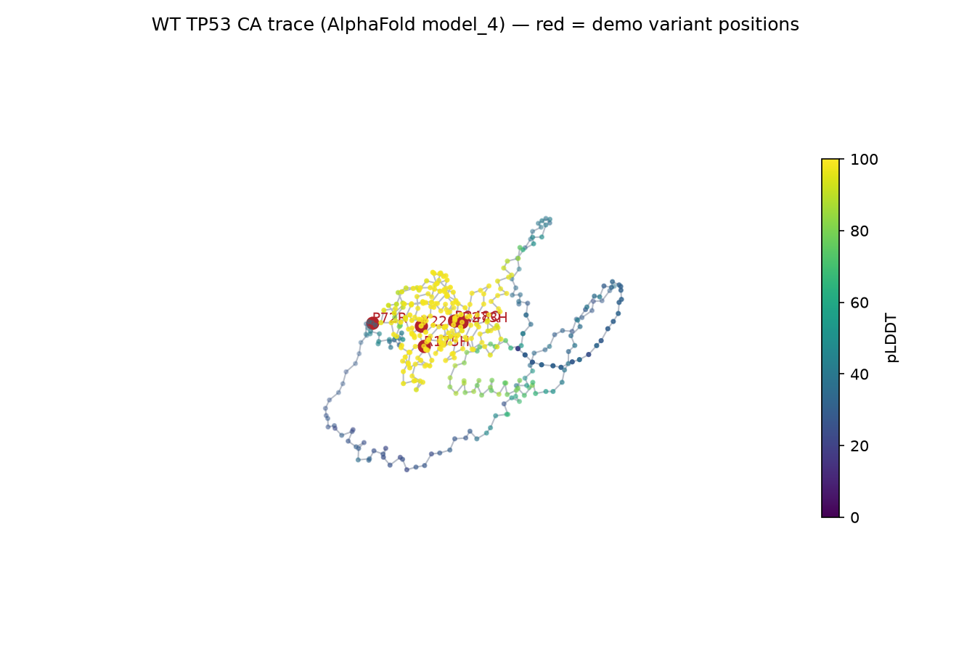
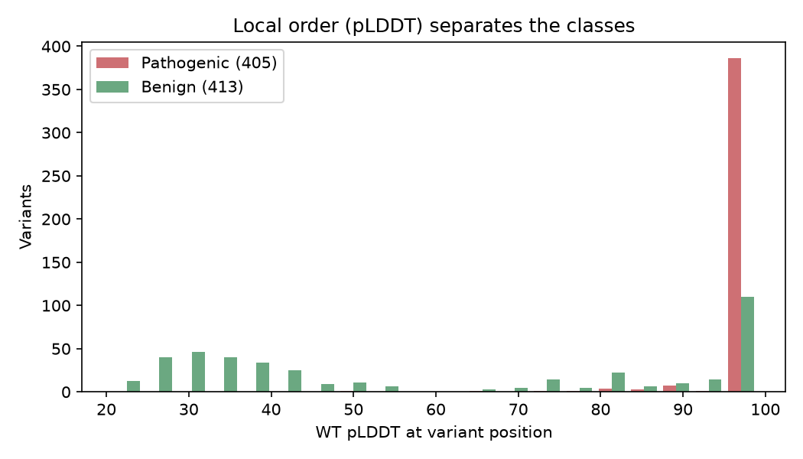
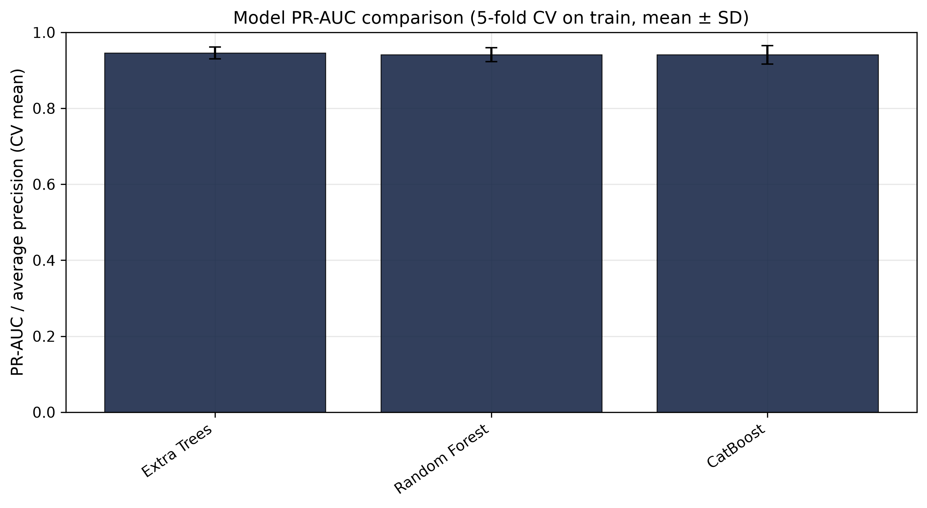
DEMONSTRATION
Structural context & live prediction panel
13
Live local demo: python3 dashboard/server.py → http://127.0.0.1:8000
CLI: python3 scripts/machine_learning/predict.py R 175 H
--model results/machine_learning/benchmark/models/catboost.joblib R 175 H
Default model = baseline RF (model.joblib); benchmark artefacts selectable per variant.
TP53 Mutation Analysis · research prototype — not a clinical tool

Slide 14
REPRODUCIBILITY
GitHub push & Kaggle deployment
14
Artefact | Status | Link / command
GitHub main | PUSHED 3c03f16 | github.com/simbisaichinhema/TP53-Sequence-Structure-and-Machine-Learning-
Kaggle notebook | RUN COMPLETE (~5 min) | kaggle.com/simbisaichinhema/tp53-mutation-analysis
Smoke tests (local + Kaggle) | ALL PASS | python3 scripts/machine_learning/test_benchmark_smoke.py
Benchmark outputs | 3 models, n=818 | results/machine_learning/benchmark/
Conflict-resolution audit | COMMITTED | data/raw/variants/clinvar_conflict_resolution.json
Kaggle pipeline (Internet ON, CPU)
1. Clone GitHub repo
2. WT baseline re-check
3. ClinVar fetch + conflict expansion → n=818
4. Features → baseline train → 3-model benchmark
5. Side-by-side tables/figures → tuning
6. Position-aware → audit → smoke tests
What the Kaggle run proved
• Full pipeline from scratch on a clean VM
• Same numbers as local (test acc/F1/AUC match)
• All smoke tests passed on Kaggle
• Table-C baseline guard fixed live after first
failed run (honest iteration, logged)
• Notebook: 36 cells, outputs cleared for import
TP53 Mutation Analysis · research prototype — not a clinical tool

Slide 15
CLOSING
Limitations & takeaways
15
Limitations (stated, not hidden)
• n = 818 still small; single random split
• Same-residue leakage possible → GroupKFold
drop ≈ 0.02–0.03 AUC reported explicitly
• No mutant 3D re-prediction (structure = WT)
• Feature importance = association, not cause
• ClinVar germline labels only; no somatic,
no clinical validity / validation cohorts
• Not a clinical decision tool
Takeaways
1. Dataset doubled honestly (388→818) with
provenance and an audit trail
2. Three competitive models under ONE fair
protocol — test held out of selection
3. Metrics stable under CV and position-aware
checks; optimism quantified
4. Fully reproducible: GitHub + Kaggle run,
smoke-tested, all numbers regenerated
Bottom line: on 818 ClinVar missense variants with 21 leak-free features, Extra Trees / Random Forest / CatBoost reach test ROC-AUC 0.946–0.956 (F1 0.875–0.893) under a protocol that never touches the test set — reproduced end-to-end on GitHub and Kaggle.
TP53 Mutation Analysis · research prototype — not a clinical tool

