Slide 1
Compute centric vector graphics with `bevy_vello`
Bevy Game Meetup #5
Spencer C. Imbleau

Slide 2
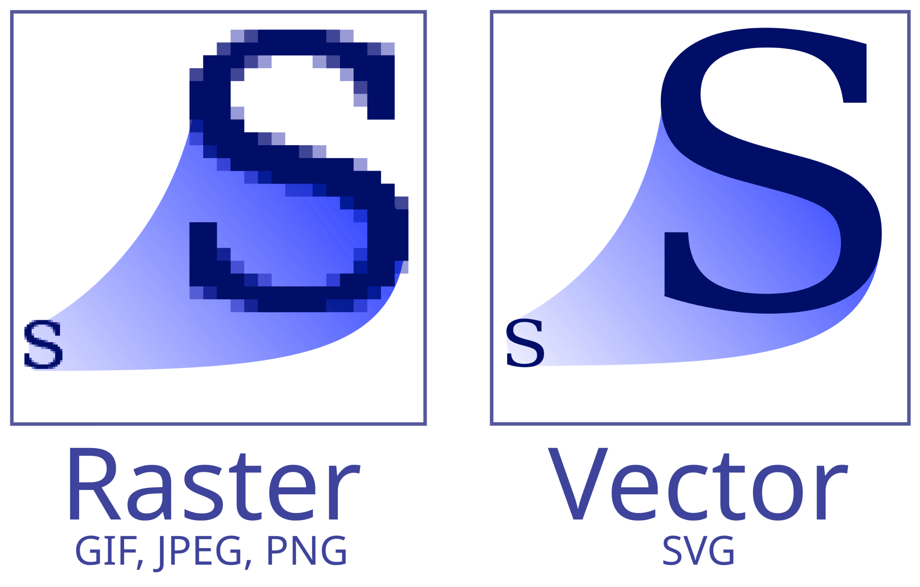
Necessary context
Raster graphics:
Rows of pixels
Favorite child of GPUs
Vector graphics:
Points, lines, equations
Smaller footprint
Infinitely scalable
Image depends on varyings
Camera scale, viewbox, etc.

Slide 3
Naive rendering of vector graphics

Slide 4
Naive rendering of vector graphics

Slide 5
Naive rendering of vector graphics
Ray

Slide 6
Naive rendering of vector graphics

Slide 7
Naive rendering of vector graphics
0
0
0
0
0
0
2
0
1
1
1
2
0
1
2
3
4
0
1
1
1
2
0
2
0
0
0
0
0

Slide 8
Naive rendering of vector graphics
0
0
0
0
0
0
2
0
1
1
1
2
Odd
0
1
2
3
4
Even
0
1
1
1
2
0
2
0
0
0
0
0

Slide 9
Naive rendering of vector graphics

Slide 10
Scaling up the problem
We have 100 shapes on the screen
Can that be done on the GPU? Not easily.
Vector graphics suffer from a locality issue. You must know all the shapes in the image
GPU pipeline is rigid Vertex shader… Geometry shader… Rasterization… Fragment shader…

Slide 11
Vello
“Compute-centric” vector graphic renderer
Compute shaders can directly process vector graphics
Written on top of WebGPU
Feature rich and “svg-like” API for drawing
fills, strokes, gradients, text, images, clips, blends
Suitable for highly dynamic scenes
does not rely on precomputation
no performance landmines

Slide 12

Vello (is complicated)
Slide attribution:
Raph Levien
Input processing
Brushes
Lines
Bboxes
Coarse rasterization
Binning
Output image
Per-tile
command list
Fine rasterization
Segment sort (tiling)
Path segments

Slide 13
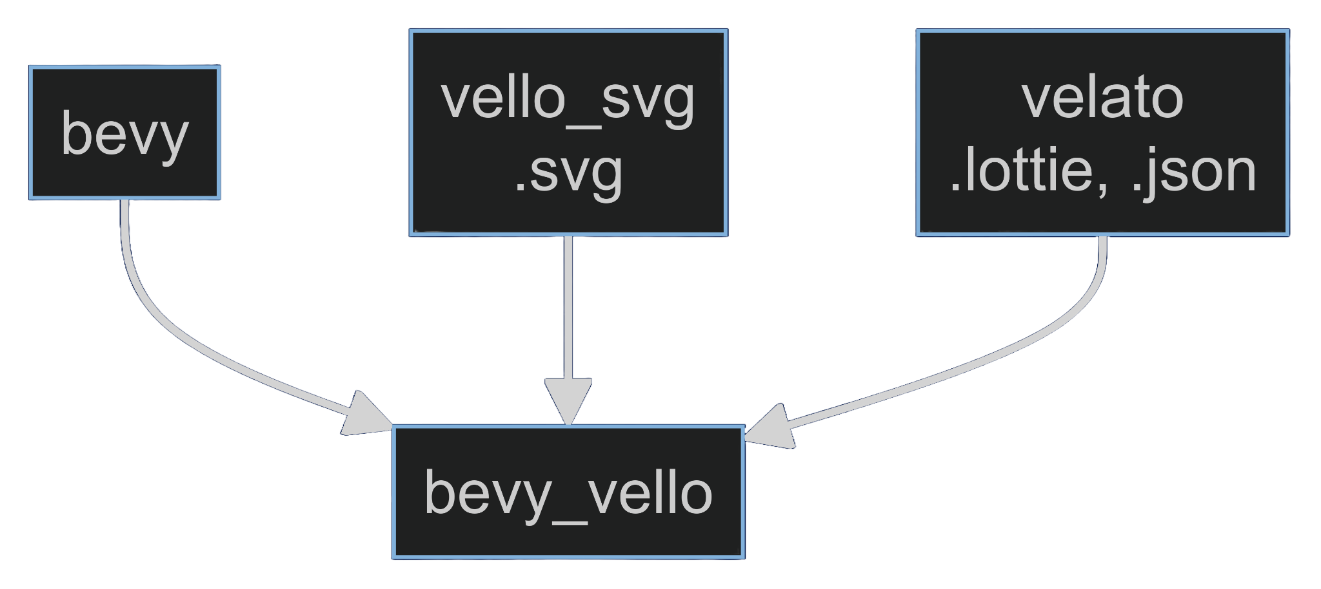
bevy_vello
Enables support for new bevy assets
Support for:
Vello Scenes
Vello Text (through parley)
SVG images
Lottie animations
In progress:
dotLottie animations
LottieLab interactive lottie

Slide 14
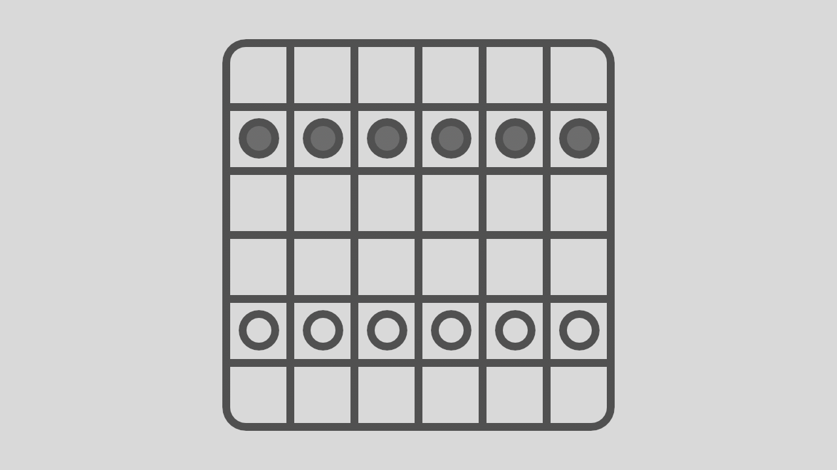
Use cases
Video games
UI
Font editor
Commercial applications
Image attribution:
Carter Anderson @cart_cart

Slide 15
Demos

Slide 16
In use
Web Demos
voxell-tech/bevy_motiongfx ⭐️150+
simbleau/vong ⭐️60+
cpetzold/splined
loopystudios/wootnewts
vello demo
https://linebender.org/vello/
bevy_vello demo
https://linebender.org/bevy_vello/
velato demo
https://linebender.org/velato/
vello_svg demo
https://linebender.org/vello_svg/
vong
https://simbleau.github.io/vong/
https://www.youtube.com/watch?v=hNu5oF18j5g

Slide 17
Usage
Plenty of examples:
https://github.com/linebender/bevy_vello/tree/main/examples

Slide 18
Questions?
Bevy Game Meetup #5
Spencer C. Imbleau

Slide 19

Find me
spencer.imbleau.com
Email: spencer@imbleau.com
GitHub: @simbleau
Mastodon: @scim@mastodon.online
Organization
Linebender Zulip: https://xi.zulipchat.com/

