Slide 1

Understanding 2D Vector Graphics on GPUs
A Thesis by Spencer C. Imbleau
Notes:
My name is Spencer C. Imbleau
Excited to share my thesis
w supervision from Dr. Parry

Slide 2
Overview
Explain the imaging model and issues
Literature review
Show our methodology for a vector graphics analytic framework
Prove our framework through a test case
Notes:
Our goal today is to discuss background such as the imaging model, issues, and dive into prior literature and approaches.
After, we will talk about the work completed on an analytic framework to help understand vector graphics further.

Slide 3
Background
Image Models
Encoding
Advantages
Disadvantages
Tessellation
Notes:
-Lengthy background
-Reality is there is a lot of material to cover
-Just teaching you about the raster pipeline is a college class, right?

Slide 4
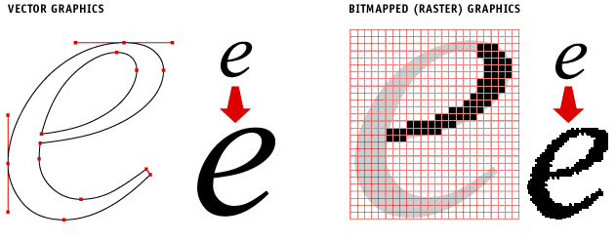
The duality of image modeling
Notes:
Raster Images
- Typically what users think of when we think of images
- Stored explicitly as rows of pixels or data fragments containing color and tonal information
Stark contrast to
Vector Images
- Stored implicitly as geometric primitives.
- Generally speaking, points, lines, and equations
We then apply varyings to these equations to get an explicit discrete image, such as:

Slide 5
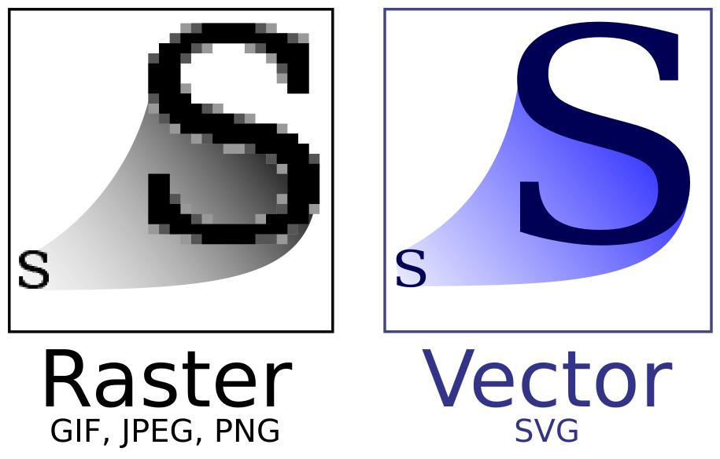
Lossless graphic fidelity
Notes:
Scale
Just one of the many benefits of vector graphics
Vector graphics maintain infinitesimally precise detail and graphic fidelity at any resolution
“Resolution independent” if you will

Slide 6
Lossless graphic fidelity
DEMO
Notes:
Play a short demo just to prove this and show what this looks like

Slide 7
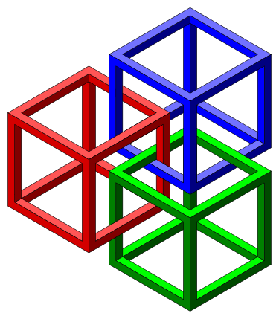
Storage
SVG Storage Footprint vs. PNG
 | SVG | PNG, 1x | PNG, 3x | PNG, 6x
Size (KB) | 9.4 | 61 | 210 | 474
Savings |  | 84.49% | 95.53% | 98.02%
Notes:
huge benefit of vector graphics is storage
It makes sense intuitively
- big raster image → lots of data, 100000 pixels
- this image → just a few equations of lines and fills
Generally, lower storage.
not true everywhere
- very small images
- very busy images
empirical benefits
- web brwoser through network load time

Slide 8
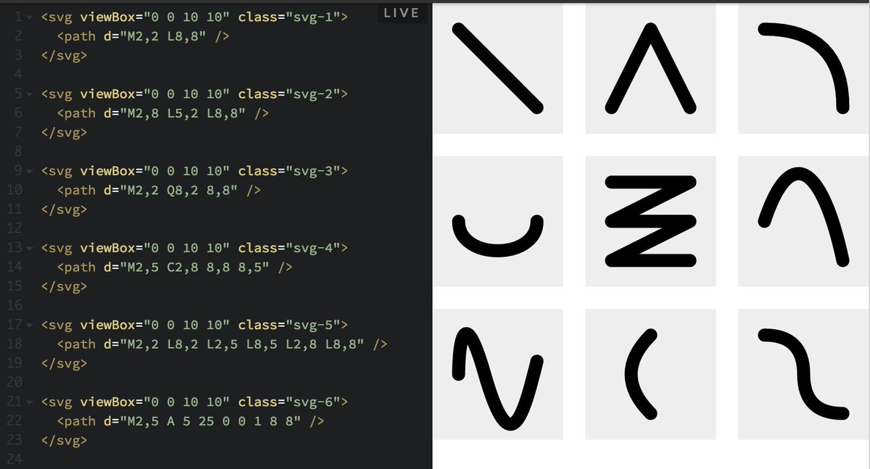
Storage
Notes:
SVG is based on XML, which is traditionally very verbose, repeats tags, and has a lot of superfluous information.
Storage could be even better, if there was a better standard out there.

Slide 9
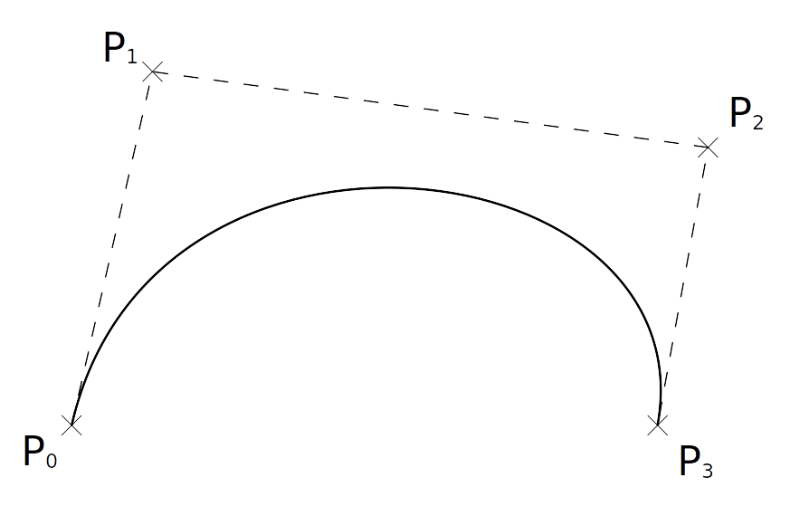
Powerful primitives
Notes:
Crux of vector graphics

Slide 10
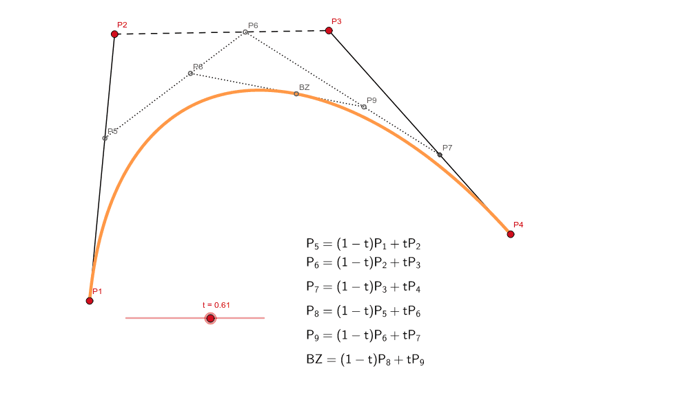
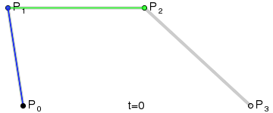
Bézier Curves
Notes:
They aren’t complicated.
It’s simple a linear interpolation between lines.
If we have 4 control points like above, and we want a curve from t=0 to t=1, you can think of this as a Point P0 going towards Point P1 initially, and then receiving some increased gravity from the other points and getting less gravity from P0 as it travels.

Slide 11

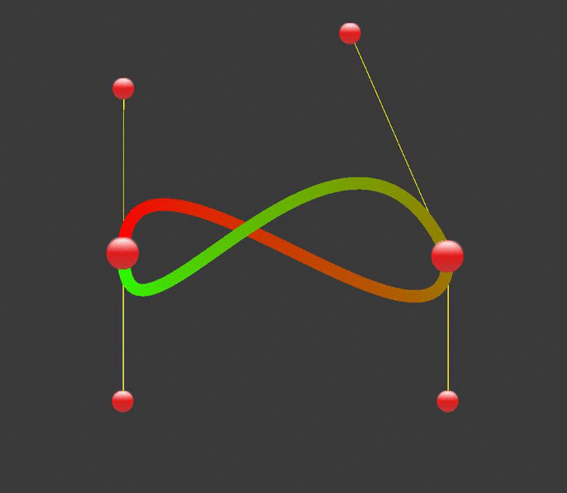
Bézier Curves
Notes:
-altered through its control points easily
-apply weights to the handles and get funny shapes
Very malleable
Interesting ideas for physics simulation, modeling, Computer aided design, geographic information systems
All affine transformations work
- Scaling
- Shearing
-

Slide 12
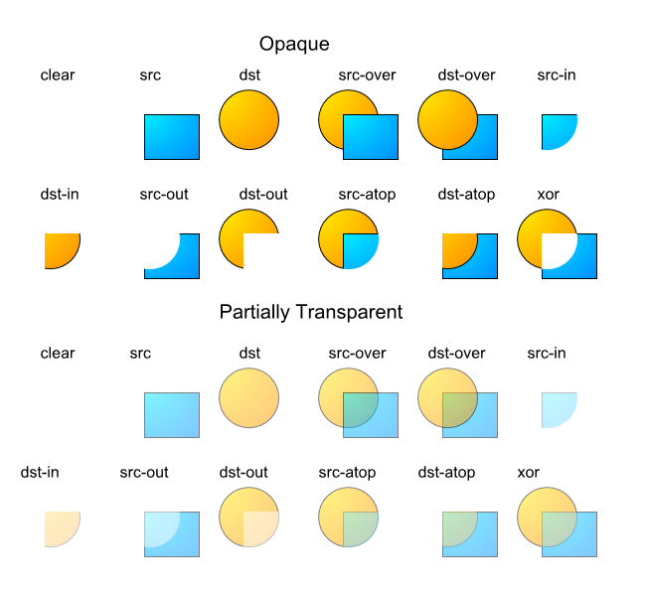
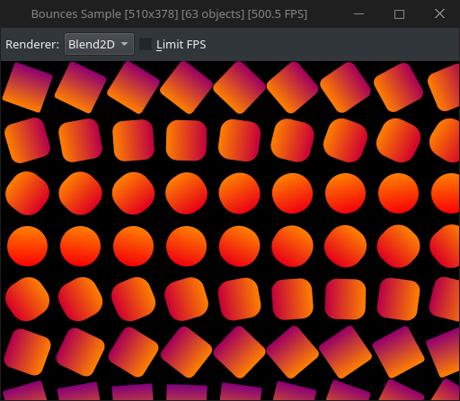
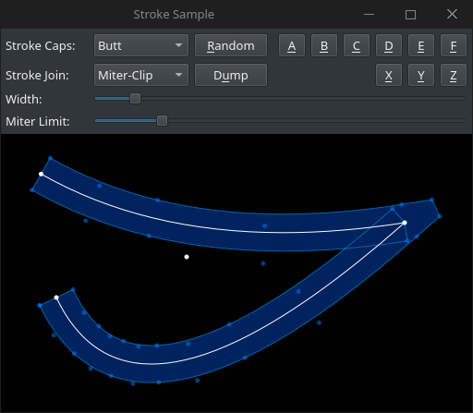
Styling
Notes:
Styling support is very rich
- Stroke vector paths
- Fill with textures, patterns, gradients
- Compositing, blending

Slide 13

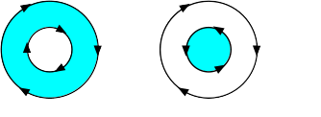
How is this done?
1 (O)
2 (E)
4 (E)

Slide 14
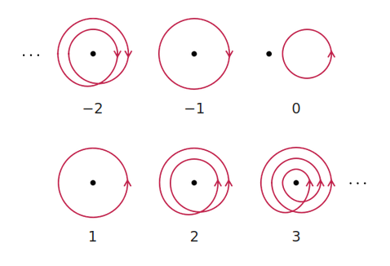
How is this done?

Slide 15


What is the issue?
Ray-casting is usually very expensive
Locality Issue = Sequential Issue
Notes:
Expense:
- Bezier curves:
- Give us polynomials
- Unavoidable square root computation
- Historically very expensive and is the reason raytracing is not very efficient
Locality issue:
- All paths must be known to compute the winding number
- Minor changes to one point will potentially change the entire image

Slide 16
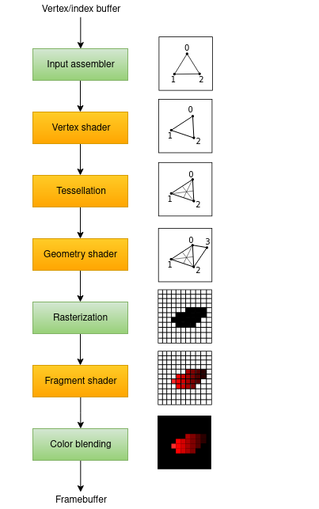
What is the issue?
Traditional
graphics pipeline
Notes:
GPU Pipeline is historically built for raster gfx
However, recent GPUs have given more support for compute kernels and low-level GPU architecture access.
While this isn’t necessarily a roadblock today for experimentation, it means that compatability with a more “custom” pipeline before 2015 is unlikely

Slide 17
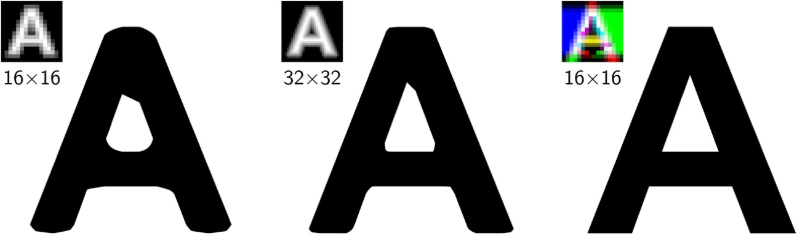
Technologies
SDFs : Signed Distance Fields
Notes:
Invented in 2007 by Valve
NOT a vector technology, but it’s kinda close
It’s a way to solve scaling for decals. Great for text
The idea is to encode the distance from the true shape in a single channel, which is why it’s black and white and looks blurry
Benefits
- low hardware requirements
- a trivial shader for the GPU
- anti aliasing support
- Can be improved with multiple chanels
- attractive to game developers
Cons
-Artifacts
- Significant CPU computation

Slide 18
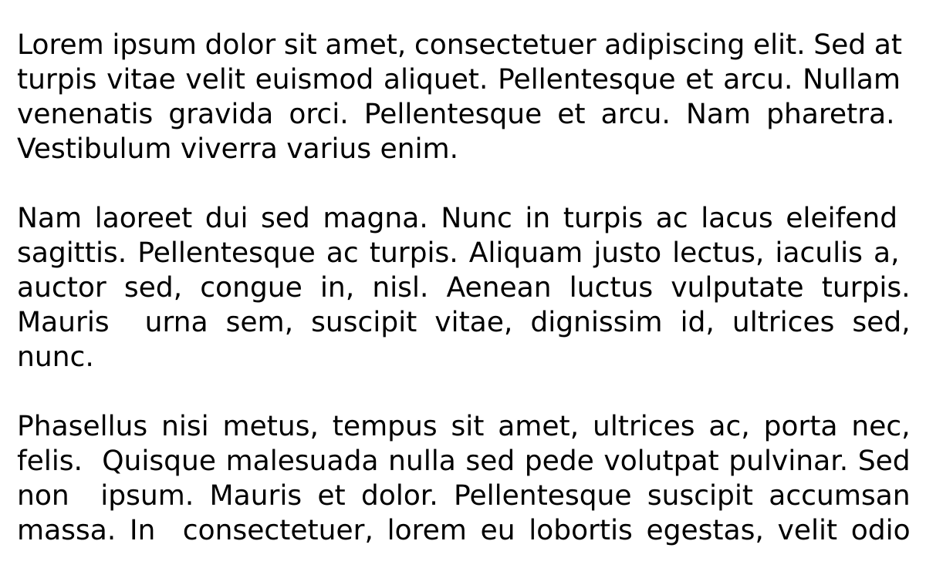
Technologies
Pre-Computation Models
Notes:
Our theory tries to categorize real technologies into buckets
The first is pre-computation
- Any model which is going to recycle computation such that future iterations are inexpensive
-Perfect example is glyph caching for fonts

Slide 19
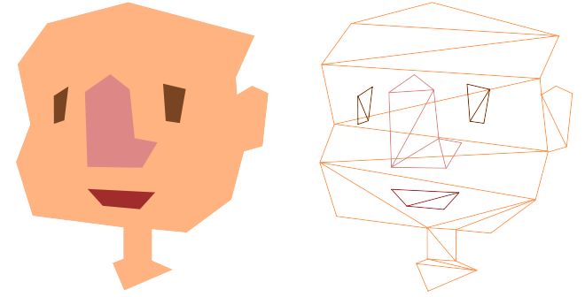
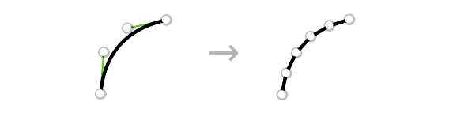
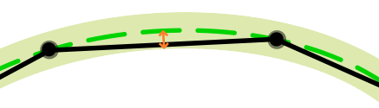
Technologies
Tessellation
Notes:
Most famous, straightforward, and naive for 2D VG rendering.
Derivative of a pre-computation model
Which substitutes the model
Convert complex paths into discrete triangles which can be input into any rendering engine
Facilitates easy integration with any GPU graphics engine with very low hardware requirements, given you just need to render triangles.
Vector tessellators are special: curve flattening
Tolerance determines the accuracy of curve flattening

Slide 20
Technologies
DEMO
Notes:
I am going to show you a tessellation based renderer that I have coded to illustrate this point as well

Slide 21
Technologies
Parallel Models
DEMO
Notes:
parallel model
- Any model which is going to tweak the traditional raster pipeline to better parallelize vector graphics.
These typically takes a compute-driven approach
Or do sorting in the pipeline or extra stages
Contrary to typical pre-computation models because pre-computation models will traditionally fit the historic raster pipeline because the most important feature needed would be a cache buffer

Slide 22

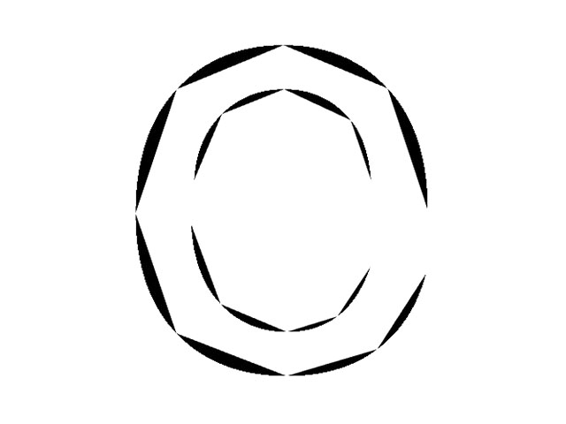


Loop Blinn
Notes:
2005 Charles Loop, James Blinn
Uses a Stencil buffer data structure to decouple the stages of vector drawing
The first pass constructs a hull of triangles to assert the shape’s fill and a second pass uses a shader to cut out the fragments.
The shader is trivial in nature
Benefits:
- First total GPU drawing approach
Cons:
- Massive overdraw

Slide 23

Overdraw
Notes:
Overdraw is a real concern too with VG, since it needs to be factored out at runtime.
The tiger on the right is the final image
The tiger on the left is the amount of times a pixel would be written assuming there was no occlusion culling
DO NOT TALK BELOW
The left image shows our Tiger if there was no occlusion culling. The whiter the pixel, the more times it is drawn. This image can be generated by using hardware to render a “1” into a target with additive blending, which would create a map of pixel writes, and then normalizing the map and coloring it.

Slide 24
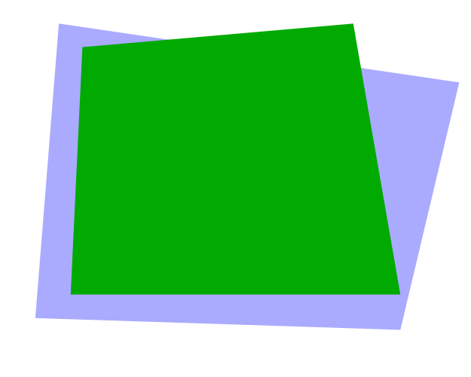
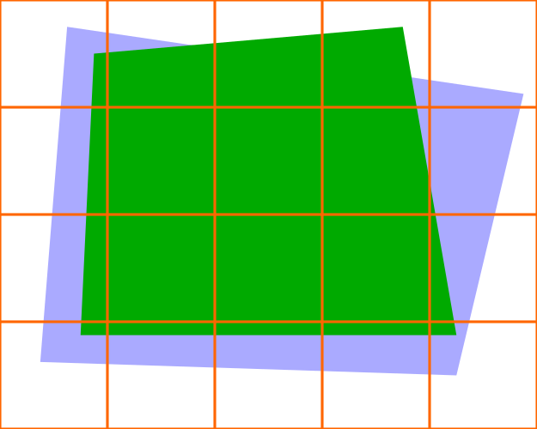
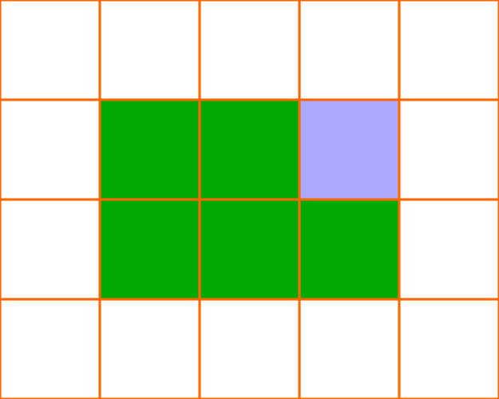

Technologies
Pathfinder
Notes:
Paths split into tiles on the CPU
Mask tiles are rendered in a float texture on the GPU
Solid tiles are uploaded as quads to the GPU
Mask tiles then get composited from the float, in any order

Slide 25
Everything is different
“vgpu-bench”
Eclectic optimization goals
Differing rendering models with GPU variance
No baseline
Notes:
3D graphics have a very typical use-case. Where can I optimize for a level of graphic-richness without sacrificing an acceptable framerate?
2D vector graphics have much more cultural application. One may optimizie:
- Low lateny
- Power consumption on mobile
- Contention of scare resources like CPU→GPU bandwidth
- Balancing several of these factors
It’s hard to analyze vector graphics with differing models, GPU leveraging, and goals.
It’s all just so experimental.

Slide 26
Design, “vgpu-bench”
Requirements
  Functional
  Non-functional

Slide 27
Requirements
Functional
  Collect measurements
  GPU metric sampling
  Rapid prototyping
  Output
Non-Functional
  Accurate
  Plays nicely
  Encourage adoption
  Minimal overhead
Notes:
A framework should, functionally:
- collect arbitrary measurements
- integrate in some kind of GPU metric sampling
- support rapid prototyping
– along with that: macros, common trait implemenations, conversions, and more so that interoperability support is high
- outputting measurements and visualizing them
Non functionally:
- collect measurements accurately and precisely
- Should be capable of sampling on recent GPUs
- encourage adoption by providing a lot of features out of the box:
– plotting utilities, serializers, and pre-written tests
- Any interfacing for data collection should be a zero cost abstraction

Slide 28
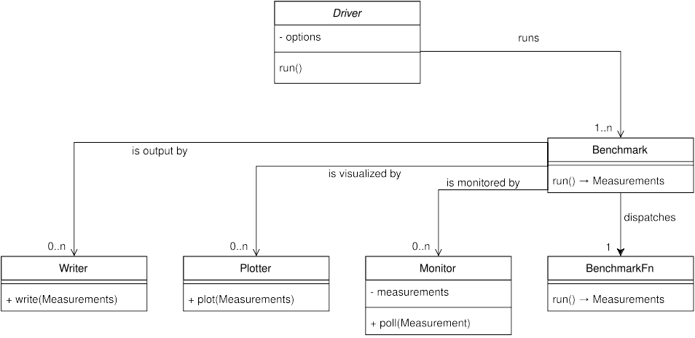
Architecture, “vgpu-bench”
Notes:
- Abbreviated version of architecture
- BenchmarkFn: Runnable closure which will return something measurable. It also comes with GPU tracer annotations.
- Benchmark: Encapsulates a BenchmarkFn with additional features
- Monitor: Which polls additional measurements during the lifetime of the BenchmarkFn
- Plotter: Responsible for plotting and outputting visualization
- Writer: Responsible for saving a serialized version of measurements
- Driver: An runtime executor for one or several benchmarks

Slide 29
Ergonomics
BenchmarkFn – A closure with GPU tracers
Benchmark – A BenchmarkFn with augmentation
  Monitor – Supplemental Measurements
  Writer – Create outputs like CSV, JSON
  Plotter – Create data visualizations
Driver – Runtime executor for benchmarks
Notes:
Just to recap

Slide 30
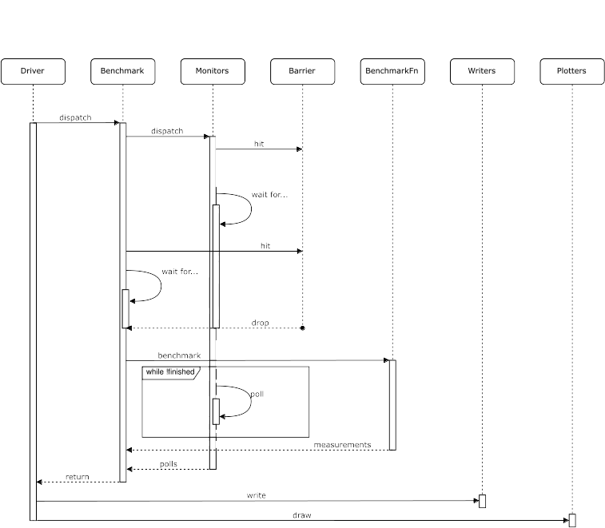
Data Flow
Notes:
Here is a sequence diagram for our data flow
Important to note is our barrier here, as this atomic ensures the closure and monitors begin synchronized and are dispatched simultaneously

Slide 31

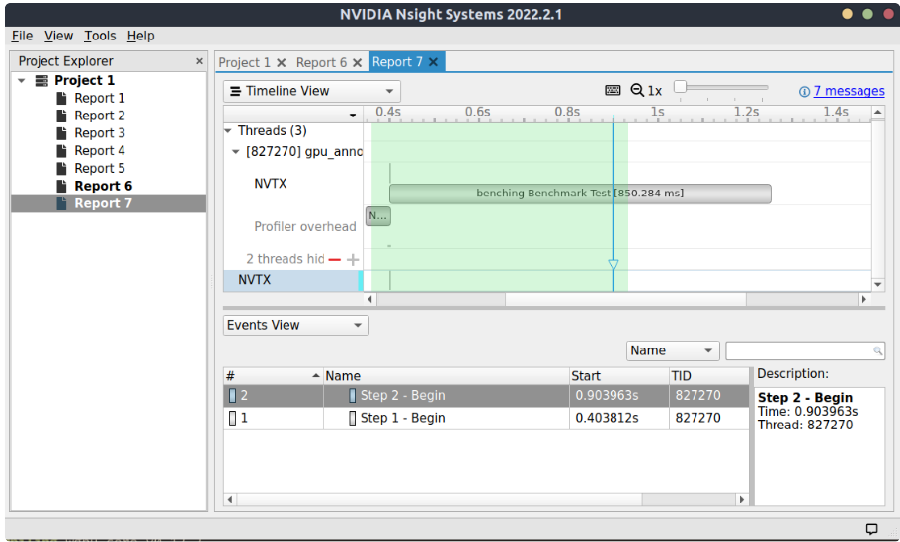
GPU Instrumentation
Notes:
What you’re seeing is the integration of BenchmarkFn’s GPU tracers into NVIDIA Nsight Systems
Our framework automatically calls these runtime tracers with minimal overhead.
Done through NVTX, a C-based API provided by NVIDIA for annotating events, code ranges, and resources in applications.
- By FFI, Foreign Function Interfacing

Slide 32

Language
Rust
  Speed
  Safety
  Utility
  Popularity
Notes:
Speed:
- zero cost abstractions
- this means behaviors and indirection is moved at compile-time to incur no runtime cost
Safety:
- memory safe model
- no undefined behavior or unstable control flow
Utility:
- Mozilla made Rust in 2015
- Firefox core is in rust
- Servo is in rust
- Google is writing one of its new VG APIs in Rust, Spinel
- Cross platform
Popularity
- Most new technologies are being written in rust today
- Spinel, piet-gpu, Pathfinder, Lyon

Slide 33
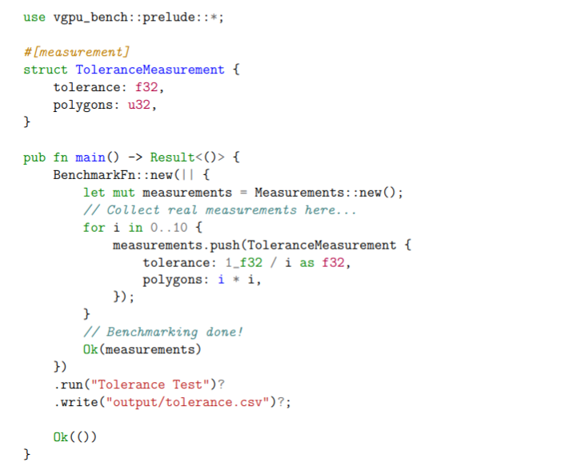
Rapid Prototyping
Notes:
Rapid prototyping is pretty well supported withing vgpu-bench
- prelude to bring in all data structures responsible for benchmarking
-the #[measurement] macro is metaprogramming which basically looks at this data structure I have written, ToleranceMeasurement, and through arbitrary syntax deconstruction, reads and generates all of the traits necessary to make this a Measurement which can be serialized into any format like CSV/JSON and more.
- You do not need to elevate a BenchmarkFn to a Benchmark if you don’t need monitors, similarly to how you do not need a Driver unless you need runtime mutation options.

Slide 34
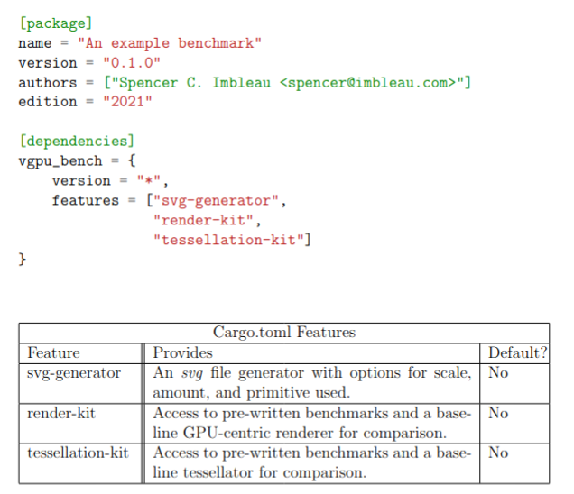
Features
Notes:
Provided additional features which are very easy to opt into.
Purpose: additional features to encourage adoption and users in this space using my tool organically for their own data science.

Slide 35

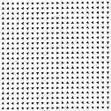

Features
Notes:
SVG Generator
- Can generate whatever primitive you want, with rotation, at any amount, even custom ones
- cubic bezigons in the bottom right.

Slide 36
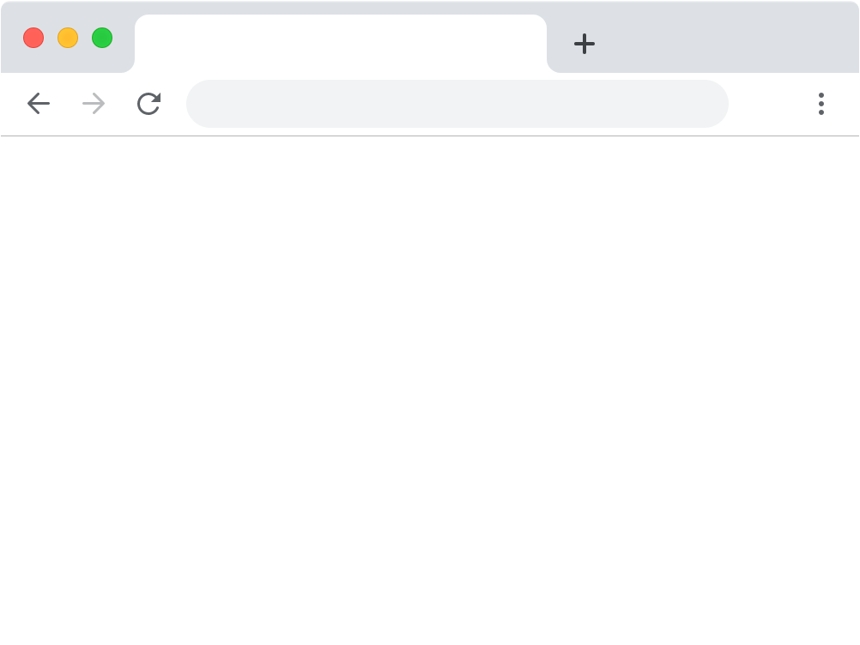

Test Case
The “web browser” case
https://google.com
Notes:
So we have made this intricate benchmarking framework and would like to ensure it works through a test case.
The test case is on the most common use-case of vector graphics, which is web based rendering.
It makes sense to analyze a fragment of web rendering because
- empirical benefits on network load time which can be subtracted by slow rendering times
- high impact on all users

Slide 37
Analysis Questions
What are some consequences of tessellation?
What are some consequences of a pre-computation model?
Can hardware acceleration improve performance?

Slide 38
Test Case Instrumentation
1 Tessellator:
  Lyon
3 Renderers:
  Render-Kit (us), GPU, CPU Pre-computation
  Resvg, CPU based, No caching
  Pathfinder, GPU, Parallel
2 GPUs:
  NVIDIA GeForce 1060 3GB
  NVIDIA GeForce RTX 3080

Slide 39

Test Case Instrumentation
Simple examples

Slide 40
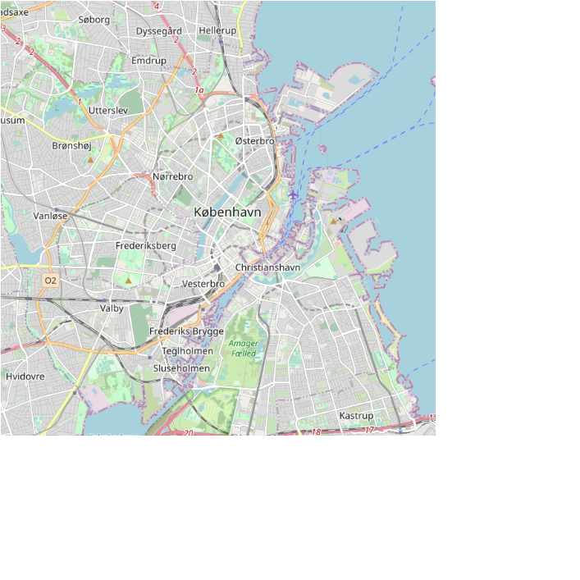
Test Case Instrumentation
Complex

Slide 41
Test Case Targets
Profiling
Tessellation
Rendering Trials
Monitoring
Notes:
Profiling:
- Complexity of our test bank, original and tessellated
Tesellation:
- Get the timing for several primitives and amounts
Rendering:
- First frame output time
- Continuous frame times
Monitoring:
- CPU utilization under our complex example

Slide 42
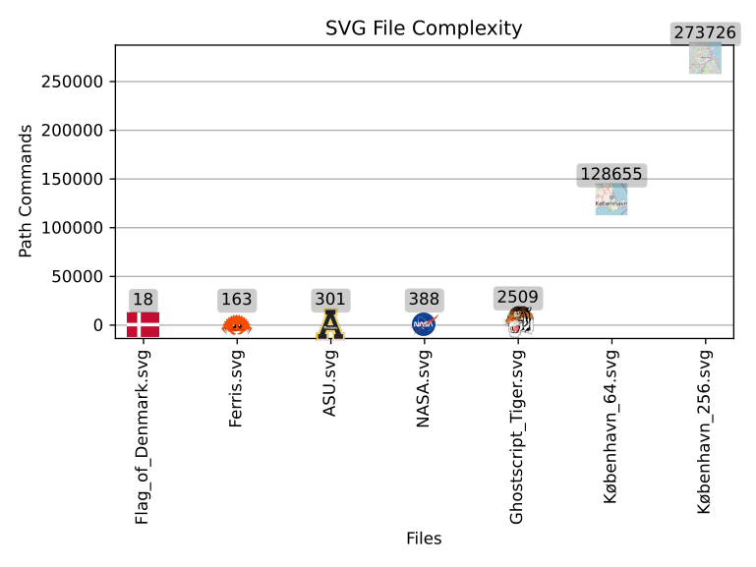
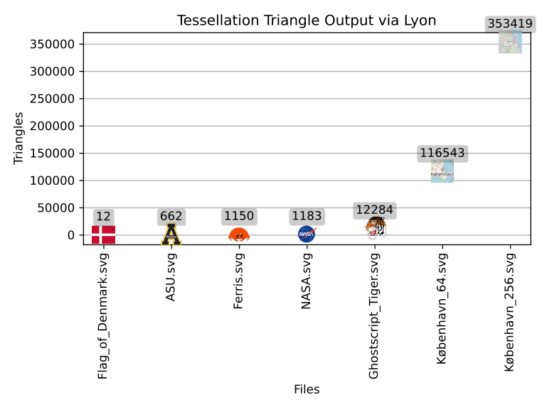
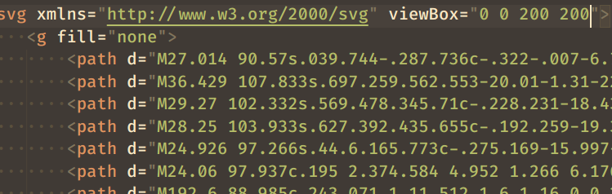
Test Case Benchmark 1: Profile
\
Notes:
Here we are viewing two plots generated by vgpu-bench
Left: SVG File complexity
x: Files
y: Path commands in an SVG
Right: Tessellation Output
x: Files
y: Triangle output by Lyon
Purpose of this: Set up a context for the other measurements we collect which are to come
Findings:
- primitive count is not always higher. Very simple objects can be tessellated in lower triangles than path commands

Slide 43
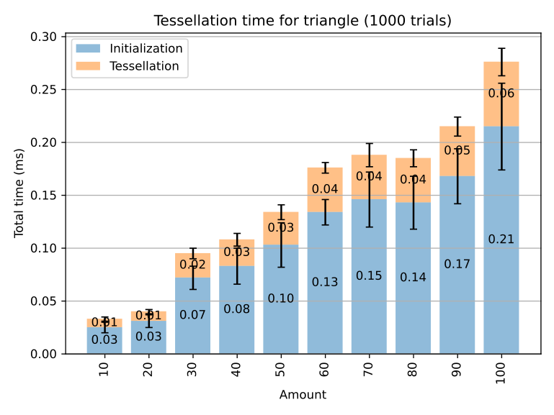
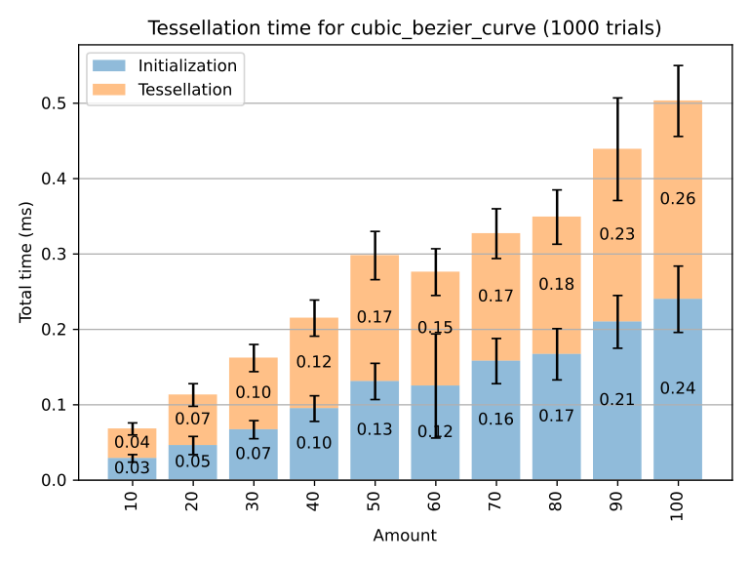


Test Case Benchmark 2: Tessellation
Notes:
Left: Tessellation time for triangles
x: Files
y: Time, ms
Right: Tessellation time for cubic bezier curves
x: Files
y: Time, ms
Initialization: Parsing the SVG into a tree or data structure in preparation for the tessellation phase
Since this is done by Lyon, it Is measuring time for the CPU
Purpose of this: Understand how long initialization and tessellation both take in a CPU based approach for a low-amount of primitives

Slide 44
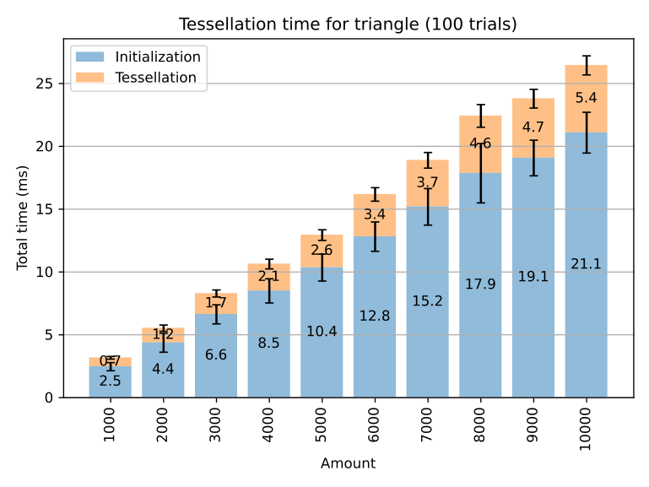
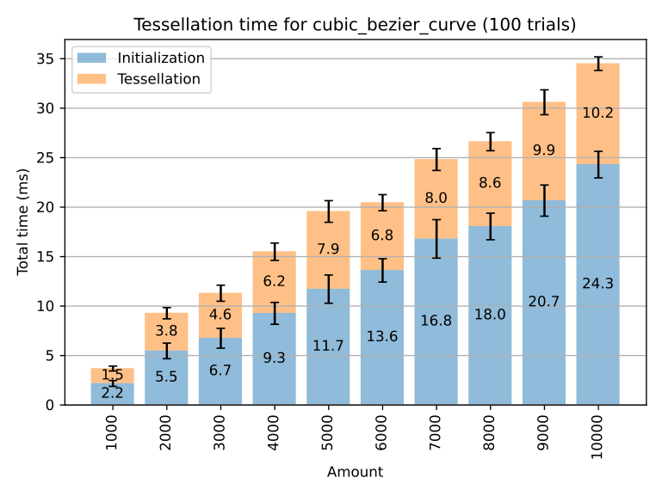


Test Case Benchmark 2: Tessellation
Notes:
Same as before, but this time with higher magnitudes of primitives.
Something noticed is the ratio of tessellation time decreases with higher amounts of primitives.
A perplexing finding.
This effect is not very straightforward to understand, but it’s an effect of tolerance

Slide 45
Tessellation (Tolerance)
DEMO
Notes:
Lyon is the tessellator we use, and one of its modern features is to tessellate for a given tolerance.
We tessellated at an allowed visual error of about 1% during curve flattening, a subjectively OKAY quality.
This lead to the prior results where as primitive count goes up, less of the cost is spent in tessellation and more is spent in parsing and initialization.
Nontheless, overall, we found consistently that tessellation costs a lot.

Slide 46
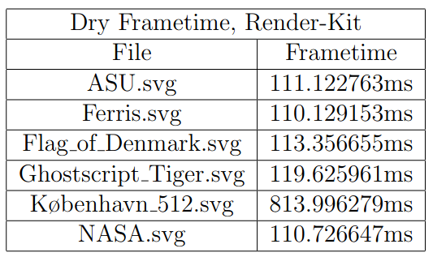
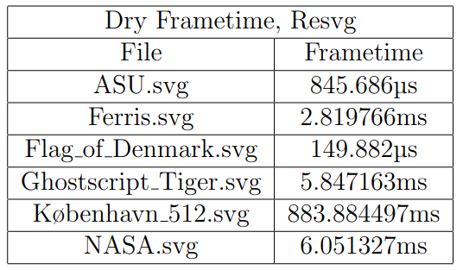
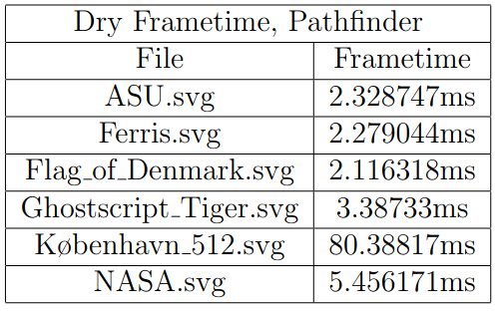
Test Case Benchmark 3: Rendering
Notes:
Render-Kit
- Unnegotiable 100ms for an image, and this uses tessellation
Pathfinder
- Unnegotiable 2ms
Resvg
- getting microsecond render times

Slide 47
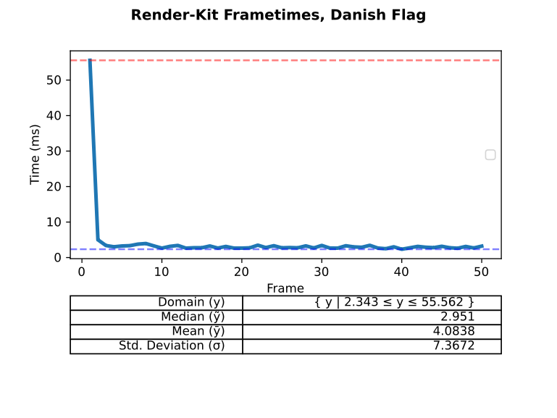

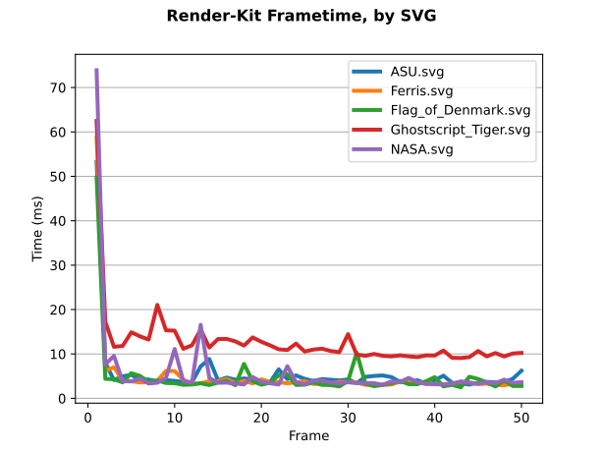
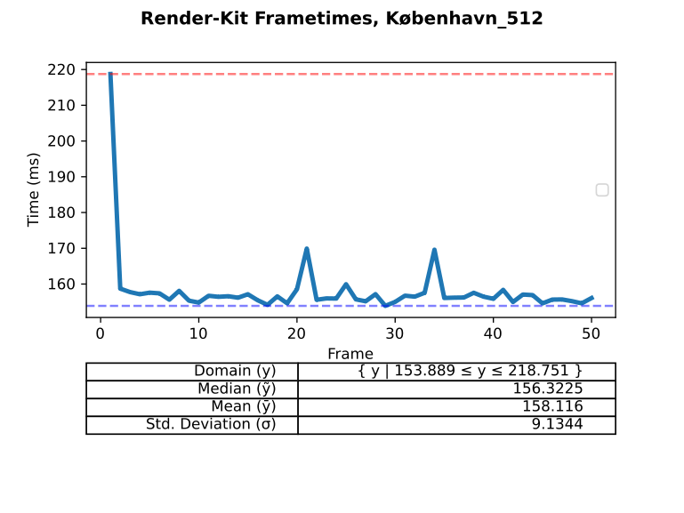
Test Case Benchmark 3: Render-Kit
Notes:
Render-Kit uses caching, which generally speeds up subsequent runs

Slide 48
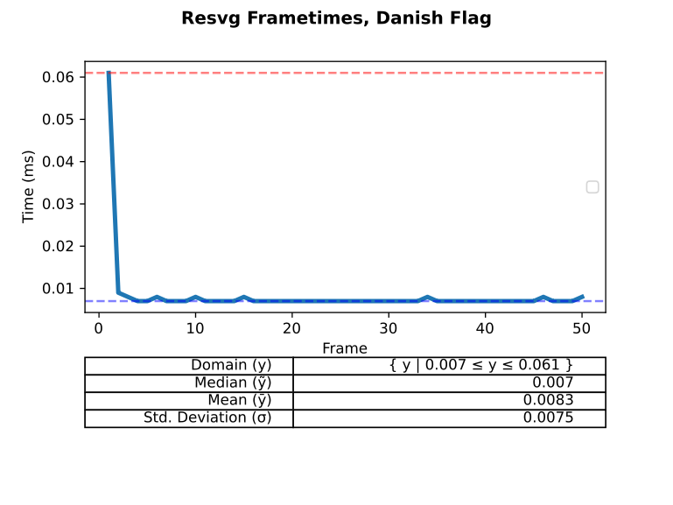
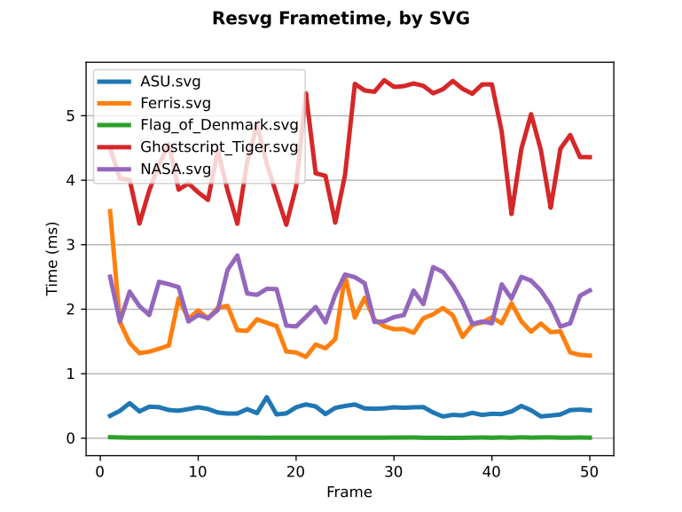
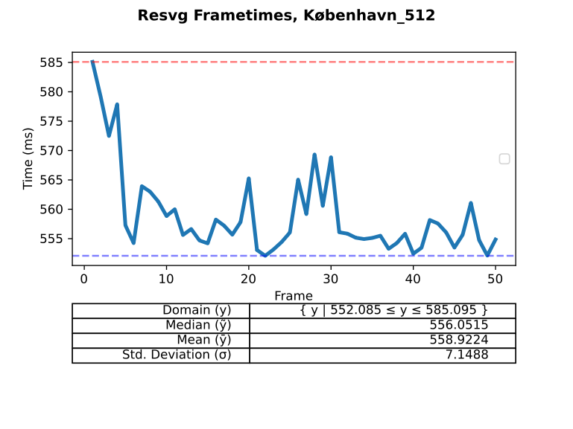
Test Case Benchmark 3:
Resvg
Notes:
Lack of GPU caching here is making all frames relatively consistent

Slide 49
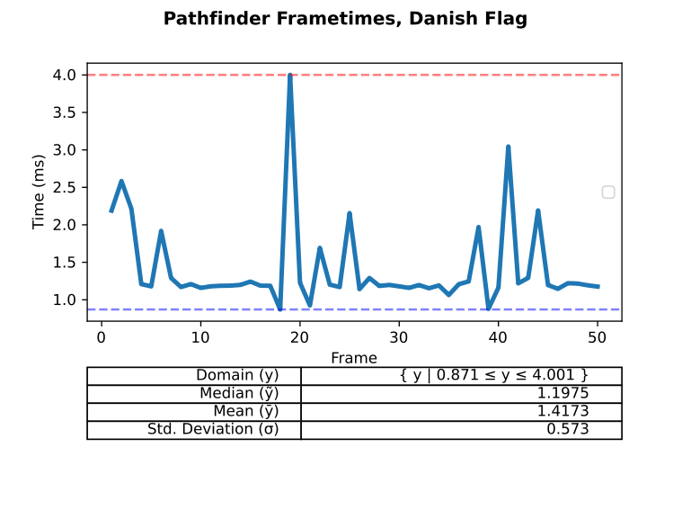
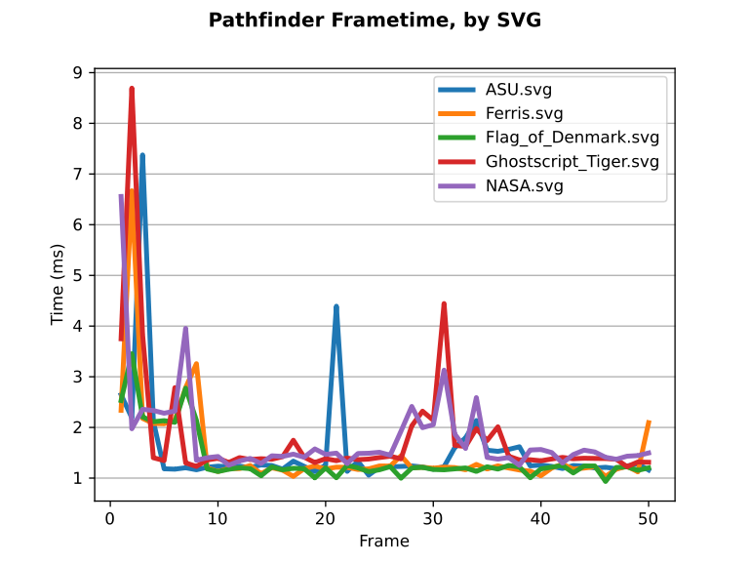
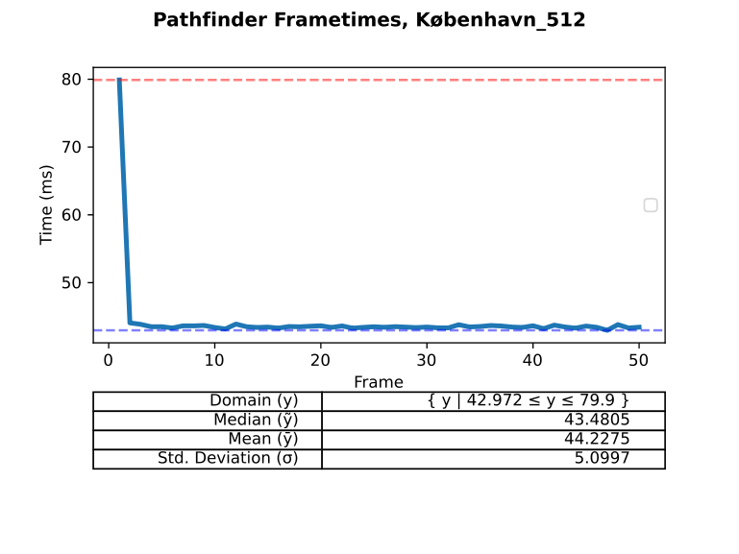
Test Case Benchmark 3:
Pathfinder

Slide 50

Test Case Benchmark 3: Rendering
Notes:
We can use our rendering library to explain these side effects.
Since we have annotation disposal, we annotated the first frame as “Strange behavior” and saw this was being caused by a GPU submit.
Basically, a bunch of load from the CPU to the GPU and waiting for it to return.

Slide 51



Test Case Benchmark 3:
Monitoring

Slide 52
Analysis Questions – Test Case
What are some consequences of tessellation?
What are some consequences of a pre-computation model?
Can hardware acceleration improve performance?
Notes:
We will revisit the analysis questions for our test case

Slide 53
Test Case : What we learned
Tessellation can, very rarely, decrease complexity
Tessellation is non-interactive, but cache friendly
Tessellation is a hardware hog
Hardware acceleration can only help so much
Compute-centric hardware acceleration is much more optimized generally
Tessellation feels dated as a symptom of poor results

Slide 54
Product Retrospective
Framework is suited for benchmarking
Complex GPU analysis is easy with integration
Useful features

Slide 55
Conclusion
Vectors have a unique imaging model
  Resolution independent
  Lightweight
  Implicit modeling
Lack of comparison in practice
Our tool can begin to mitigate that tension

Slide 56
Future Work
Research: Compute-centric
Encoding: SVG (it’s bad)
Improving our framework:
  Rust language features
  Async API
  Live Monitoring
Notes:
Ran into rust language roadblocks actually
Since the language is still mature, some features are not yet stabalized, specifically variadic generics which would enable static dispatch for monitors, a slight improvement.
Also would like to see an Async API so it doesn’t necessarily depend on the Driver runtime

Slide 57
Questions?

