Slide 1
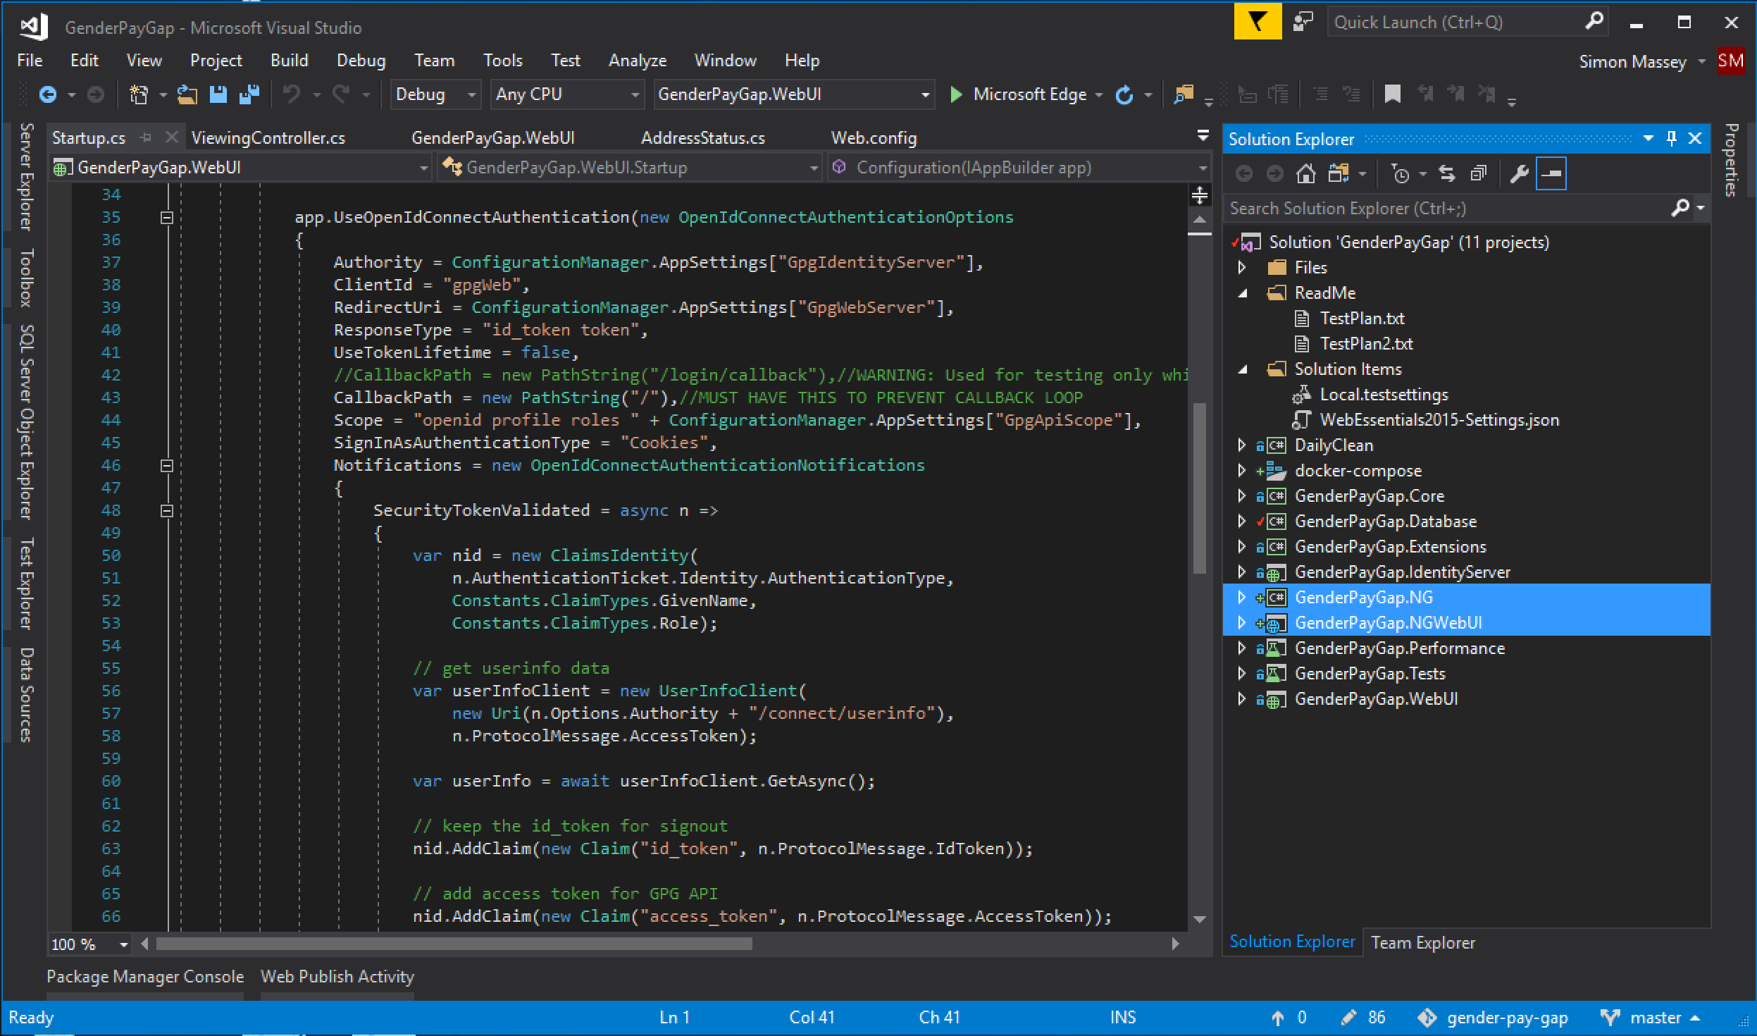
Better supported in Core 2.0
Live Legacy EF
ASP.NET Core & EF Core
Live Legacy ASP.NET

