Slide 1

Backgammon Framework
CS 347
Spring 2010
Stephen Mues

Slide 2
Access
Google Code
  svn checkout http://cs347backgammon.googlecode.com/svn/trunk/ cs347backgammon-read-only
  This command will be on the assignment
Email
  Only when absolutely necessary

Slide 3
Directories
codegen (Ignore This)
guiClient (In progress)
sampleClient (This is what you will edit)
server (This is what you will connect to)
forPython2.5 (For campus machines)
  sampleClient
  server

Slide 4
Code Generator
No longer necessary
Automatically generates clients
The clients have been modified by hand

Slide 5
guiClient
Work in progress
Will be used for the tournament
Implemented in Java

Slide 6
forPython2.5
Functionally identical copies of the server and client
Guaranteed to work on the machines in CS 213
Differences
  Python client includes a copy of ctypes package
  Server uses the threading python package instead of the multiprocessing package.

Slide 7
Server
To start a server
  Move into the server directory
  Run ‟python main.py -b”
To stop a server
  Ctrl-C on normal machines
  Run ‟killall python” on campus machines (Using the code in the forPython2.5 folder)

Slide 8
sampleClient
Contains directories for C++, Python, Java
All 3 clients communicate with the server through a C library
You will only edit AI.* and create any other files you need.
All the function calls you need are used in the example ASCII GUI client provided in each language

Slide 9
AI.*
run()
  Is called to begin your turn
  Returning True from this function ends your turn
  Returning False from this function requests a status update, causing run to be called again.
  Your moves are not sent to the server until you return True or False (and your ServerBoard object is not updated until then either)

Slide 10
Available functions in run()
void serverBoards[0].move(int from, int to)
void serverBoards[0].bearOff(int from)
int player0Score()
int player1Score()
int getPoint(int index)
int getDie(int index)
double player0Time()
double player1Time()
int getPlayerID()
int turnNumber()

Slide 11
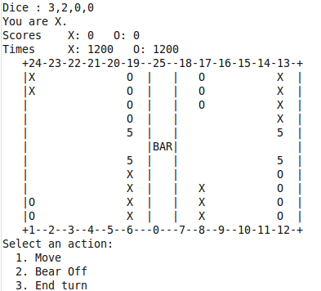
Example ASCII GUI

Slide 12
Running Your Client - C++
Move into the sampleClient/c/ directory
Run ‟make”
Run ‟./client localhost” to create a game
Run ‟./client localhost 0” to join game 0

Slide 13
Running Your Client - Java
Move into the sampleClient/java/ directory
Run ‟make”
Run ‟./run localhost” to create a game
Run ‟./run localhost 0” to join game 0

Slide 14
Running Your Client - Python
Move into the sampleClient/python/ directory
Run ‟make” the first time
  This builds the C library that communicates to the server
Run ‟./run localhost” to create a game
Run ‟./run localhost 0” to join game 0

Slide 15
Other Rules
If you try to end your turn with unused dice that you could have used, your turn will not end. Instead, the server will send you the updated board state, and your run function will be called again.
The doubling cube is not used. Your score is the number of checkers removed.
If you run out of time, you lose. Your opponent receives all 15 points. Your score is unchanged.

Slide 16
Questions?

