Slide 1

CARPOOLING APP
TEAM :
Nihil Pellissery
Vaishnavi Bhoite
Rutuja Patil
Anirudh Balasubramaniam

Slide 2
FEATURES
Login authentication logic implemented for User Registration through the Database
Google Maps rendered across Driver Search
Finding nearest Drivers by using Google Maps nearest proximity searching algorithm
Built CRUD applications to show history of Past Rides for Rider and User
Created Ride Request Feature for Rider to specify rides with criteria like Origin/Destination and Pickup Times
Implemented options for Drivers to Reject/Accept ride request from users
Developed a Payment tab for Riders to pay via the Stripe API
Developed a Cost Calculation and Pricing Methodology to display fare for Commute

Slide 3
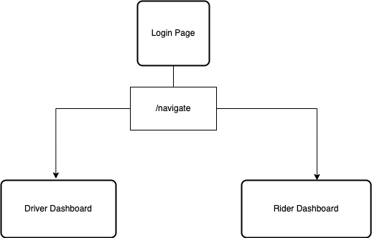
WORKFLOW NAVIGATION

Slide 4
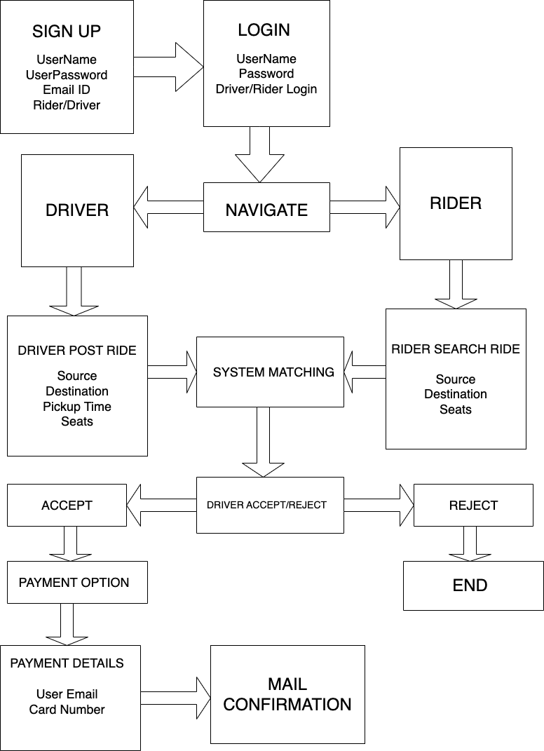
APPLICATION WORKFLOW

Slide 5
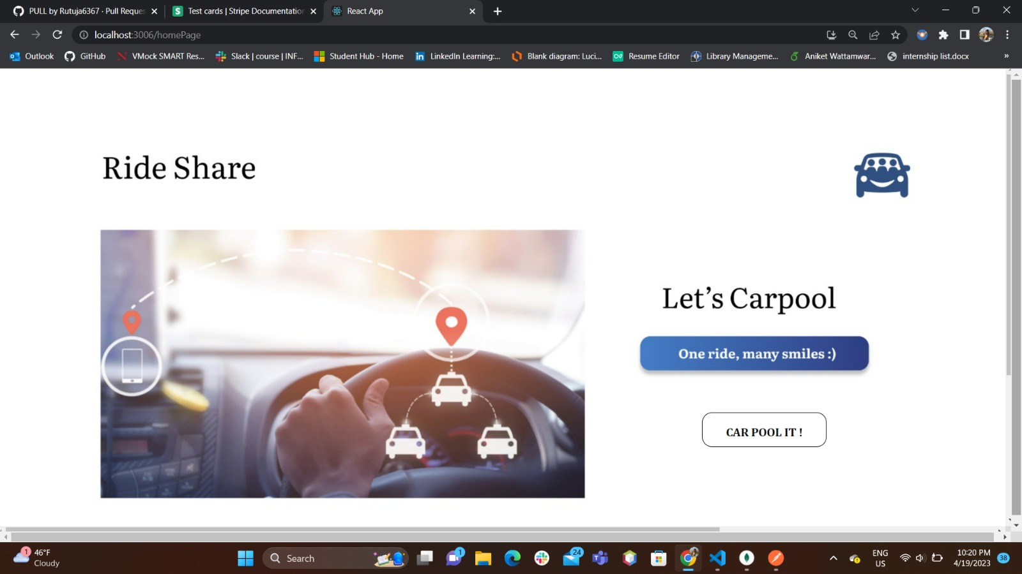
HOME PAGE

Slide 6
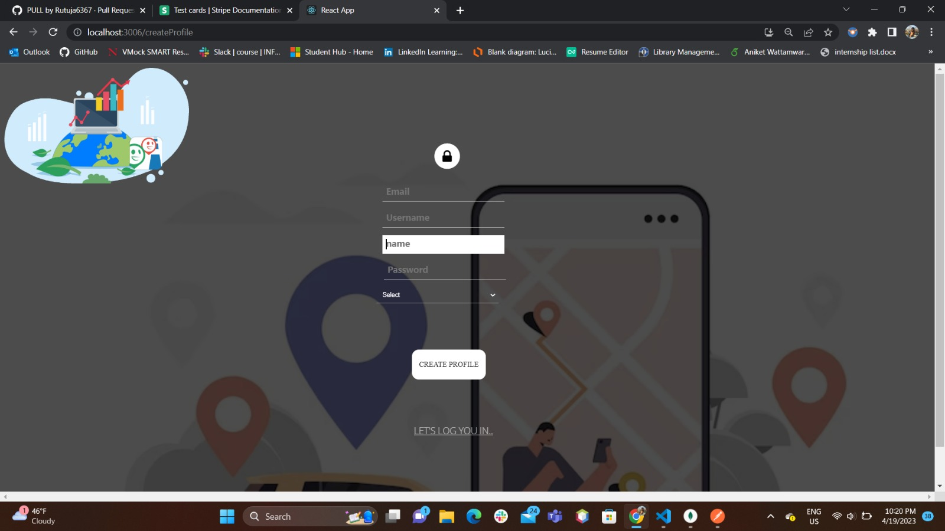
SIGN UP PAGE

Slide 7
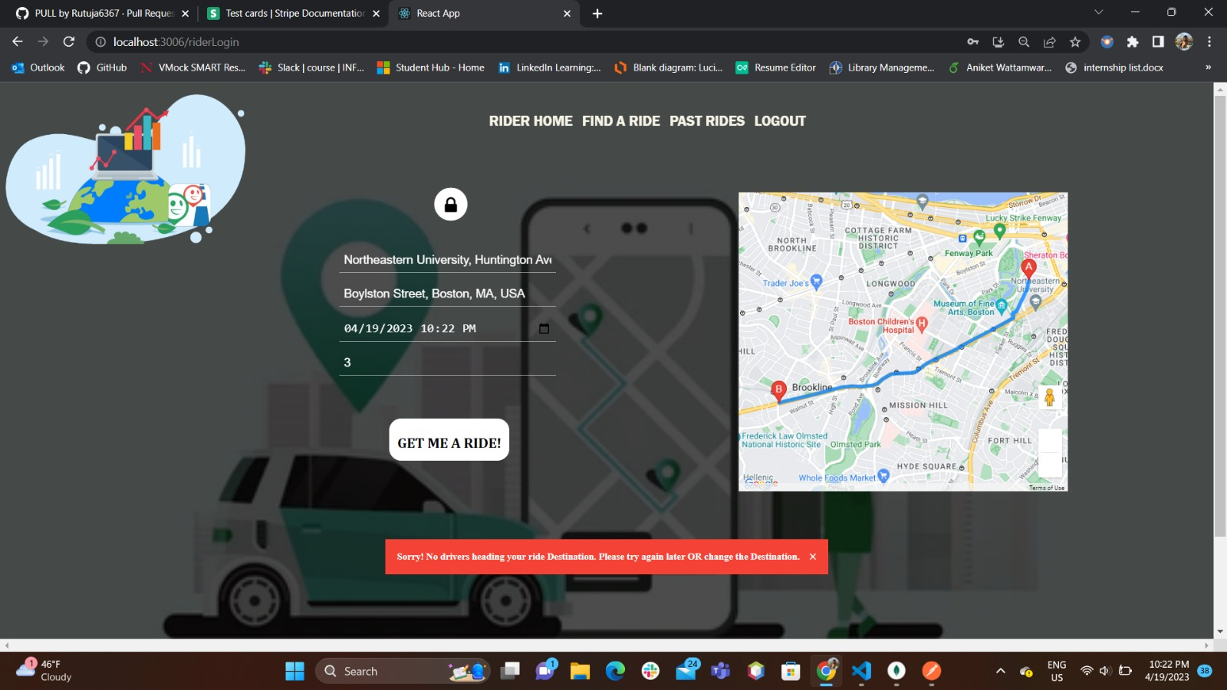
GET A RIDE

Slide 8
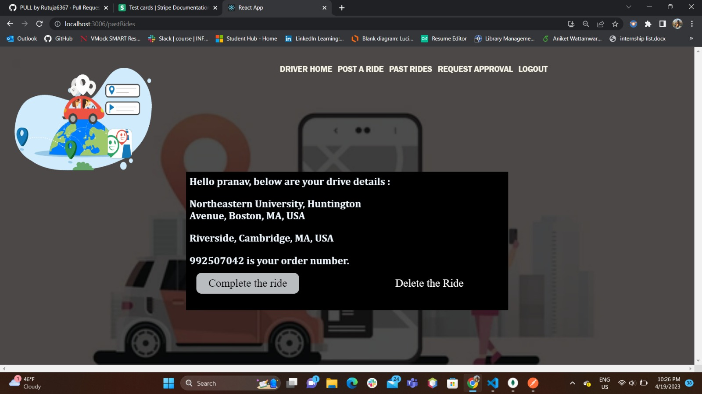
Complete a Ride

Slide 9
Integration of the Google Maps API to facilitate route planning and proximity matching functionalities.
Utilization of Email.js to enable efficient communication between riders and drivers through email notifications.
Implementation of Mongoose for seamless interaction with a MongoDB database.
Incorporation of the Stripe API to allow secure payment processing for transactions
Integration of SASS as a preprocessor for CSS styling to enhance the visual appeal of the application
API Implemented

Slide 10







TECH STACK USED

Slide 11
REFERENCES
https://reactjs.org/docs/getting-started.html
https://developers.google.com/maps/documentation/javascript/overview
https://stripe.com/docs/api
https://www.emailjs.com/docs/

