Slide 1
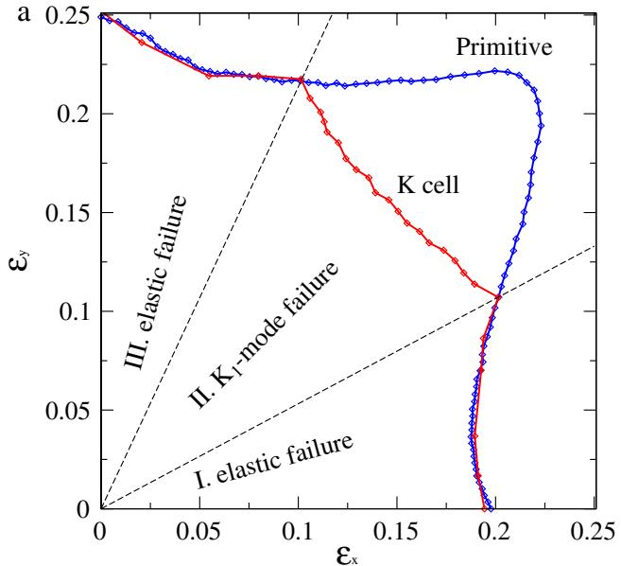
Graphene Failure
The predicted failure mode depends on the tensile state.
Paper
Failure Mechanisms of Graphene
under Tension
Authors and journal
C. A. Marianetti & H. G. Yevick ·
Physical Review Letters 105 (2010)
Fig. 4(a). Maximum stable strain across tensile directions; regions differ in
which instability occurs first.
EV0002 · EV0045
Notes:
Paper: “Failure Mechanisms of Graphene under Tension,” C. A. Marianetti and H. G. Yevick, Physical Review Letters 105, 245502 (2010), DOI 10.1103/PhysRevLett.105.245502. The title is shortened for the cover; the full paper title and citation are shown below. Figure 4(a) is the paper’s loading-direction map.
Evidence: EV0002 · EV0045

Slide 2
What limits near-ideal graphene?
The first failure mechanism under a generic tensile state was still an open question.
Nanoindentation
Uniaxial phonons
Open question
This study
Lee et al. strained
graphene to failure
under conditions
described as nearly
ideal.
Earlier calculations
found elastic
instability for
armchair or zigzag
loading.
Which instability
occurs first for a
generic state of
tension?
Compare the elastic
limit with a finite-
wave-vector K1
phonon instability.
The prior experiment and calculations probe different loading contexts.
EV0057 · EV0033 · EV0004 · EV0002
Notes:
The paper opens with two findings from different loading contexts: nearly ideal nanoindentation caused failure, while previous armchair/zigzag phonon calculations identified elastic instability. The authors ask which instability comes first for a generic tensile state. This comparison motivates the calculations; it does not claim that the experiment and calculations reproduce identical boundary conditions.
Evidence: EV0057 · EV0033 · EV0004 · EV0002

Slide 3
How are both limits tested?
The workflow compares elastic instability with the K1-mode onset.
1 · Strain states
2 · DFT forces
3 · Phonons
4 · Compare limits
Evaluate strain-
dependent tensile
response, including
equibiaxial loading.
Generate strained-
structure forces using
the local density
approximation.
Calculate phonons
with the
displacement method
.
Track the elastic
instability against the
K1-mode onset.
EV0004 · EV0009 · EV0017 · EV0025
Notes:
DFT forces as a function of strain are used to assess elastic instability. Phonons are computed with the displacement method, with forces generated using DFT in the local density approximation. The calculation then compares the elastic and K1-mode limits across tensile states. See the cited evidence in the speaker-note footer for the source spans.
Evidence: EV0004 · EV0009 · EV0017 · EV0025

Slide 4
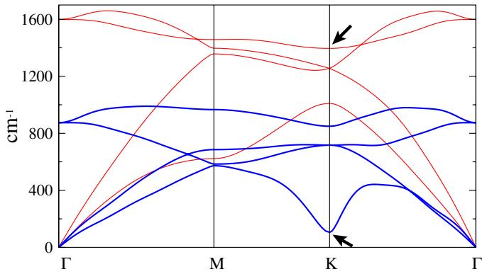
When does the K1 mode soften?
Two calculations place K1 softening near ε_A ≈ 0.21.
Phonon threshold
K1 softens at ε_A = 0.205–0.212
under equibiaxial strain.
Independent check
Mode-energy analysis predicts ε_A
= 0.213, closely matching the
phonon threshold.
Fig. 1. In-plane phonon branches under equibiaxial strain; the K1 mode
approaches instability at K.
These are calculated thresholds for idealized equibiaxial loading, not measured breaking strains.
EV0055 · EV0025
Notes:
Figure 1 shows significant softening of in-plane phonons under equibiaxial strain. The phonon calculation places the K1 soft mode at ε_A = 0.205–0.212. A separate mode-energy analysis predicts ε_A = 0.213. These are closely matching calculated thresholds, not a direct measurement of breaking strain.
Evidence: EV0055 · EV0025

Slide 5
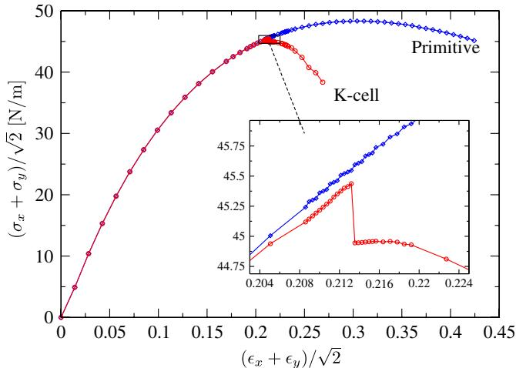
How can K1 softening reduce strength?
The authors link K1 softening to a structural transition and reduced strength in some tensile
states.
Structural route
The authors infer that the
deepening K1 double well leads
toward isolated hexagonal rings.
Strength implication
The K-cell stress drops near
softening; the proposed route can
reduce strength.
Fig. 3. Nominal stress versus equibiaxial strain; the K-cell response drops
near K1 softening.
EV0031 · EV0034 · EV0032
Notes:
The paper reports that further strain deepens and widens the K1 double-well potential. It interprets the mode as a route toward isolated hexagonal rings and reduced strength. Figure 3 supplies the mechanical response: the K-cell stress curve drops near the K1 softening. Present the structural pathway as the authors’ interpretation, not as a directly imaged transition in this calculation.
Evidence: EV0031 · EV0034 · EV0032

Slide 6
Tensile state selects the failure mode
Elastic instability governs regions I and III; the K1 mode occurs first in region II.
Regions I and III
Elastic instability precedes the K1
mode.
Region II
The K1-mode instability arrives first
; the route changes with tensile
direction.
Fig. 4(a). Maximum stable strain across tensile directions; regions I/III are
elastic-limited and region II is K1-limited.
EV0029 · EV0045 · EV0002
Notes:
The authors identify regions I and III as elastic-instability failure, where the elastic limit precedes the K1 mode. The complementary region is limited first by the K1 instability. They emphasize that equibiaxial loading follows a different route from the usual uniaxial armchair/zigzag case. Use the labels in Figure 4(a) when presenting the regions.
Evidence: EV0029 · EV0045 · EV0002

Slide 7
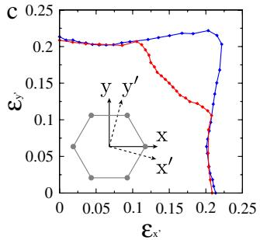
Do orientation and shear matter?
Rotation and shear make only small changes to the predicted K1 onset, but the state map is
incomplete.
Rotation
The 15° map stays within the
original/rotated envelope;
orientations were sampled every 3°.
Shear and scope
Shear shifts K1 onset only slightly.
Anisotropy leaves some tensile
states untested.
Fig. 4(c). At 15° rotation, the failure map remains within the original/rotated
envelope.
Rotation and shear checks do not enumerate every possible tensile state.
EV0049 · EV0024 · EV0046 · EV0005
Notes:
The coordinates were rotated in 3-degree increments; Figure 4(c) displays the 15-degree case. The rotated results remain within the envelope formed by the original and 15-degree curves. The authors report no qualitative shear-induced change and only small quantitative shifts to K1 onset. Because graphene is anisotropic, the paper notes that the orientation/shear enumeration is not exhaustive.
Evidence: EV0049 · EV0024 · EV0046 · EV0005

Slide 8
Experiment vs prediction?
The measured nominal strain (0.225) is closer to the calculated elastic limit (0.216), but the
failure route remains unresolved.
Measured
Calculated elastic limit
Authors’ proposal
Possible differences
Nanoindentation
reports nominal
equibiaxial breaking
strain 0.225.
The equibiaxial
elastic-instability
strain is 0.216.
The K1 mode may be
stabilized during
nanoindentation.
Indenter environment
and strain
construction may
affect the comparison
.
K1 stabilization is a proposed explanation, not a demonstrated mechanism.
EV0054 · EV0028 · EV0021 · EV0020 · EV0014
Notes:
Lee et al. report a nominal equibiaxial breaking strain of 0.225. The paper says this is in much better agreement with its calculated equibiaxial elastic-instability strain of 0.216. The authors suggest that K1 may be stabilized in nanoindentation, but they do not establish this. They identify possible differences involving the indenter environment and the experimental versus constructed equibiaxial strain state.
Evidence: EV0054 · EV0028 · EV0021 · EV0020 · EV0014

Slide 9
Conclusions and limits
Tensile state selects whether elastic instability or a K1 soft mode limits strength.
Mode selection
Elastic failure in regions I/III; K1
soft-mode failure in region II.
Open limits
Indentation leaves the route
unresolved; rotation/shear
sampling is incomplete.
Fig. 4(a). The loading-direction map summarizes where elastic and K1-mode
instabilities occur first.
PaperWorkflow evidence coverage is under review; the paper also notes that rotation/shear sampling is not exhaustive.
EV0029 · EV0034 · EV0002 · EV0054 · EV0021 · EV0005
Notes:
The paper’s central result is mode selection by tensile state: elastic instability in regions I/III and a K1 soft-mode route in region II. The authors connect K1 softening with a phase transition and reduced strength in some states. The nanoindentation comparison does not settle which route occurred. The paper says its orientation/shear treatment is incomplete. PaperWorkflow’s synthesis readiness also marks evidence coverage as review, so this deck should not be read as exhaustive coverage of all workflow facets.
Evidence: EV0029 · EV0034 · EV0002 · EV0054 · EV0021 · EV0005

