Slide 1
SAST & SCA Analysis of Redis and CIE NIS Java SDK using SonarCloud and OWASP Dependency Check
Department of Engineering and Architecture
Trieste, 27 November 2025

Slide 2
THE REPOS
REDIS
CIE NSI SDK
In-memory “database”
World-class performance, widely used, written in C
Created by an Italian (Antirez)
Few dependencies: jemalloc, lua, hiredis, linenoise
SDK to check validity of NSI numbers through a shared protocol
Written in Java
Only one dependency: BouncyCastle
Very critical codebase for PA operations
2

Slide 3
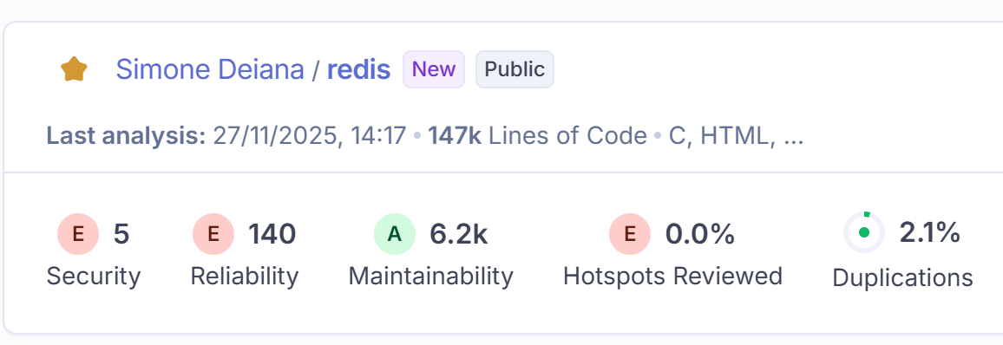
REDIS V6 [2023] (SAST)
Mostly maintainability issues
Very few security issues (but very bad)
Some reliability issues can have dangerous security implications (e.g. buffer overflows)
3

Slide 4
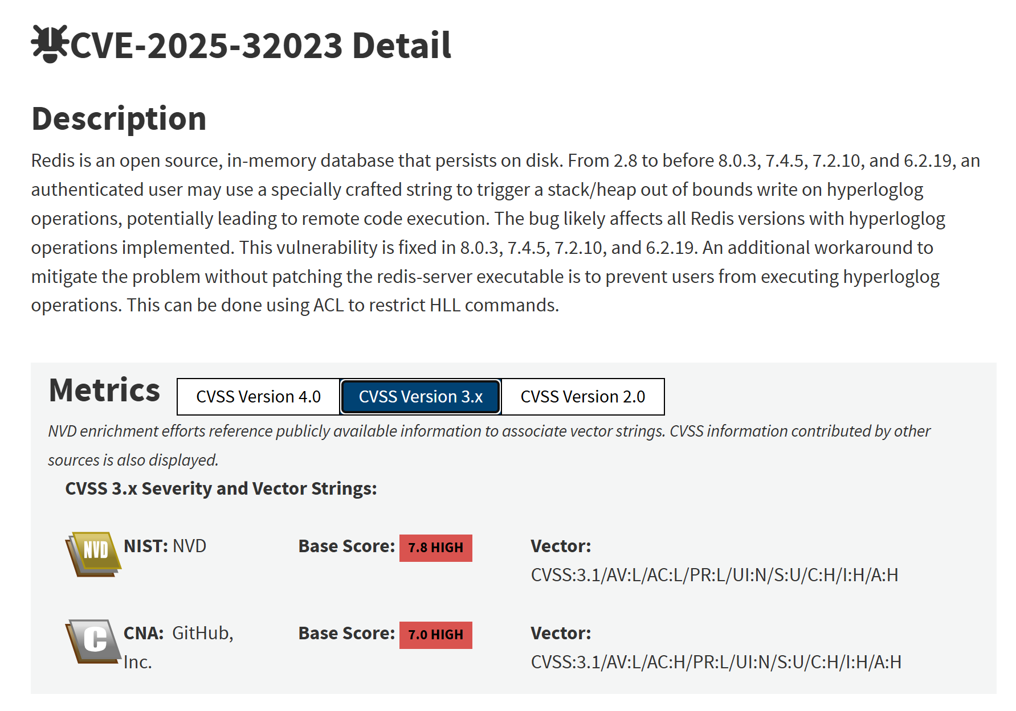
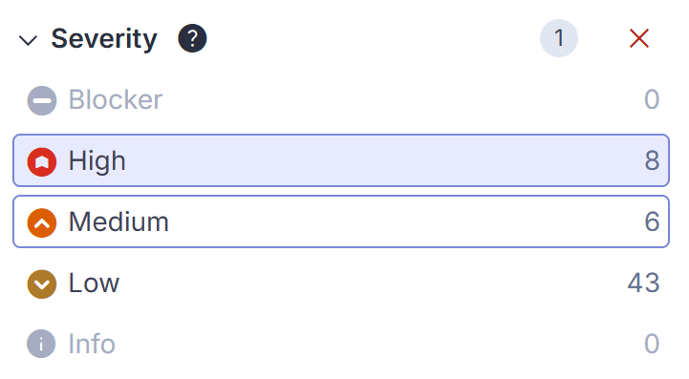
REDIS V6 [2023] – SAMPLE CVE
Fixed in Redis v6.2
Out of bounds write in the hyperloglog.c file
Not spotted by SonarQube
Completely different LoC, marked as maintainability issues
4

Slide 5
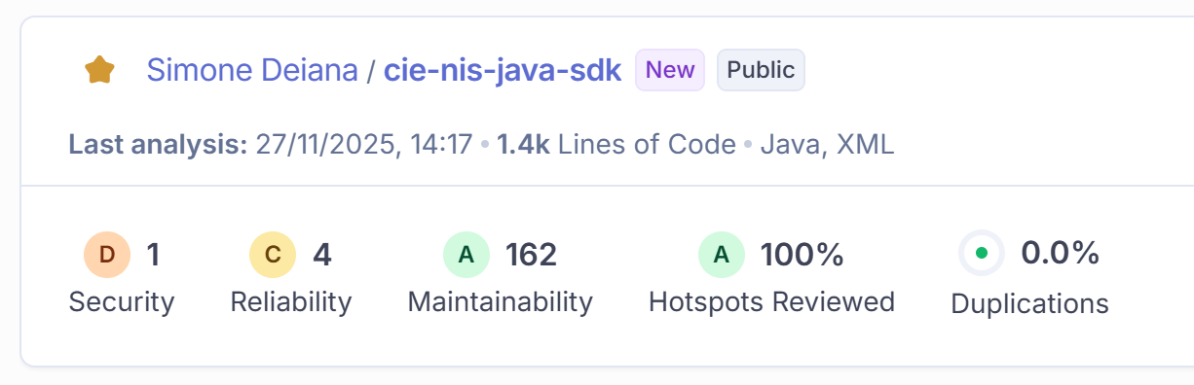
CIE NSI JAVA SDK (SAST)
Only one security issue (we’ll see later)
A few mild reliability issues
Some maintainability issues with a very mild rating
5

Slide 6
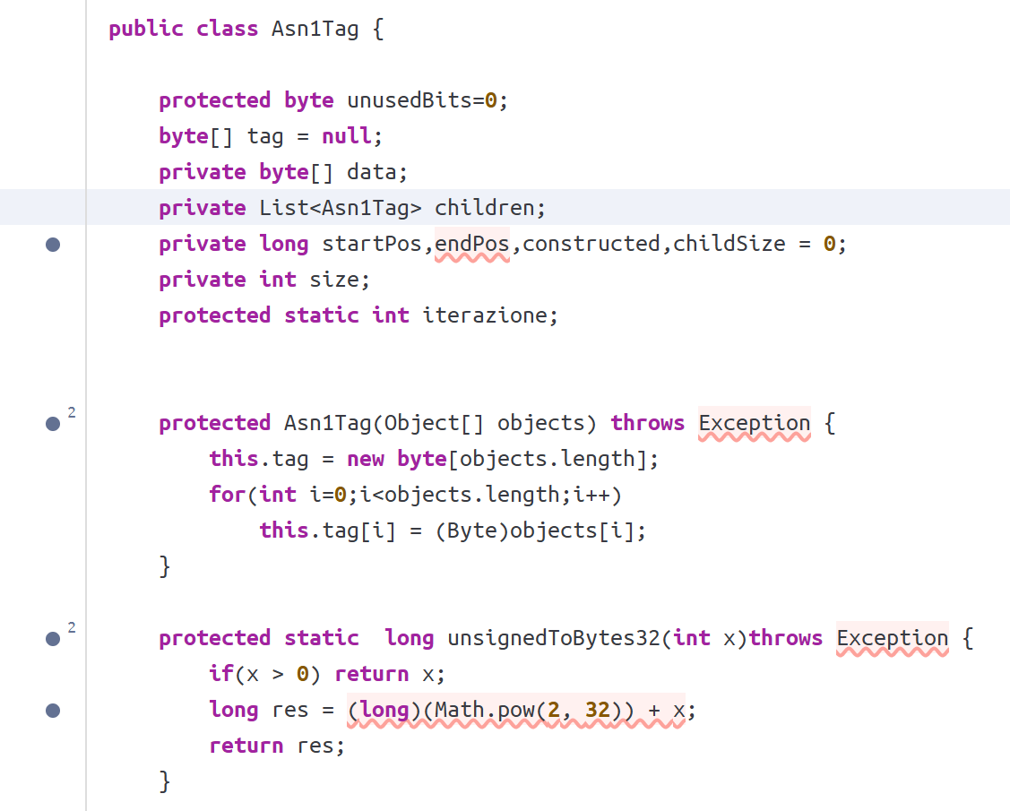
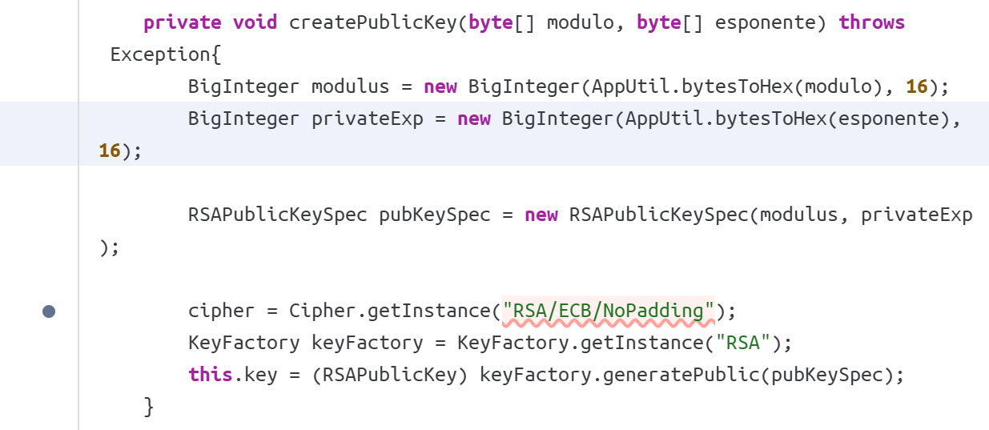

CIE NSI JAVA SDK – SECURITY AND RELIABILITY
RELIABILITY EXAMPLE
security EXAMPLE
6

Slide 7
REDIS & CIE NSI JAVA SDK (SCA)
Redis includes its dependencies directly in the repo as source code, thus OWASP doesn’t recognize them
The NSI Java SDK uses a custom script to download dependencies, thus OWAS doesn’t find them from the normal repo
7

