Slide 1
NewCoders
Simran Dua
Treman Singh Kaloya

Slide 2
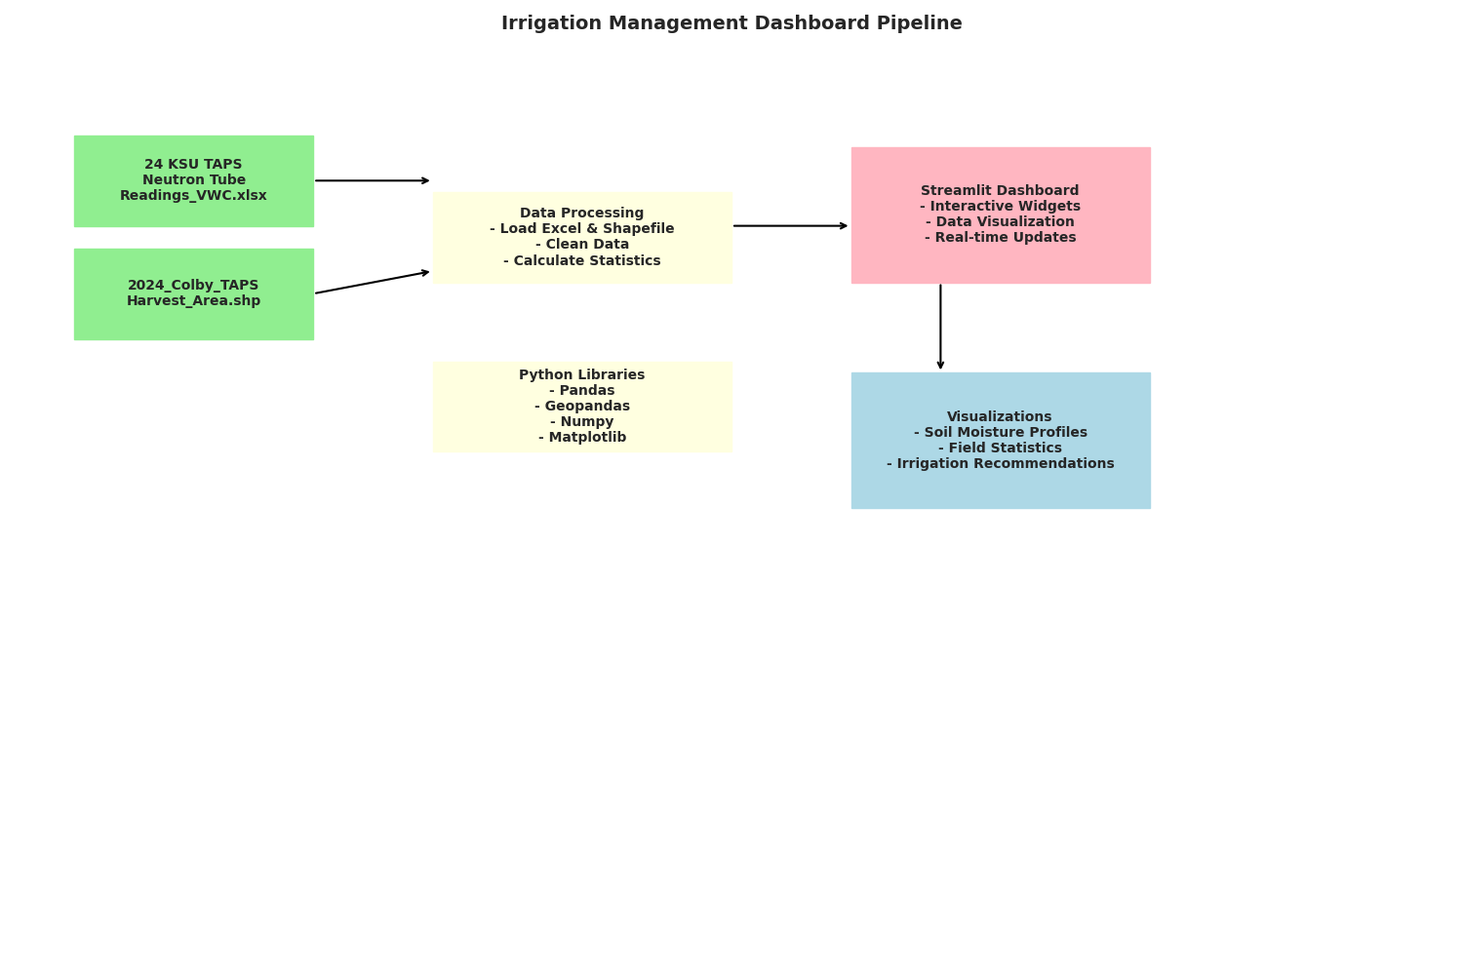
Irrigation Recommendation workflow
Input: Neutron Probe Data, Soil texture, Crop type, depth selection
Output: Visualization about Soil moisture available, Irrigation recommendation
Python ~ Streamlit app for dashboard

