Slide 1
FINAL PRESENTATION
WEB APPLICATION DEVELOPMENT
UET – VNU,
December 24th 2019

Slide 2




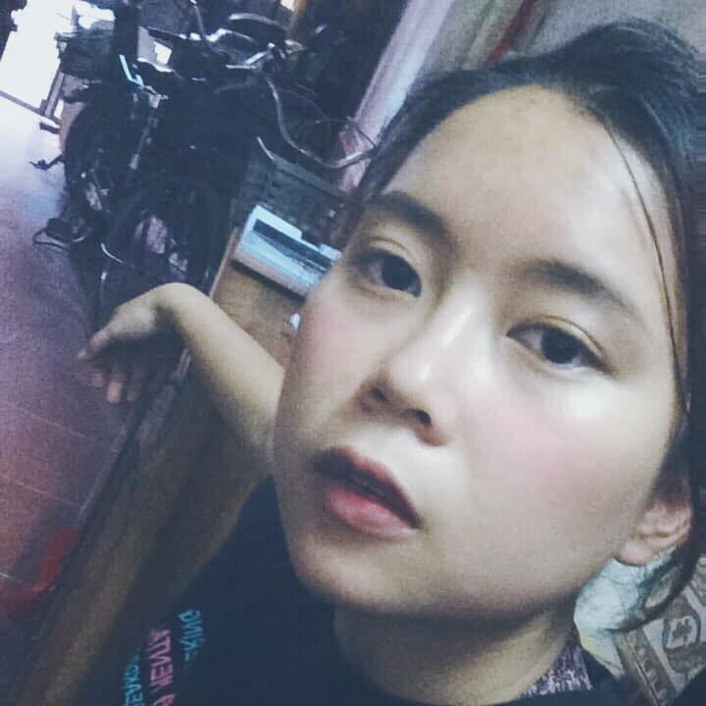
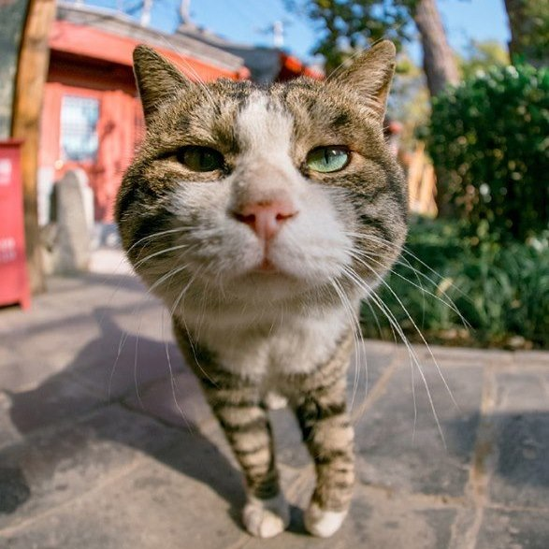
TEAM
MEMBERS
TRAN BA HOA
Front-end leader & developer
NGUYEN HUU HOA
Back-end leader & developer
DUONG THI THUY HANNG
Back-end Developer
PHAM NGOC ANH TRANG
Back-end Developer
LE MINH TAM
BA & Front-end Developer
KHONG THI MAI LOAN
Tester & Back-end Developer

Slide 3

ONLINE SHOPPING INFORMATION PORTAL

Slide 4

OBJECTIVES
1.
Tracking and capturing hot keywords on some popular ecommerce websites
ONLINE SHOPPING INFORMATION PORTAL

Slide 5
OBJECTIVES
2.
Searching goods in some popular ecommerce websites at the same time
ONLINE SHOPPING INFORMATION PORTAL

Slide 6
OBJECTIVES
3.
Finding, tracking promotions as well as managing favorite promotions
ONLINE SHOPPING INFORMATION PORTAL

Slide 7
OBJECTIVES
4.
Finding and tracking flash-sales in some popular ecommerce websites
ONLINE SHOPPING INFORMATION PORTAL

Slide 8
FEATURES
User
Administrator
Tracking trending/hot keywords.
Searhcing keywords/goods.
Finding promotions.
Managing favorite promotions.
Finding flash-sales.
Managing users’ account.
Managing functions.
Managing roles.
ONLINE SHOPPING INFORMATION PORTAL

Slide 9
STRUCTURE AND FLOW
(8)
OSIP Webapp
Crawl Service
(5)
(4.1)
(4.2)
Valid?
Outside System
(6)
(4)
(7)
(1)
OSIP Server
DB
(3)
(2)
ONLINE SHOPPING INFORMATION PORTAL

Slide 10
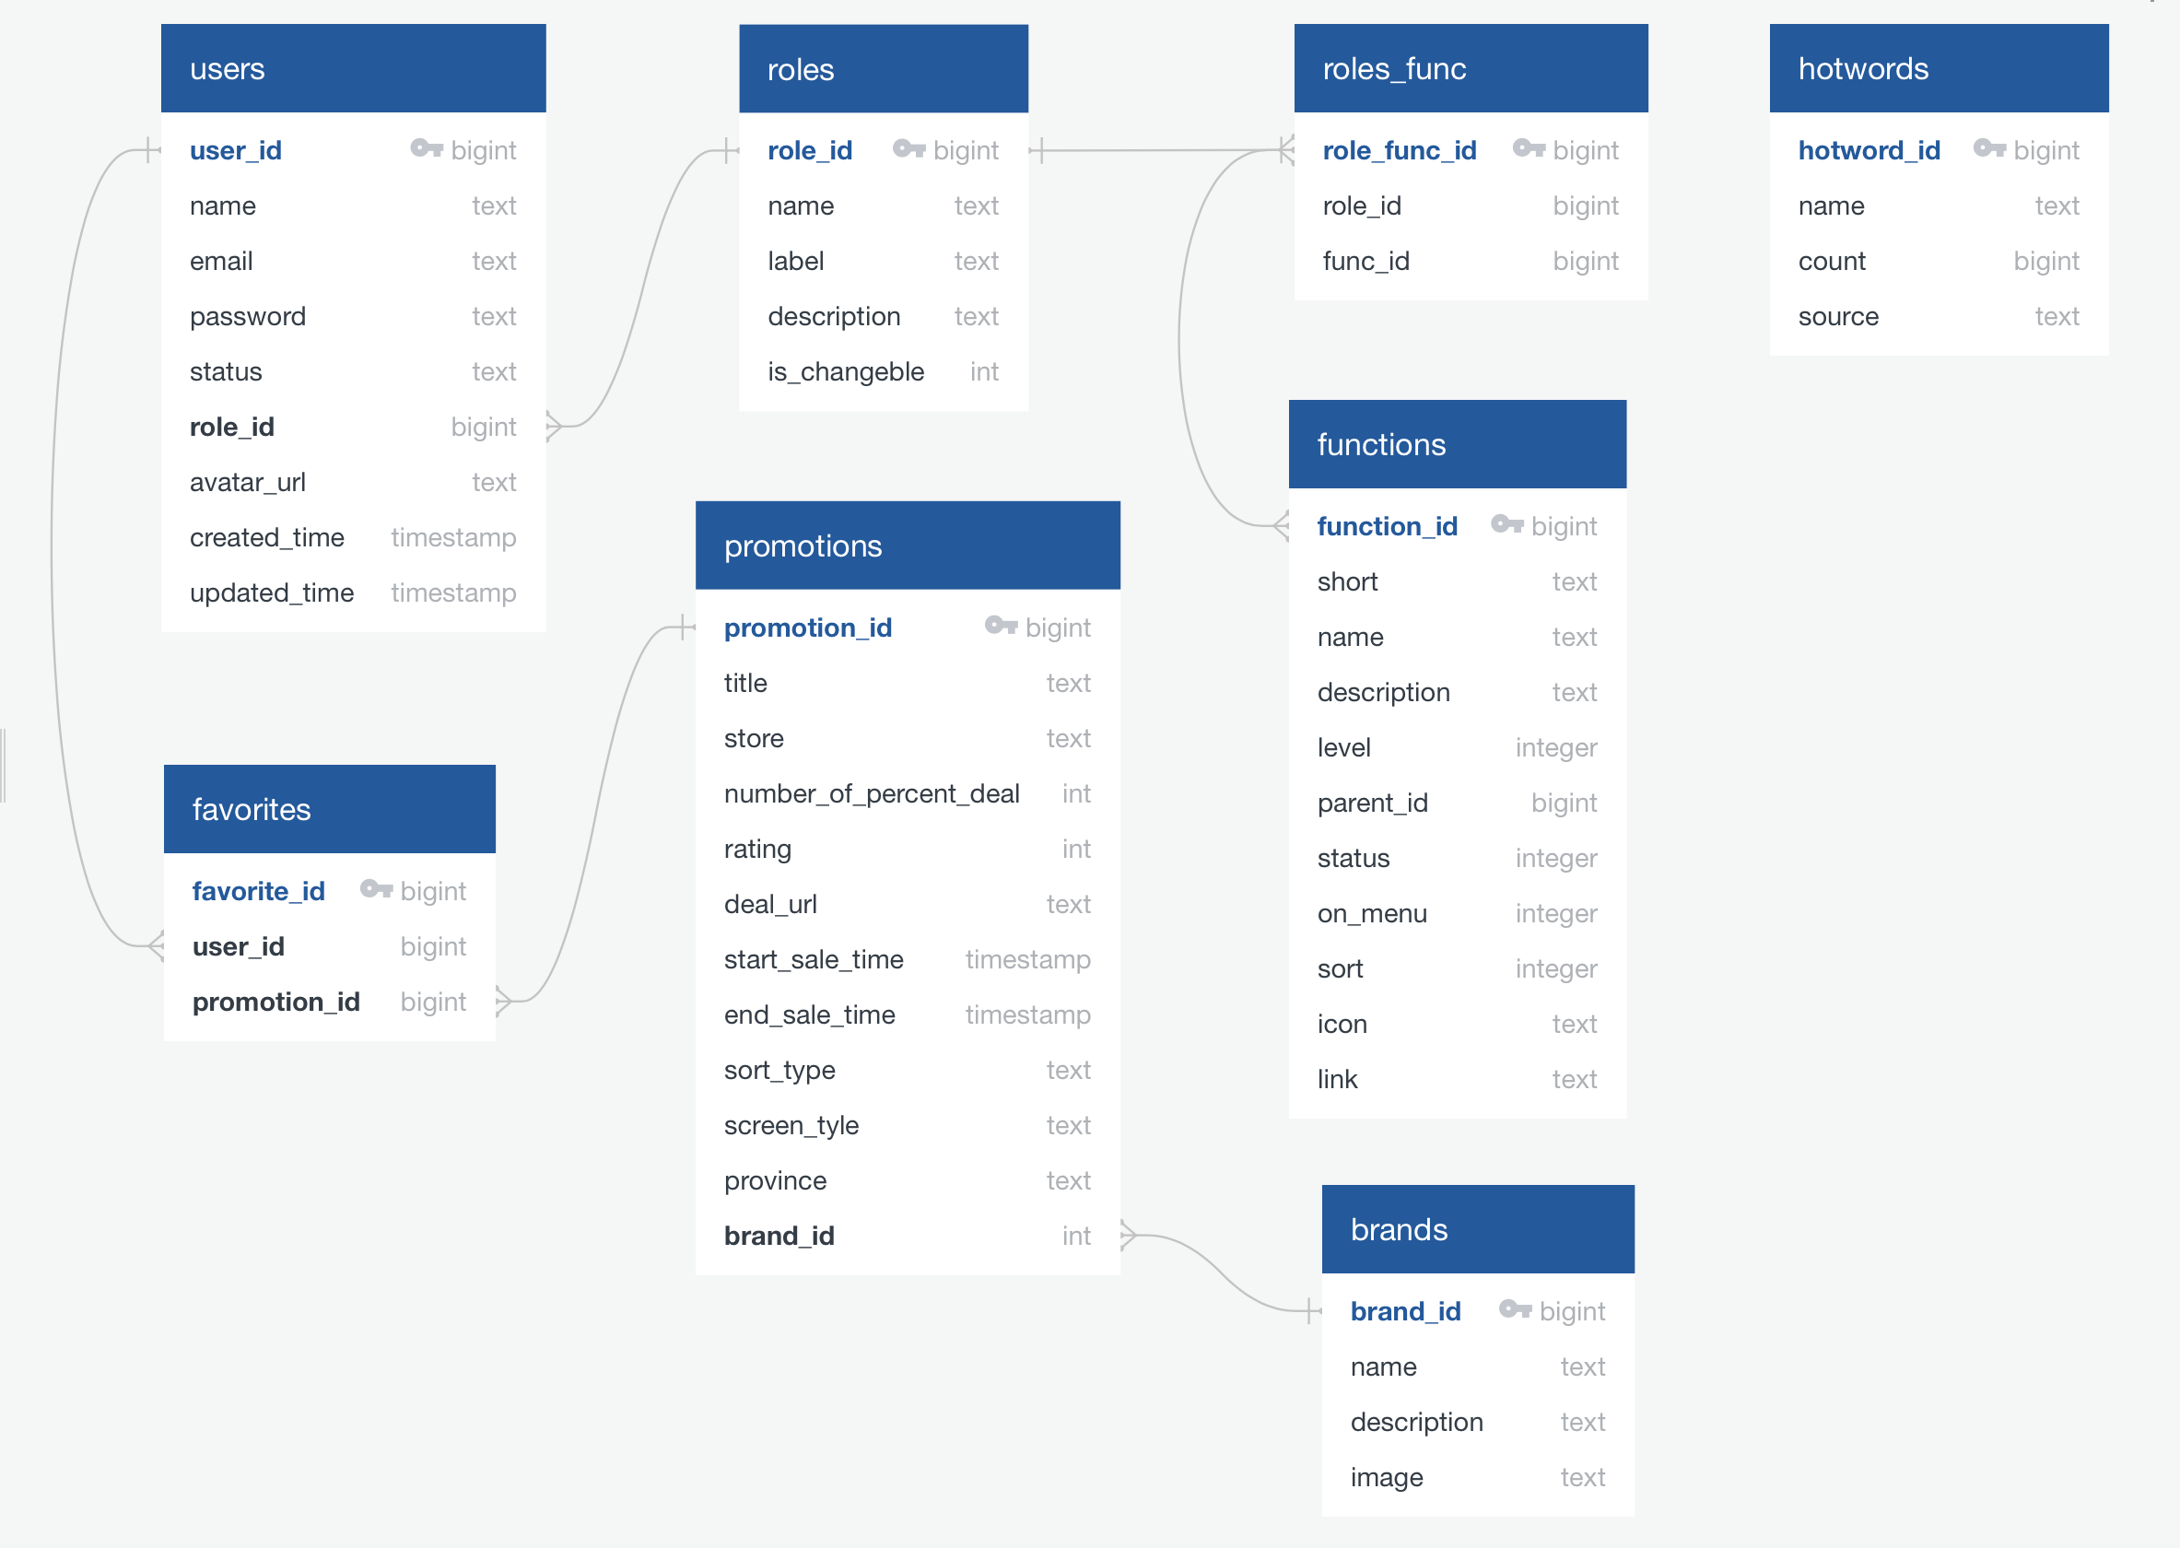
DATABASES
ONLINE SHOPPING INFORMATION PORTAL

Slide 11









FRAMEWORKS AND TOOLS
ONLINE SHOPPING INFORMATION PORTAL

Slide 12
WHAT HAVE WE DONE?
TIME TO
DEMO
ONLINE SHOPPING INFORMATION PORTAL

Slide 13

THANKS FOR YOUR ATTENTION
ANY QUESTIONS?

