Slide 1

Principal component analysis
GATE Institute
July 2025

Slide 2
Overview
What is PCA?
Why do we use it?
How to do it?
Applications;
Example.

Slide 3
What is PCA?
Given a table of two or more variables, PCA generates a new table with the same number of variables, called the principal components.
Each principal component is a linear transformation of the entire original data set.
The coefficients of the principal components are calculated so that the first principal component contains the maximum variance (which we may tentatively think of as the "maximum information").
The second principal component is calculated to have the second most variance and, importantly, is uncorrelated (linearly) with the first principal component.
Further principal components, if there are any, exhibit decreasing variance and are uncorrelated with all other principal components.

Slide 4
Why do we use it?
Principal components analysis (PCA) is a technique that can be used to simplify a dataset.
It is a linear transformation that chooses a new coordinate system for the data set such that greatest variance by any projection of the data set comes to lie on the first axis (then called the first principal component), the second greatest variance on the second axis, and so on.
PCA can be used for reducing dimensionality by eliminating the later principal components.

Slide 5
How to do it?
Standardize data;
Form the covariance matrix of the data;
Find its eigenvalues and eigenvectors;
By finding the eigenvalues and eigenvectors of the covariance matrix, we find that the eigenvectors with the largest eigenvalues correspond to the dimensions that have the strongest correlation in the dataset;
Form the feature vector;
Plot the data in the pc-space.

Slide 6
Variance and Covariance
Variance and Covariance are a measure of the “spread” of a set of points around their center of mass (mean).
Variance – measure of the deviation from the mean for points in one dimension e.g. heights
Covariance as a measure of how much each of the dimensions vary from the mean with respect to each other
Covariance is measured between 2 dimensions to see if there is a relationship between the 2 dimensions e.g. number of hours studied & marks obtained.
The covariance between one dimension and itself is the variance.

Slide 7
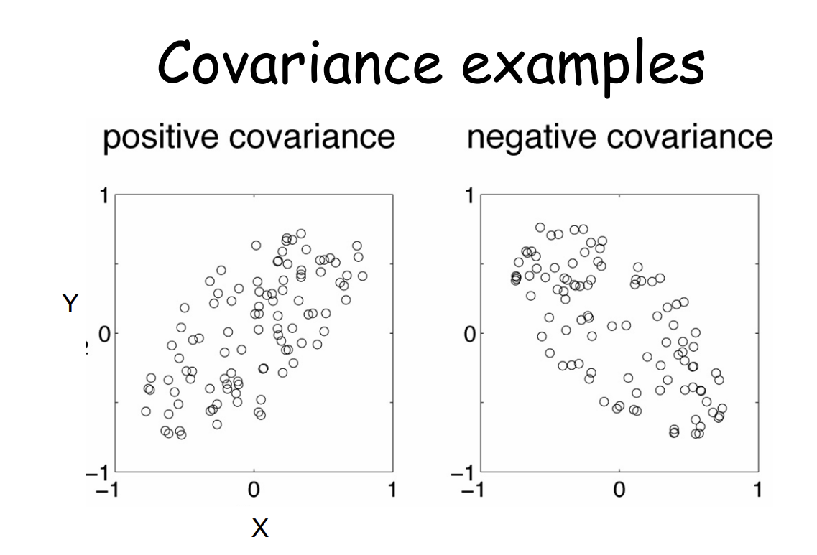

Slide 8
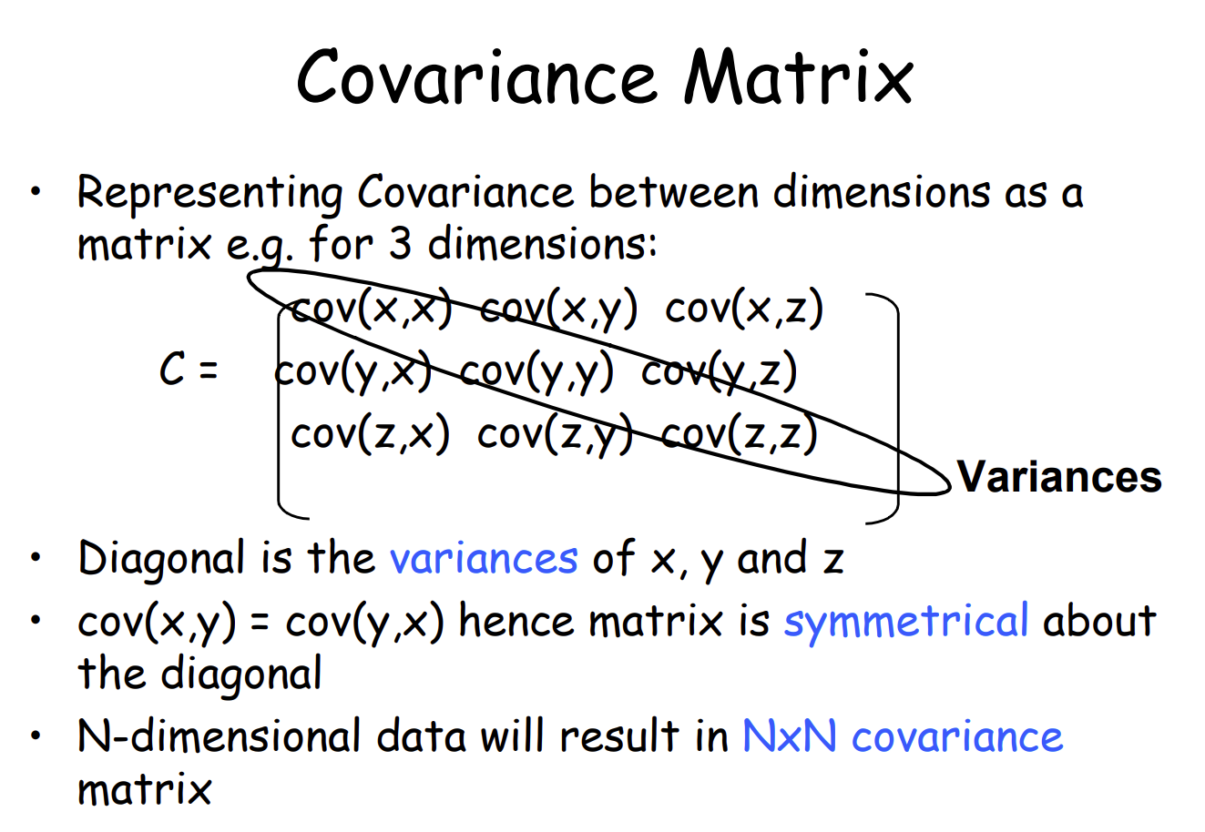

Slide 9
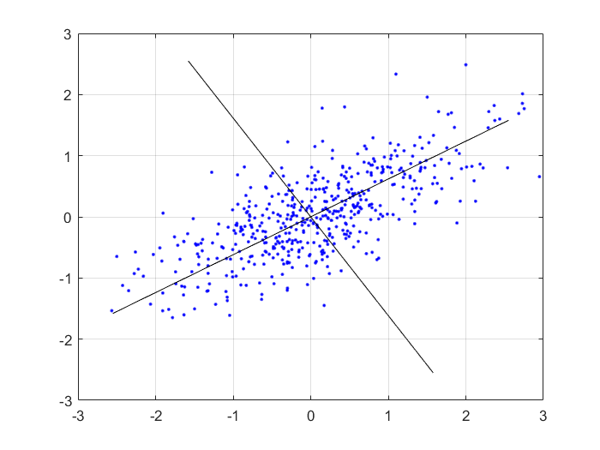
PC space

Slide 10
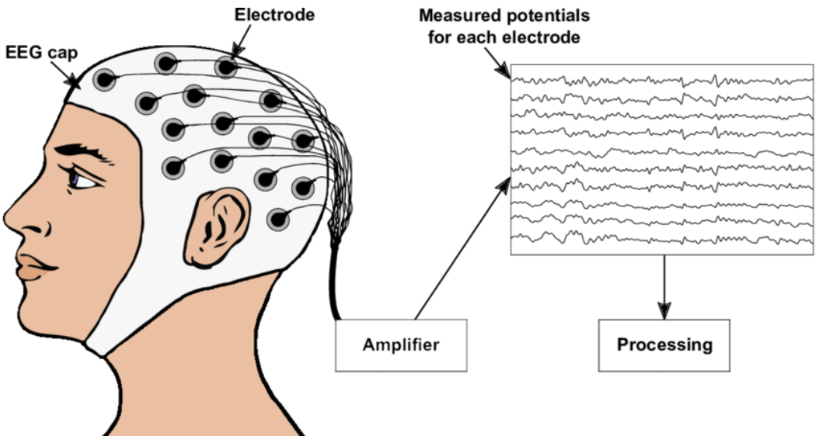
Example: EEG data
Depending on the EEG cap used, a region of the brain may be examined with a varying number of electrodes.
How to compare data from different sensors?
PCA is used to standardize the dimensionality of the data, so that it can be analyzed an summarized, regardless of the sensor used.
Reference: Towards a home-use BCI: fast asynchronous control and robust non-control state detection, Sebastian Nagel

Slide 11
Summary
Why perform PCA?
It is used to find interrelations between variables in the data.
It is used to interpret and visualize data.
The number of variables is decreasing which makes further analysis simpler.
It’s often used to visualize genetic distance and relatedness between populations.

