Slide 1
RecSys Challenge 2015
By Simo
task One - Will a certain session end up with a purchase?

Slide 2
Preprocessing of data
Starting with yoochoose-clicks.dat, yoochoose-buys.dat
Importing to mongoDB
mongoimport -d challenge -c buys --type csv --file yoochoose-buys.dat --fields sessionId,timestamp,itemId,price,quantity
mongoimport -d challenge -c clicks --type csv --file yoochoose-clicks.dat --fields sessionId,timestamp,itemId,categor

Slide 3
Aggregating clicks by session
Want to observe whether session attributes result in a purchase
$group :
{
_id : "$sessionId",
clicks: {
$push: {
timestamp: "$timestamp",
itemId: "$itemId",
category: "$category"
}
},
clicksCount: {$sum: 1},
distinctItems: {$addToSet: "$itemId"},
distinctCategories: {$addToSet: "$category"},
timestampArray: {$push: "$timestamp"},
sessionStart: {$min: "$timestamp"},
sessionEnd: {$max: "$timestamp"}
}

Slide 4
Adding more fields
{
$project: {
clicks: 1,
clicksCount: 1,
distinctItems: 1,
distinctCategories: 1,
timestampArray: 1,
sessionStart: 1,
sessionEnd: 1,
numCat: {$size: "$distinctCategories"},
numItems: {$size: "$distinctItems"},
}
},

Slide 5
Time to leave mongoDB( it is bad)
Final attributes, yay :P
_id,clicksCount,sessionStart,sessionEnd,distinctCategories,numCat,numItems,bought,boughtNumber,duration,dayOfWeek,month,hour,isWeekend,isDuringWork,isAfterWork,isAtNight,hasNoCat,hasGroupCat,hasSpecificCat,hasPromoCat

Slide 6
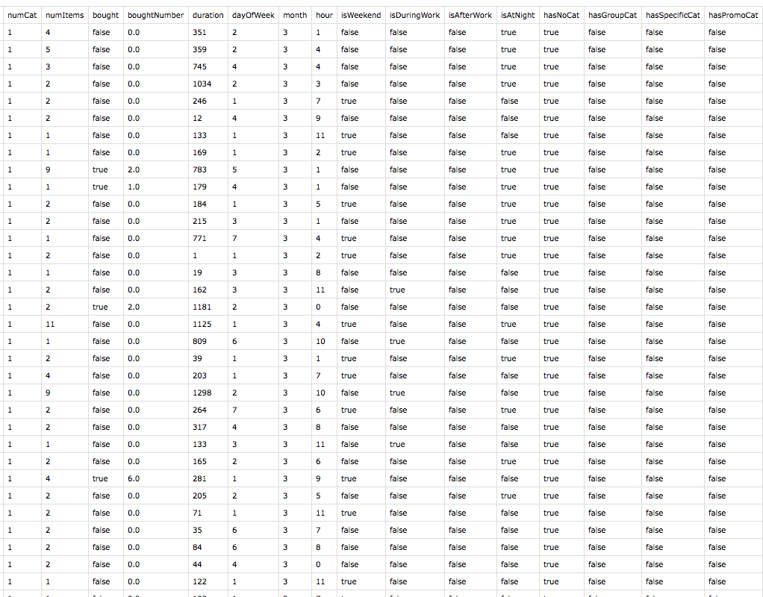

Slide 8
Loading the train set to Mahout
String descriptor = "I N I I I N N L I N N N N C C C C C C C C";
String[] trainDataValues = fileAsStringArray("/Users/monkeybusiness/Documents/RecSys/workspace/testNotBroken.csv");
Data data = DataLoader.loadData(
DataLoader.generateDataset(descriptor, false, trainDataValues),
trainDataValues);

Slide 9
Building trees
int numberOfTrees = 100;
DecisionForest forest = buildForest(numberOfTrees, data);
String[] testDataValues = testFileAsStringArray("data/test.csv");
Data test = DataLoader.loadData(data.getDataset(), testDataValues);
Random rng = RandomUtils.getRandom();

Slide 10
still building
int m = (int) Math
.floor(Maths.log(2, data.getDataset().nbAttributes()) + 1);
DefaultTreeBuilder treeBuilder = new DefaultTreeBuilder();
treeBuilder.setM(m);
return new SequentialBuilder(RandomUtils.getRandom(), treeBuilder,
data.clone()).build(numberOfTrees);

Slide 11
Classification
for (int i = 0; i < test.size(); i++) {
Instance oneSample = test.get(i);
double classify = forest
.classify(test.getDataset(), rng, oneSample);
int label = data.getDataset().valueOf(0,
String.valueOf((int) classify));
System.out.println("label: " + label);
}

Slide 12

Questions? (better not very difficult)

