Slide 1


Analysis of repated measures data in RStan
Marco Munda [marco.munda@pharmalex.com] Pharmalex [formerly ]

Slide 2
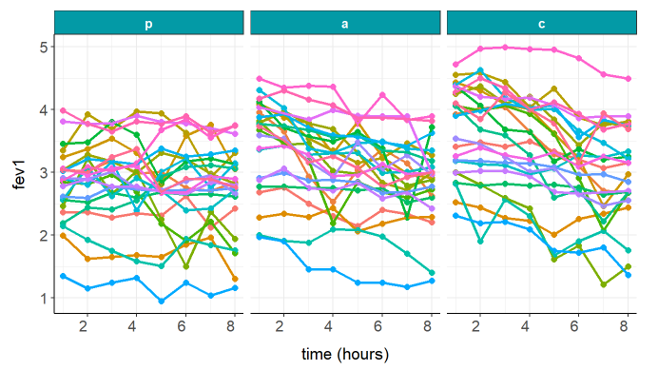
Case study: a repeated measures clinical asthma study
24 asthma patients received each of 3 drugs at random
the FEV1 measure (forced expiratory volume in 1 sec) was taken prior to administration of the drug (baseline) and every hour for 8 hours following administration

Slide 3


Case study: a repeated measures clinical asthma study
How differences between treatment means change over time?
24 asthma patients received each of 3 drugs at random
the FEV1 measure (forced expiratory volume in 1 sec) was taken prior to administration of the drug (baseline) and every hour for 8 hours following administration

Slide 4


Asthma study model
$$y_{ijk}=μ+β{×y}_{ij0}+α_{i}+b_{j}+γ_{k}+{\left(αγ\right)}_{ik}+e_{ijk}$$
mean for patient $j$ on drug $i$ at time $k$
error
baseline
$$N(0,σ_{b}^{2})$$
drug
patient
time
correlated over time

Slide 5
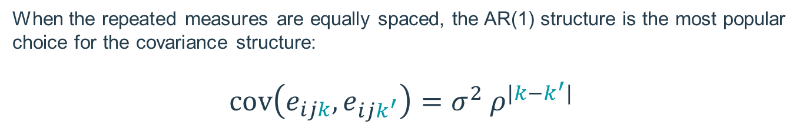

Asthma study model
$$y_{ijk}=μ+β{×y}_{ij0}+α_{i}+b_{j}+γ_{k}+{\left(αγ\right)}_{ik}+e_{ijk}$$
mean for patient $j$ on drug $i$ at time $k$
error
baseline
$$N(0,σ_{b}^{2})$$
drug
patient
time
correlated over time
When the repeated measures are equally spaced, the AR(1) structure is the most popular choice for the covariance structure: $$cov\left(e_{ijk},e_{ijk^{′}}\right)=σ^{2} ρ^{|k−k^{′}|}$$
$$(0<ρ<1)$$

Slide 6
Outline
modelling in RStan
inference based on probability of success
prediction of a longitudinal profile

Slide 7
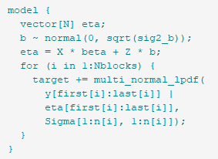
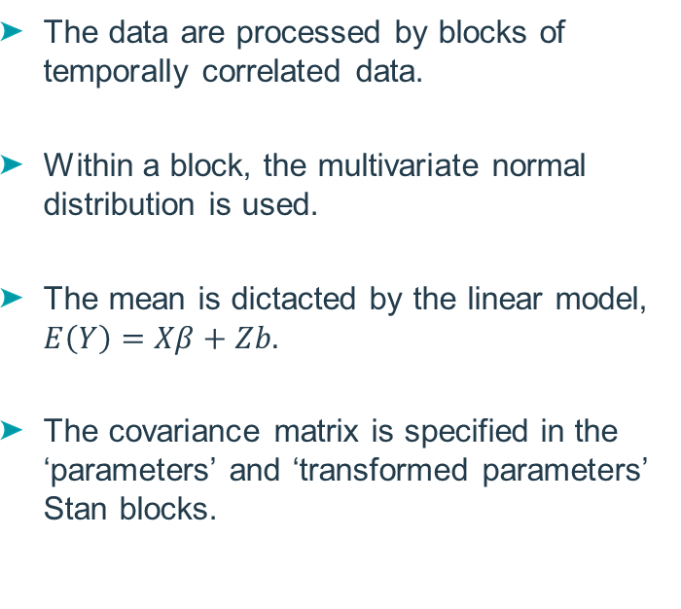
Stan model: ‘model’ block
The data are processed by blocks of temporally correlated data.
Within a block, the multivariate normal distribution is used.
The mean is dictacted by the linear model, $E\left(Y\right)=Xβ+Zb.$
The covariance matrix is specified in the ‘parameters’ and ‘transformed parameters’ Stan blocks.

Slide 8
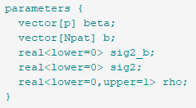
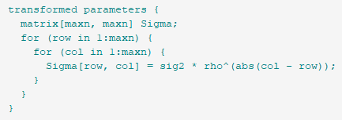


Stan model: ‘parameters’ and ‘transformed parameters’ blocks
$β$ = regression parameters
$b$ = patient effects
$σ_{b}^{2}$ = patient-to-patient variance
$σ^{2}$ = residual variance
$ρ$ = residual correlation parameter
$Σ$= residual covariance matrix
can easily be adapted to other covariance structures

Slide 9
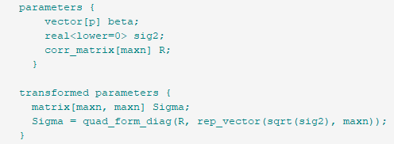
A note on the (homogeneous) unstructured covariance matrix
There exists a specialized matrix data type for correlation matrices: corr_matrix.
The function quad_form_diag can be used to convert a correlation matrix into a covariance matrix.
Priors on correlation matrices can be assigned in Stan by means of the LKJ distribution.

Slide 10
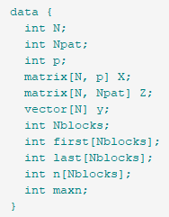
Stan model: ‘data’ block
N = total number of observations
Npat = number of patients
p = number of regression parameters
X = design matrix of the explanatory variables
Z = design matrix of the patient effects
y = response variable
Nblocks = nb of blocks of temporally correlated data
first = index of the first record per block
last = index of the last record per block
n = number of records per block
maxn = maximum number of records in a block

Slide 11
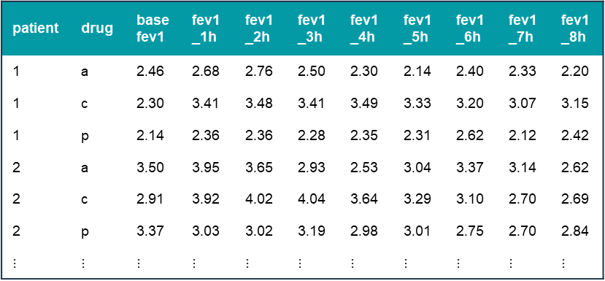
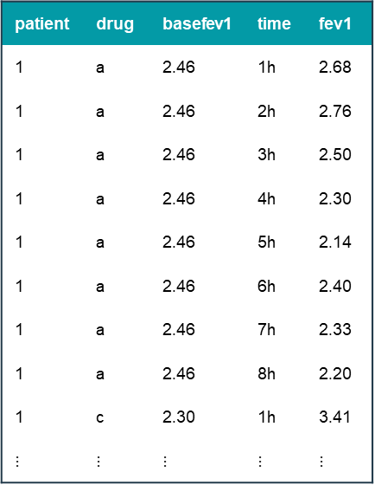
Data preparation for Stan (1)
from wide to long
patient | drug | basefev1 | time | fev1
1 | a | 2.46 | 1h | 2.68
1 | a | 2.46 | 2h | 2.76
1 | a | 2.46 | 3h | 2.50
1 | a | 2.46 | 4h | 2.30
1 | a | 2.46 | 5h | 2.14
1 | a | 2.46 | 6h | 2.40
1 | a | 2.46 | 7h | 2.33
1 | a | 2.46 | 8h | 2.20
1 | c | 2.30 | 1h | 3.41
$⋮$ | $⋮$ | $⋮$ | $⋮$ | $⋮$
patient | drug | basefev1 | fev1_1h | fev1_2h | fev1_3h | fev1_4h | fev1_5h | fev1_6h | fev1_7h | fev1_8h
1 | a | 2.46 | 2.68 | 2.76 | 2.50 | 2.30 | 2.14 | 2.40 | 2.33 | 2.20
1 | c | 2.30 | 3.41 | 3.48 | 3.41 | 3.49 | 3.33 | 3.20 | 3.07 | 3.15
1 | p | 2.14 | 2.36 | 2.36 | 2.28 | 2.35 | 2.31 | 2.62 | 2.12 | 2.42
2 | a | 3.50 | 3.95 | 3.65 | 2.93 | 2.53 | 3.04 | 3.37 | 3.14 | 2.62
2 | c | 2.91 | 3.92 | 4.02 | 4.04 | 3.64 | 3.29 | 3.10 | 2.70 | 2.69
2 | p | 3.37 | 3.03 | 3.02 | 3.19 | 2.98 | 3.01 | 2.75 | 2.70 | 2.84
$⋮$ | $⋮$ | $⋮$ | $⋮$ | $⋮$ | $⋮$ | $⋮$ | $⋮$ | $⋮$ | $⋮$ | $⋮$

Slide 12
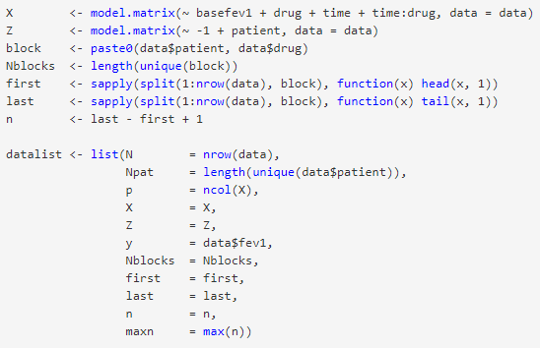
Data preparation for Stan (2)
To feed stan, data must be arranged in a list:
N = total number of observations
Npat = number of patients
p = number of regression parameters
X = design matrix of the explanatory variables
Z = design matrix of the patient effects
y = response variable
Nblocks = nb of blocks of temporally correlated data
first = index of the first record per block
last = index of the last record per block
n = number of records per block
maxn = maximum number of records in a block

Slide 13
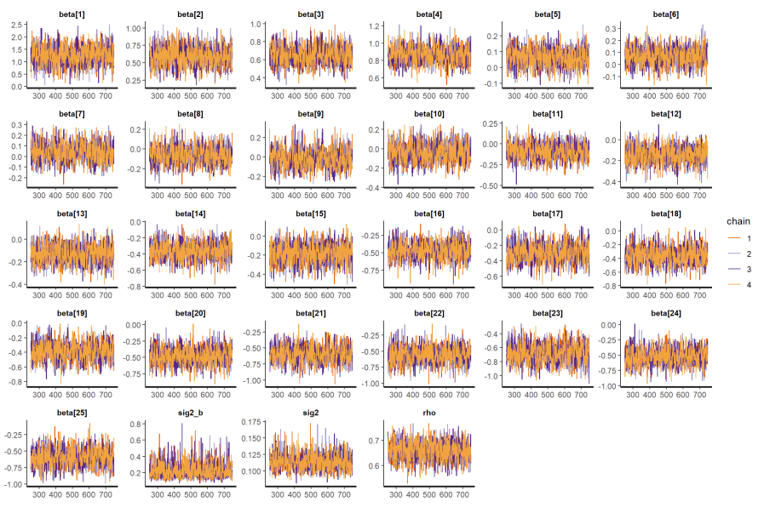
Posterior distributions: trace plots

Slide 14
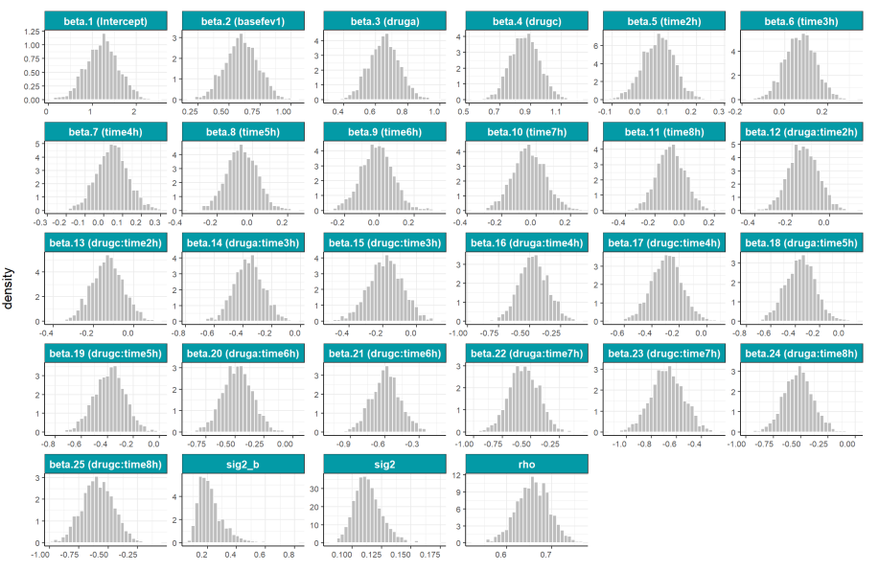
Posterior distributions: densities

Slide 15
Outline
modelling in RStan
inference based on probability of success
prediction of a longitudinal profile

Slide 16
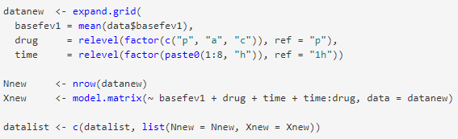

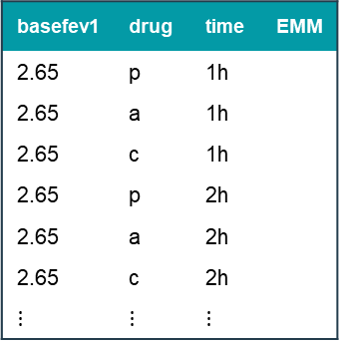
Estimated marginal means (EMMs)
main interest
how differences between treatment means change over time
quantities of interest
estimated marginal means (EMMs) for each drug over time
obtained by linear combinations of the model coefficients
basefev1 | drug | time | EMM
2.65 | p | 1h
2.65 | a | 1h
2.65 | c | 1h
2.65 | p | 2h
2.65 | a | 2h
2.65 | c | 2h
$⋮$ | $⋮$ | $⋮$
all EMMs are generated at once

Slide 17
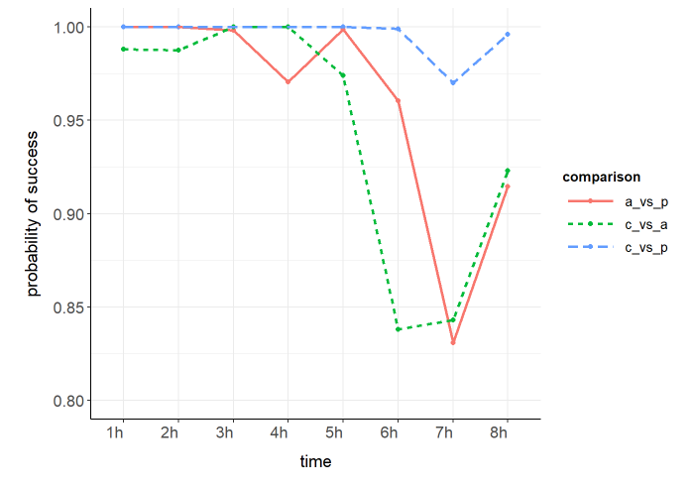
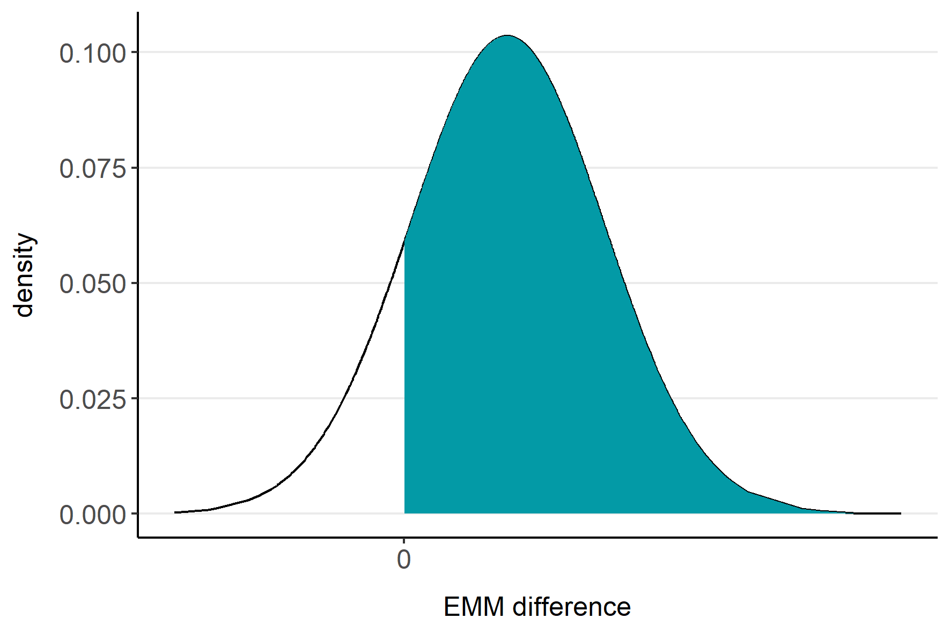
Probability of success
PoS

Slide 18
Outline
modelling in RStan
inference based on probability of success
prediction of a longitudinal profile

Slide 19
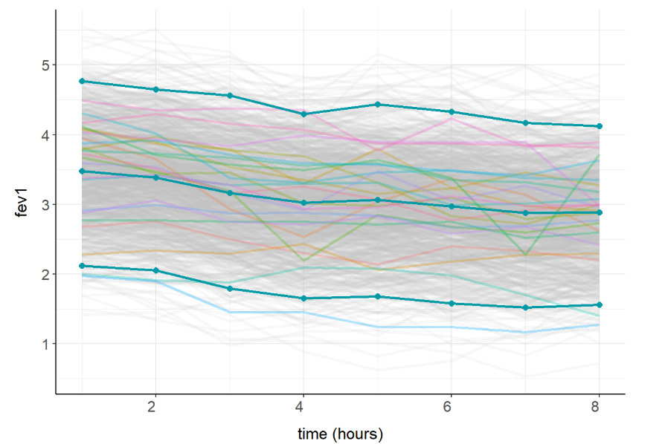
FEV1 profile for a future patient receiving drug A
Predictions are more conveniently done outside the Stan model, by extracting the parameters from the posterior samples.
simulations
predictions

