Slide 1

Gaia-X
A Federated Secure Data Infrastructure

Slide 2
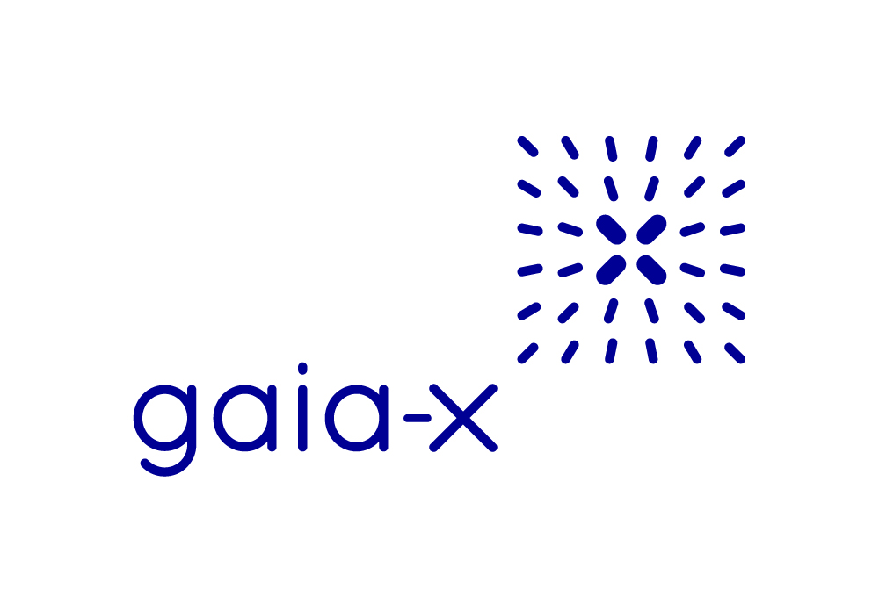
Table of Contents
01
What is Gaia-X?
02
Who is behind Gaia-X?
03
How does it work?
04
Benefits of Adoption
05
Limitations

Slide 3
What is Gaia-X?
An initiative
Gaia-X has a vision of decentralized ecosystems consisting of data providers and data consumers
Secure, trustworthy environment (based on strong cryptographic standards)
Open catalogues of service offerings (cloud providers, datasets, etc…)
Digital governance
Compliance with data protection laws
Transparence
Interoperability

Slide 4
Who is behind Gaia-X?
Gaia-X European Association for Data and Cloud AISBL
International non-profit organization
Registered in Belgium
Privately funded
At the time of founding
Registered in January 2021
22 companies and organizations
French and German industry leaders
Siemens, SAP, BMW, Deutsche Telekom, …
Orange, Atos, OVHcloud, ...
Currently (January 2024)
350+ members
1800+ contributors
Workshops, talks, ...
Companies, startups, research institutions, ...

Slide 5
How does it work?
Compliance
Gaia-X releases documents containing policies, Service Provider should comply with
Policies ensure safe data handling, transparent contracts, …
Policy compliance through agreement with T&C
Compliance is self-declared or verified through 2nd or 3rd parties
Identity can be revoked upon breach
Authenticity
Use of trusted parties (Trust Anchors) for identity validation
Digital signatures
Open registries (of Trust Anchors)
All claims are digitally signed (Provider Description, Service Offering, …)
Claims can be mutually verified among all parties
Identities based on digital certificates (eIdas, etc...)
Data Federation
Data can be shared or exchanged among participants
Machine and human readable contracts
Legally binding (optional)
Secure
Contract negotiation
Logging of usage

Slide 6
Benefits of adoption
Why bother?
As a service provider
Findable service (public catalogues)
Compliance with EU laws
Trusted and secure environment
Use of open-source tooling (e.g. data use logging)
Customizable (contracts, policies)
Secure data handling
As a service consumer
Increases confidence of service providers complying with regulations
Trusted and secure environment
Catalogue of providers and services
Interoperability (unified interfaces)

Slide 7
Limitations
An initiative
The initiative deliverables (policies, service, registries, software) are still in active development and some features are missing or may change
Documents may contain redundancies
Intellectual Property Protection (missing feature)
Standards may change (designed to be in extendable way)
Compliance is valid up to 12 months after a new document is released

Slide 8
Thank you
for your attention

