Slide 1

Gaia-X
A Federated Secure Data Infrastructure
Machine Learning and Data Analytics (MaD) Lab

Slide 2
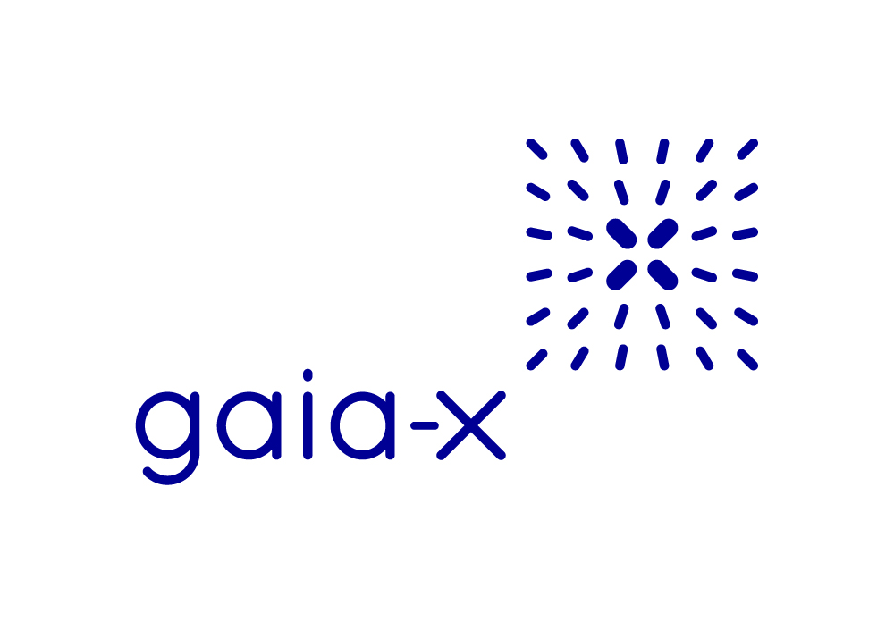
Table of Contents
1
What is Gaia-X?
2
Who is behind Gaia-X?
3
How does it work?
4
Benefits of Adoption
5
Use Case

Slide 3

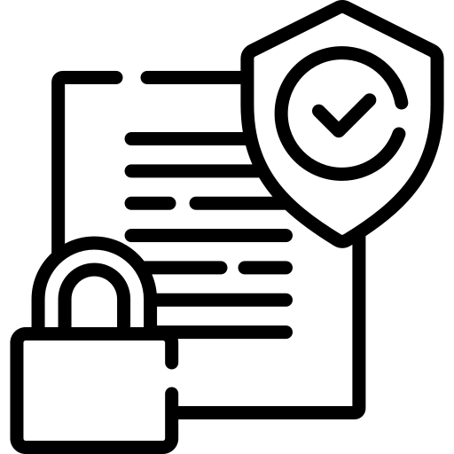
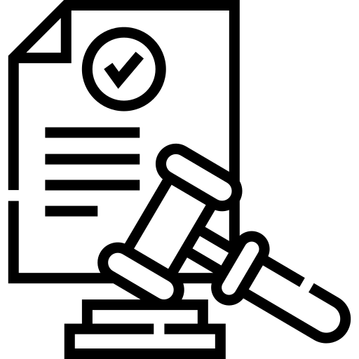
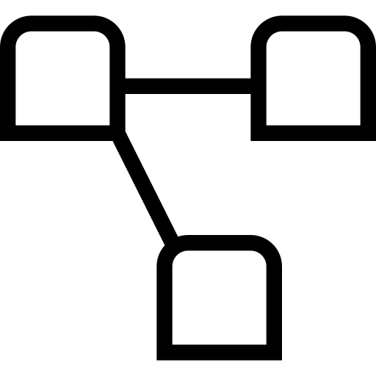
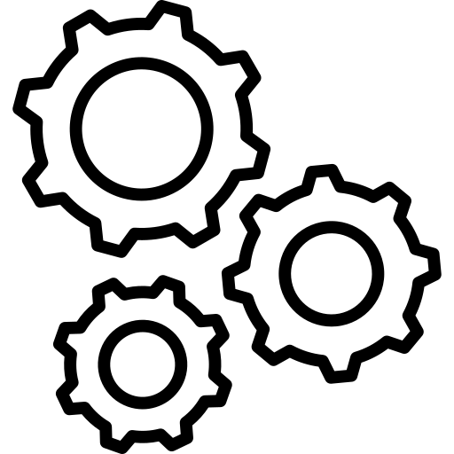


What is Gaia-X?
Gaia-X wants to build decentralized ecosystems around service exchange
Gaia-X Initiative [BMWK, BMWK Publications, 2019]
Digital Sovereignty
Security
Compliance with regulations
Federated architecture
Interoperability
Findability
Reusability
The icons are a courtesy of Flaticon.com
Website: https://gaia-x.eu/

Slide 4
Who is behind Gaia-X?
Gaia-X European Association for Data and Cloud AISBL
International non-profit organization
Registered in Belgium
Privately funded
At the time of founding
Registered in January 2021
22 companies and organizations
French and German industry leaders
Siemens, SAP, BMW, Deutsche Telekom, …
Orange, Atos, OVHcloud, ...
Currently (January 2024)
350+ members
1800+ contributors
Workshops, talks, ...
Companies, startups, research institutions, ...

Slide 5
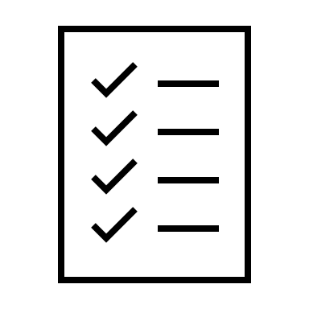




How does it work?
Compliance
Specifications governing the exchange process
Policies constrain the usage of a service or data
Policy compliance through agreement with T&C
Compliance is self-declared or verified through 2nd or 3rd parties
Identity can be revoked upon breach of conduct

Slide 6



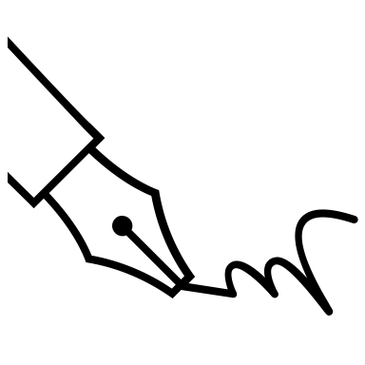
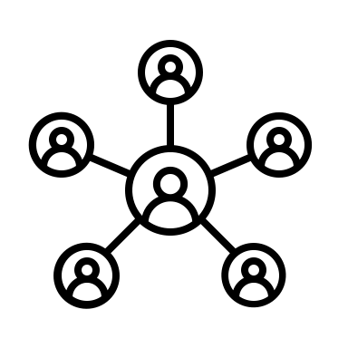

How does it work?
Authenticity
Use of trusted parties (Trust Anchors) for identity validation
Digital signatures
Open registries of Trust Anchors
All claims are digitally signed (Provider Description, Service Offering, …)
Claims can be mutually verified among all parties
Identities based on digital certificates (eIDAS, EV SSL)

Slide 7

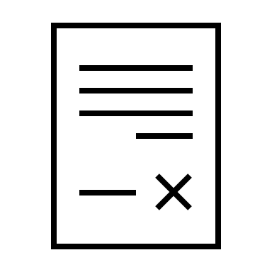



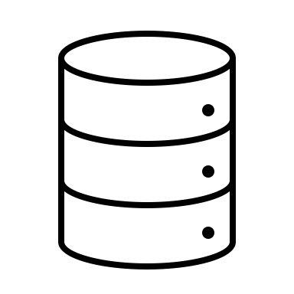

How does it work?
Data Exchange
Data can be shared or exchanged among participants
Machine and human readable contracts
Legally binding (optional)
Secure
Contract negotiation
Logging of usage
Decentralized

Slide 8
Benefits of adoption
Gaia-X offers a framework for service exchange
As a service provider
Findable service (public catalogues)
Compliance with EU laws
Trusted and secure environment
Use of open-source tooling (e.g. data use logging)
Customizable (contracts, policies)
Secure data handling
As a service consumer
Increases confidence of service providers complying with regulations
Trusted and secure environment
Catalogue of providers and services
Interoperability (unified interfaces)

Slide 9
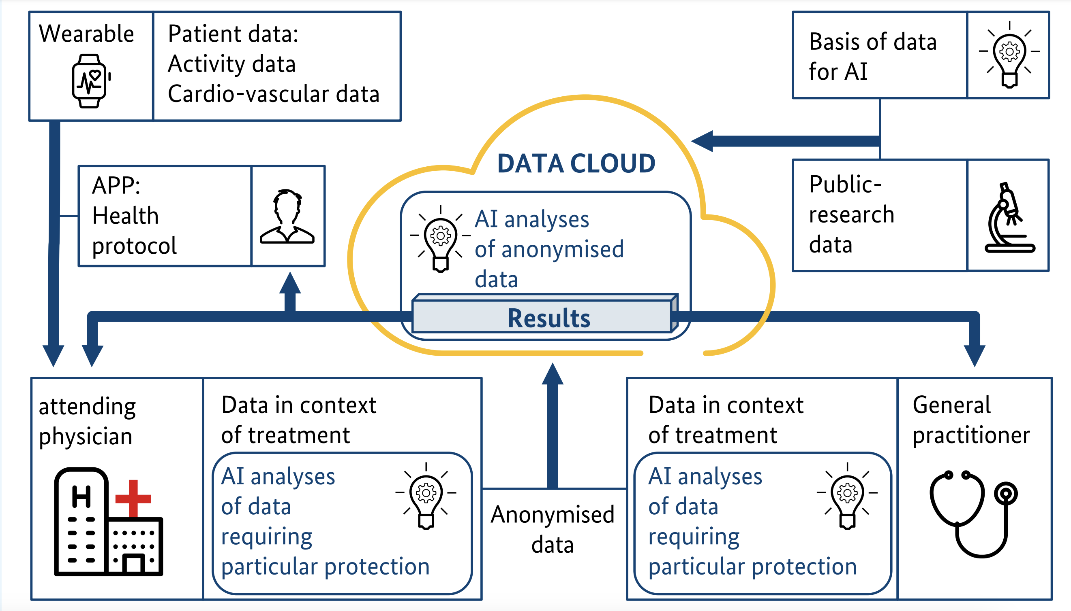
Use Case
Better preventive healthcare with Smart Wearables
Basis for developing standardized interfaces
Link-up data from many involved parties
Rigorous and binding data classifications
Openness and flexibility
Connect with existing data for further research
Secure handling of sensitive data
Source: https://www.bmwk.de/Redaktion/EN/Publikationen/Digitale-Welt/project-gaia-x.pdf

Slide 10
Thank you
for your attention

